Slide 1
Swift Education and Public Outreach Program
Presentation at the Swift Team meeting
Lynn Cominsky
Sonoma State University
December 6, 2002

Slide 2
Program Overview
Swift Web site (http://swift.sonoma.edu)
Printed materials
GEMS guide (Lawrence Hall of Science)
Teacher’s activity booklets and posters
Educator training
Conference workshops
Educator Ambassadors
Informal Education
What’s in the News? (PSU)
Program Evaluation
Future Plans

Slide 3

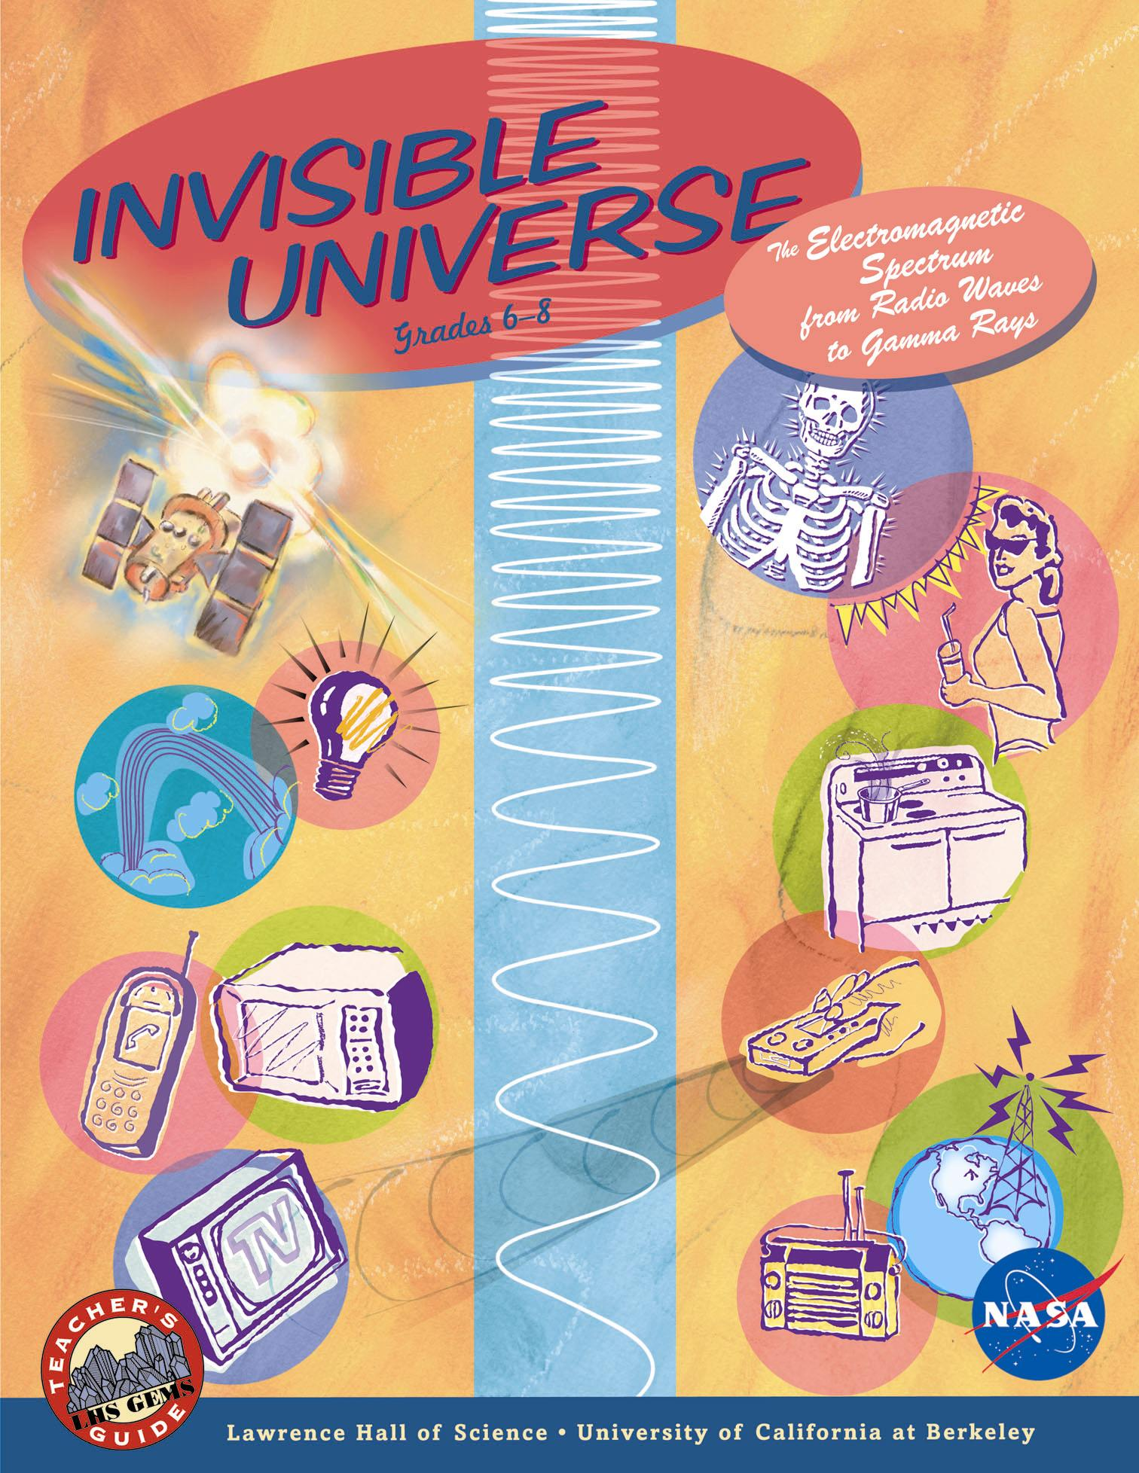
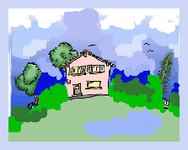
Now in print!
Copies available through materials@universe.sonoma.edu
Includes short story “The Swift and the Astronomer” by Monica Sperandio

Slide 4
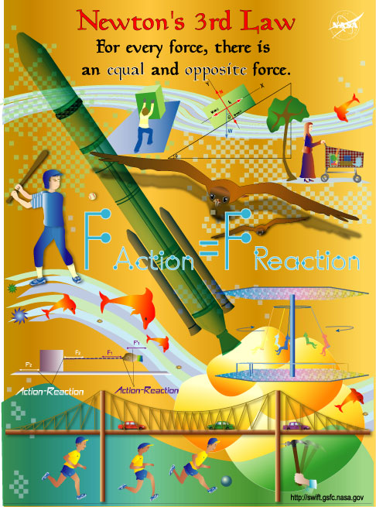
Newton’s Laws Posters
Set of 3 - Now in print!
Developed by Laura Whitlock
Copies available through materials@universe.sonoma.edu
Poster activities on-line at http://swift.sonoma.edu/education/

Slide 5
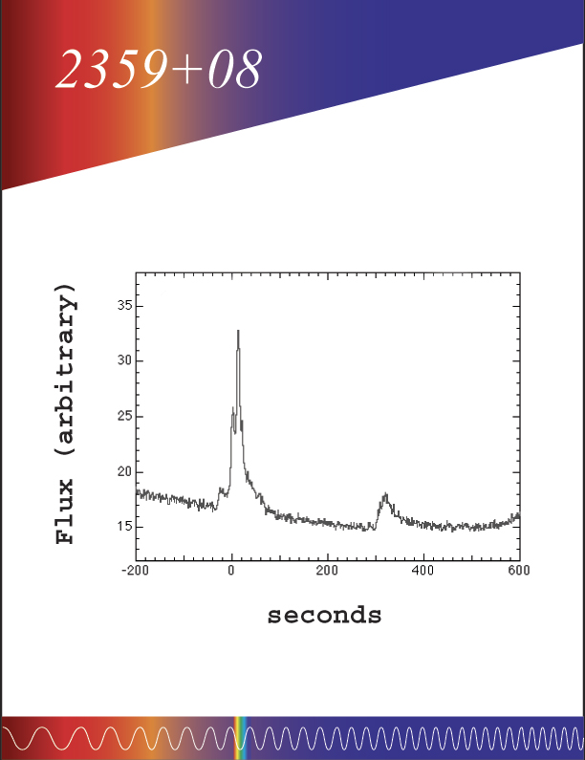
New Educator’s Guide
Gamma-ray Burst Educator’s Guide now in progress
Aligned with mathematics standards
First activity already classroom tested

Slide 6
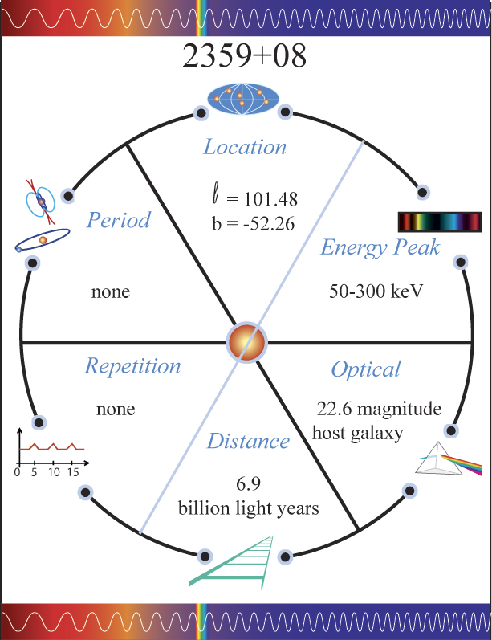
New Educator’s Guide
Sorting & classifying activity using
8 GRBs
4 SGRs
8 XRBs
Second activity uses 2D version of IPN location scheme
Third activity based on isotropy

Slide 7
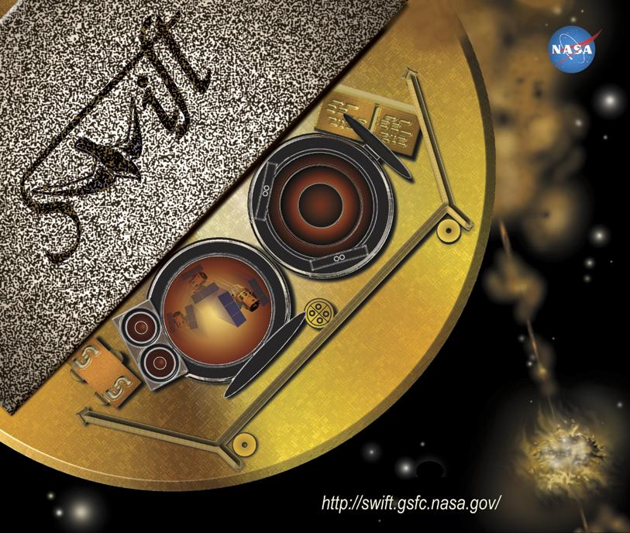
Swift Mouse Pad
Created by SSU artist Aurore Simonnet, based on BAT mask suggestion by Presidential Science Advisor John Marburger III

Slide 8
Reaching Teachers
Swift/GLAST booth at CSTA in October, 2002 in San Francisco
750 Newton's Laws Posters
504 Slinkies
880 Waves Light Up the Universe booklets
1000 kits with "Spin A Spectrum"
Cominsky,Silva and Graves presented GEMS workshop at AAPT-NCN to ~75 teachers in November, 2002

Slide 9
Educator Ambassador Presentations
8/29: Ambassador Rae McEntyre explained the importance of scientific notation to Swift to ~70 high school students at Gallatin HS in Kentucky
10/19: McEntyre discussed gamma-ray astronomy at the Astronomy and Space Science Workshop at Western Kentucky University with 15 teachers
10/25: McEntyre led an activity on the electromagnetic spectrum using GEMS materials in the NASA Educational Workshops Aerospace Educators Share-a-Thon at the NSTA/Louisville Conference with ~20 teachers

Slide 10
Educator Ambassador News
7/31: Ambassador Rob Sparks explained Swift to ~15 master teachers attending a week-long workshop at Tuft University’s Wright Center for Education
9/20: Sparks gave a public lecture about Swift and gamma-ray astronomy to ~75 attendees during a day-long event hosted by the Geneva, IL astronomy group
11/20: Sparks discussed Swift and shared Swift materials at Chicago's Physics Northwest with ~30 high school teachers
Sparks will be giving workshops on GEMS materials at the upcoming Wisconsin Society of Science Teachers Meeting in March and with McEntyre at the Summer AAPT meeting

Slide 11
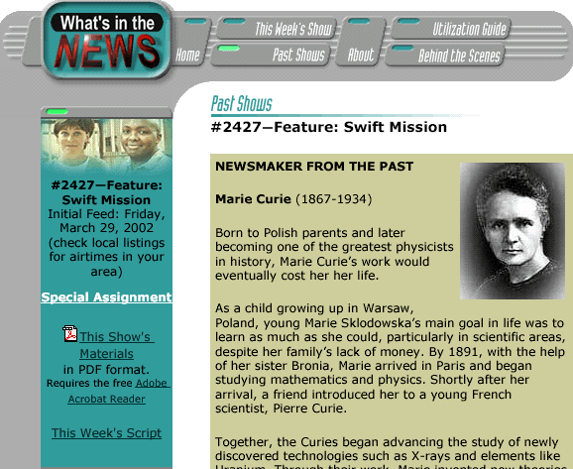
WPSX Public Television
For FY03, 3 short pieces will focus on Newton’s Laws materials
Subject of 15 minute piece is Swift’s space environmental testing
Pre-production work for 15 minute segment is now in progress

Slide 12
Our Italian Partners
Monica Sperandio reports:
Swift paper model in Italian is being finalized. (SSU is doing an English version of the model)
5 three-D models of Swift are being made for educational display in the US and in Italy
“Magie in cielo e in Terra” - a new Public Outreach and Education conference hall is being inaugurated in January
a lecture about Swift will be part of the ongoing program
Swift mirror is being displayed in the entrance, along with other famous X-ray and gamma-ray astronomy mirrors

Slide 13
Program Evaluation
WestEd
Back under contract
Will assist in formative evaluation of classroom materials, especially Newton’s Laws activities
Will do summative assessment of SSU and Ambassador dissemination activities, including GEMS workshop at AAPT national meeting
Will evaluate planning for Swift launch outreach
SwEC
Will be meeting at SSU in 8/03
Now includes 2 Educator Ambassadors

Slide 14
Status of Near-Future Plans from 7/02
Field Testing of classroom materials in classrooms to improve instructional design
Increased scientific review and error correction of existing materials
Increased involvement of Swift team scientists
Improved coordination with GLAST E/PO and EA programs, including participation in the GTN
New GRB activity #1 already tested – more forthcoming
GEMS reviewed by Brad Schaefer – Thanks!
More help still needed!
GRBs added to GTN target list – timing issues under study

Slide 15
New Near Future Plans
Finish upgrade and re-release of existing Swift instructional materials prior to launch
Field-test, finish instructional design and print new GRB activities prior to launch
Plan (in conjunction with Educator Ambassadors and SwEC) an exciting public outreach program that focuses on launch
Include Swift material in PBS television show now beginning development by Tom Lucas (in conjunction with GLAST E/PO)

