Slide 1
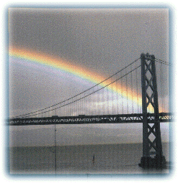
The Electromagnetic Spectrum
Phil Plait, thermal emitter
July 15, 2002

Slide 2
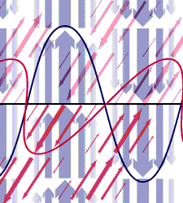
What does the EMS tell us?
Transports energy
Electric and magnetic fields
oscillate: that’s the “wave”
Moves at speed of light, 3 x 10⁸ m/s
Wavelength, frequency, energy all
related
Type of radiation (usually) depends
on energy/temperature of object

Slide 3
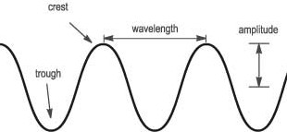
Do the wave
Wavelength = distance between crests
Amplitude = half the height of trough to crest
Frequency = number of crests that pass a point
in space every second
… so wavelength = speed / frequency

Slide 4

So, what’s nu with you?
Radio Infrared Visible UV X-Ray Gamma ray
E (eV)
1
1x10⁻³
1x10⁻⁶
1x10⁻⁹
1x10⁻¹²
1x10⁻¹⁵
1x10⁻¹⁸
λ (m)
2x10⁸
2x10¹¹
2x10¹⁴
2x10¹⁷
2x10²⁰
2x10²³
2x10²⁶
ν (Hz)
c = speed of light = 3 x 10⁸ m/s
E = energy
E = h c / λ
λ = c / ν
ν = c / λ
λ = wavelength
ν = frequency
h = Planck’s constant
= 4 x 10⁻¹⁵ eV seconds

Slide 5
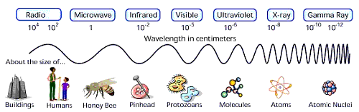
Putting it into perspective

Slide 6
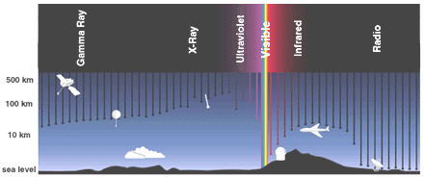
I like a place with a little atmosphere…
http://imagers.gsfc.nasa.gov/ems/atmosphere.gif
Only visible, radio and some IR gets through the air!
To see gamma rays, X-rays, UV and some IR you must go to space

Slide 7
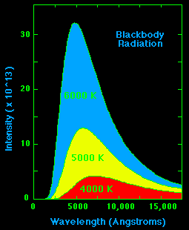
What emits EM radiation? Everything does! You do!
Anything above absolute zero emits EMR in a process called
thermal or blackbody radiation
the hotter the object, the shorter the wavelength of the peak
the hotter the object, the more intense the radiation

Slide 8
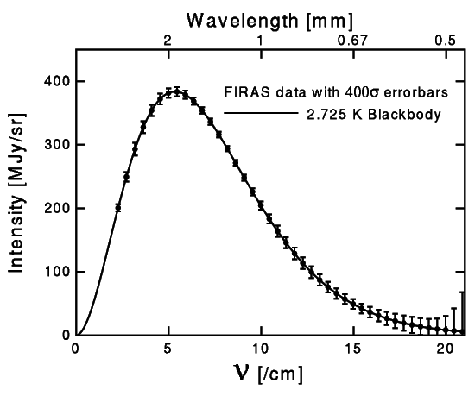
What’s a good blackbody?
stars (not quite, but close, especially hot ones)
the Universe!

Slide 9
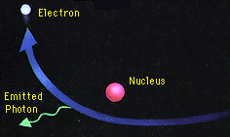
Not so hot emission methods (1)
Bremsstrahlung: “braking radiation”
Radiation is emitted as charged particles suddenly decelerate, releasing a torrent of photons or when electrons accelerate in the field of an ion

Slide 10
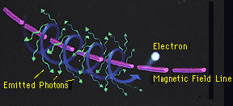
Not so hot emission methods (2)
Synchrotron: “magnetic spin radiation”
Caused by a relativistic electron as it spirals around a magnetic field line
Non-relativistic version is called cyclotron radiation

Slide 11
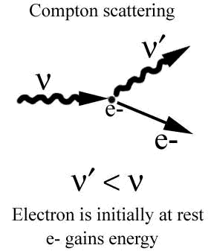
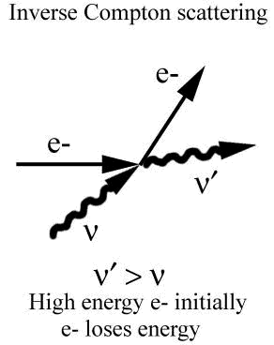
Not so hot emission methods (3)
Compton scattering: “rebound radiation”
A high-energy photon hits a low-energy electron. The photon loses energy, and the electron gains some.
Inverse Compton Scattering: A low-energy photon hits a relativistic electron. The photon gains energy, becoming an X- or gamma ray.

Slide 12
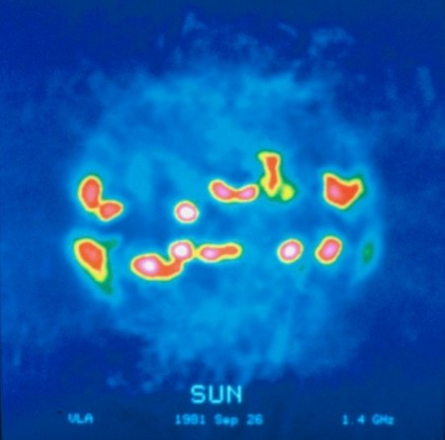
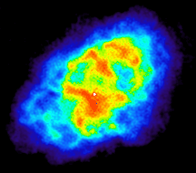
Radio
Cool objects (0 to a few 10s Kelvin)
Synchrotron radiation: electrons spiraling
around magnetic fields
Bremsstrahlung: collisionally
decelerated electrons
Cold molecular clouds
Planets
Pulsars
Radio galaxies
Intergalactic matter

Slide 13
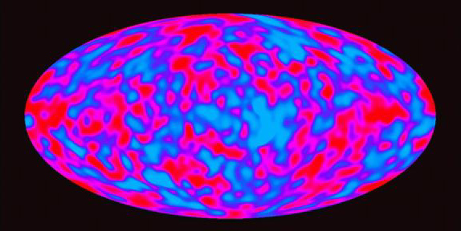
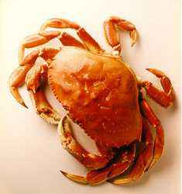
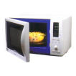
Microwave
A bit warmer objects (10s to 100K)
Masers
Warm molecular clouds
Planets
Galaxies
The Universe!

Slide 14
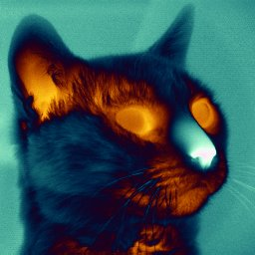
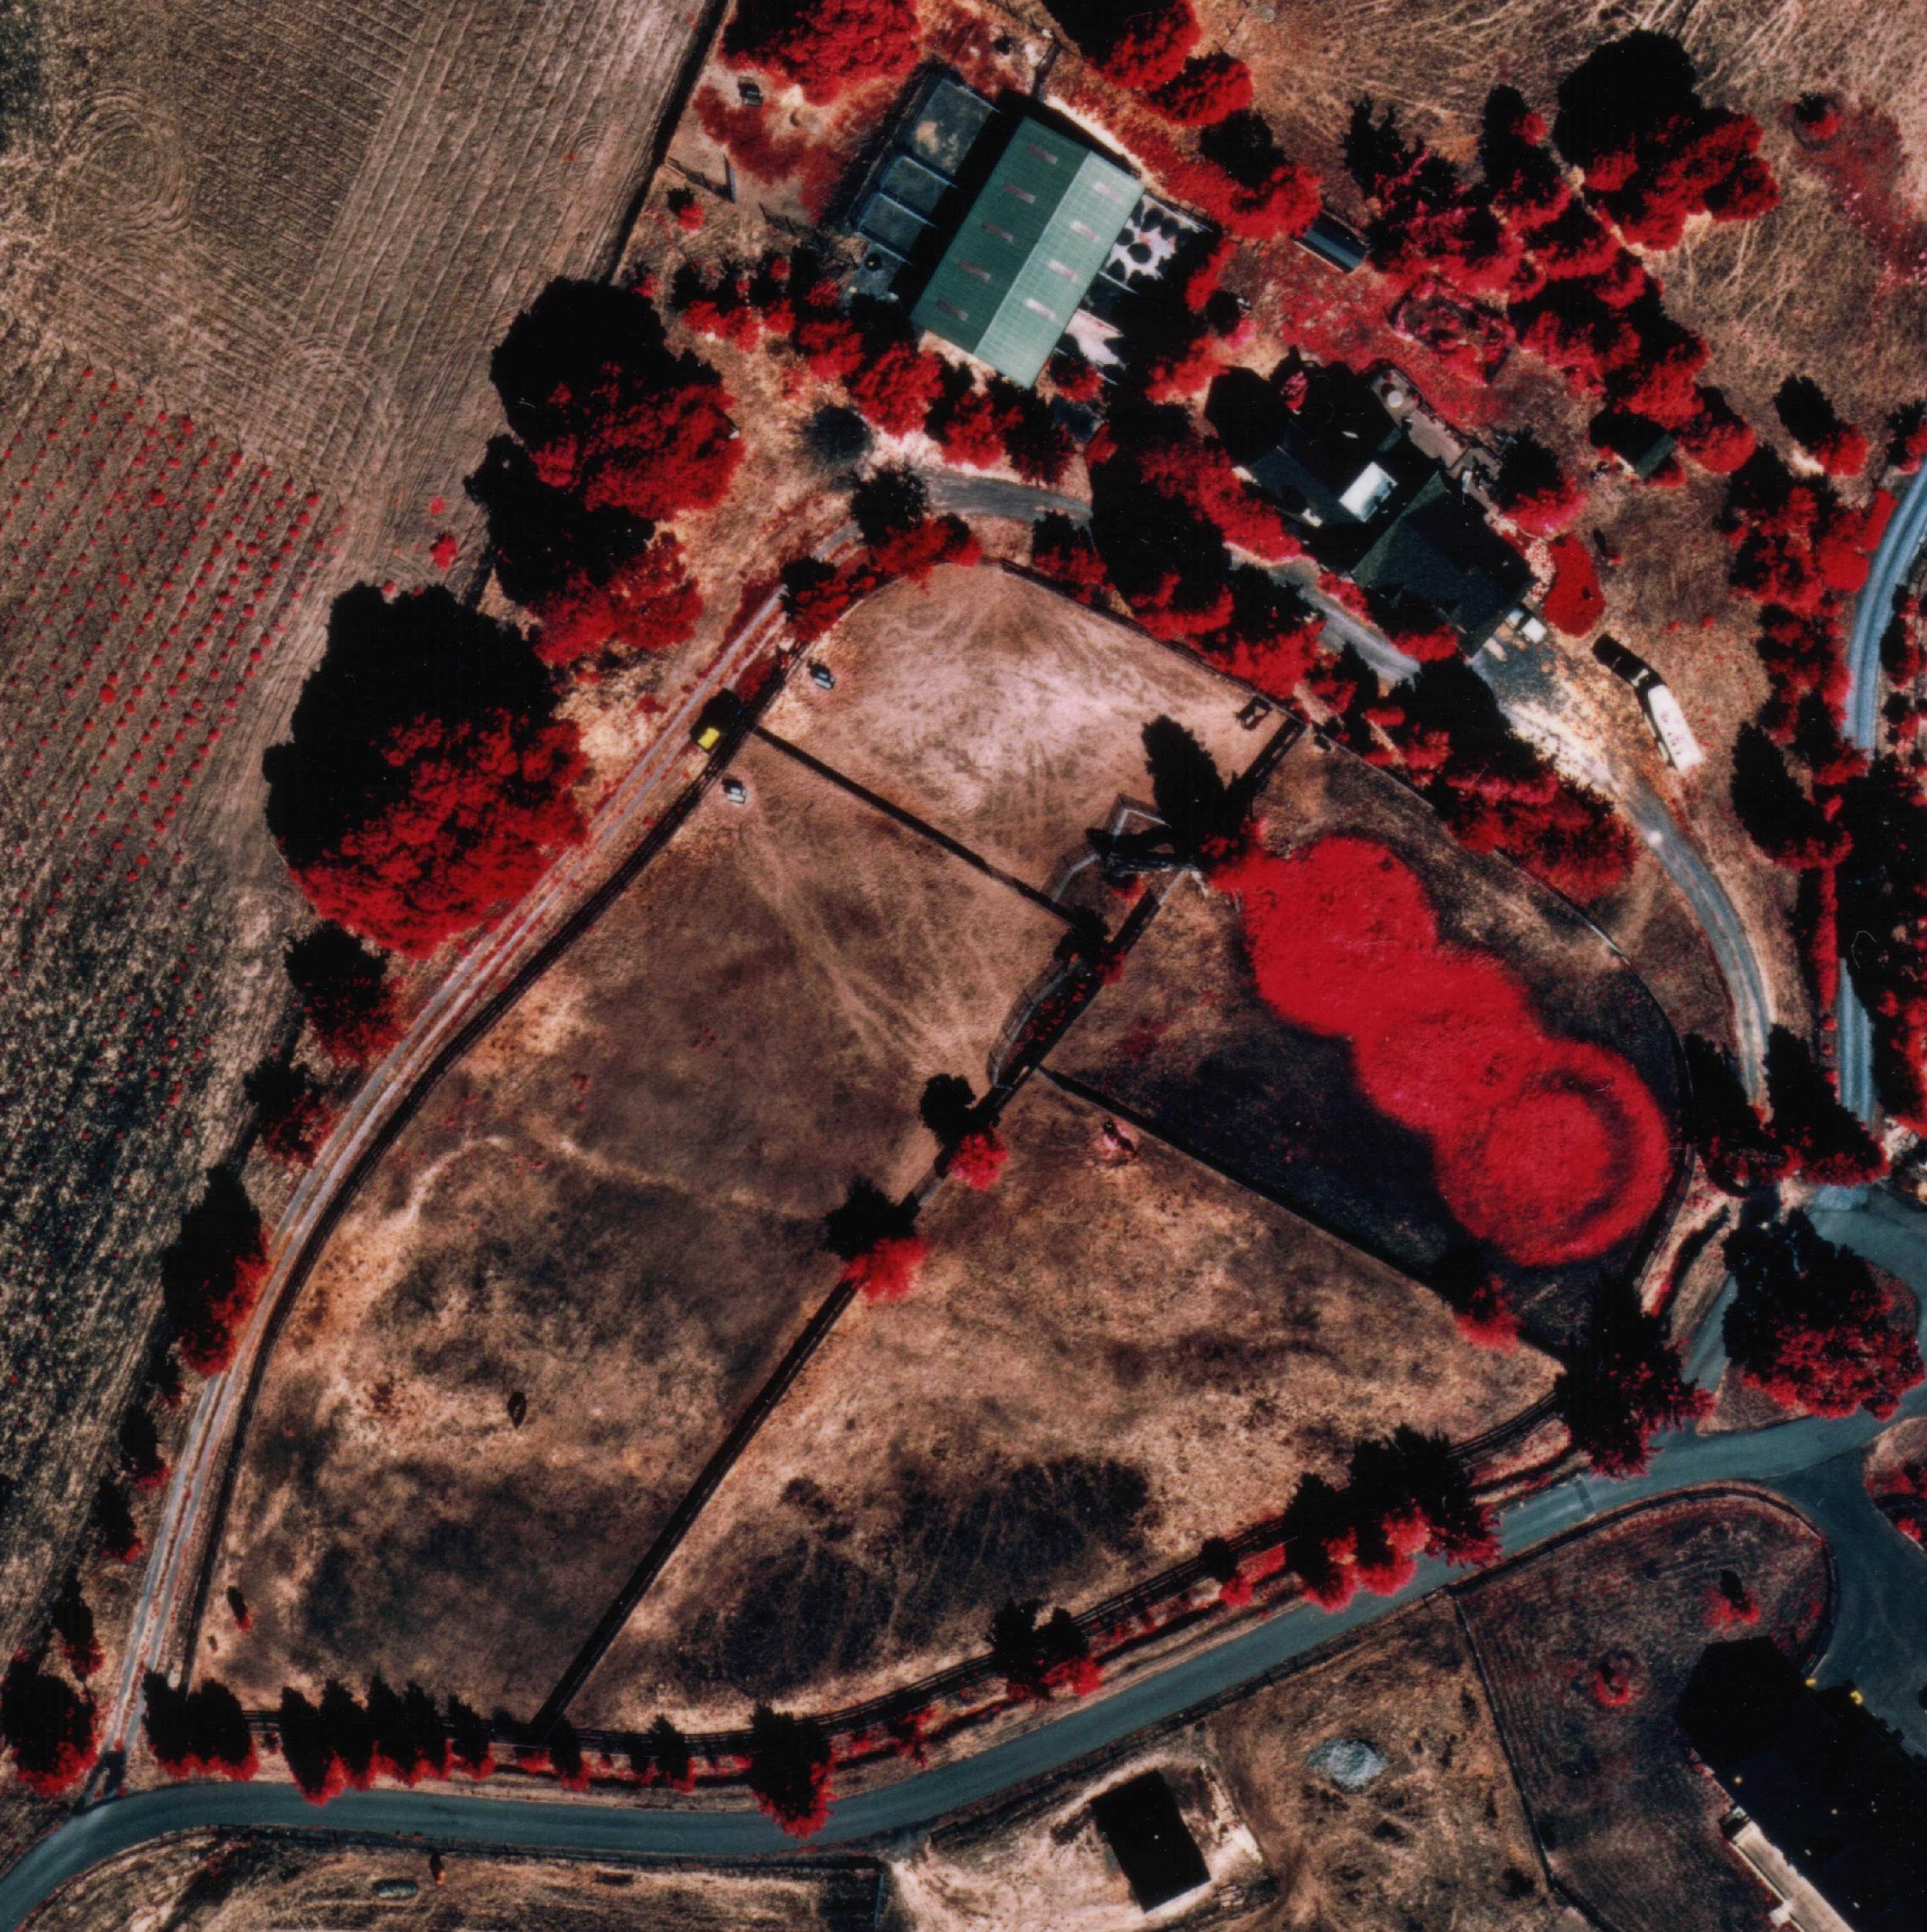
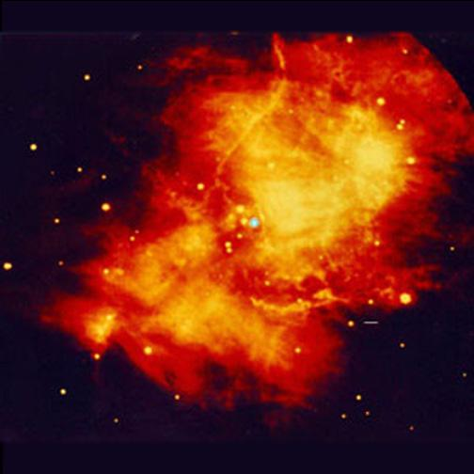
Infrared
Warm objects (100s to about 2000 K)
Nebulae
Planets
“Normal” stars
Brown dwarfs
Enshrouded protostars
Galaxies

Slide 15
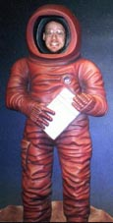
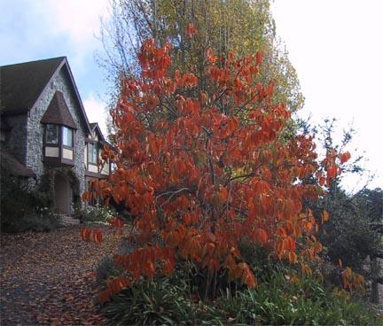
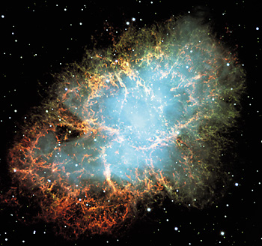
Visible
Hot objects (2000 to about 10000 Kelvin)
Nebulae
Planets
“Normal” stars, sun-like
and hotter
Galaxies

Slide 16
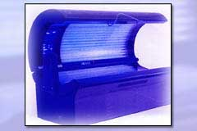
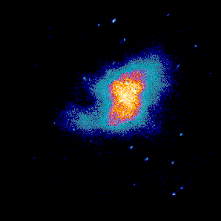
Ultraviolet
Hotter objects (10,000 to about 100,000 Kelvin)
Nebulae
Planets with magnetic fields
(aurorae)
O-F stars
Galaxies

Slide 17
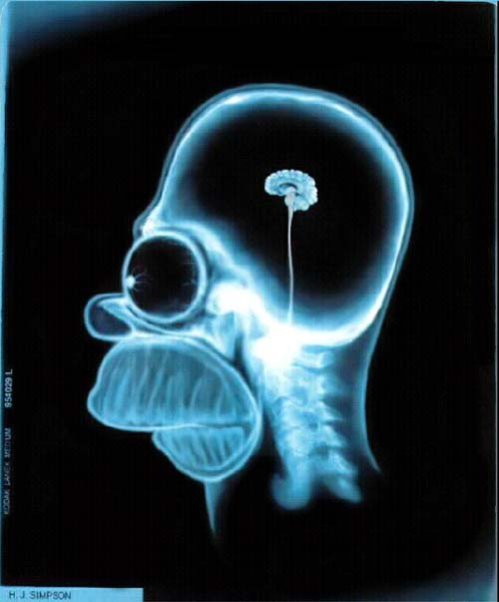
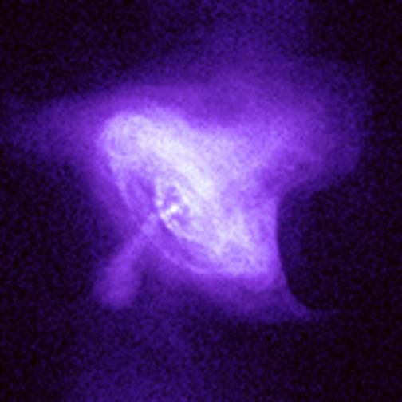
X-Rays
Very hot objects (100,000 to a few 10⁶ Kelvin)
Synchrotron radiation
Inverse Compton scattering
Bremsstrahlung
Planets
O star winds
Solar corona
White dwarfs
Pulsars
Black holes
Galaxy clusters
Dark matter, indirectly

Slide 18
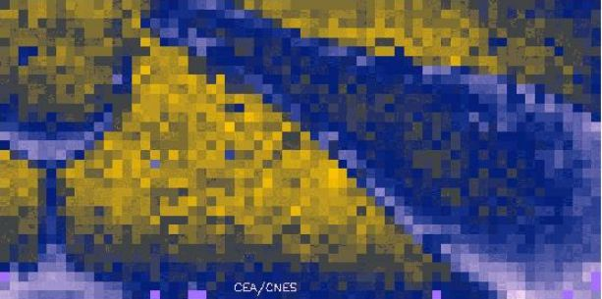
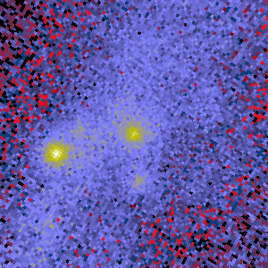
Gamma Rays
Extremely energetic objects
Radioactive decay (Co⁵⁶, Ti⁴⁴)
Fusion
Cosmic ray/gas interaction
Matter/antimatter annihilation
Magnetic field reconnection
Supernovae
Diffuse Galactic emission
Active Galaxy jets
(some) Pulsars
Gamma Ray Bursts
Solar flares

Slide 19

Gamma Rays
Extremely energetic objects
Radioactive decay (Co⁵⁶, Ti⁴⁴)
Fusion
Cosmic ray/gas interaction
Matter/antimatter annihilation
Magnetic field reconnection
Supernovae
Diffuse Galactic emission
Active Galaxy jets
(some) Pulsars
Gamma Ray Bursts

Slide 20


Joanne Woodward,
a lesser known source
of gamma rays

Slide 21
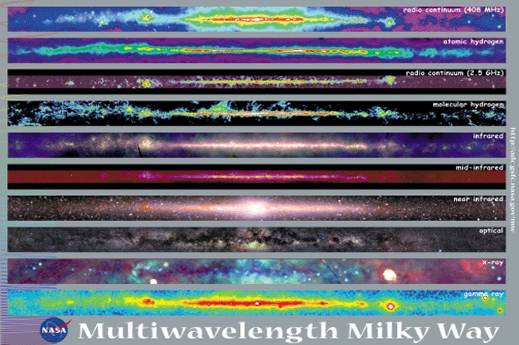
Different Views from the Inside

