Slide 1
The Extreme Universe of Gamma-ray Astronomy
Professor Lynn Cominsky
Department of Physics and Astronomy
Sonoma State University

Slide 2
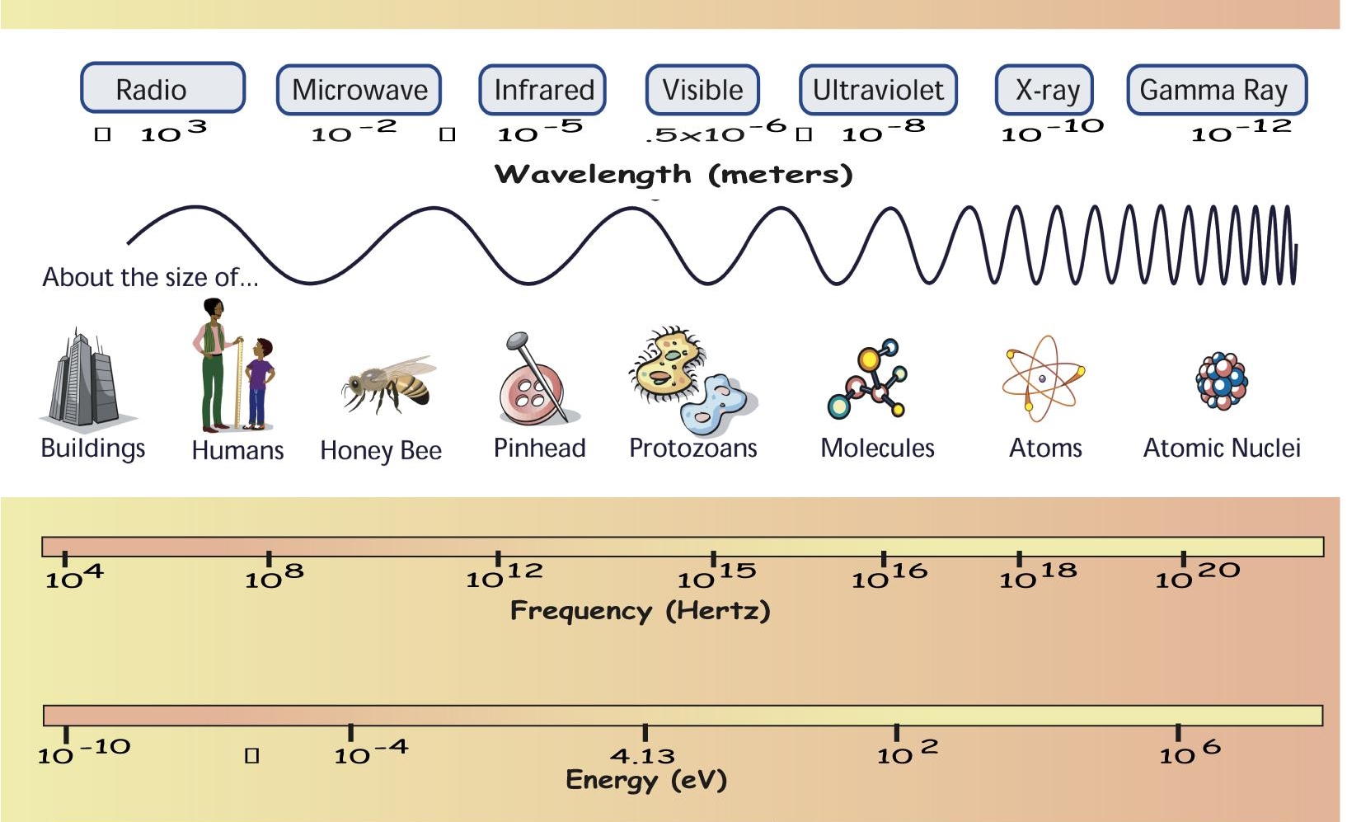
What are Gamma rays?

Slide 3
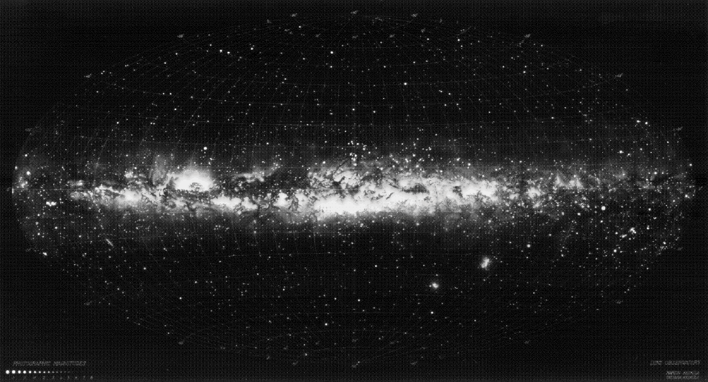
Why study gamma rays?
Universe as seen by eye is peaceful

Slide 4
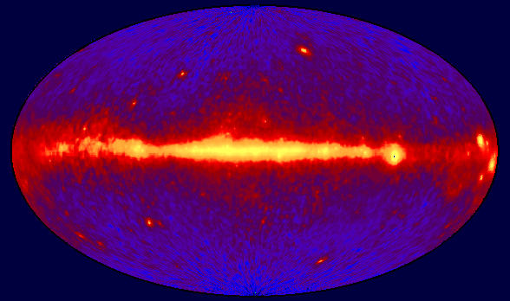
The Gamma-ray Sky
Gamma ray sky shows us the most exotic and extreme creatures in the cosmic zoo
CGRO/EGRET All Sky Map

Slide 5
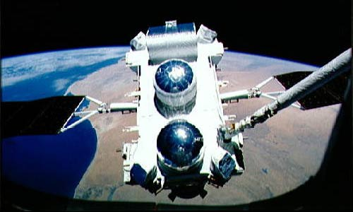
Compton Gamma-ray Observatory (1991-2000)
Burst And Transient Source Experiment (BATSE)
Oriented Scintillation Spectrometer Experiment (OSSE)
Imaging Compton Telescope (COMPTEL)
Energetic Gamma-Ray Experiment Telescope (EGRET)
CGRO being placed into orbit by the robotic arm on the Space Shuttle

Slide 6
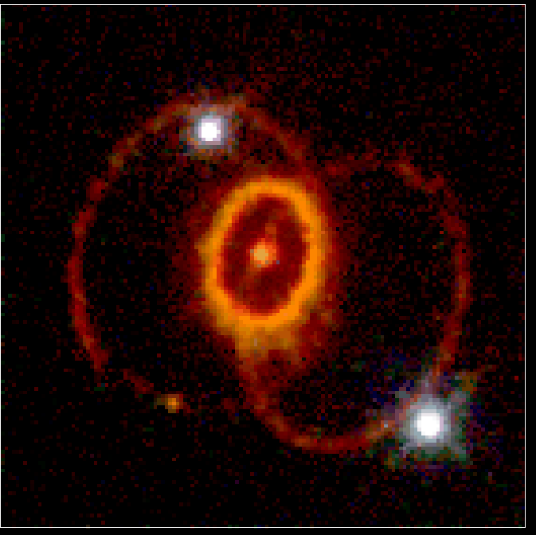
Exploding Stars
Supernova 1987A in
Large Magellanic Cloud
HST/WFPC2
At the end of a star’s life, if it is large enough, it will end with a bang (and not a whimper!)

Slide 7
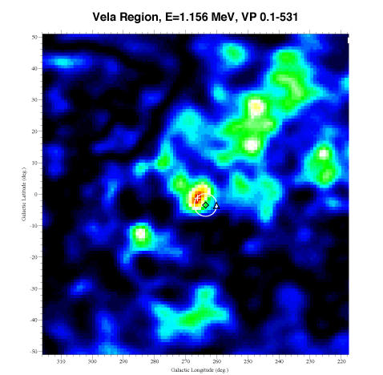
Supernova Remnants
Vela Region
CGRO/Comptel
Radioactive decay of chemical elements created by the supernova explosion

Slide 8
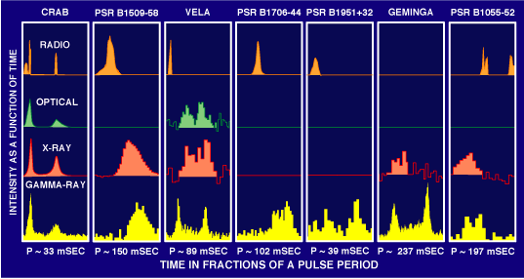
Pulsars
Stellar corpses - size of a city, mass of the Sun, spinning up to 1000 times per second

Slide 9
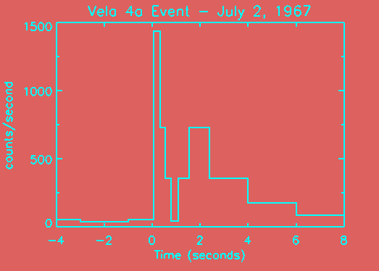
Gamma-ray Bursts
Discovered in 1967 while looking for nuclear test explosions - a 30+ year old mystery!

Slide 10
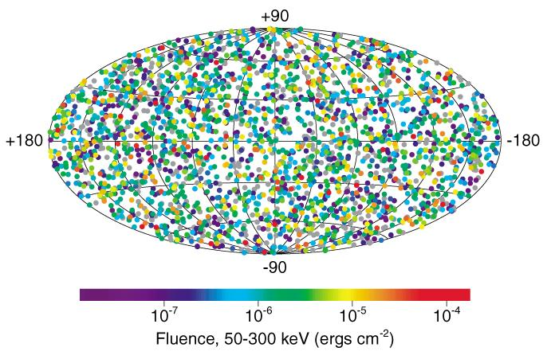
Gamma-ray Burst Sky
CGRO/BATSE
Once a day, somewhere in the Universe

Slide 11
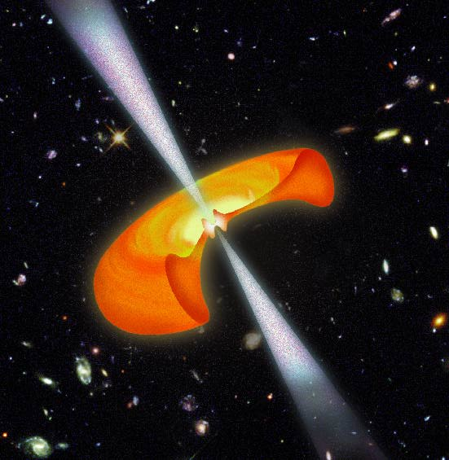
Hypernova
The end of the life of a star that had 100 times the mass of our Sun
A billion trillion times the power from the Sun

Slide 12
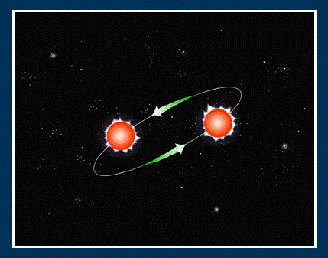
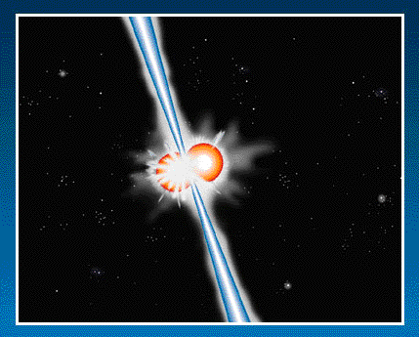
Catastrophic Mergers
Death spiral of 2 neutron stars or black holes

Slide 13
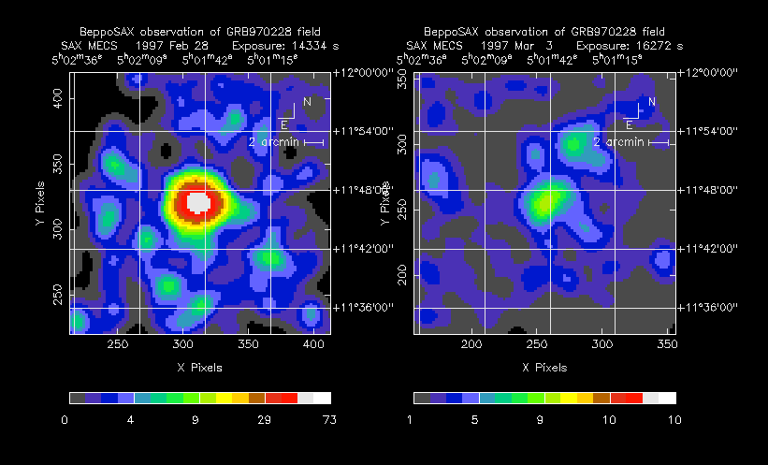
Afterglow
Discovered in 1997 by BeppoSAX satellite

Slide 14
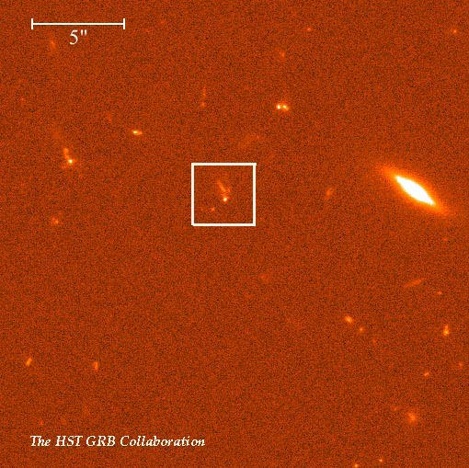
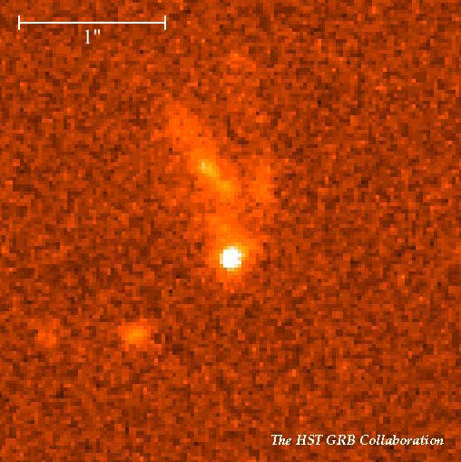
Afterglow
Cooling ashes in distant galaxies

Slide 15
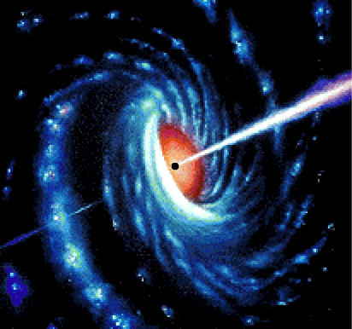
Gamma-ray Bursts
Signal the birth of a black hole?

Slide 16
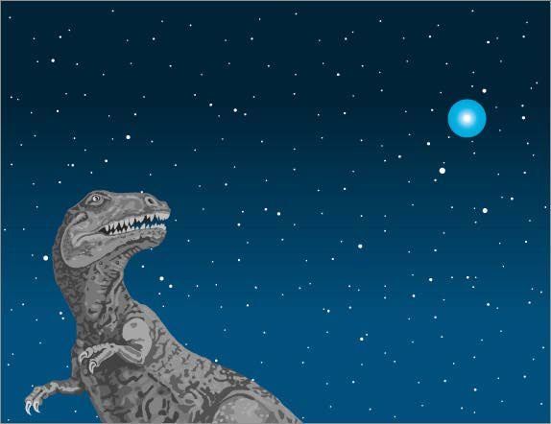
Gamma-ray Bursts
Or the death of life on Earth?

Slide 17
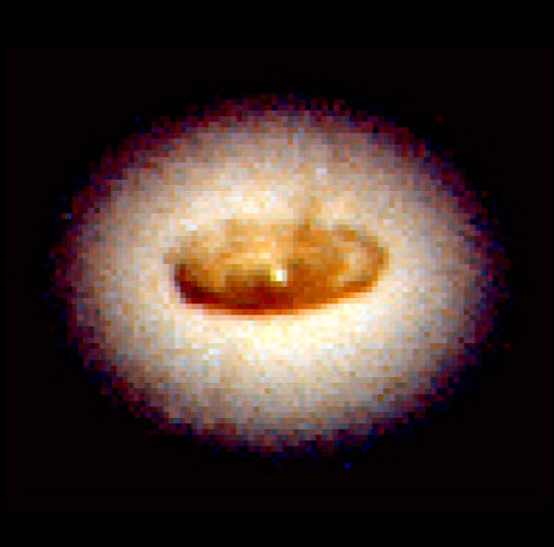
Monstrous black holes
At the heart of every galaxy lies a black hole, millions to billions times the mass of our Sun
HST/NGC 4261
Notes:
100 million light years away
1.2 billion M_{o} black hole in a region the size of our Solar System
Mass of disk is 100,000 M_{o}
Disk is 800 light years across

Slide 18
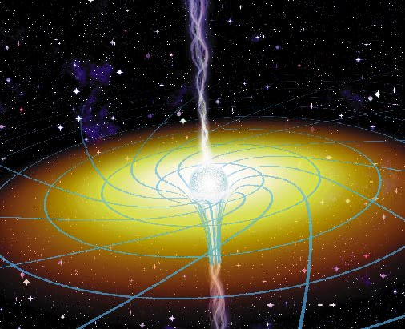
Blazing Galaxies
Credit: J. Bergeron Sky & Telescope
Gravity is so strong inside its “event horizon” that not even light can escape

Slide 19
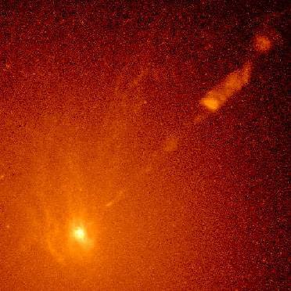
Jet Mysteries
So, how do black holes emit jets of particles and light?
And, how do the particles in the jets accelerate to near light speed?
HST/ M87

Slide 20
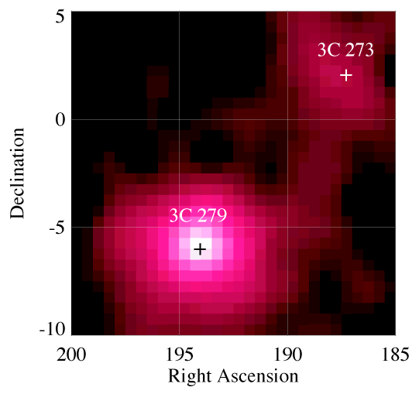
Gamma-ray Jets
Jets flare dramatically in gamma rays
Galaxies that point their jets at us are called “blazars”
EGRET/ 3C279 and 3C273

Slide 21

Anti-matter
E = mc²
Positrons are anti-electrons
When they meet, they annihilate each other!

Slide 22
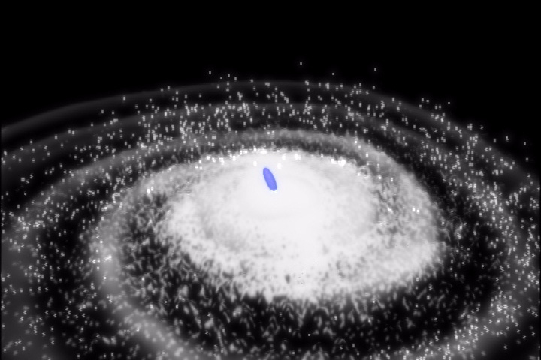
Anti-matter fountain
An artist’s view of the fountain
Annihilation near the center of our galaxy creates a fountain of gamma rays

Slide 23
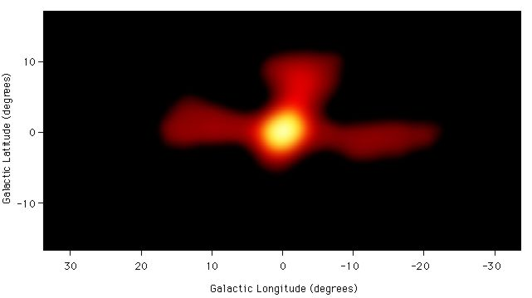
Annihilation gamma rays
fountain
Discovered by CGRO-OSSE in 1997

Slide 24
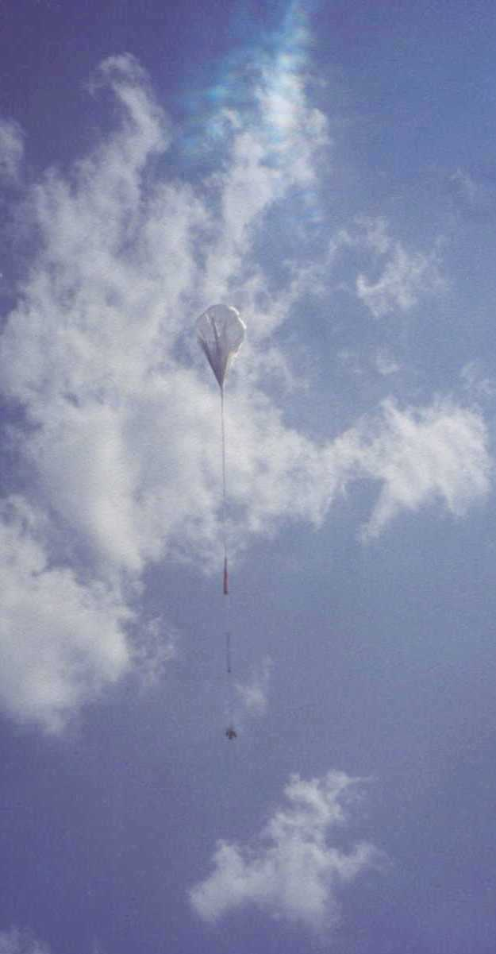
How to study Gamma rays?
Absorbed by the Earth’s atmosphere
Use rockets, balloons or satellites
Can’t image or focus gamma rays
Special detectors: crystals, silicon-strips
GLAST balloon test

Slide 25
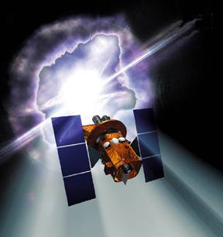
Swift Mission
Burst Alert Telescope (BAT)
Ultraviolet/Optical Telescope (UVOT)
X-ray Telescope (XRT)
To be launched in 2003

Slide 26


Swift Mission
Will study GRBs with “swift” response
Survey of “hard” X-ray sky
To be launched in 2003
Nominal 3-year lifetime
Will see ~300 GRBs per year

Slide 27
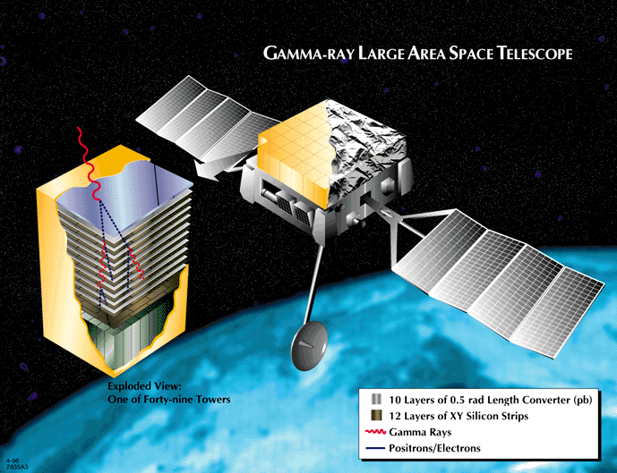
Gamma-ray Large Area Space Telescope (GLAST)
GLAST Burst Monitor (GBM)
Large Area Telescope (LAT)

Slide 28

GLAST Mission
First space-based collaboration between astrophysics and particle physics communities
Launch expected in 2006
Expected duration 5-10 years
Over 3000 gamma-ray sources will be seen

Slide 29
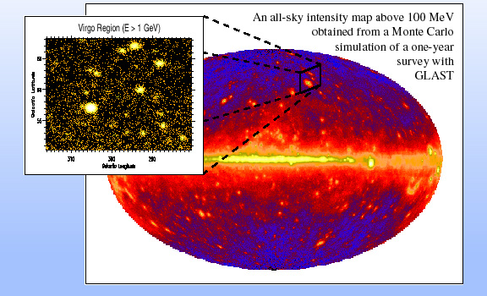
GLAST Sky Map

Slide 30
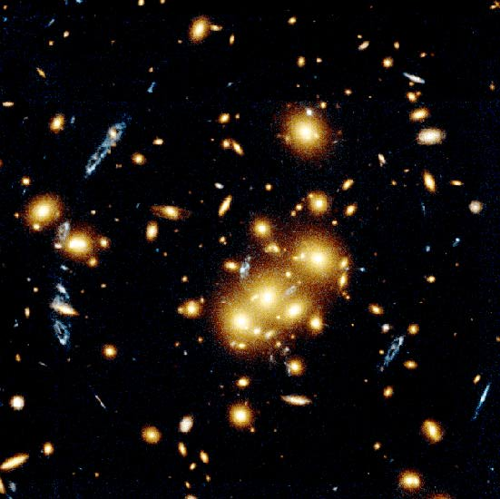
Dark Matter
Dark Matter makes up over 90% of the matter in the Universe
You can’t see it, but you can feel it!
HST/CL0024+1654

Slide 31
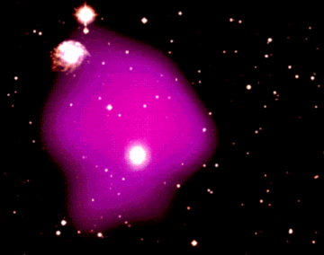
Shining light on dark matter
Dark Matter can be traced by studying X-rays from hot gas in clusters of galaxies
ROSAT X-ray over visible light image

Slide 32
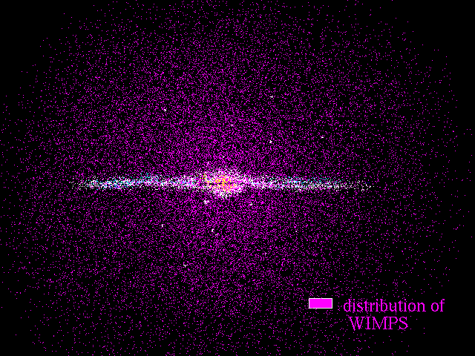
WIMPs
A calculation of WIMPs around our galaxy
Dark matter may be Weakly Interacting Massive Particles

Slide 33
Our Cosmic Destiny
The amount of dark matter in the Universe influences its ultimate fate
WIMPs may determine our Cosmic Destiny!
GLAST should be able to see gamma rays from WIMPs within 3 years of observations
"As for the question of the end of it I advise: Wait and see!" - A. Einstein

Slide 34
For more information:
http://www-glast.sonoma.edu
http://swift.gsfc.nasa.gov
http://imagine.gsfc.nasa.gov
http://zebu.uoregon.edu/~soper/Mass/WIMPS.html

