Slide 1

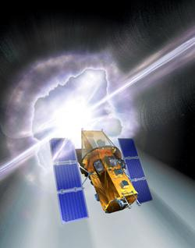
The Invisible Universe
Tim Graves
And
Sarah Silva
Sonoma State University

Slide 2
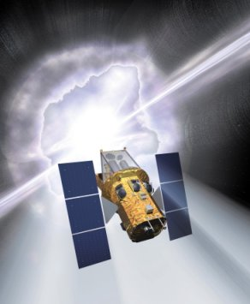
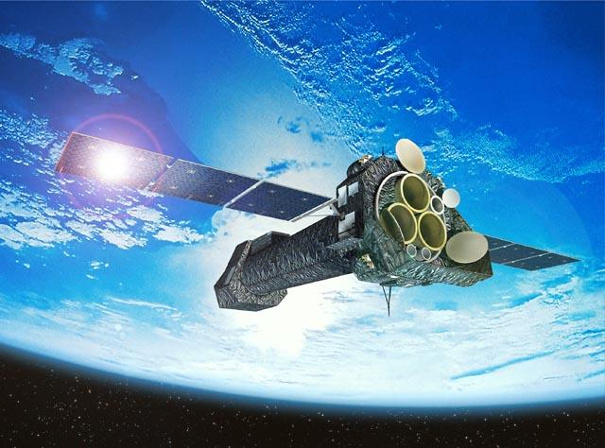
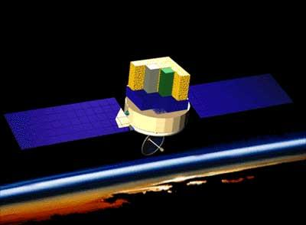
The NASA EPO Program at Sonoma State University
A group of ten people working collaboratively to educate the public about current and future NASA High Energy Astrophysics/Astronomy Missions.
Led by Prof. Lynn Cominsky
GLAST
XMM Newton

Slide 3
The GEMS Series
The Great Explorations in Math and Science Program has developed over 70 teachers guides handbooks for use in classrooms across the US.
GEMS guides are tested in the classroom nationwide
Come with clear step-by-step instructions
Assessment suggestions
Ideas for further investigations

Slide 4
The Invisible Universe The electromagnetic spectrum from radio waves to gamma rays…
A workbook and teachers guide based around the Swift mission and developed as part of the GEMS Program.
Activities in this book:
Activity 1: Comparing Wave Makers
Activity 2: Invisible Light Sources and Detectors
Activity 3: Putting the Electromagnetic Spectrum Together
Activity 4: Tour of the Invisible Universe
Activity 5: The Most Powerful Explosions in the Universe

Slide 5
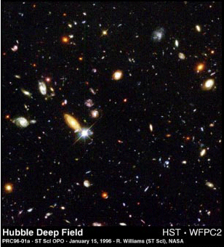
The Invisible Universe The electromagnetic spectrum from radio waves to gamma rays…
The Visible Universe
The Invisible Universe

Slide 6

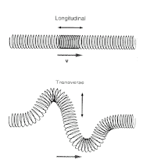
Activity 1
Activity 1: Comparing Wave Makers
A series of news flashes set the stage for the unit by introducing the mystery of gamma-ray bursts.
To work toward understanding gamma rays as very high energy waves, students first investigate properties of simple waves produced in different media.

Slide 7



Activity 2
Activity 2: Invisible Light Sources and Detectors
Students work at different learning stations to explore different kinds of light energy and how they can be detected, emitted, and absorbed.

Slide 8
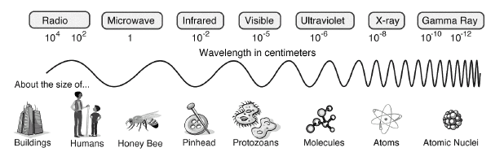
Activity 3
Activity 3: Putting the Electromagnetic Spectrum Together
In this activity, students have an opportunity to sort cards that contain information about the main regions of the electromagnetic spectrum.

Slide 9
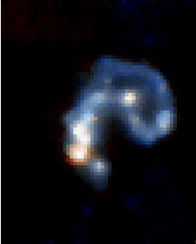
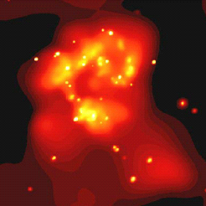
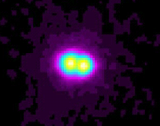
Activity 4
Activity 4: Tour of the Invisible Universe
This presentation is intended to help students improve their understanding of objects in the Universe, including those connected with gamma-ray bursts.

Slide 10
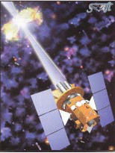


Activity 5
Activity 5: The Most Powerful Explosions in the Universe
Students return to the gamma-ray burst mystery that opened the unit. Since it is so difficult for anyone to grasp the amount of energy unleashed every day in space, students climb a mental ladder of “energetic events.”

Slide 11



GEMS Activity 2 - Sources
Question: Name some visible sources of light in the room
Flashlight
Laptop Monitor
Projector
Question: Is the screen at the front of the room a light source?
But it seems to be emitting light?
Oh, I see the screen is reflecting the light, not emitting it.
Definition: Sources of light are objects that emit light energy

Slide 12
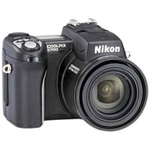
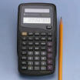


GEMS Activity 2 - Detectors
Question: Can you tell me where there are light detectors in this room?
Motion Sensitive Light Switches
Cameras
Those two openings on either side of our noses!
Solar Calculators
Question: Are there any other light detectors that you know of?

Slide 13
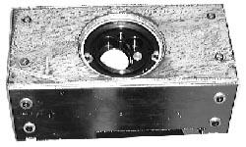
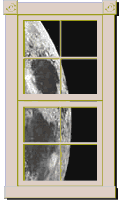
GEMS Activity 2 – Transmitters and Shields
Question: What are some things that don’t allow light through?
Is it safe to say these things “Shield the Light”?
Question: What are some materials we know of that do allow light to either completely or partially pass through it?
Is it safe to say these things “Transmit the Light”?

Slide 14

GEMS Activity 2 – More Than Your Eyes Can See

Slide 15
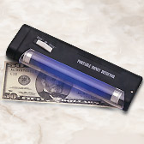
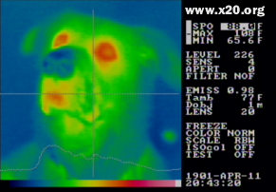
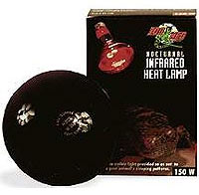
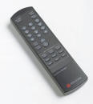
GEMS Activity 2 – Invisible Sources
In addition to visible sources of light in the room there are many of invisible Sources light too.
Question: Can anyone name any invisible sources of light in the room?
UV Black Light
Yes! Us.
Infrared Heat Lamps
Infrared Remote

Slide 16
GEMS Activity 2 – Invisible Sources of Light
There are 6 different stations throughout the room, each with two setups.
They are equipped with a source of invisible light and a detector for detecting that light.
In a moment we will break up into groups.
Each group will have a set of materials.
These materials are potential shields.

Slide 17
GEMS Activity 2 - Procedure
Each group with collectively go from station to station and test each material to see if it is a Transmitter (T) or a Shield (S) for that particular type of light energy.
IMPORTANT – As scientists we are obligated to make a prediction about how we think each material will behave.
Try and figure out what property of the materials we are testing blocks each type of light energy.

Slide 18
GEMS Activity 2 – What did we learn?
Question: What property of the materials we tested caused radio waves to be blocked?
Question: Are all the plastics we tested translucent/transparent to infrared light?
Question: If someone had no sunscreen while at the beach what could they cover their face with to keep from getting sun burned by UV light?

Slide 19
GEMS Activity 2 – Reflection
Each group should pick a station.
Try to figure out which of your materials can reflect the invisible light of that station.
Try and use what you have learned in the previous section to test your ideas in this section.
Question: What did you find out?

Slide 20
GEMS Activity 5 The Most Powerful Explosions in the Universe
The Mystery of the Gamma-Ray Bursts

Slide 21
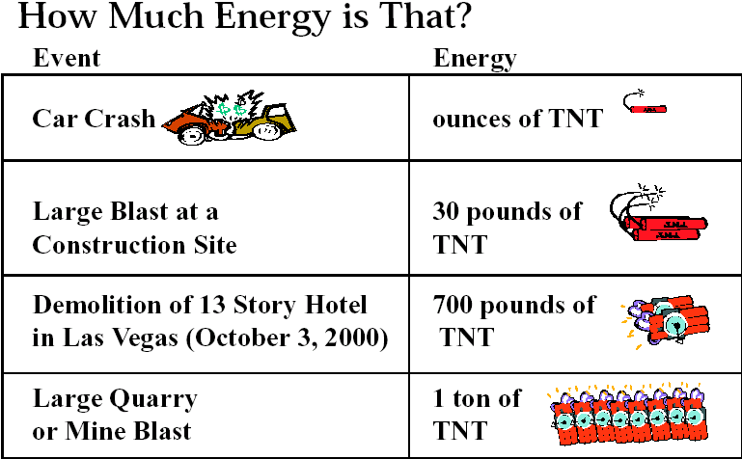




GEMS Activity 5 The Most Powerful Explosions in the Universe

Slide 22
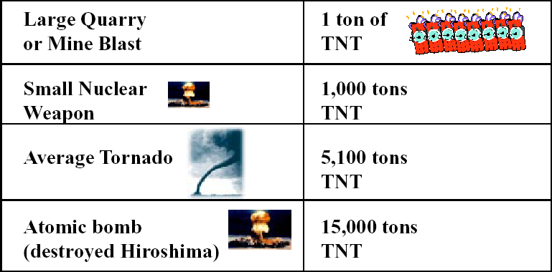



GEMS Activity 5 The Most Powerful Explosions in the Universe
What scale should we use now for Graph B, to fit the
biggest energy event on the scale?

Slide 23

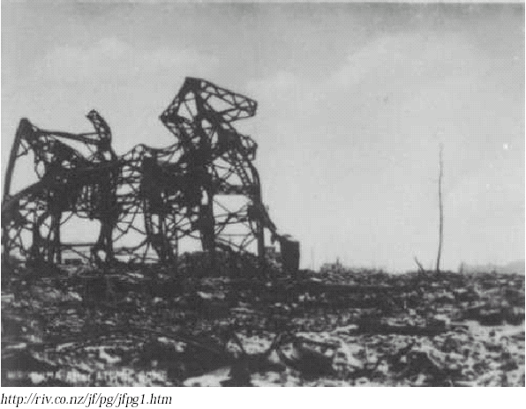
GEMS Activity 5 Hiroshima A-bomb

Slide 24
GEMS Activity 5 The Most Powerful Explosions in the Universe
What do ya think,
are we close to the energy of a gamma-ray burst?
NOT EVEN CLOSE!
Since we are still nowhere near the energy of a
gamma-ray burst, how can we continue graphing for
even larger energy events?

Slide 25
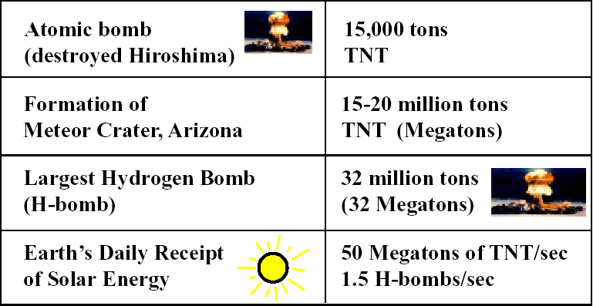



GEMS Activity 5 The Most Powerful Explosions in the Universe
Now you’ve seen the energy, what scale should we use
for Graph C?

Slide 26
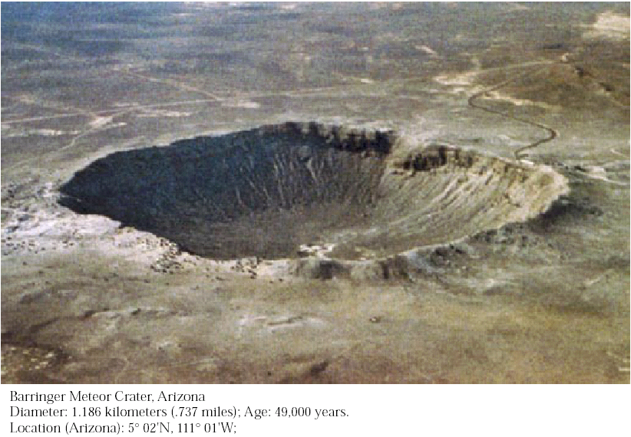
GEMS Activity 5 Meteor Crater, Arizona

Slide 27

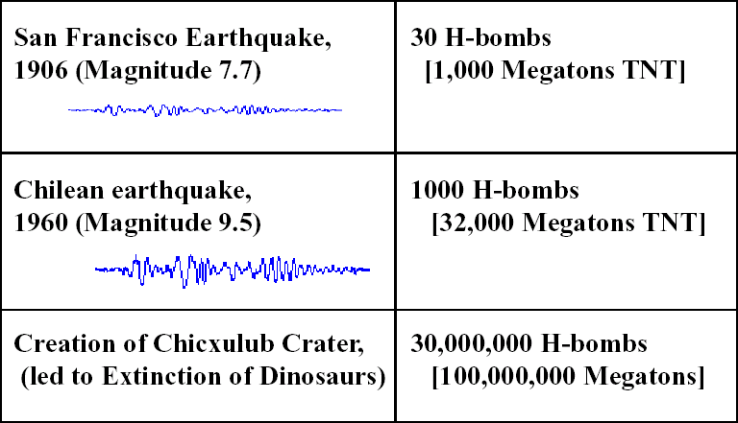
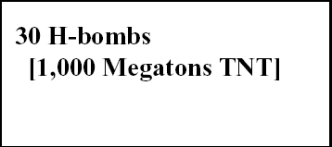
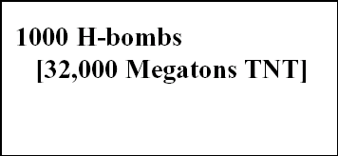

GEMS Activity 5 The Most Powerful Explosions in the Universe

Slide 28
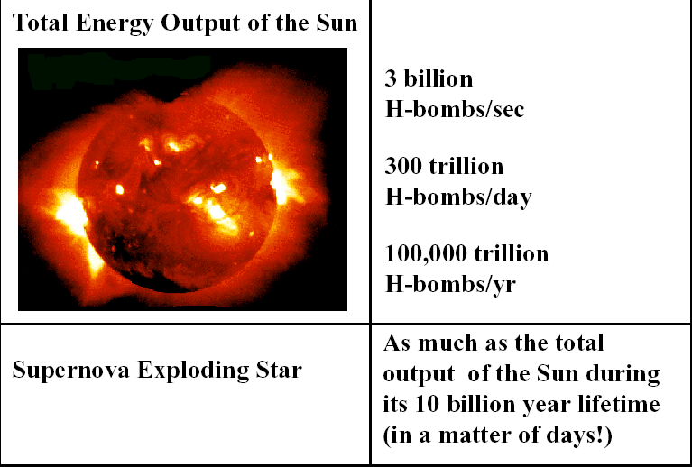
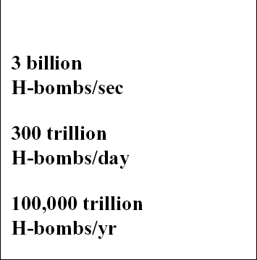
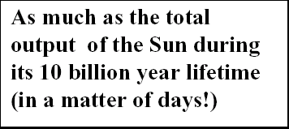
GEMS Activity 5 The Most Powerful Explosions in the Universe

Slide 29
GEMS Activity 5 The Most Powerful Explosions in the Universe
Why do you think the units changed to total lifetime output
of the Sun, instead of using tons of TNT as an energy unit?
If we used the unit of TNT it would be so high that we
would have over 30 zeros!
1,000,000,000,000,000,000,000,000,000,000 TNT
or 1x10³⁰ TNT
So let’s use something else…

Slide 30
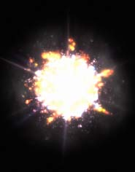
GEMS Activity 5 The Most Powerful Explosion in the Universe
Gamma-Ray Burst
100 SUPERNOVAE
(in seconds!)

Slide 31
GEMS Activity 5 The Most Powerful Explosion in the Universe
Gamma-Ray Burst
100 SUPERNOVAE
(in seconds!)
What do you think might be causing such incredible
powerful events, that can release the energy of
trillions of Suns in a matter of minutes or even
seconds?

Slide 32

More Information
Swift - http://swift.sonoma.edu
GLAST – http://glast.sonoma.edu
XMM Newton - http://xmm.sonoma.edu
NASA EPO @ SSU – http://epo.sonoma.edu
Tim Graves – gravest@universe.sonoma.edu
Sarah Silva - sarah@universe.sonoma.edu

