Slide 1

Things My Mother Never Told Me About the Universe
Professor Lynn Cominsky
Sonoma State University

Slide 2
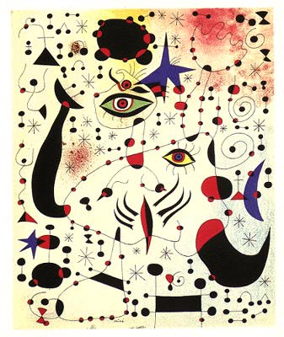
Outline
My Mom and the Constellations
Mass, Weight and Acceleration
Einstein, Mass and Energy
What’s the Matter?
Matter and Energy in the Universe
Going Beyond Einstein
Some Last Words

Slide 3
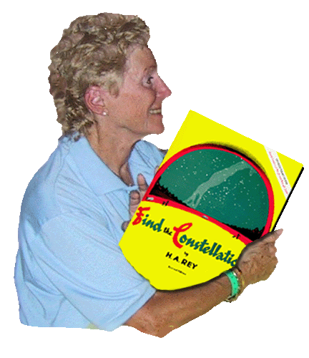
My Mom and the Constellations
I first learned about the stars from my Mom
She taught me the constellations on camping trips with our girl scout troop
And so I started looking up at the night sky in wonder…

Slide 4
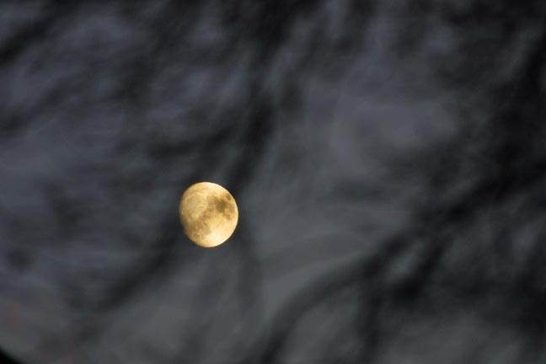
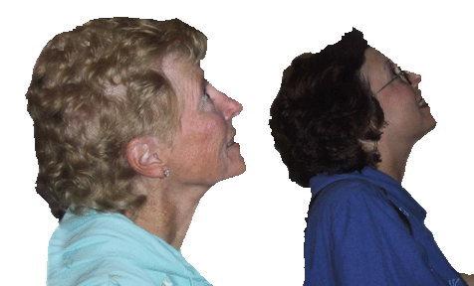
Fly Me to the Moon
In 1969, humans first went to the Moon
I thought a trip to the moon would be an easy way to lose weight!

Slide 5
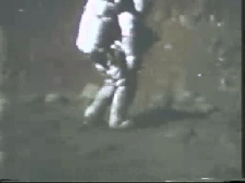
Mass and weight on the Moon
But the astronauts didn’t look any skinnier!

Slide 6
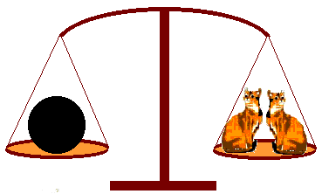
Mass and weight
On the moon, it is the weight that changes, not the mass.
Mass is the quantity of stuff that makes up an object. It is measured in grams (or slugs).
Weight is the force of gravity on mass. It is measured in Newtons (or pounds).
Here on earth, we often use the terms interchangeably (and incorrectly). We say “1 kg = 2.2 pounds” but 1 kg weighs 2.2 pounds
Notes:
1 kg weighs 9.8 Newtons
1 slug weighs 32 pounds
(on earth).

Slide 7
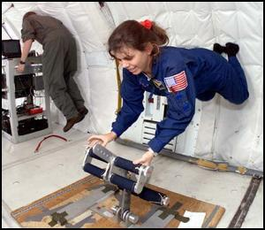
“Weightless” in space?
So, then how do astronauts in the Space Shuttle float around, seemingly weightless?
Astronauts are in orbit about 250 km above the Earth

Slide 8
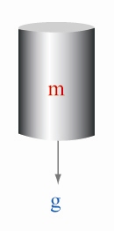
“Weightless” in space?
On the Earth, F = mg where
g = 9.8 m/s² is the gravitational acceleration at the surface of the Earth
In general, F = GmM/r² where G is the Universal gravitational constant
Therefore g = GM_{e}/R_{e}² where R_{e} = 6378 km is the Earth’s radius, and
M_{e} = 5.972 x 10²⁴ kg is the Earth’s mass .

Slide 9
“Weightless” in space?
Astronauts orbit at R_{e} + 250 km
= 6628 km
Solving for g_{orbit} 🡪
9 m/s²
This is not zero gravity!!
(Not to scale)

Slide 10
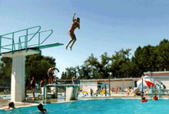
“Weightless” in space?
Astronauts seem “weightless” because they are in freefall – they are constantly falling inside their falling spaceships
Jump in the air, or from a diving board and you too can be in freefall or “weightless”

Slide 11
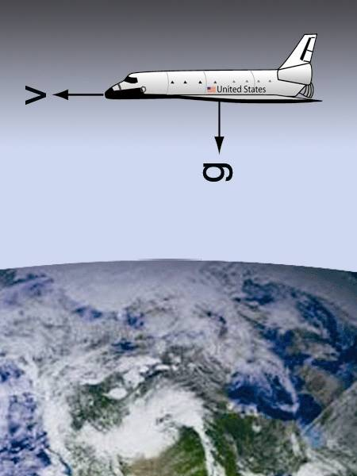
“Weightless” in space?
Of course, the astronauts are in freefall for much longer, because they are in orbit, traveling around the Earth while falling continuously
So they don’t feel the Earth’s gravity until they reenter the atmosphere, which pushes on them so hard, that they temporarily weigh more than on Earth

Slide 12
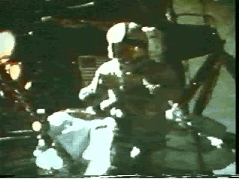
Mass and Acceleration
Galileo showed that since the acceleration due to gravity is a constant, two bodies of different mass will fall at the same rate
In other words:
F = ma = mg
So a=g
(mass cancels)

Slide 13
Mass conservation
In most everyday situations, mass is conserved.
M₁ + M₂ = M₁₊₂

Slide 14
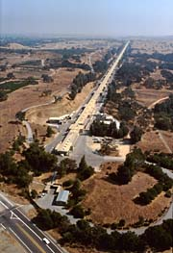
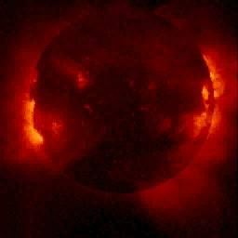
Mass conservation
BUT: Mass is not conserved in extreme environments, such as inside the Sun or at particle accelerators
Sun’s image in X-rays from Yohkoh
SLAC

Slide 15
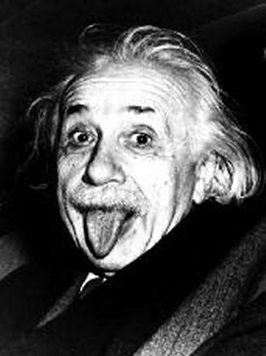
Mass and energy
My mom told me about Einstein
But I had to go to college to learn
the meaning of his famous equation:
E = mc²
Einstein realized that mass and energy were equivalent and interchangeable
SO: It is the total of mass & energy that is really conserved.

Slide 16

Creating Energy from Mass
When two oppositely charged particles meet in flight, they can annihilate to create two gamma-ray photons traveling in opposite directions
The rest mass of an electron or its anti-particle, the positron, is 511 keV/c²
Annihilating an electron creates E= 511 keV

Slide 17
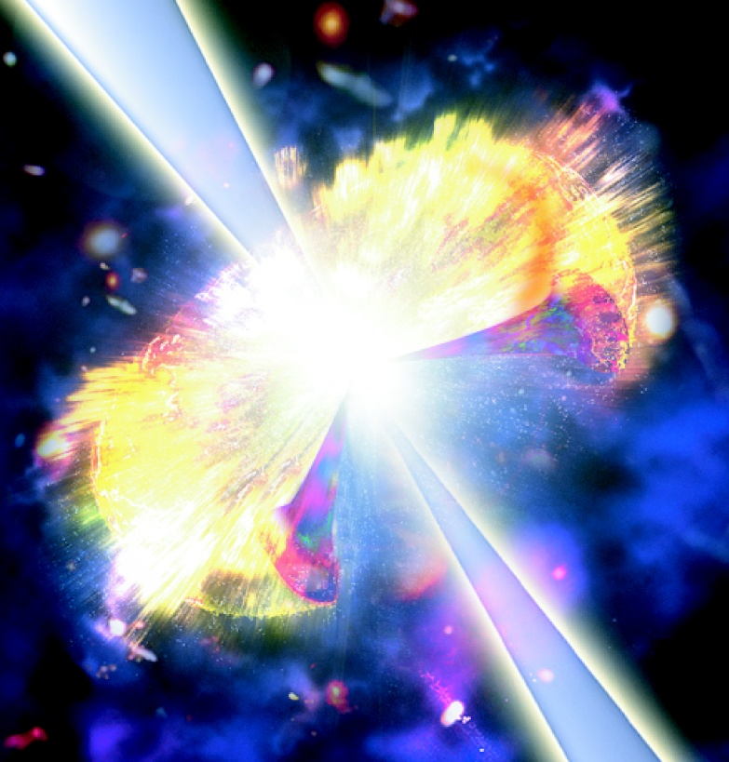
Explosions in Space
Energy is also created from mass when stars explode
Supernovae herald the deaths of stars
Gamma-ray Bursts signal the deaths of even more massive stars
They are the birth cries of black holes

Slide 18
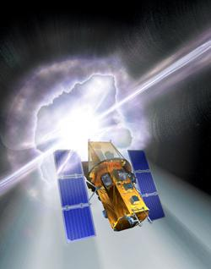
Swift Gamma-ray Burst Mission
Will study Gamma-Ray Bursts with a “swift” response
To be launched in 2004
Nominal 2-year lifetime
Will see ~150 GRBs per year

Slide 19
Creating Mass from Energy
Pairs of oppositely charged particles can be produced from a single energetic gamma-ray photon, interacting with converter material

Slide 20
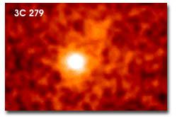
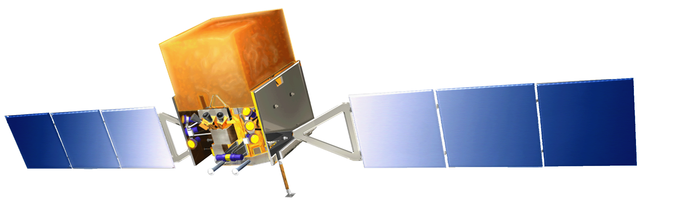
Pair production in space
NASA is launching a telescope in 2006 that uses pair production to track gamma-rays from space to their sources – often huge black holes!

Slide 21
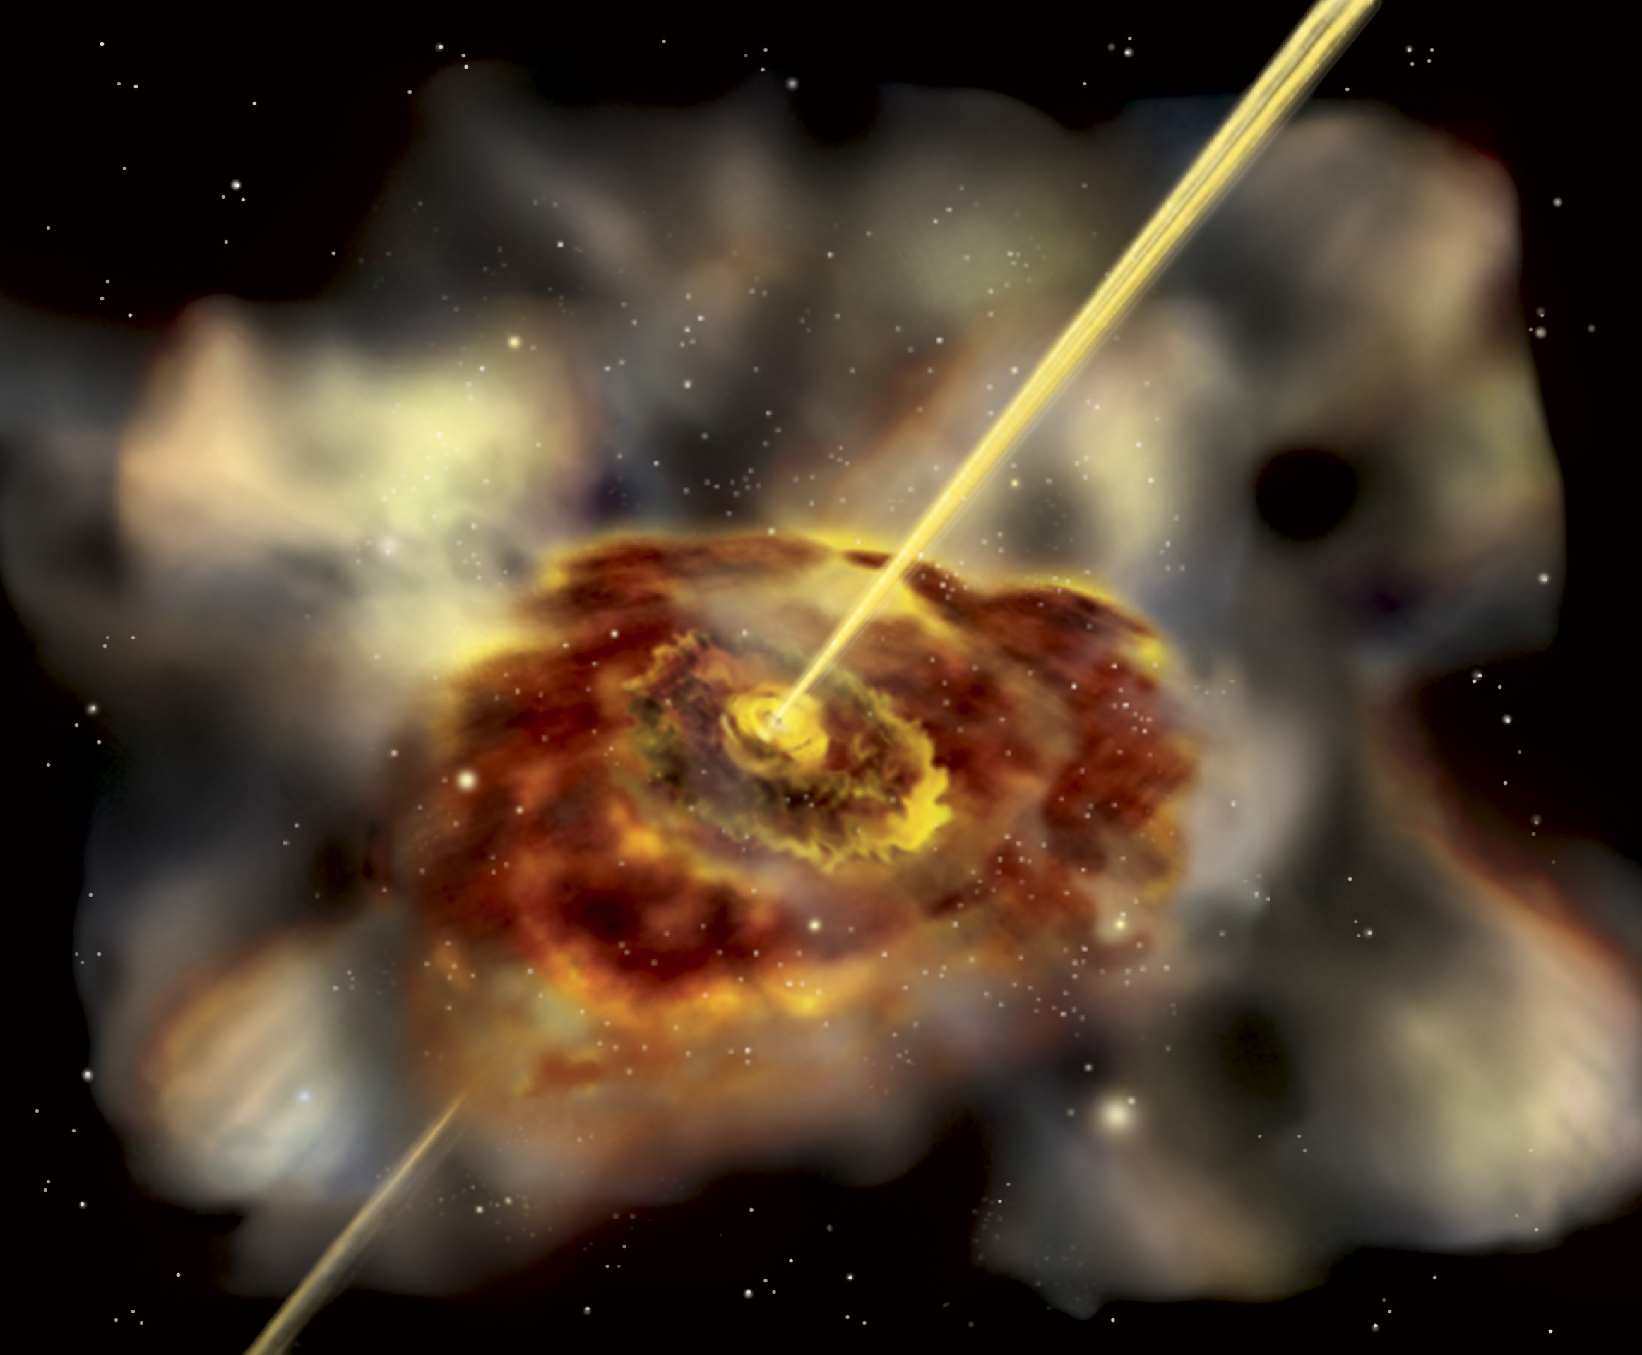
GLAST sees the Universe
The Gamma-ray Large Area Space Telescope will locate thousands of super-massive black holes that are beaming jets of gamma-rays towards the Earth
We want to figure out what types of matter are in the jets and how they are made

Slide 22
What’s the matter?
Growing up in Buffalo, we didn’t see too many different types of matter
Instead of ice, liquid water and steam, we had snow, snow and more snow!

Slide 23



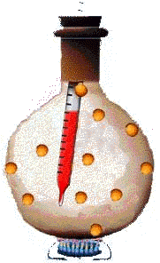
Three states of matter
My mom told me there
are three states of matter:
Solids Liquids Gases

Slide 24

How many states of matter?
The state of California science standards agree with my Mom:
Students know matter has three forms: solid, liquid and gas (3)
Students know the states of matter (solid, liquid, gas) depend on molecular motion (8)
BUT: Are there really 3 states of matter?

Slide 25
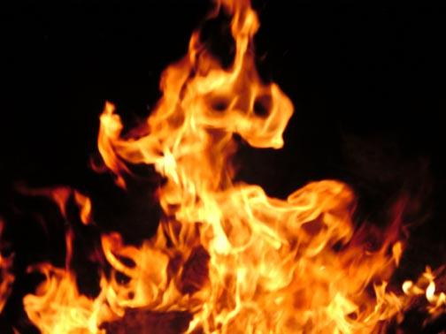
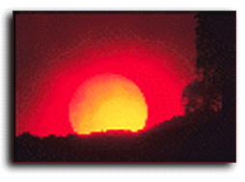
A fourth state of matter
But even the ancients knew that there are four types of matter: Earth, Air, Water and
FIRE
So, what is the matter in fire?
Or the Sun?
Or inside fluorescent light bulbs?

Slide 26
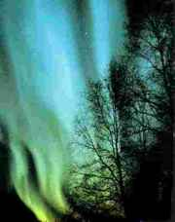
Plasma – the fourth state
Plasma makes up more than 99% of everything in the Universe that is luminous
Plasma is ionized atomic matter
The electrons are dissociated from their nuclei and are free to move around, interacting with any remaining neutral atoms

Slide 27
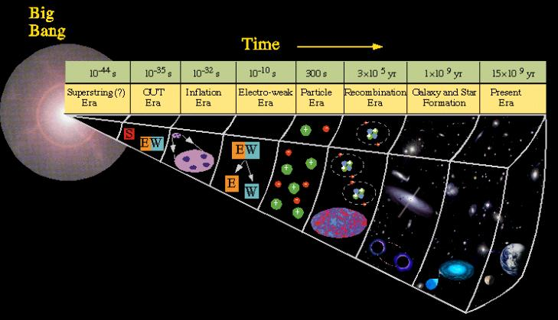
Creating matter in the Universe
Nuclei formed
Atoms formed

Slide 28
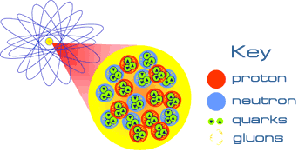
A new type of matter?
Scientists at Brookhaven are now trying to break down nuclear matter to create a plasma from quarks and gluons

Slide 29
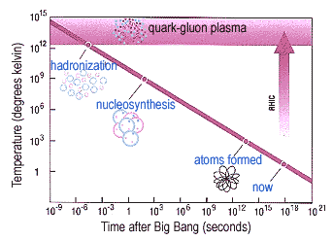
Quark-Gluon Plasma
QGP formed:
after the Big Bang
before the formation of protons, neutrons and atoms
with the first light

Slide 30
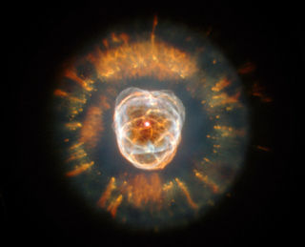
Seeing the Light in the Universe
We see light across the entire energy spectrum:
Radio waves (cold gas)
Infrared (warm dust)
Visible and ultraviolet
(hot stars and galaxies)
X-rays and gamma-rays
(stellar explosions)
HST/Eskimo nebula

Slide 31
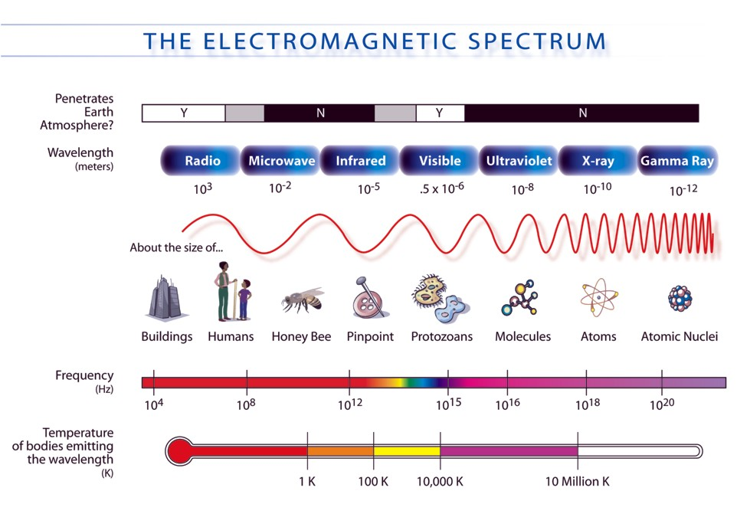

Slide 32

What’s the Matter in the Universe?
Most normal matter is in the form of atoms of hydrogen and helium
Normal matter (even including plasma) only makes up 5% of the mass-energy of the Universe
Is there matter that does not emit light?
Can we feel it, even if we can’t see it?

Slide 33
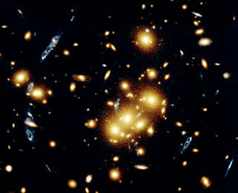
Dark Matter
Dark matter emits no light, but it interacts with luminous matter through gravity
The blue arcs are images of a blue galaxy that is being lensed gravitationally by dark matter in the yellow-orange galaxy cluster
HST/CL0024+1654

Slide 34
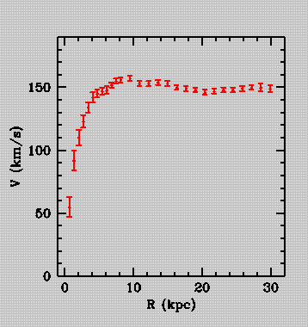
Dark Matter
Dark matter holds in rapidly orbiting stars in the outer parts of galaxies
It also flattens a galaxy’s rotation curve
NGC 3198

Slide 35
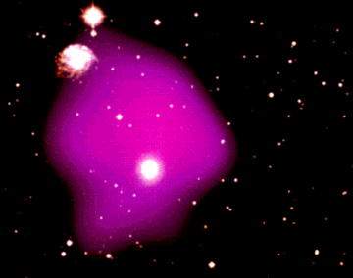
Dark Matter
Dark matter holds x-ray heated gas inside of clusters of galaxies
Overlay of visible light image of galaxy cluster with x-ray heated gas (purple)

Slide 36
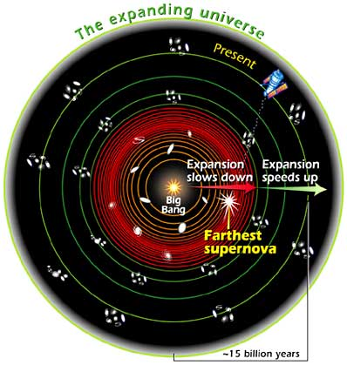
Dark Energy
In 1998, two teams of researchers announced that they had found evidence for the acceleration of the expansion of the Universe
Some type of new “anti-gravity” seems to be at work, driving this acceleration
It is known as the mysterious dark energy

Slide 37
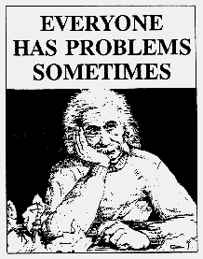
Dark Energy
A form of DE was predicted by Einstein to solve a problem with his Theory of General Relativity
GR predicted that the Universe would either expand or collapse
However, Einstein believed it should be stable
When the Universe was found to expand, Einstein called this his “biggest blunder”

Slide 38
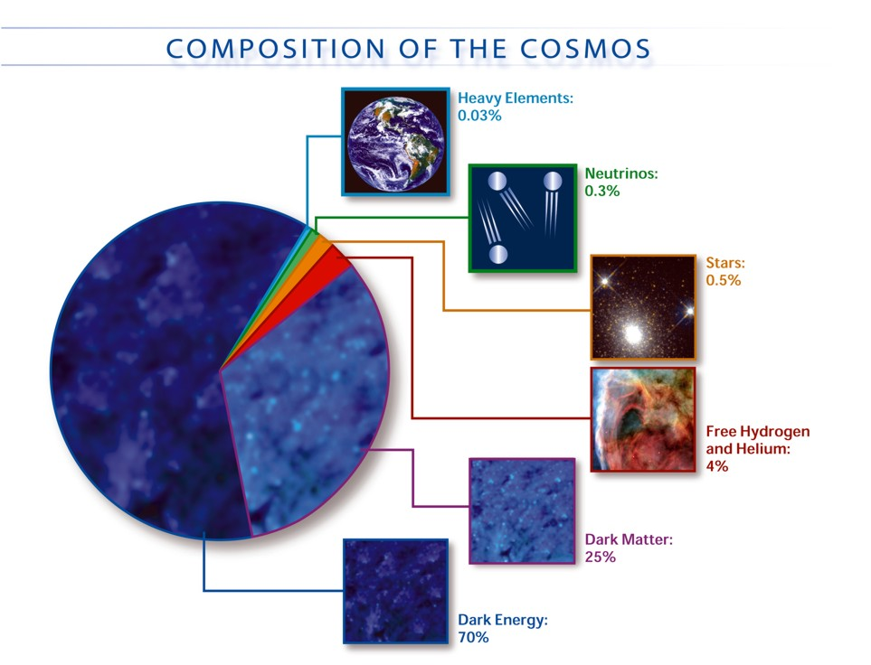

Slide 39

Going Beyond Einstein
NASA is beginning a new program to test predictions of Einstein’s theories:
What happens at the edge of a black hole?
What powered the Big Bang?
What is the mysterious Dark Energy that is pulling the Universe apart?
Do Einstein’s theories completely describe our Universe?

Slide 40
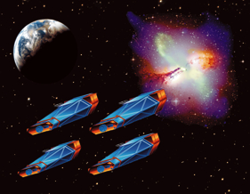
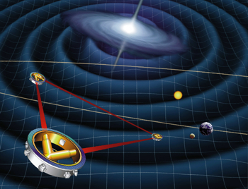
BE Great Observatories
Constellation X
LISA
Four X-ray telescopes flying in formation
Three satellites, each with 2 lasers and 2 test masses

Slide 41
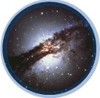
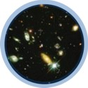
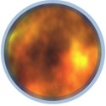
Beyond Einstein Probes
Black Hole Finder
Dark Energy
Inflation
Census of hidden Black Holes
Measure expansion history
Polarization of CMB

Slide 42
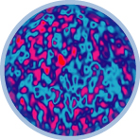
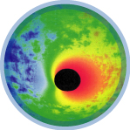
Beyond Einstein Vision Missions
Big Bang Observer
Black Hole Imager
Direct detection of gravitational waves from Big Bang
Resolved image of the Event Horizon

Slide 43
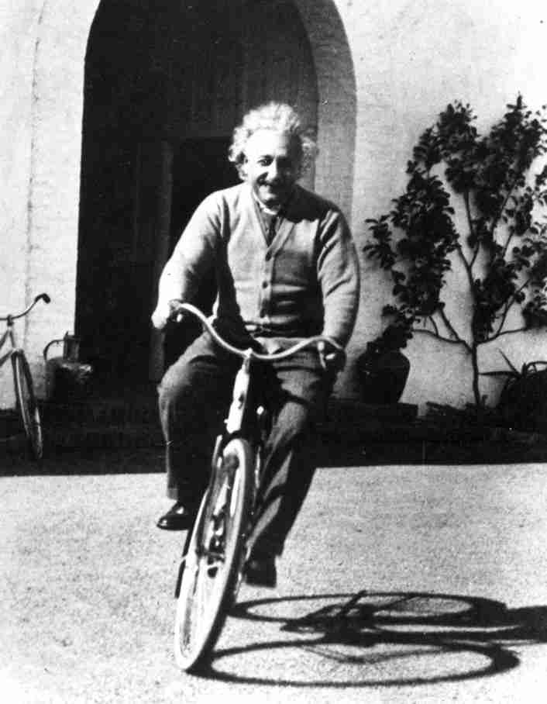
Some last words from Einstein
“The most incomprehensible thing about the Universe is that it is comprehensible”

Slide 44

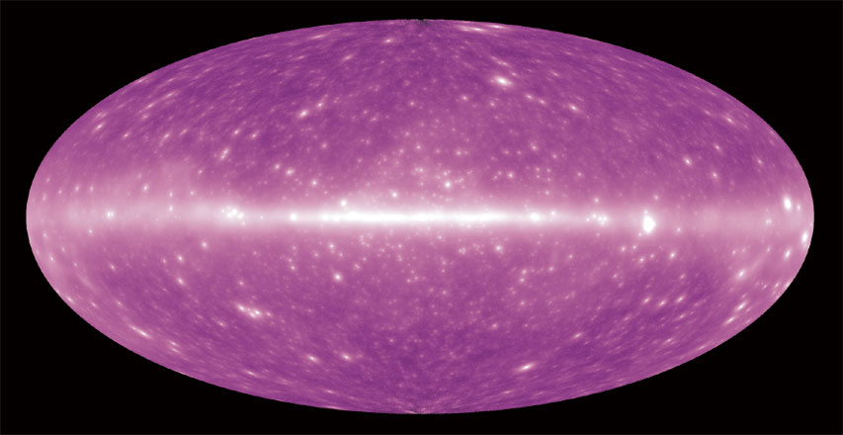
And some last words about my Mom…
When my mother taught me a few stars, she opened my eyes to the entire Universe
Gamma-ray sky that will be seen by GLAST

Slide 45
Resources
http://glast.sonoma.edu
http://imagine.gsfc.nasa.gov
http://regentsprep.org/Regents/physics/phys01/accgravi/nogravsm.htm
http://scidiv.bcc.ctc.edu/wv/0001-02-statesofmatter.html
http://www.plasmacoalition.org/
http://universe.gsfc.nasa.gov
Uwe R. Zimmer - transit-port.net/Galleries/Germany/ pages/Full%20moon.htm
http://www.bnl.gov/rhic/primer.htm
http://www.nobel.se/

Slide 46
Backup Slides follow

Slide 47
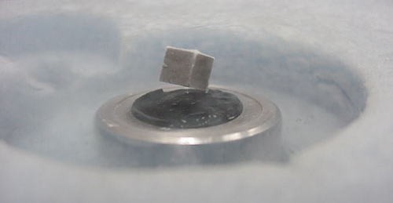
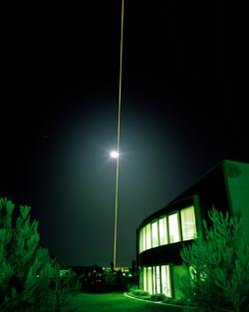
“Super” states of matter & energy
Superfluids, superconductors, Bose-Einstein condensates and lasers
Many Nobel prizes have been won for explaining these phenomena
All involve unusual physical manifestations in which the particles/photons have the same properties on a quantum level

