Slide 1
The Swift Education and Public Outreach Program
Philip Plait and Lisa Brown
Sonoma State University/
Penn State University
April 29, 2003

Slide 2
Program Overview
Swift E/PO Web site (http://swift.sonoma.edu)
Printed materials
Teacher’s activity booklets and posters
Educator training
Conference workshops
Educator Ambassadors
Informal Education
What’s in the News? (PSU)
Program Evaluation
Future Plans

Slide 3
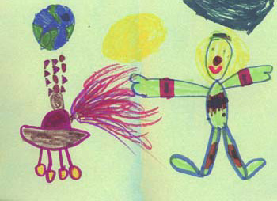
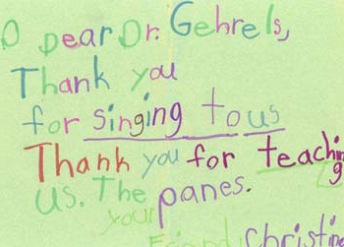
Swift E/PO Website
New addition: Cards from students at Arthur Slade school after Neil Gehrels’ visit
http://swift.sonoma.edu

Slide 4
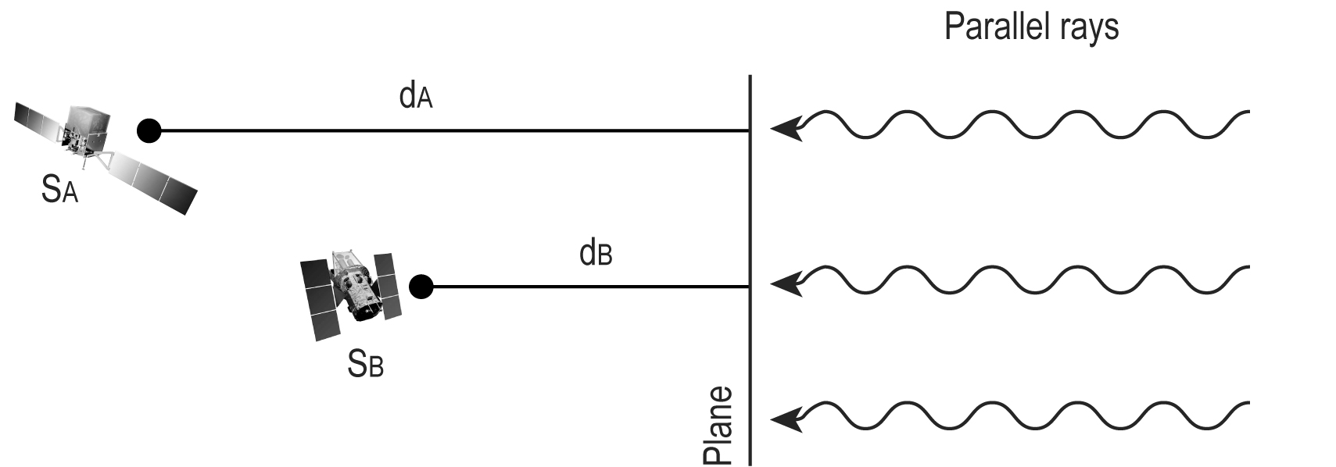
New Educator’s Guide
Gamma-ray Burst Educator’s Guide in progress
Aligned with mathematics standards
First and second
activities already
classroom tested

Slide 5
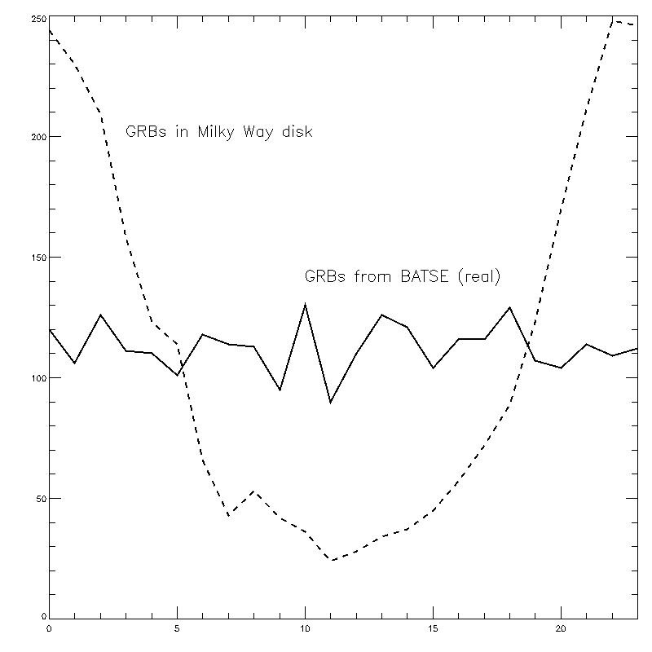
New Educator’s Guide
Activity 3 being developed
GRB distribution on sky: students will compare real BATSE distribution with simulated distributions
Aligns with many math and science standards
We encourage suggestions

Slide 6
AAS Poster
To be presented at May 2003 Nashville meeting
Overview of all E/PO activities
Designed to get educators involved with Swift E/PO

Slide 7
Reaching teachers
Swift/GLAST booth at:
AAS (Seattle) (1/03)
AAPT (Austin) (1/03)
HEAD (Quebec) (3/03)
NCN/AAPT (SSU) (4/03)
AAS (Nashville) (5/03)
GEMS presented at AAPT by Tim Graves and Sarah Silva
PSU teacher workshops:
7/21-25 “Galaxies and Cosmology”
7/28 – 8/01 “Space-based Astronomy” w/tour of Swift operations

Slide 8
Materials Distributed (since 11/02)
462 Newton's Laws Posters
580 Slinkies
154 Waves Light Up the Universe booklets+ “Spin A Spectrum”
154 kits with "Spin A Spectrum“
154 “Powers of 10” booklets
317 “Powers of 10” card decks
293 GEMS Guides
1000 Swift mousepads (1000 more ordered!)

Slide 9
Educator Ambassador Presentations (since 11/02)
12/17/02: Ambassador Rob Sparks presented Swift materials at Southern Wisconsin Area Physics Sharing (SWAPS)
02/06/03: Sparks discussed Swift mission at Milwaukee Area Physics Sharing (MAPS), Milwaukee, WI
03/09/03: Sparks: “Seeing the Universe in a Different Light“ Wisconsin Society of Science Teachers (WSST) 2003 convention.

Slide 10
04/05/03: Rae McEntyre: "NASA's Swift Mission and Gamma Ray Astronomy" National Congress on Aviation and Space Education, Cincinnati, OH
04/05/03: Rob Sparks: "Bringing Modern Astronomy Into the Classroom“ AAPT-Spring Meeting, Florida
04/15/03: David Beier: “Invisible Universe” Rockhurst University, Kansas City, MO – our unofficial EA! – Was in the GEMS workshop given at AAPT by Silva and Graves

Slide 11
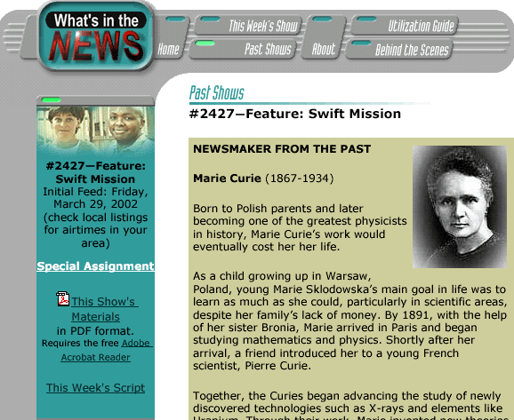
WITN
For FY03, 3 short pieces focus on GRBs
15 minute piece on how stars live and die, tying in SNe with GRBs via black holes
2 short segments already aired (3/21 on MAP and Swift and 4/4 on cold war/GRB connection)
Last short airs May 9, long airs May 2

Slide 12
Program Evaluation
WestEd
Will assist in formative evaluation of classroom materials, especially Newton’s Laws and GRB activities
Assessed GEMS workshop at AAPT national meeting
Will evaluate planning for Swift launch outreach
SwEC
Will be meeting at SSU in 8/03
Now includes 2 Educator Ambassadors
WITN staff attending; brainstorm FY’04 segments

Slide 13
Status of Near-Future Plans
Field testing of classroom materials continues
Increased scientific review and error correction of existing materials
Increased involvement of Swift team scientists
Improved coordination with GLAST E/PO and EA programs, including participation in the GTN (C J Rodkey gave presentation at AAVSO, paid by Swift/GSFC)
New GRB activity #3 to be tested soon
More help still needed!
GRBs added to GTN target list – timing issues under study
Leuschner observatory for GRBs

Slide 14
Preliminary Launch Plans
GRB Educator’s Guide available
New Swift poster with GRB activity on back
Public outreach program that focuses on launch
Swift model booklet available
Swift launch filmed for PBS Nova show by Tom Lucas (in conjunction with GLAST)
T-shirts!

Slide 15
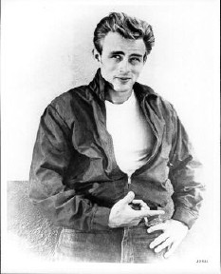
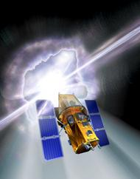
Swift T-Shirts
Commemorate launch
Made at cost
T-shirts ($15 – 20)
Polo shirts (~$30, can be embroidered)
Your input welcome!

