Slide 1
Education and Public Outreach
Laura Whitlock
Sonoma State University

Slide 2
Team Members
Sonoma State University
Laura Whitlock, Lynn Cominsky
Penn State University
Lisa Brown, Eric Feigelson
Goddard Space Flight Center
Padi Boyd, Alan Smale, Karen Smale
Coordinated Efforts in Italy and UK
Swift Education Committee (SwEC)
Barbara Crawford (PSU, Chair); Bruce Hemp, Tom Arnold, Scot Weigert (Master Teachers); Paul Roche (UK); Joan Sanders (AESP); Isabel Hawkins (UCB); Margaret Chester (PSU); Ann Parsons (GSFC); Jim Lochner (GSFC)

Slide 3
Team Members
Subcontracts
Lawrence Hall of Science
Key Personnel: Alan Gould
Videodiscovery, Inc.
Key Personnel: Shaun Taylor
What’s in the News?
Key Personnel: Katie O’Toole
WestEd
Key Personnel: Kristin Hershbell, Steve Schneider

Slide 4
Overview of Program Components
GEMS Guide
Educator Training
Appalachian Region Project
North Bay Science Project
Conventions, workshops, etc
Web Materials, Quest Chats, Space Mystery Module
What’s in the News? programs
Curriculum materials
Evaluation

Slide 5
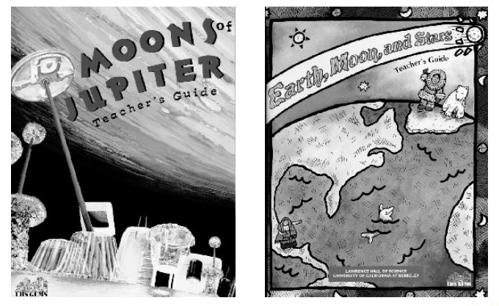
GEMS Guide
Initial meeting between LHS and SSU personnel, May 2000
“Way Beyond the Rainbow” working title
Subcontract in place between SSU and Lawrence Hall of Science, October 2000
Tentative schedule
Draft #1 completed by Summer 2001
Local field testing Fall 2001
Draft revisions completed Summer 2002
National Field Testing Fall 2002
Final release Summer 2003

Slide 6
Educator Training
Appalachian Region Project
Swift materials included during Summer 2000
~ 25 participants
Role of materials will expand over next few years
North Bay Science Project
Swift materials included during Summer 2000
~ 30 participants
Role of materials will expand over next few years

Slide 7
Educator Training
Conventions, Workshops - “High Energy Bursts of Math & Science”
NSTA, April 2000 (Orlando, 20 participants)
NCTM, April 2000 (Chicago, 30 participants)
CSTA, Oct 2000 (Sacramento, 28 participants)
HEAD, Nov 2000 (Honolulu, 35 participants)
Next Year Conventions, Workshops - “Light Up the Universe”
NSTA, March 2001, St. Louis
NCTM, April 2001, Orlando
CSTA, Oct 2001 (Short Course, workshop), Palm Springs
CMC, Dec 2001, Asilomar

Slide 8
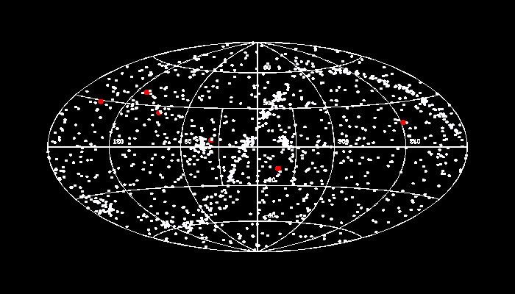

Web Materials
Web Site
Swifty Bits
Cosmic Lottery
NASA Quest Chats
1st one held in Sept 2000
One a month, alternating with GLAST

Slide 9

Web Materials
Space Mystery Module - 2003
A deep space traveler
awakes from the flight-freezer
when a long-range sensor sounds
the alert for a dangerous
environment. You must
discover what is happening and
what course of action to take.
Currently working on 3 other
Mystery Modules with Videodiscovery
as part of NASA’s LEARNERS program

Slide 10
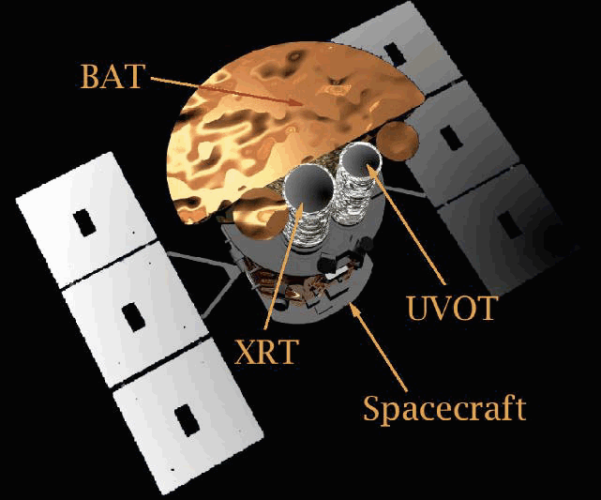
What’s in the News?
First segment introducing Swift and the EM spectrum is scheduled to be completed in Jan 2001

Slide 11
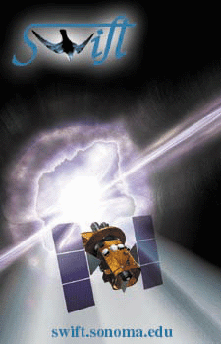
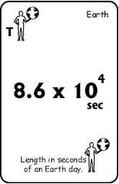
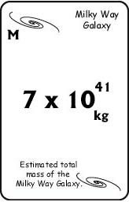
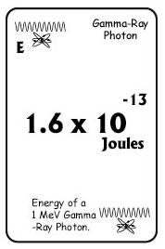
Curriculum Materials
Theme for 2001 is “Waves and Wave Motion”
Who’s Got the Power? - a deck of cards and activities to reinforce scientific notation, units, and astronomy concepts

Slide 12
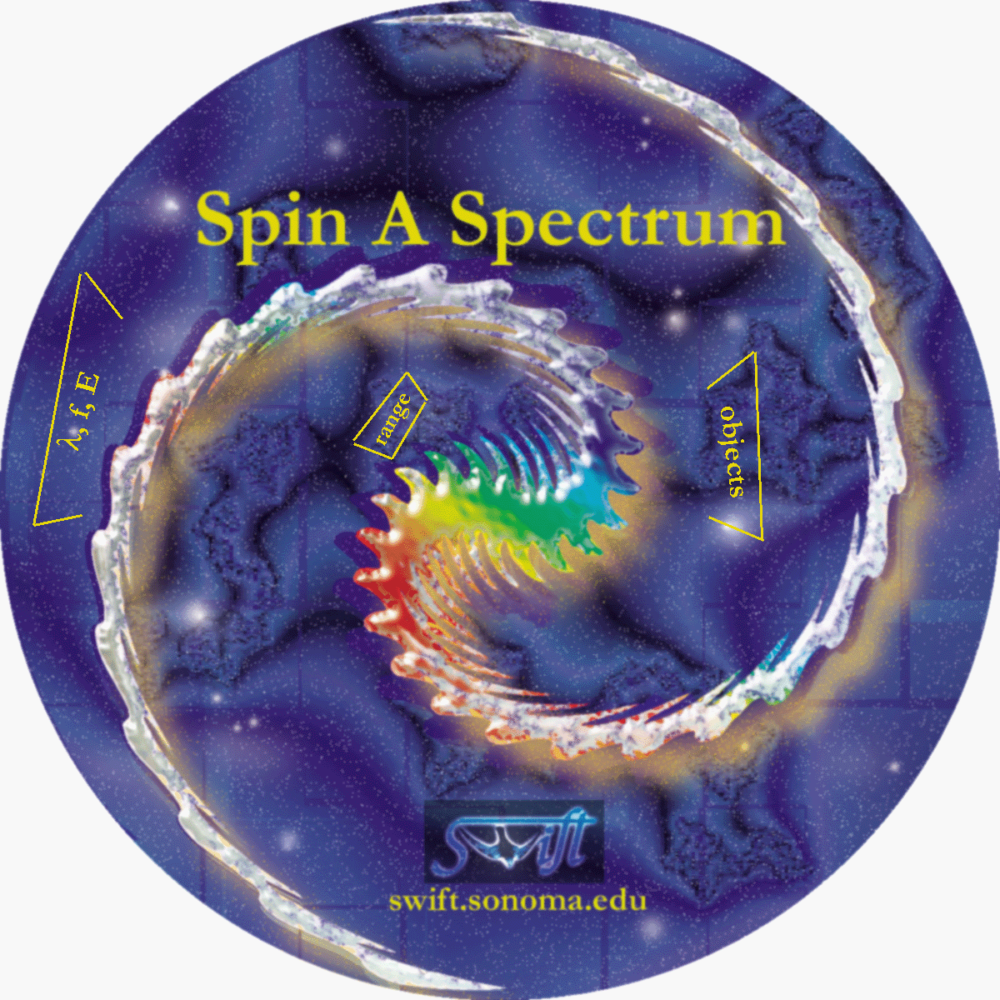
Curriculum Materials
• Spin a Spectrum - use our
EM spectrum wheel to
help you solve a series
of mysteries
and riddles based
on content topics
in the National Science
and Mathematics
Standards

Slide 13
Curriculum Materials
• Catch the Wave - a Swift slinky and series of classroom activities and lessons will teach the fundamentals of waves

Slide 14
Curriculum Materials
Theme for 2002 is “Forces & Motions”
Theme for 2003 is “Interactions of Energy and Matter”
After launch, we will focus on interpretation of results --depending on what they are and how the discoveries fit into the National Science and Math Standards

Slide 15
Evaluation
Contract recompeted Spring/Summer 2000
WestEd selected; subsequently selected for GLAST evaluation as well, resulting in a cost savings to both missions.
Subcontract between SSU and West Ed established Nov 2000
Draft teacher survey completed

Slide 16
Conclusion
Swift E/PO on track
All subcontracts in place, all contacts established, SwEC membership filled
First educator workshops done in 2000
First new materials scheduled to come out early 2001
Long-term plan established

