Slide 1
The Swift Education and Public Outreach Program
Lynn Cominsky
Sonoma State University
July 26, 2005

Slide 2
Program Overview
Swift E/PO Web site (http://swift.sonoma.edu)
Launch products
Printed materials
Teacher’s activity booklets and posters
Educator training
Conference workshops
Educator Ambassadors
Informal Education
Global Telescope Network
GRB Skymap website
Program Evaluation
Future Plans

Slide 3

E/PO Web Site
Multi-media gallery reorganized:
Image gallery
Swift song
Educational video gallery
Video gallery
Animation gallery
Newsletter
Remember - To order printed materials: http://epo.sonoma.edu/orderformpublic.html

Slide 4
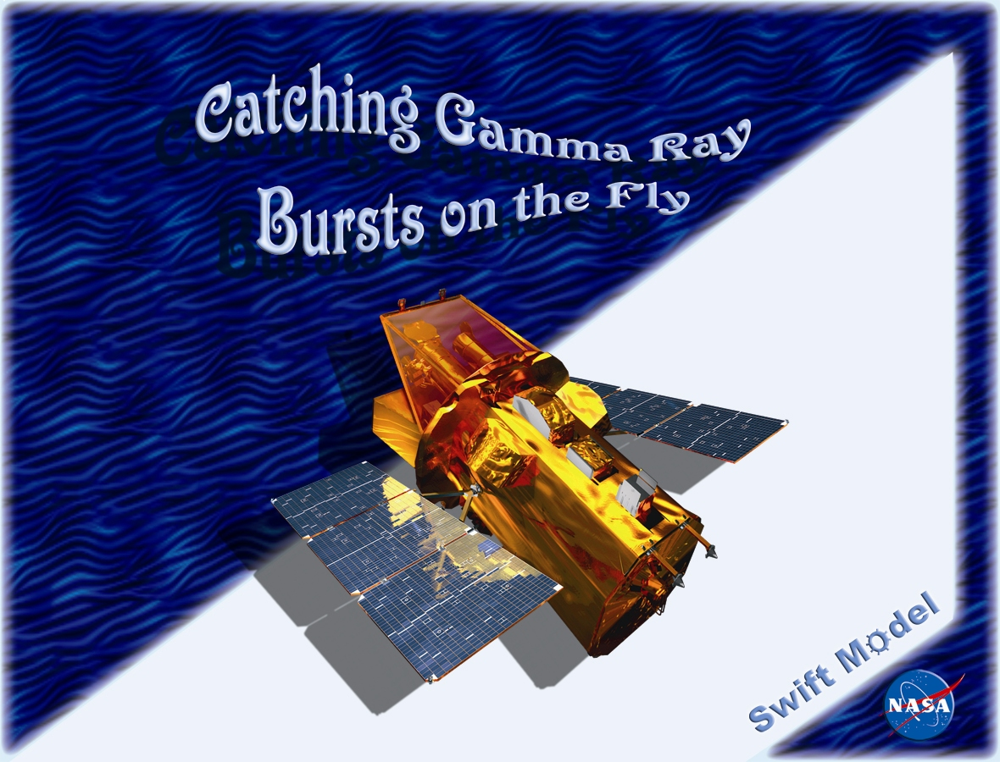
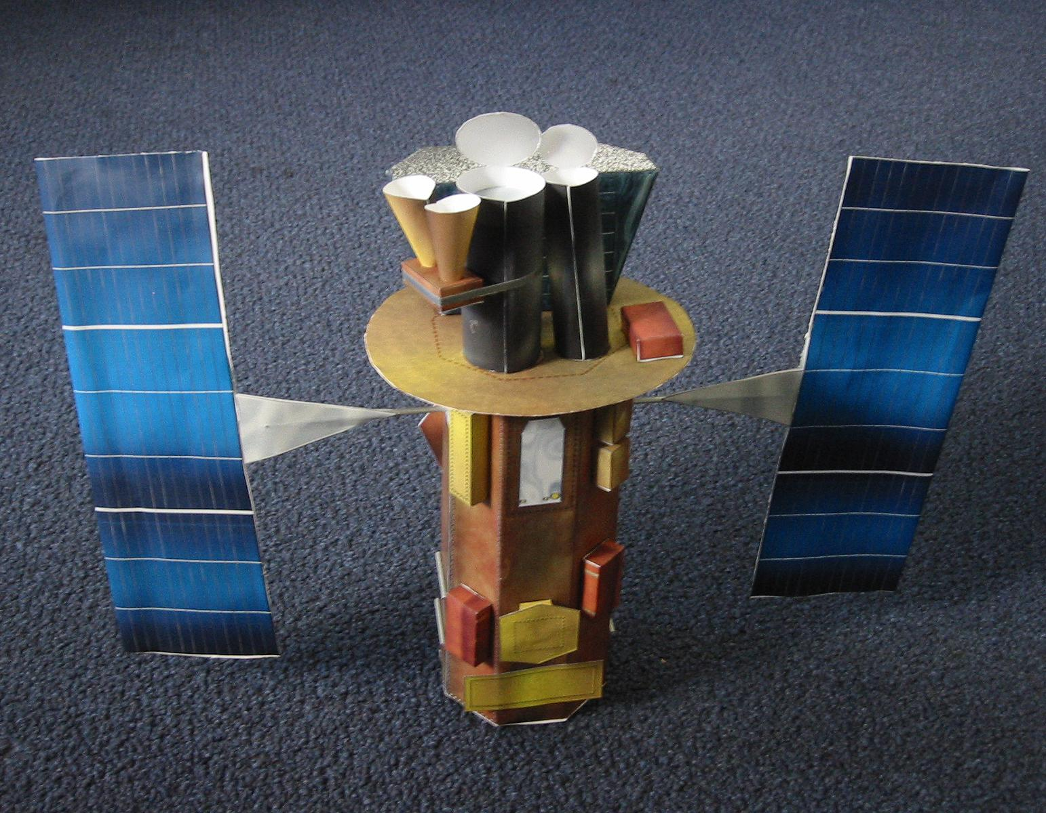
Swift model booklet
We are ordering another 2500 of these

Slide 5
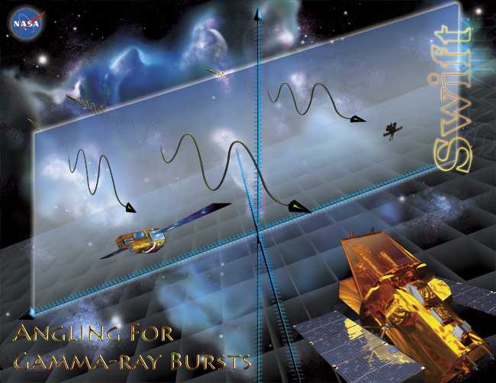
Angling for GRBs poster
Original posters were printed at SSU
Being resubmitted to GPO after being redesigned to meet new communications rules

Slide 6

3rd AAVSO HEA Workshop
March 20-23, 2005
Co-sponsored by Swift and GLAST – about 90 AAVSO members and educators in attendance
Cominsky: “Swift View of the Universe”
Plait: GTN – included live demo of GORT
Plait also did public lecture “7 Ways a Black Hole Can Kill You”
Cominsky, Silva, Plait and Graves did a workshop for educators using “Cookie Cutter Astrophysics” beginning photometry activity

Slide 7
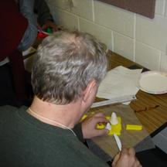
Cookie Cutter Astrophysics
Goal is to remove background from stellar image
They also had to compare the brightnesses of the two stars in the “image”
Tools: scale, ruler and plastic knife
star
background

Slide 8
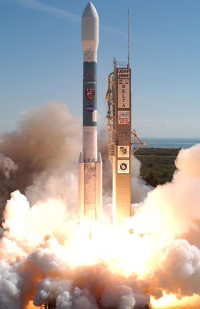
Swift Newsletter
http://swift.sonoma.edu/resources/multimedia/newsletter/
First issue now online:
SGR flare – “Whale of a Burst” by David Palmer
Regular Columns by Gehrels, Nousek
E/PO section by Plait
Swift in the News by Cominsky
SSC News by Boyd
Second issue planned for September, 2005
To subscribe: http://swift.sonoma.edu/resources/multimedia/newsletter/signup.html

Slide 9
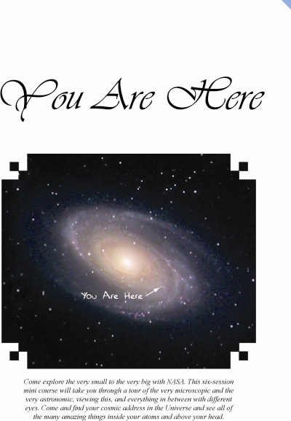
You are Here!
Mini-course for 8th -9th grade students
The Size and Scale of Things
How We See the Universe
Trip to the Sun
Solar System Travel Plans
Our Milky Way Galaxy and Beyond
6 one-hour sessions
Uses Scale the Universe and GEMS
Developed and presented by Silva
Roseland University Prep (May 18-27)
Valley of the Moon Boys & Girls Club (June 21- July 28)
Website for Course materials: http://epo.sonoma.edu/youarehere/

Slide 10
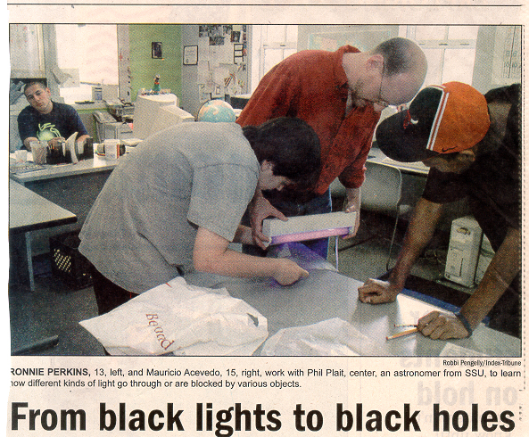
You are Here!
Phil Plait helps out at the Boys and Girls Club

Slide 11
Educator Ambassador Presentations (since 3/05)
July 11-13, 2005 Cheryl Niemela "Introducing Swift" Stars, Galaxies and the Universe Workshop (NASA ERC) Wenatchee, WA
July 6-8, 2005 Cheryl Niemela "Introducing Swift" University of Washington, Seattle, WA
June 29-30, 2005 Bruce Hemp "A Chording We Will Go“ Blue Ridge West Teacher Training Institute Regional Converence, Bristol, VA
April 15, 2005 Janet Lynne Moore “GRBs: Nature's Second Biggest Bang“ Mathematics Education Student Teaching Seminar, Bloomington, IL
April 14-16, 2005 Rob Sparks "Measuring the Monster in the Middle: Massive Black Holes“ Wisconsin Society of Science Teachers Convention, LaCrosse, WI
April 8-9, 2005 Bruce Hemp "A Chording We Will Go“, Blue Ridge East Teacher Training Insitute Regional Conference, Roanoke, VA
April 2, 2005 Rob Sparks "Find that Gamma Ray Burst!” NSTA National Convention, Dallas, TX

Slide 12
April 2, 2005 David Beier, "NASA Walks You Through the Invisible Universe”, NSTA National Convention, Dallas, TX
April 1, 2005 Robert Sparks, "The Biggest Bang Since the Big One : The Gamma Ray Burst Zoo”, NSTA National Convention, Dallas, TX
April 1, 2005, Walter Glogowski, "How to Use a Research-based Approach to Teach About Gamma-ray Bursts”, NSTA National Convention, Dallas, TX
March 12, 2005 Michiel Ford, "The Invisible Universe”, Holton High School, Holton, KS
By SSU E/PO (since 03/05)
July 5, 2005 Professor Lynn Cominsky "Swift View of the Universe“ Santa Rosa Kiwanis Lecture, Santa Rosa, CA
June 15, 2005 Professor Lynn Cominsky "Swift View of the Universe,” San Francisco Amateur Astronomers, San Francisco, CA
April 16, 2005 Professor Lynn Cominsky "A Swift View of the Gamma-ray Universe” Astronomy Day, Holton, KS
March 29 & 31, 2005 Sarah Silva “Modeling the Universe” California College of Arts & Crafts Oakland, CA.

Slide 13
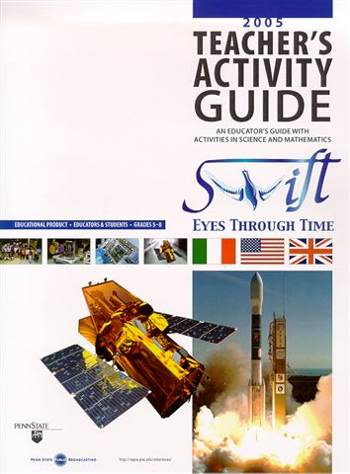
New from Penn State E/PO: Eyes through Time
Six 5-minute video segments on a DVD, each with activity – some from WITN?
Focus is process of Science
Earth, the Universe and Culture
Theories
Accidental Discoveries
The Relationship Between Science and Technology
Looking Back in Time
Creativity in Science
Being field-tested this summer by PSU Astronomy Workshop teachers and EAs

Slide 14
GRB SkyMap: http://grb.sonoma.edu
New version coming soon – will include expanded burst table
Over 250,000 unique hits to date

Slide 15
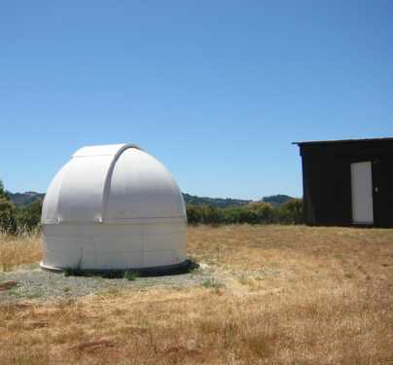
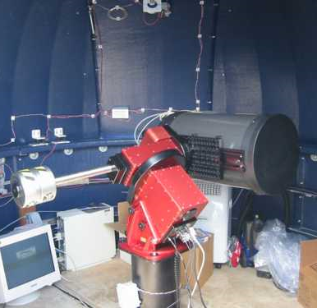
Global Telescope Network
http://gtn.sonoma.edu
Now online – one burst chased within 15 min!

Slide 16
Near-Future Plans
CSTA 10/05 "NASA Universe Strand" - Swift workshops include:
two from the GEMS guide
one from the GRB guide
one that covers the missions
Swift launch will be featured in Planetarium Show being produced by Denver Museum of Nature and Science – to air in late 2005
E/PO Session at Winter AAS in DC January 2006
Education and Public Outreach for NASA's Universe
Proposal organized and submitted by Sarah Silva – accepted!
Lessons learned and best practices

Slide 17
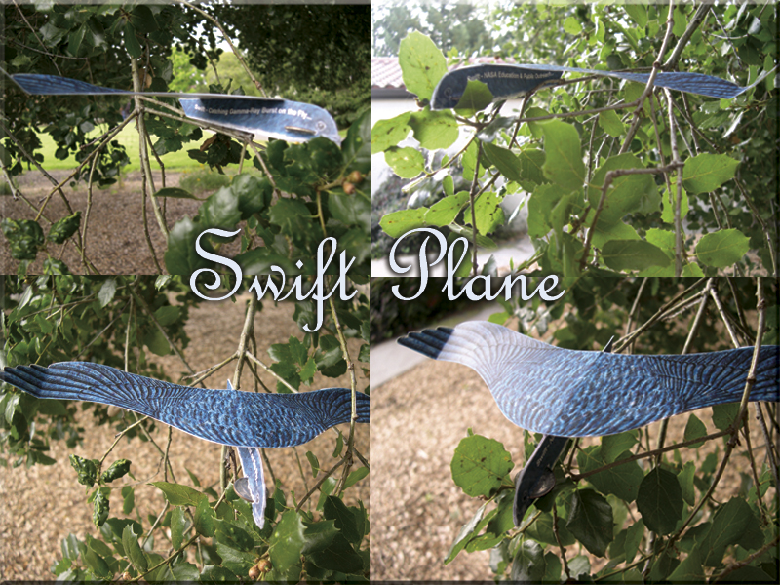
New Giveaway – Swift Glider

Slide 18
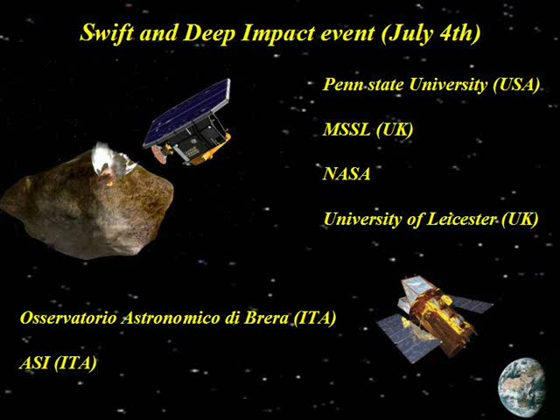
PR since 3/05
April 5, 2005 - Swift Mission Nabs Its First Distance Measurement to Star Explosion
July 4, 2005 - NASA Swift Satellite Offers a Different View of the Great Comet Collision
Swift coverage featured in AP wire article
July 8, 2005 - Scientists Measure How Deep "Deep Impact" Was, With X-rays
Nature article and more

Slide 19
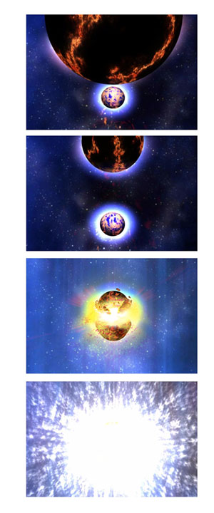
PR since 3/05
May 11, 2005 - NASA Scientists Catch Unique Gamma-Ray Burst (HQ release)
First short burst
Leaked through GCN into Space.com within 24 hours
HQ would not do press conference due to leak
Part of press conference at AAS in Minnesota (Bloom)

Slide 20
Future PR
Swift Science Meeting in November, 2005 in DC
AAS in DC in January 2006
AAAS in St. Louis in 2/06 - A GIANT FLARE FROM A MAGNETAR: BLITZING THE EARTH FROM ACROSS THE GALAXY
Kevin Hurley
Bryan Gaensler
Umran Inan
David Palmer
LRC Moderator (and organizer)
New Swift results as they occur

