Slide 1
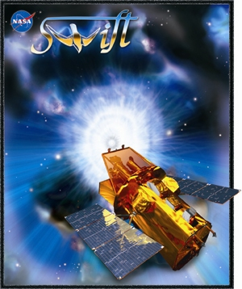
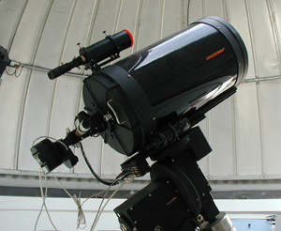
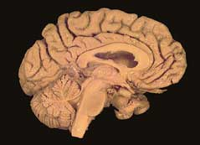
Swift and the
Global Telescope
Network
Lynn Cominsky
Sonoma State
University

Slide 2

The Global (nee GLAST) Telescope Network
Network of ground-based telescopes
Purpose: to support GLAST, Swift and XMM-Newton science, and educate students about astronomy by partnering with NASA scientists
Partners:
Sonoma State University E/PO Group
AAVSO
Hands On Universe Project (Yerkes)
Elk Creek Observatory (Kansas)
California Academy of Sciences
WIRO (Wyoming + 2 other possible locations)
Actively recruiting other partners (VERITAS?)

Slide 3
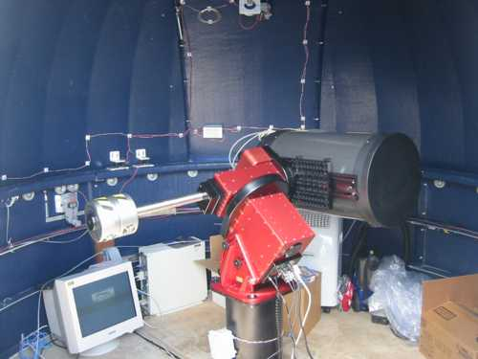
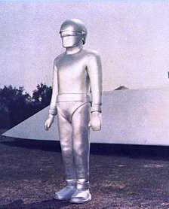
GORT (GLAST Optical robotic telescope)
The original GORT
Celestron 14” Paramount/AP47P
CCD and filter wheel
Pepperwood Preserve, Hume Observatory (California Academy of Sciences)
About 30 minutes north of SSU

Slide 4
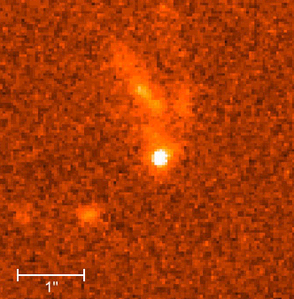
GTN Science Projects
Active galaxy, polar surveillance
V and I observations of 2 targets / month
S/N >100, photometry ~1%
High time-resolution datasets
Microvariability
Observe one target for
many hours
At least once/year
Gamma-ray bursts
Rapid response (GCN notification)
High S/N, but fast, multiple images more critical

Slide 5
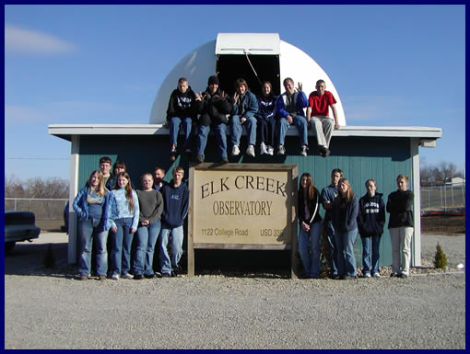
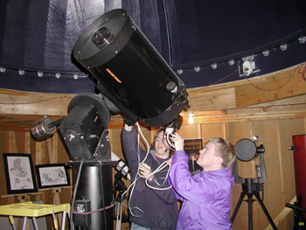
GTN Educational Projects
Simple image reduction
and analysis
Hands-On Universe
AAVSO cooperation
Educational unit (under development)
Goals:
Combine gamma-ray and visible light data
Partner with scientists to publish data in scientific journals

Slide 6
JOIN THE GTN
What/Who are we looking for?
Observers with access to telescopes w/CCD
Willing to observe a minimum amount (depends on project)
Willing to have data archived and used by others
Not up for a long-term commitment? Go through the AAVSO!
Swift scientists to partner with our ground-based partners

Slide 7
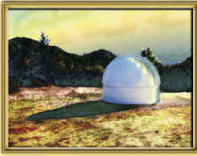
GTN Partner Benefits:
Real science with real scientist partners!
Submit proposals to acquire data if you do not have your own visible-light telescope
GRB Astrometry analysis
GRB Photometry analysis
Data archiving at SSU
Light curves reported through AAVSO
FOR MORE INFORMATION:
http://gtn.sonoma.edu
Pepperwood dome

