Slide 1
Swift Education Committee
Lynn Cominsky
Sonoma State University
October 20, 2003

Slide 2
Overview
Status Report for FY2003
Action Items from last meeting
Newton’s Law reviews by NASA OSS Ed
GRB activity status
Discussion

Slide 3
FY2003 Status report
Materials produced:
GRB Educator’s Guide
second draft now in testing with SSU students
http://swift.sonoma.edu/education/GRB_activities_introtwo.pdf
Swift Model booklet
Ready for review by science team
http://swift.sonoma.edu/education/swmodguide2.pdf
EM Spectrum poster (with Origins Forum)
Featured GEMS #2, distributed to 40,000 teachers

Slide 4
FY2003 Status report
Material Supply Status
Spin a Spectrum wheels/booklets
150/180 left
Newton’s Law posters
450 left of each but unfolded
Powers of Ten card sets
Gone
Wave booklets/Slinkies
190/24 left
GEMS guides
270/2000 remaining
EM Spectrum posters
120 left to hand out to EAs
Swift miniplot pads
800 left, but meant for scientists
Mouse Pads
Gone

Slide 5
FY2003 Status report
SwEC Status
SSU Meeting in July 2003
Presentations on line at http://swift.sonoma.edu/resources/swift/educa_pres/swec_03/swec_pres03.html
Minutes on line at http://swift.sonoma.edu/swec/SwEC_0703.doc
SwEC membership
Gould, Runyon no longer attending – remove?
Sparks, McEntyre not yet official members – add?
Anastasia Pappa new UK representative

Slide 6
FY2003 Status report
Swift Educator Ambassador Status
Biographies and photos needed for Hemp and Arnold so that we can make web pages similar to these:
http://swift.sonoma.edu/ambassador/ambassadors.html
McEntyre and Sparks should check their web biographies and update as needed
We will most likely be getting a fifth Swift EA – David Beier, who has been our “unofficial” EA for the past year and who has done numerous (mostly GEMS) workshops. He is in Missouri.

Slide 7
FY2003 Status report
“Official” Swift High School Status
We seem to have lost regular contact with C. J. Rodkey who works at the Keystone Oaks High School in Pennsylvania
He did not apply to be an EA – missed the deadline
We need someone nearby to restart this interface and see what we can do for them and what they would like to do
Any volunteers?

Slide 8
Action Items
Find out rules for NASA contests – still in progress by LRC
See if we can get into “Current Science” – still in progress by Phil Plait
Mercury published Plait’s article about Swift in Sept/Oct issue
Stardate Magazine is also publishing an article about Swift by Plait
See if Brokers will find reviewers for us – will not be done
WestEd is finding reviewers instead
Newton’s Laws focus group having debrief telecon in November 2003
Look into Association of Astronomy Educators – DONE
Find out (Who’s reviewing the material for NASA OSS? Scientists? Educators? (both). Should those reviewing the material be present at the educator workshops? ) - DONE

Slide 9
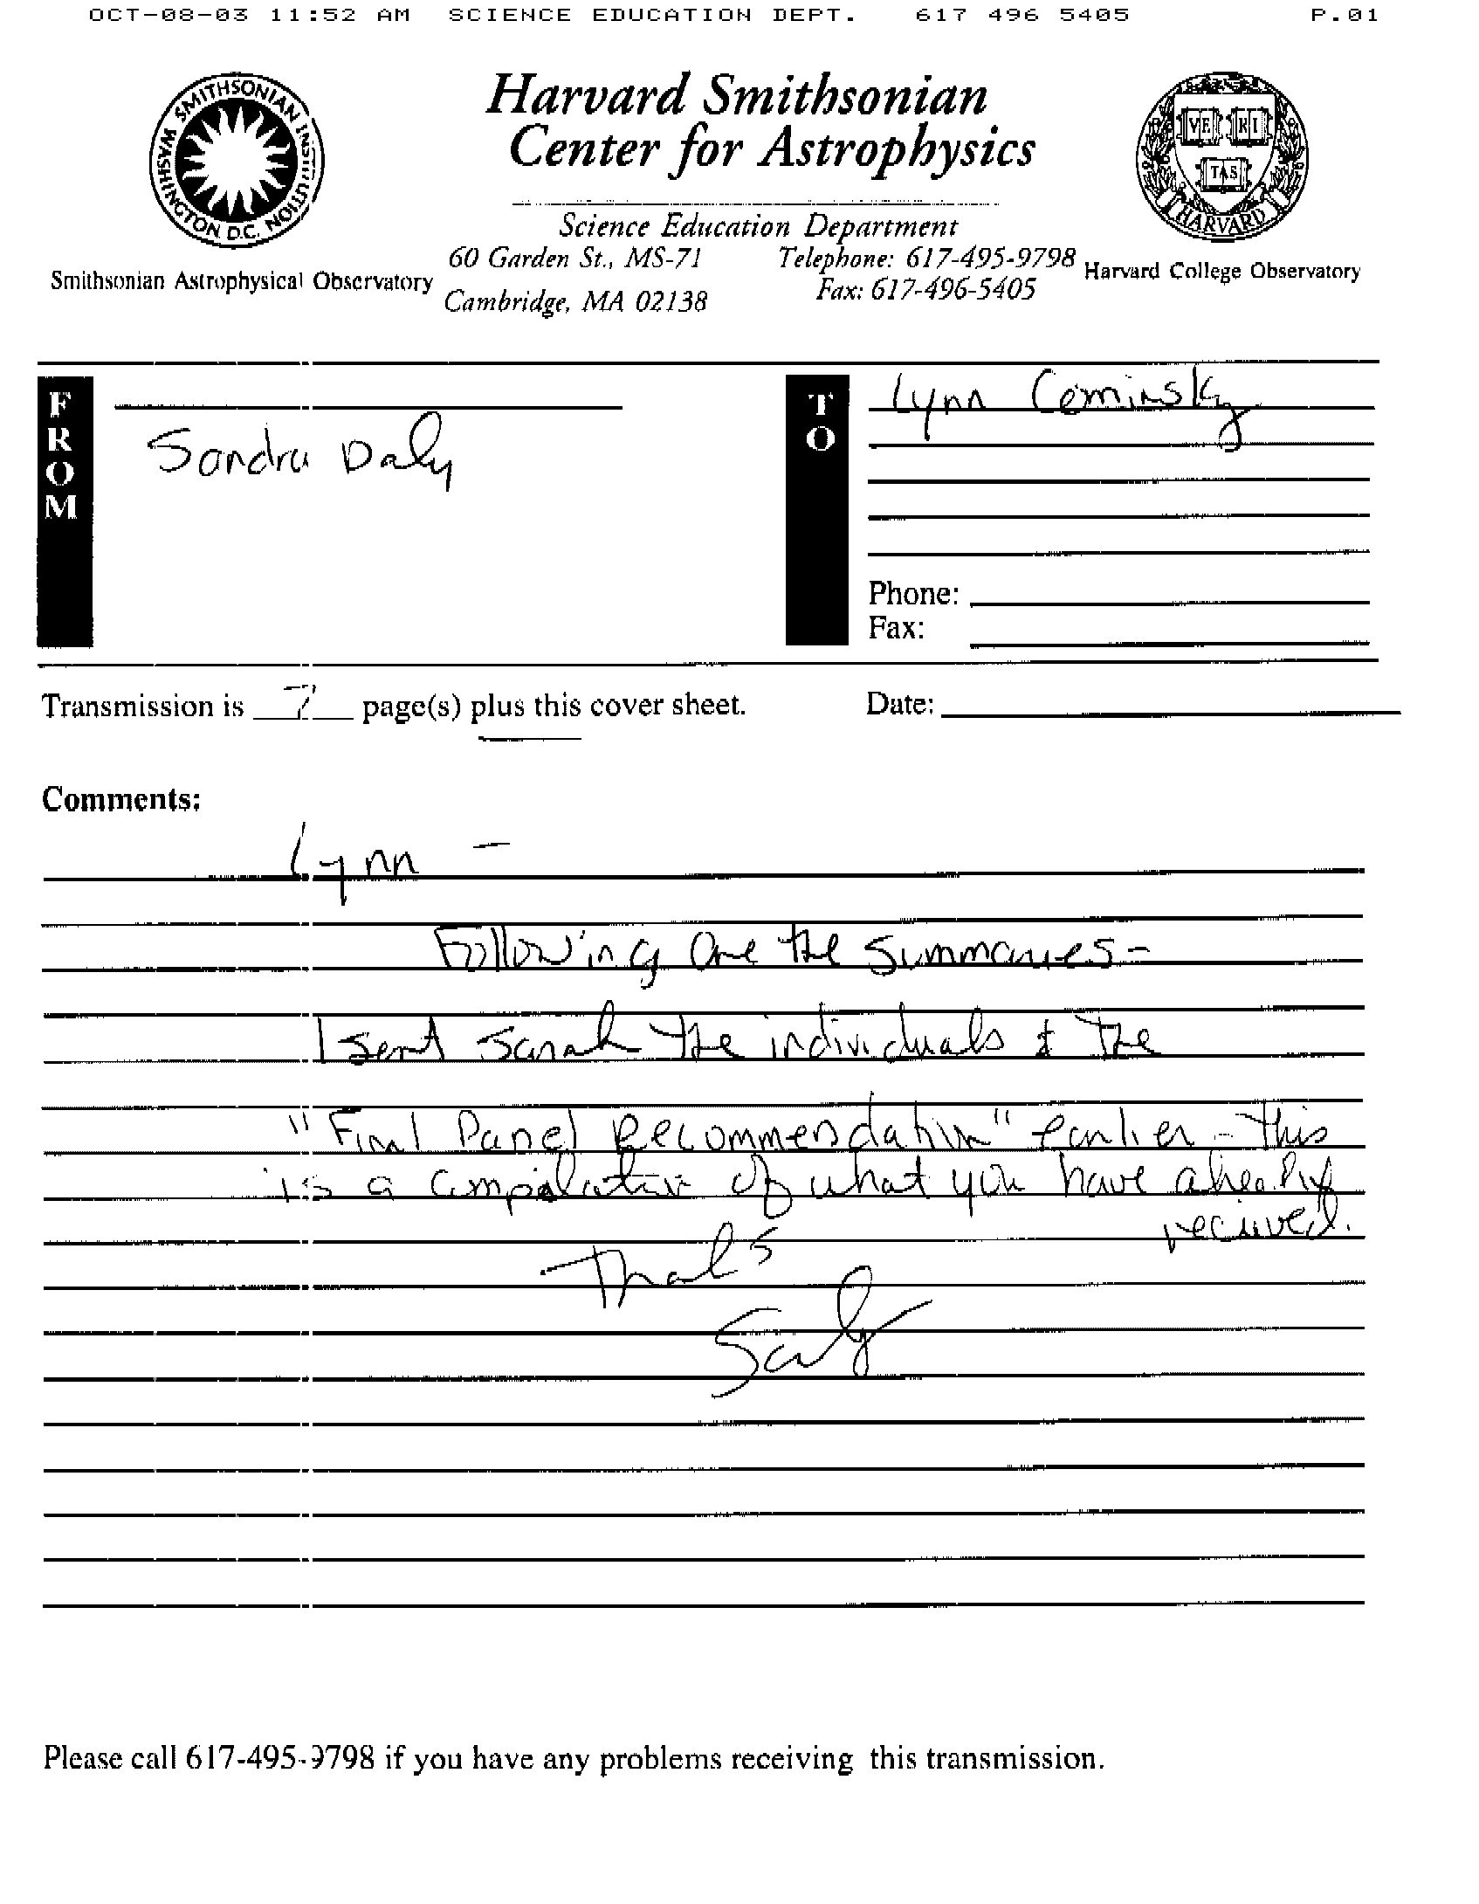
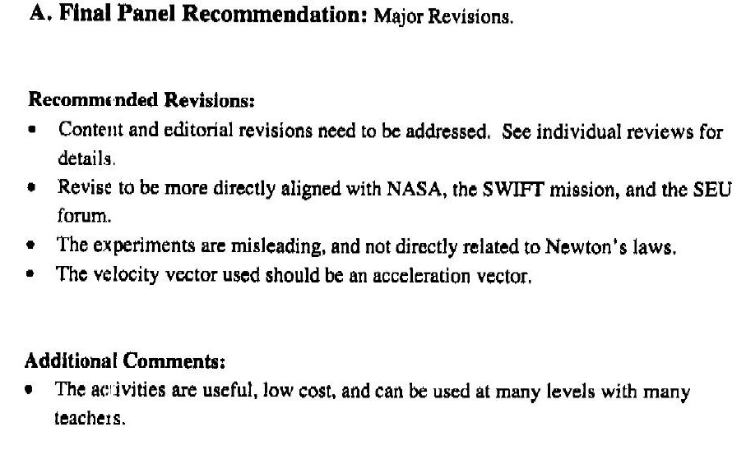
Newton’s Laws Reviews

Slide 10
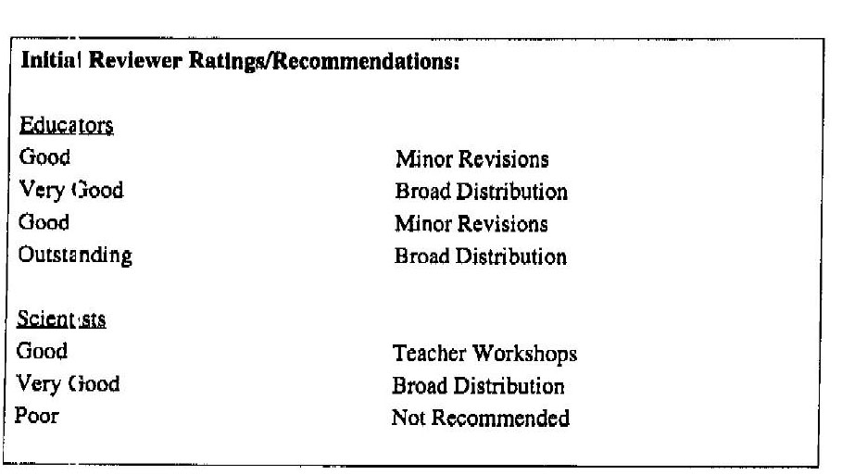
Newton’s Laws Reviews
Reviewed by 4 educators and 3 scientists

Slide 11
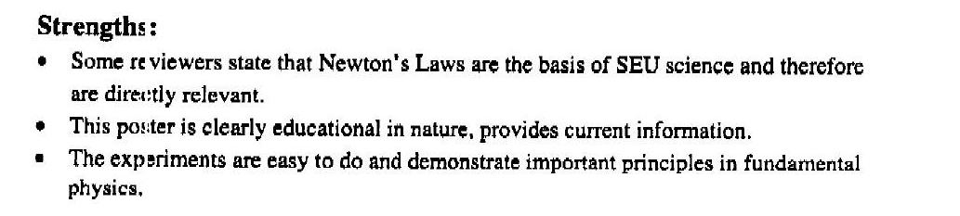
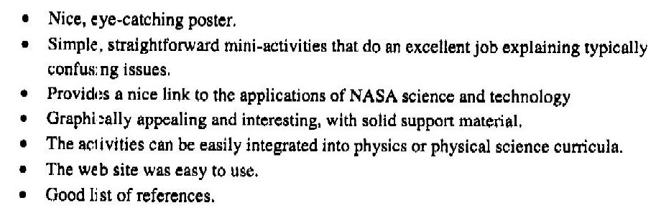
Newton’s Laws Reviews

Slide 12
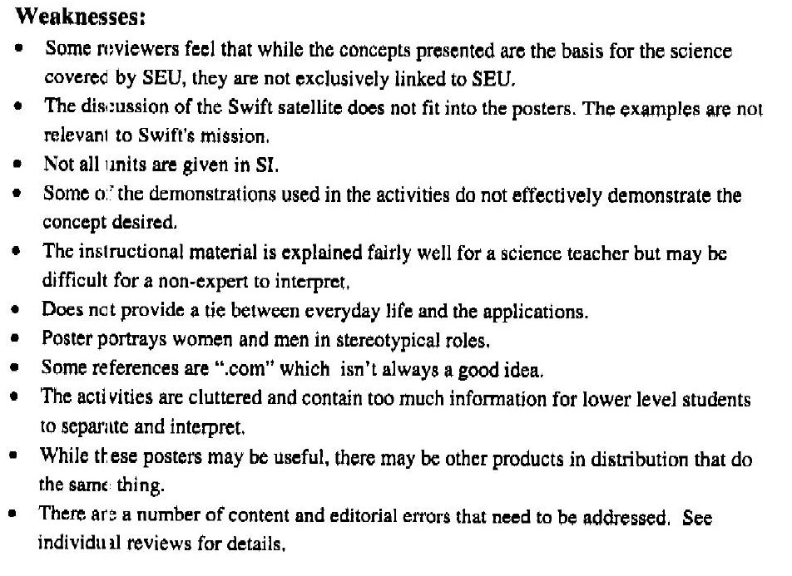
Newton’s Laws Reviews

Slide 13
Newton’s Laws Reviews
Weaknesses (continued)

Slide 14
Newton’s Laws -discussion
Posters are very popular with teachers despite OSS Ed review criticism of lack of tie-in with SEU goals
Could each EA volunteer to critically review one of the 4 units (including gravitational unit, which is not (yet) on a poster) in the light of the NASA OSS Ed reviews?
Telecon with focus group teachers, led by WestEd on 11/5 at 330 PM PST
Also Cathy Ringstaff has a detailed review of #1

Slide 15
Newton’s Laws -discussion
Goals would be to:
redo back of posters to fit our instructional design template
fix mistakes in units and physics
perhaps reuse some but not all of the existing material?
or use new material entirely?
EA role would be to recommend which activities to keep from each poster (or suggest replacement)
EAs could also help spot mistakes or test out these activities more thoroughly to help with rewrite

Slide 16
GRB Activities revisited
Cosmic Zoo (GRB #1) cards have been simplified
CSTA workshop on GRB #1 was a great success
Awaiting WestEd review from ~40 teachers
GRB #2 (parallel rays) is in pretty good shape, needs minor revisions, has been tested 3 times in the classroom, will be going on the back of poster
GRB#3 (distribution) and #4 (beaming) are being reworked and tested tomorrow in SSU GE class
A new idea for GRB #3: use the students themselves!

Slide 17
GRB #3 Activity revisited
(adapted from Jeff Adkins from globular cluster- galaxy activity)
You can do this with a group of people, or by yourself if necessary. Have people stand around the edge of the room evenly spread out. Next, have a volunteer stand in the center of the room and point to a djacent people with arms outstretched. Using a video camera here is another way of making the point. Slowly pan from person to person to show that from the center, all of the people are evenly spaced.
Now repeat what you just did, but stand near the edge of the room. You will find that some people (the ones closest to you) are spread far apart compared to the ones most distant across the room. Again, this is most effectively visualized with video tape.

Slide 18
GRB #3 Activity revisited
In what direction is the spacing most crowded, due to perspective?
How does this direction compare to the direction towards the center of the room?
Adkins then follows this up with a plotting activity.
We could have the students plot the locations of a bunch of known bursts to see that they do not have a preferred direction, then compare to the distributions for cosmic and galactic distances, in the same coordinate system.

