Slide 1
Nature’s Second Biggest Bangs: The Gamma Ray Burst Zoo
Dr. Philip Plait
NASA E/PO Group at
Sonoma State University
Saturday, October 11, 2003

Slide 2
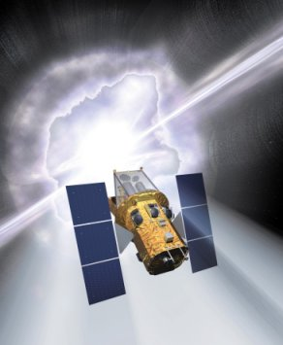
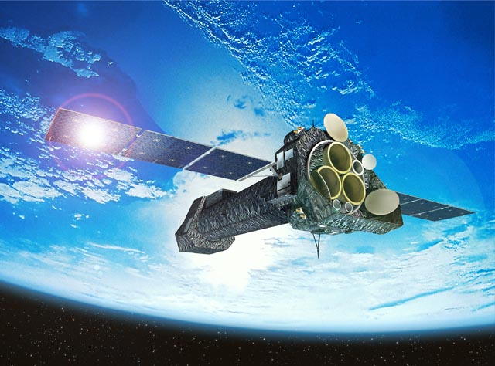
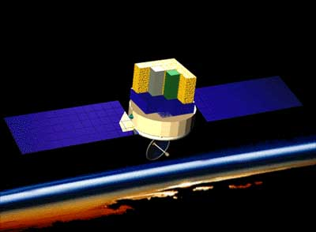
The NASA E/PO Program at SSU
A group of ten people working collaboratively to educate the public about current and future NASA high-energy astronomy missions
Led by Prof. Lynn Cominsky
Swift
GLAST
XMM-Newton
Notes:
Our group is located in Northern California at Sonoma State University. We are part of the Physics and Astronomy Department and call ourselves the NASA Education and Public Outreach Group. Our group is led by Professor Lynn Cominsky, is lead of five NASA funded projects and 1 California Project. The one California project is called The North Bay Science Project and is a California Subject Matter Project. The five NASA projects are; the Educator Ambassador Program a master teacher program that trains master teachers to go all around the country to teach the science behind our missions to other educators. We have the Education and Public Outreach portion of three different satellite missions, Swift- A Gamma Ray Burst Mission, XMM-Newton- a X-ray Spectroscopy mission and GLAST-general gamma-ray mission. We also do the Press for the Swift and GLAST missions.

Slide 3
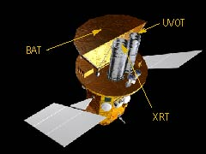

What is Swift?
Swift: Not an acronym!
Gamma ray burst finder
Detects GRBs in soft gamma rays
“Swiftly” turns to aim instruments
Relays position to ground for
follow-up observations
Swift has three instruments:
Burst Alert Telescope (BAT)
X-Ray Telescope (XRT)
Ultraviolet/Optical Telescope (UVOT)
Planned for launch in mid-2004
Notes:
Swift is one of the few NASA missions that is not an acronym! It is named this way because it can swiftly changes its orientation; where its pointed in the sky. It is designed to detect gamma ray bursts, flashes of high-energy radiation that have puzzled astronomers for decades. When it finds one, it relays the brightness and position to the ground as it moves to pinpoint the location of the burst. It has three instruments: the BAT, which initially detects the GRB in soft gamma rays, the XRT, which observes hard X-rays, and the UVOT, which is sensitive to optical and ultraviolet light. Swift is due to launch in May 2004.

Slide 4
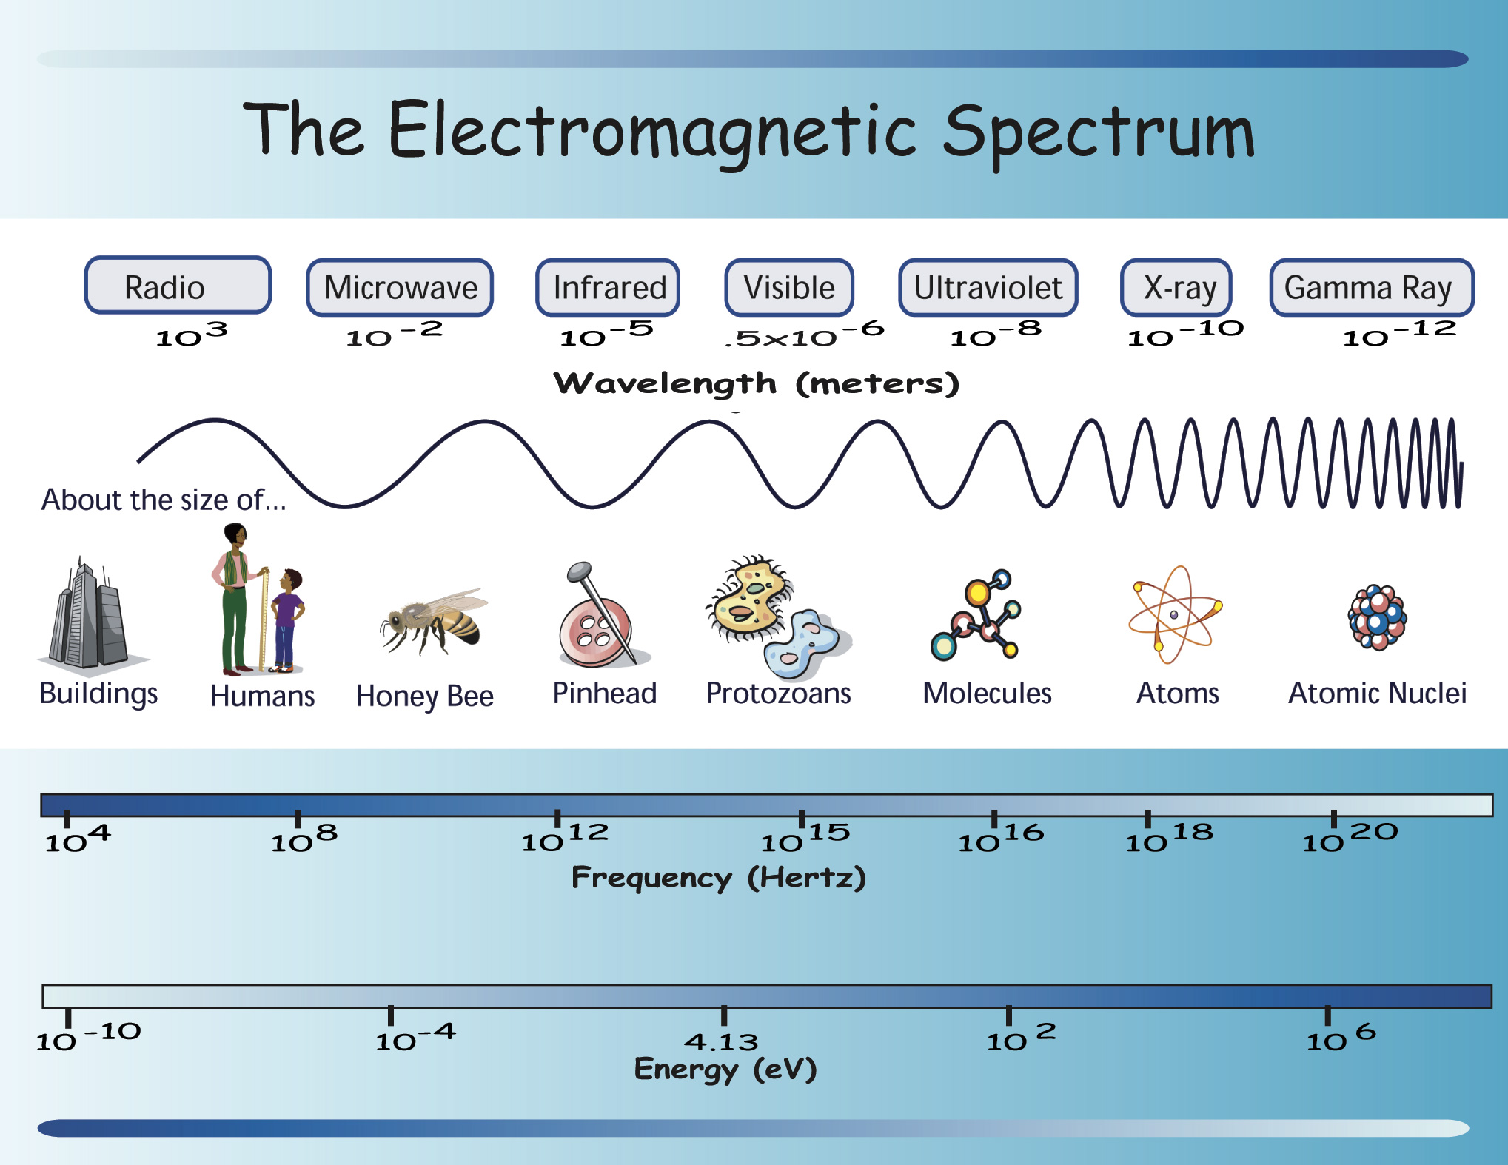
What Are Gamma and X-Rays?
Notes:
A gamma ray is the highest energy of light. As you can see here it has an incredible amount of energy. You can also see that the frequency is inversely proportional to the wavelength.

Slide 5
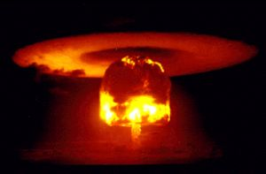
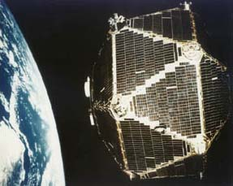
The Discovery of High Energy Bursts
Nuclear test ban treaty needed enforcement
US launched series of Vela satellites to detect gamma rays from nuclear weapons tests
Found gamma rays from space, and not the Earth!
What could be generating such high-energy events in space?
Notes:
Go into history of GRBs here, starting with the initial finding using the Vela satellites. Refer to “The Mystery of the Gamma Ray Bursts” from the GEMS guide.

Slide 6

What Astronomers Don’t Know Can Hurt Them
In the 1970s, not much was known about high-energy astronomical bursts. Were they close by, or far away? We need the distance to get the luminosity, and we need the luminosity to understand the source (or sources)!
Notes:
Stress that early on, the astronomers didn’t have much info on GRBs besides location and light curve. Distance, a critical characteristic, was unknown. The position was not known well enough to find optical counterparts, and there weren’t enough to get a distribution across the sky.

Slide 7
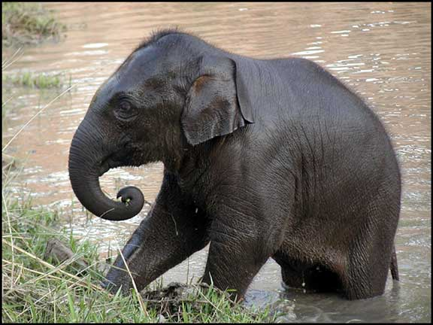
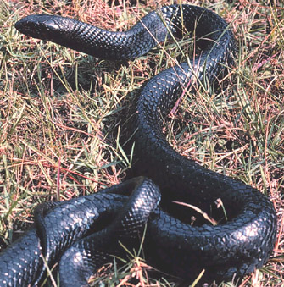
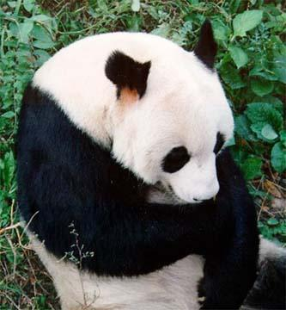
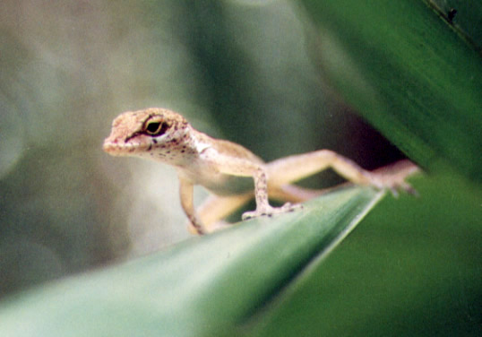
The Terrestrial Zoo
Notes:
How would you categorize these animals? Most will put the panda with the elephant, the snake with the anole. But they look different; the elephant is much larger than the panda, has less hair, bigger ears, etc. We put objects into broad categories because it helps us sort out the gross characteristics. Further observations allow us to subdivide the categories.

Slide 8
The Cosmic Zoo
Need to categorize the objects seen
By sorting into different categories, distinguishing characteristics are found
Potentially misleading differences can be determined
Further investigation can reveal
the nature of the phenomenon
Notes:
We do the same thing in astronomy!

Slide 9
Space Sleuths
In this Swift gamma ray burst activity, your students become cosmic detectives. They are put in the shoes of astronomers from the 1970s, and must sort out the matching characteristics of different astronomical explosions.
Notes:
Self-explanatory.

Slide 10
The Activity Booklet Setup
1) Science concepts and estimated time
2) Background information specific to the activity
3) The “essential question” asked by the activity
4) A materials list
5) A list of abbreviations
6) Specific learning objectives
7) Step-by-step procedures
8) An assessment rubric
9) Transfer activities
10) Suggested extension and reflection activities
11) Lesson adaptations that will help you cope with special needs students
12) An answer key
13) Student worksheets
14) Detailed Standards
15) A glossary
16) A list defining any acronyms used
17) A resource list
Note: this is a work in progress, due for completion in 2004
Notes:
Each activity has some or all of the following components to help you make it an exciting learning experience for the students:
1) Science concepts and estimated time.
2) Background information specific to the activity.
3) The “essential question” asked by the activity.
4) A materials list.
5) A list of abbreviations.
6) Specific learning objectives.
7) Step-by-step procedures.
8) An assessment rubric.
9) Transfer activities
10) Suggested extension and reflection activities.
11) Lesson adaptations that will help you cope with special needs students.
12) An answer key.
13) Student worksheets.
14) Detailed Standards.
15) A glossary.
16) A list defining any acronyms used.
17) A resource list.
Handout the booklet.

Slide 11
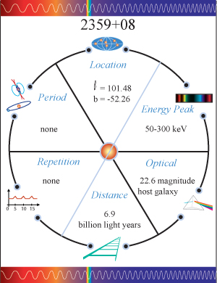
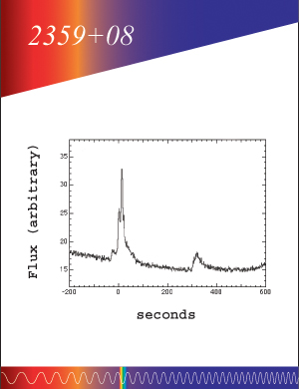
Pick a Card…

Slide 12
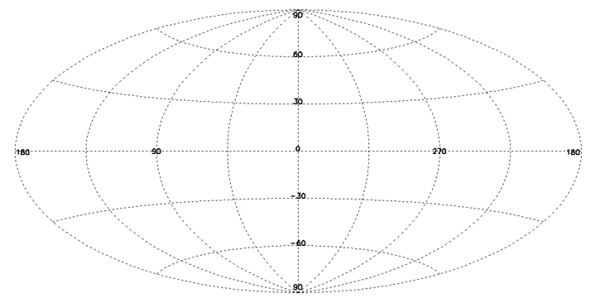

Aitoff Projection & Galactic Coordinates (1)

Slide 13
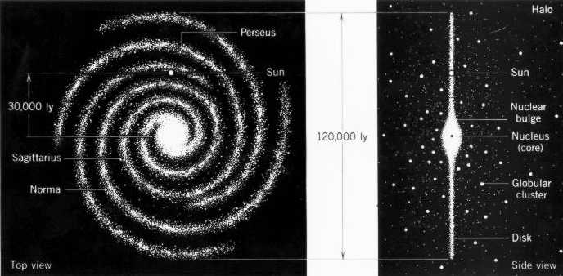
Aitoff Projection & Galactic Coordinates (2)

Slide 14
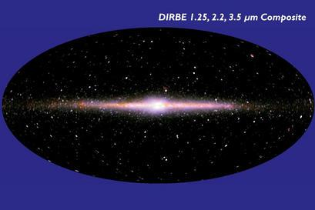
Aitoff Projection & Galactic Coordinates (3)

Slide 15
Let’s get busy!
Notes:
Start the activity!

Slide 16
Answers (1)
X-ray Bursters
Soft Gamma-Ray Repeaters
Gamma ray bursts
0748-67
0526-66
0501+11
1636-53
1627-41
0656+79
1659-29
1806-20
1156+65
1728-34
1900+14
1338-80
1735-44
1525+44
1820-30
1935-52
1837+05
2232-73
1850-08
2359+08
Notes:
Answer for Question 1

Slide 17
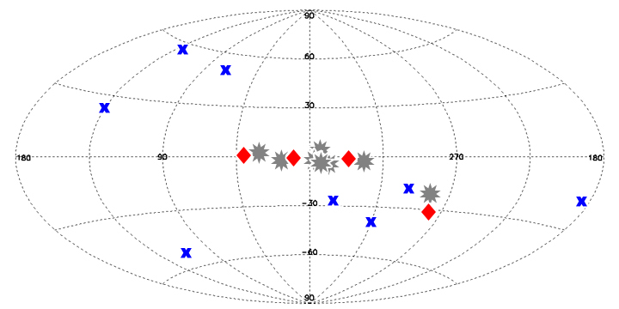
Answers (2)
X = Gamma Ray Bursts
= Soft Gamma Ray Repeaters
= X-ray Bursters
Notes:
Answer for Question 2

Slide 18
Answers (3)
3) The first group has a low peak energy around 2-3 keV. The second group peaks somewhat higher, at 30 keV, and the last group peaks much higher at 175-1500 keV, with a few at somewhat lower energies.
4) The distance to the first and second groups (with one exception in the second group; 0526-66) is the smallest, inside the Milky Way. The first group averages about 30,000 light years, and the second group about 70,000 light years. The GRBs are all very distant, ranging from 100 million to 10 billion light years, with an average of 6 billion light years.
5) See the answer to question 1.
6) The peak energies would be a big help, as this fairly cleanly separates the groups (see Question 3). The position on the sky helps (Question 2). Also, GRBs do not repeat, which separates them from the other two groups.
Notes:
Answers for Questions 3-6.

Slide 19
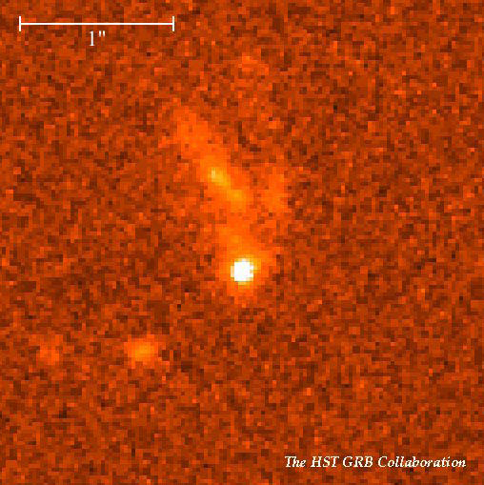
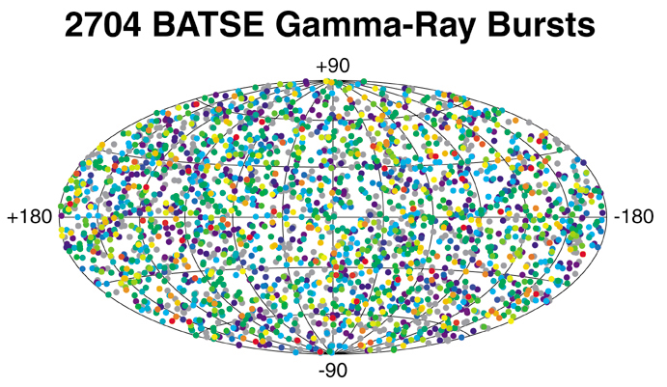
That Was Then, This Is Now
Now know that GRBs are very distant
Known by association with distant galaxies
Also known due to distribution in sky
VERY luminous
Accompanied by fading afterglow
Appear to be two flavors: rapid and slow
Notes:
Now explain what has been discovered about GRBs since then. The distribution on the sky implied either very close or very far, but redshifts of host galaxies clinched the cosmological distance theory. This means they are incredibly bright. Follow-up observations became possible, and Beppo-Sax (next slide) got the first X-ray afterglow. Host galaxies were found, redshifts determined. Two kinds of GRBs: less than 2 seconds, longer than 2 seconds.

Slide 20
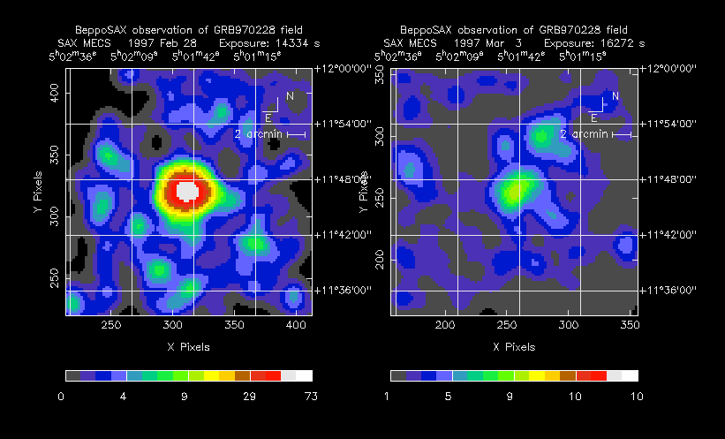
Flash!
The fading afterglow, seen for the first time in X-rays
Notes:
Beppo-Sax observation of a GRB. Left: 8 hours after burst. Right: 3 days later.

Slide 21
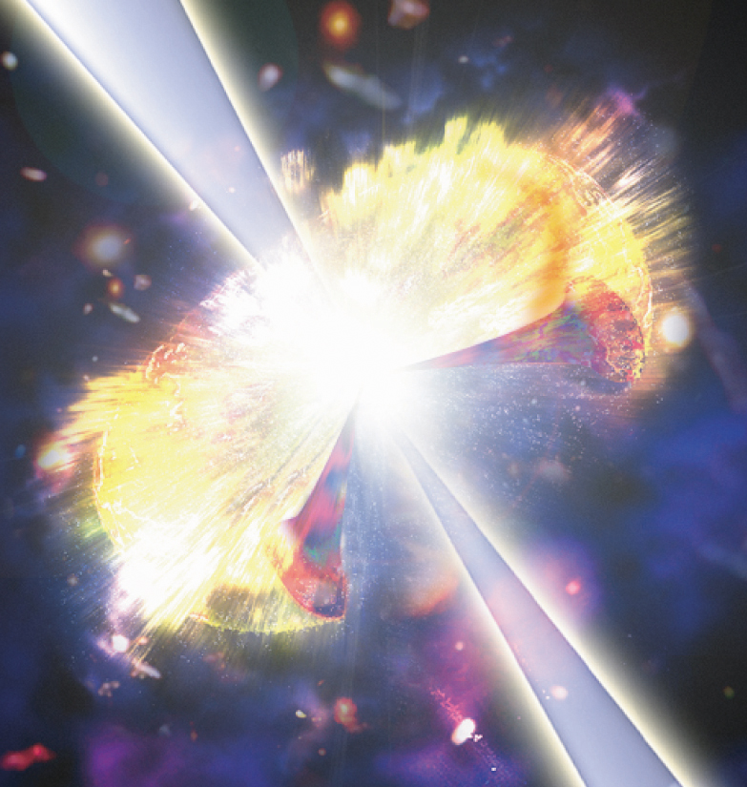
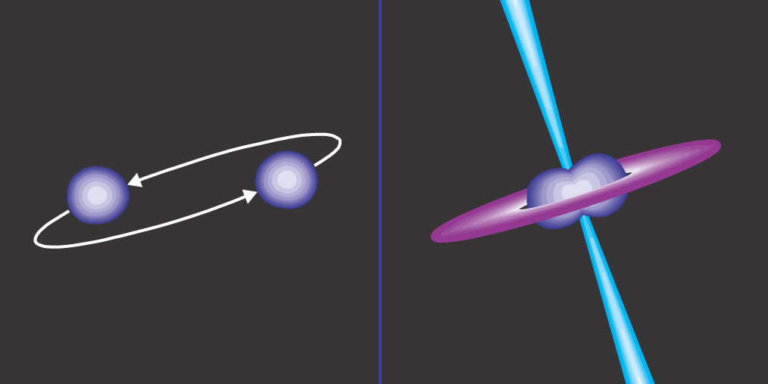
Birth of a Black Hole
Long bursts (>2 seconds) may be from a hypernova: a super-supernova
Short bursts (<2 s) may be from merging neutron stars
Both create nature’s vacuum cleaner: a black hole
Notes:
Self-explanatory.

Slide 22
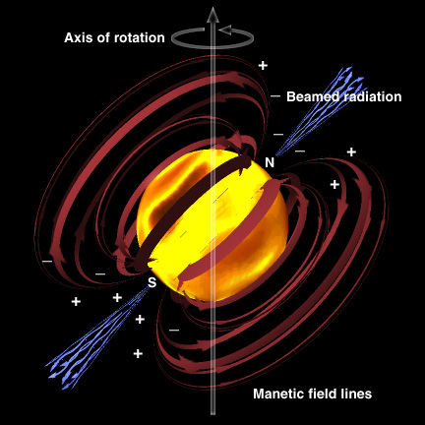
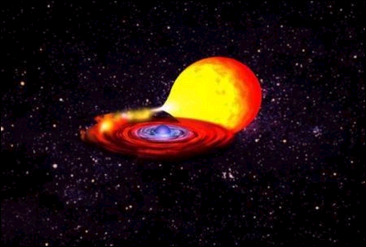
A Burst By Any Other Name…
Neutron star: dense core leftover from a supernova
Possess incredibly strong magnetic fields
Soft Gamma Ray Repeater: violent energy release due to starquake
Accretion: neutron star draws matter off binary companion
Matter piles up, undergoes fusion: bang!
Cycle repeats: X-Ray Burster
Notes:
Self-explanatory.

Slide 23
How Does This Apply? NSES
Content Standard A: Science as Inquiry
Abilities necessary to do scientific inquiry
Identify questions and concepts that guide scientific investigations
Formulate and revise scientific explanations and models using logic and evidence
Communicate and defend a scientific argument
Understanding about scientific inquiry
Scientists rely on technology to enhance the gathering and manipulation of data.
Mathematics is essential in scientific inquiry
Results of scientific inquiry--new knowledge and methods--emerge from different types of investigations and public communication among scientists.
Content Standard B: Physical Science
Interactions of energy and matter
Waves, including sound and seismic waves, waves on water, and light waves, have energy and can transfer energy when they interact with matter.
Content Standard G: History and Nature of Science
Science as a Human Endeavor
Individuals and teams have contributed and will continue to contribute to the scientific enterprise.
Nature of Scientific Knowledge
Science distinguishes itself from other ways of knowing and from other bodies of knowledge through the use of empirical standards, logical arguments, and skepticism, as scientists strive for the best possible explanations about the natural world.
Because all scientific ideas depend on experimental and observational confirmation, all scientific knowledge is, in principle, subject to change as new evidence becomes available.
Notes:
Since we are funded by NASA we have to make sure our activities address the National Science Education Standards or NSES. On this slide I have placed the content standards taught in this activity and how they are addressed specifically. For each activity we have done this, as well as put a quick reference table on page 4 of the booklet. Not only have we shown in this booklet how our activities address the Science standards, but we have also listed the National Mathematics standards that can be taught in this activity booklet. Because this is a CSTA conference and we care more about the California standards I have done this for them too.

Slide 24
How Does This Apply? California Grades 9-12
Earth Science: Earth’s Place in the Universe
Physics: Waves
2. Earth-based and space-based astronomy reveal the structure, scale, and changes in stars, galaxies, and the universe over time. As a basis for understanding this concept:
a. Students know the solar system is located in an outer edge of the disc-shaped Milky Way galaxy, which spans 100,000 light years.
d. Students know that stars differ in their life cycles and that visual, radio, and X-ray telescopes may be used to collect data that reveal those differences.
4. Waves have characteristic properties that do not depend on the type of wave. As a basis for understanding this concept:
a. Students know waves carry energy from one place to another.
e. Students know radio waves, light, and X-rays are different wavelength bands in the spectrum of electromagnetic waves whose speed in a vacuum is approximately 3 x 10⁸m/s (186,000 miles/second).
Investigation and Experimentation
1. Scientific progress is made by asking meaningful questions and conducting careful investigations. As a basis for understanding this concept and addressing the content in the other four strands, students should develop their own questions and perform investigations.
Notes:
This activity addresses many of the California Earth Science standards for grades 9-12. The Category within the Earth Science standards that this best fits is the “Earth’s Place in the Universe.” Some or all of the standards listed here can be taught while using this activity. The easiest standards to integrate are the overall concepts of section 1, about the size and scale of the universe and how Earth stands relative to the size of other objects. The Earth is part of our Sun’s system. Similarly, our Sun is one of many stars in many star systems in our Galaxy, the Milky Way Galaxy, which is one of many Galaxies in our Universe. The students are given the opportunity to compare their own size to the size of other objects in the Universe using the AGN poster. They then are able to infer sizes and distances of even larger objects by using the knowledge they acquire after using the poster. In addition the standards in section 2 of Earth Science are just as easily taught when using this activity. In section 2 the emphasis is on how we observe the size, scale and structure of the universe. Depending on your unit emphasis, all or some of the subsections can be taught while using this activity. If you use this activity to talk about the GLAST telescope using space-based astronomy to observe these objects in space at high energy wavelengths, then the students will be able to grasp the idea of different objects emitting light at various wavelengths and the characteristics of the galaxies in the Universe.

Slide 25
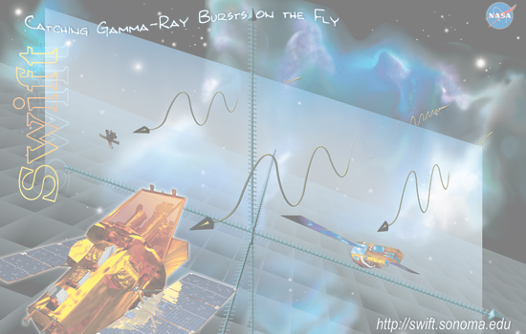
The Swift Future
Swift should detect ~100 GRBs per year
Simply collecting detailed data on so many GRBs will help us understand them
Ultimate goal: understand the progenitors and underlying physics of the most powerful bangs since The Big One.

Slide 26
Resources
Swift Education and Mission sites:
http://swift.sonoma.edu
http://swift.gsfc.nasa.gov
What else can Swift do for you?
http://swift.sonoma.edu/education
GRB Info:
http://imagine.gsfc.nasa.gov
http://www.batse.com
Notes:
Self-explanatory.

Slide 27
See me, rate me
Please fill out your assessment forms now!

Slide 28
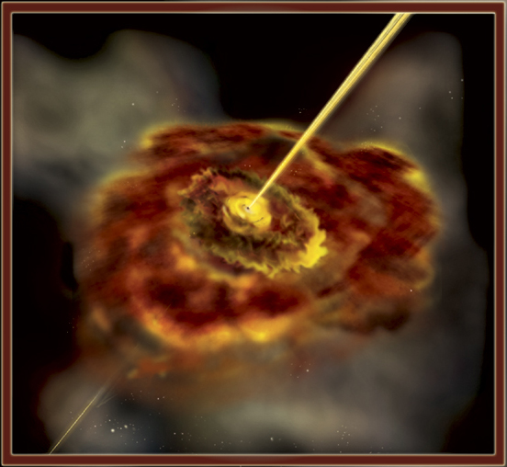
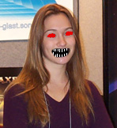
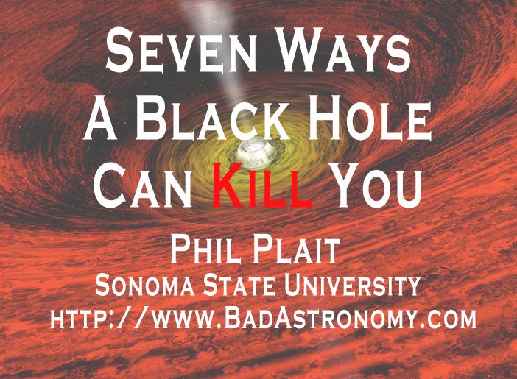
Coming Attractions
“Huge Black Holes: Measuring the Monster in the Middle”
Sarah Silva, 3:30 – 4:30 in this very room.
Come see my luncheon talk, “Seven Ways a Black Hole Can Kill You” in Regency Ballroom A on Sunday, 11:30 – 2:00 p.m.

