Slide 1

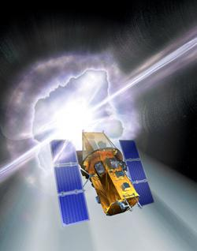
The Invisible Universe
Prof. Lynn Cominsky
Sonoma State University

Slide 2
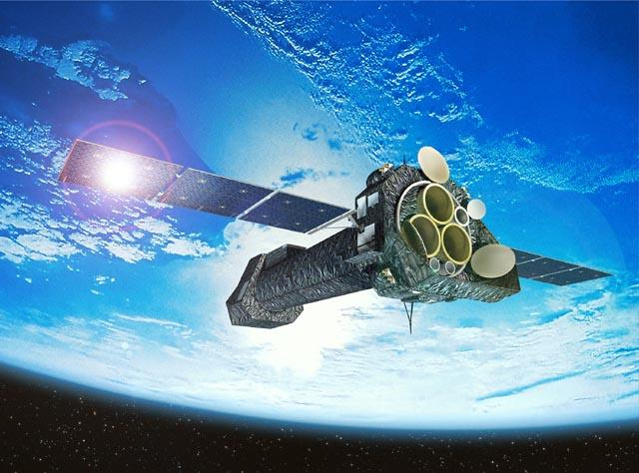
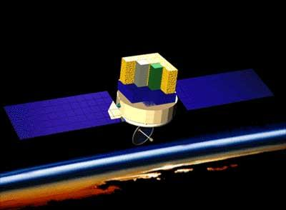

The NASA E/PO Program at Sonoma State University
A group of ten people working collaboratively to educate the public about current and future NASA High Energy Astrophysics/Astronomy Missions.
Space Mysteries
GLAST
XMM Newton

Slide 3
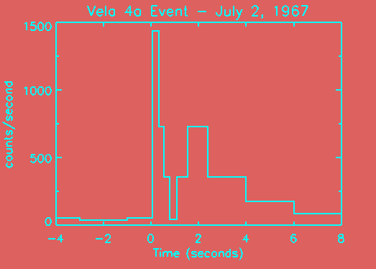
Gamma-ray Bursts
Discovered in 1967 while looking for nuclear test explosions - a 30+ year old mystery!

Slide 4
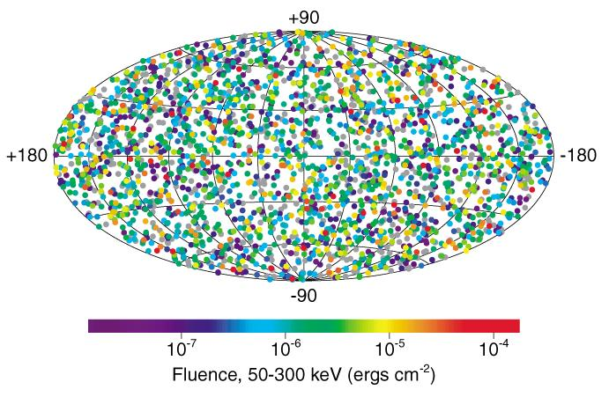
Gamma-ray Burst Sky
Once a day, somewhere in the Universe

Slide 5
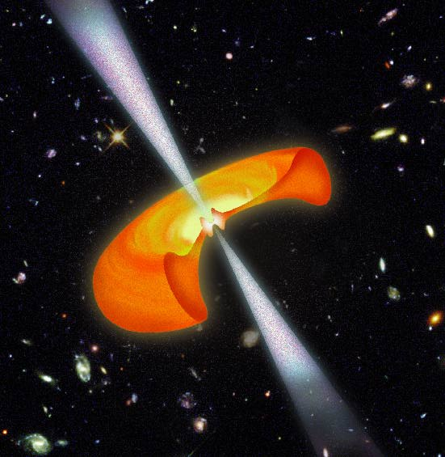
Hypernova
The end of the life of a star that had 100 times the mass of our Sun
A billion trillion times the power from the Sun

Slide 6
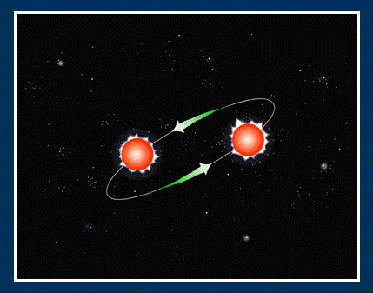
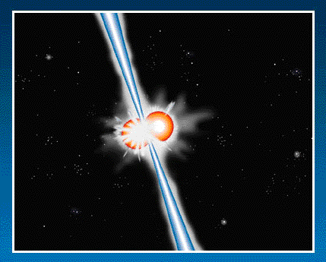
Catastrophic Mergers
Death spiral of 2 neutron stars or black holes

Slide 7
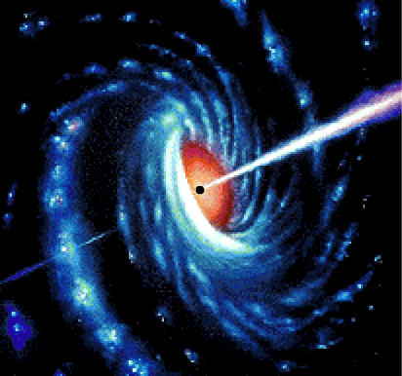
Gamma-ray Bursts
Either way, when we see a GRB, we are seeing the birth of a black hole
GRBs bring tremendous excitement to the classroom!

Slide 8
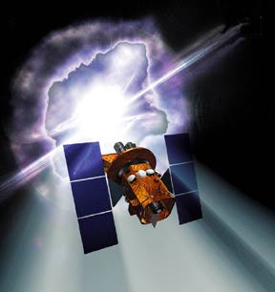
Swift Mission
To be launched in 2004
Burst Alert Telescope (BAT)
Ultraviolet/Optical Telescope (UVOT)
X-ray Telescope (XRT)

Slide 9


Swift Mission
Will study GRBs with “swift” response
Survey of “hard” X-ray sky
To be launched in 2004
Nominal 2-year lifetime
Will see ~150 GRBs per year

Slide 10
The GEMS Series
The Great Explorations in Math and Science Program has developed over 70 educators guides for use in classrooms
GEMS guides are tested in the classroom nationwide
Come with clear step-by-step instructions
Assessment suggestions
Ideas for further investigations

Slide 11
The Invisible Universe The electromagnetic spectrum from radio waves to gamma rays…
A workbook and teachers guide inspired by the Swift mission and developed in collaboration with the GEMS Program.
Activities in this book:
Activity 1: Comparing Wave Makers
Activity 2: Invisible Light Sources and Detectors
Activity 3: Putting the Electromagnetic Spectrum Together
Activity 4: Tour of the Invisible Universe
Activity 5: The Most Powerful Explosions in the Universe

Slide 12
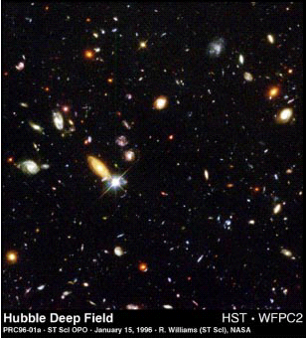
The Invisible Universe The electromagnetic spectrum from radio waves to gamma rays…
The Visible Universe
The Invisible Universe

Slide 13

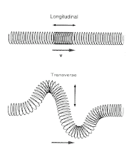
Activity 1
Activity 1: Comparing Wave Makers
A series of news flashes set the stage for the unit by introducing the mystery of gamma-ray bursts.
To work toward understanding gamma rays as very high energy waves, students first investigate properties of simple waves produced in different media.

Slide 14



Activity 2
Activity 2: Invisible Light Sources and Detectors
Students work at different learning stations to explore different kinds of light energy and how they can be detected, emitted, and absorbed.

Slide 15
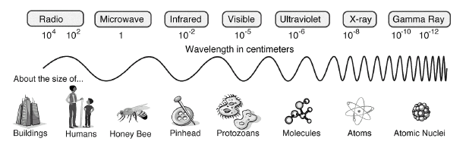
Activity 3
Activity 3: Putting the Electromagnetic Spectrum Together
In this activity, students have an opportunity to sort cards that contain information about the main regions of the electromagnetic spectrum.

Slide 16
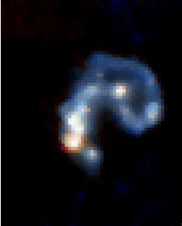
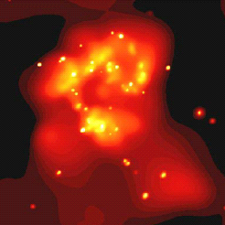
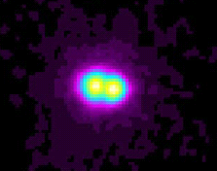
Activity 4
Activity 4: Tour of the Invisible Universe
This presentation is intended to help students improve their understanding of objects in the Universe, including those connected with gamma-ray bursts.

Slide 17
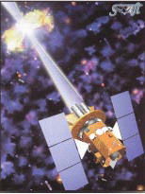


Activity 5
Activity 5: The Most Powerful Explosions in the Universe
Students return to the gamma-ray burst mystery that opened the unit. Since it is so difficult for anyone to grasp the amount of energy unleashed every day in space, students climb a mental ladder of “energetic events.”

Slide 18



GEMS Activity 2 - Sources
Question: Name some visible sources of light in the room
Flashlight
Laptop Monitor
Projector
Question: Is the screen at the front of the room a light source?
But it seems to be emitting light?
Oh, I see the screen is reflecting the light, not emitting it.
Definition: Sources of light are objects that emit light energy

Slide 19
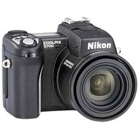
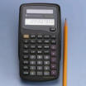

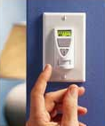
GEMS Activity 2 - Detectors
Question: Can you tell me where there are light detectors in this room?
Motion Sensitive Light Switches
Cameras
Those two openings on either side of our noses!
Solar Calculators
Question: Are there any other light detectors that you know of?

Slide 20
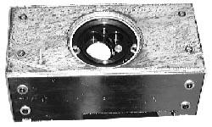
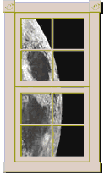
GEMS Activity 2 – Transmitters and Shields
Question: What are some things that don’t allow light through?
Is it safe to say these things “Shield the Light”?
Question: What are some materials we know of that do allow light to either completely or partially pass through it?
Is it safe to say these things “Transmit the Light”?

Slide 21
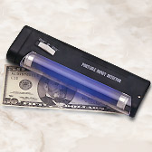
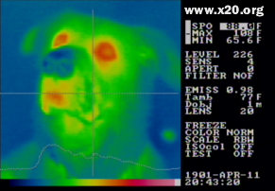
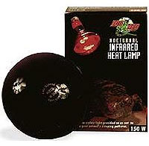
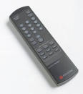
GEMS Activity 2 – Invisible Sources
In addition to visible sources of light in the room there are many invisible sources of light too.
Question: Can anyone name any invisible sources of light in the room?
UV Black Light
Yes! Us.
Infrared Heat Lamps
Infrared Remote

Slide 22
GEMS Activity 2 – Invisible Sources of Light
There are 6 different stations throughout the room, each with three setups.
They are equipped with a source of invisible light and a detector for detecting that light.
In a moment we will break up into groups.
Each station will have a set of materials.
These materials are potential shields.

Slide 23
GEMS Activity 2 - Procedure
Each group will go from station to station. You have about 5 minutes per station.
As scientists we are obligated to make a prediction about how we think each material will behave. DO THIS FIRST!
Then test each material at each station to see if it is a Transmitter (T) or a Shield (S) for that particular type of light.
Try to determine the common properties of the materials that block the different types of light

Slide 24
Stations:
AM Radio
Infrared lamp
Flashlight
FM Radio
Remote control
“Black” light
Let’s Get Busy!

Slide 25
GEMS Activity 2 – What did we learn?
Question: What property of the materials we tested caused radio waves to be blocked?
Question: Are all the plastics we tested translucent/transparent to infrared light?
Question: If someone had no sunscreen while at the beach what could they cover their face with to keep from getting sun burned by UV light?

Slide 26
GEMS Activity 2 – Reflection
Each group should pick a station.
Try to figure out which of your materials can reflect the invisible light of that station.
Try and use what you have learned in the previous section to test your ideas in this section.
Question: What did you find out?

Slide 27
Other SSU E/PO events:
Dr. Phil Plait presents: Nature’s Second Biggest Bangs: The Gamma Ray Burst Zoo in LBCC 202B Saturday 2 – 3 PM
Sarah Silva presents: Huge Black Holes: Measuring the Monster in the Middle in LBCC 202B Saturday 3:30 – 4:30 PM
Dr. Phil Plait’s luncheon talk, “Seven Ways a Black Hole Can Kill You” in Regency Ballroom A on Sunday, 11:30 – 2:00 p.m.

Slide 28

More Information
Swift - http://swift.sonoma.edu
GLAST – http://glast.sonoma.edu
XMM Newton - http://xmm.sonoma.edu
NASA EPO @ SSU – http://epo.sonoma.edu
Space Mysteries – http://mystery.sonoma.edu
To order our materials:
http://epo.sonoma.edu/orderforms/orderformpublic.html

