Slide 1
Waves Light Up the Universe!
Dr. Laura A. Whitlock
NASA’s Swift Mission
Kara C. Granger
Maria Carrillo HS

Slide 2
CA Content Standards
• Grades 9-12 Physics: Waves have characteristic properties that do not depend on the type of wave:
* Students know waves carry energy from one place to another
* Students know how to identify transverse and longitudinal waves in a mechanical media
* Students know how to solve problems involving wavelength, frequency, and wave speed
* Students know radio waves, light, and X-rays are different wavelength bands in the spectrum of electromagnetic waves whose speed in a vacuum is approximately 300,000,000 m/s.
* Students know how to identify the characteristic properties of waves: interference, diffraction, refraction, Doppler effect, and polarization.

Slide 3
CA Content Standards
• Grades 9-12 Earth Sciences: Earth’s Place in the Universe: Earth-based and space-based astronomy reveal the structure, scale, and changes in stars, galaxies, and the universe over time.
* Students know the solar system is located in an outer edge of the the disc-shaped Milky Way galaxy, which spans 100,000 light years
* Students know that stars differ in their life cycles and that visual, radio, and X-ray telescopes may be used to collect data that reveal those differences
* Students know the evidence indicating that the color, brightness, and evolution of a star are determined by a balance between gravitational collapse and nuclear fusion
* Students know how the redshift from distant galaxies and the cosmic background radiation provide evidence for the “big bang” model that suggests that the universe has been expanding for 10 to 20 billion years

Slide 4
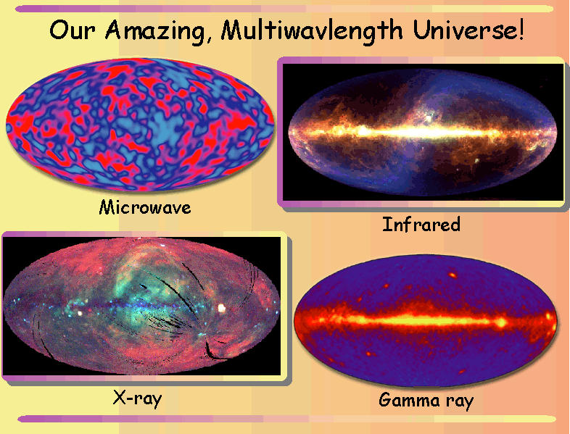
Pretty!

Slide 5
But First...

Slide 6
The Universe is a VERY Big Place
At least 13 billion light-years
(or about 100,000,000,000,000,000,000,000 kilometers)
It is full of VERY big numbers!
2.7 - 10,000,000,000 Kelvin temperatures
0.000000001 - 1,000,000,000,000 Gauss magnetic fields
100,000,000,000 - 1,000,000,000,000 stars in a galaxy
1,000,000,000,000 galaxies

Slide 7
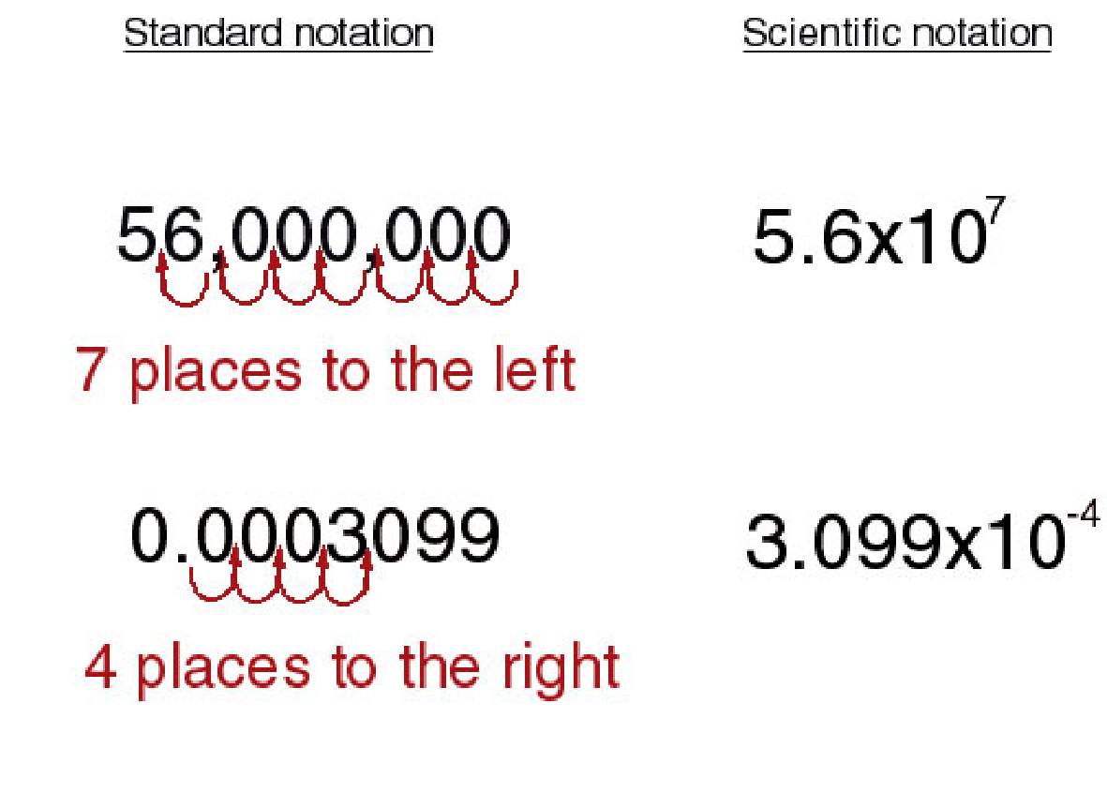
Scientific Notation is Required!

Slide 8
Rules for Scientific Notation
10^{n} means 10 x 10 x 10 x 10 … [n times]
10^{-n} means 1/(10 x 10 x 10 ….) [n times]
To Multiply & Divide
10ª •10^{b} = 10 ^{a + b}
10ª ÷10^{b} = 10 ^{a - b}

Slide 9
So now, we can say….
• 10¹¹ - 10¹² stars in a galaxy
• 10¹² Gauss magnetic fields
• 10⁻⁷ m wavelengths
• 10²⁰ Hz frequencies
And now, we can ask….
Who's Got the Power?

Slide 10
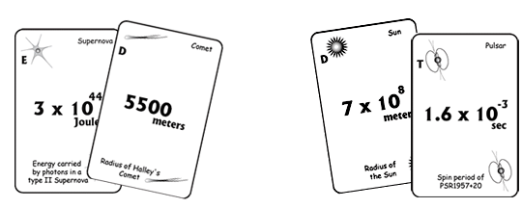
Multiplication War

Slide 11
Pretty…and Full of Information!

Slide 12
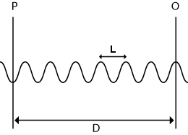
Defining a Wave
Wavelength - distance from peak to peak, or trough to trough
Frequency - cycles per second; how many peaks pass a given point in 1 second

Slide 13
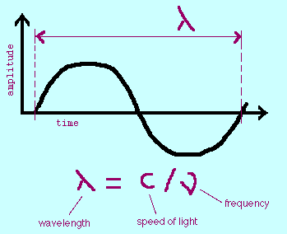
EM Radiation Travels as a Wave
c = 3 x 10⁸ m/s
It’s not just a good idea, it’s the law!

Slide 14
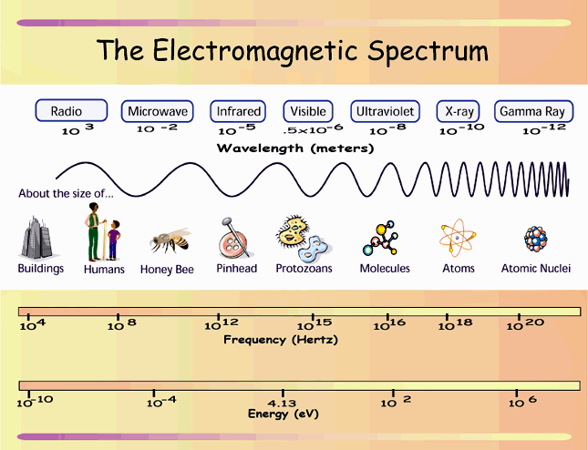
EM Spectrum Probes the Universe

Slide 15
EM Spectrum Data Table
Wavelength (m) Frequency (Hz) Energy (ev)
Radio 3 1 x 10⁸ 4.1 x 10⁻⁷
Microwave 2 x 10⁻² 1.5 x 10¹⁰ 6.2 x 10⁻⁵
Infrared 4 x 10⁻⁴ 7.5 x 10¹¹ 3.1 x 10⁻³
Visible 5 x 10⁻⁶ 6 x 10¹³ 0.25
Ultraviolet 1 x 10⁻⁷ 3 x 10¹⁵ 12.4
X-ray 8 x 10⁻¹¹ 3.75 x 10¹⁸ 1.5 x 10⁴
Gamma-ray 2.5 x 10⁻¹² 1.2 x 10²⁰ 4.95 x 10⁵

Slide 16
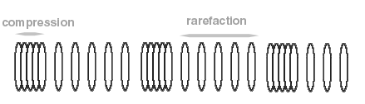
Understanding Waves
• Longitudinal waves - displacement is in same direction
as the wave motion
• Example: sound waves
• Obeys the equation λf = v, where λ is the wavelength,
n is the frequency, and v is the velocity.

Slide 17
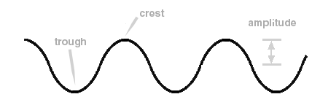
Understanding Waves
• Transverse Waves - displacement is perpendicular to
the direction of motion of the wave
• Example: Light
• Obeys the equation λf = v, where λ is the wavelength,
f is the frequency, and v is the velocity.

Slide 18
Special Things About a Light Wave
• It does not need a medium through which to travel
• It travels with its highest velocity in a vacuum
• Its highest velocity is the speed of light, c,
equal to 300,000 km/sec
• The frequency (or wavelength) of the wave determines
whether we call it radio, infrared, visible, ultraviolet,
X-ray or gamma-ray.

Slide 19

Fun For Every Girl and Boy!

Slide 20
Time for the Spring!
The lab we will do is best done in groups of 3 :
"shaker", "holder" and "observer/recorder". Rotate through each role!
Procedure:
• By vibrating your hand steadily back and forth, you can produce a train of pulses, or a periodic wave. The distance between any two neighboring crests on such a periodic wave is the wavelength. The rate at which you vibrate the spring will determine the frequency of the periodic wave. Follow the procedure on your lab sheet in order to answer the following question.
Question:
How does the wavelength depend on the frequency?

Slide 21
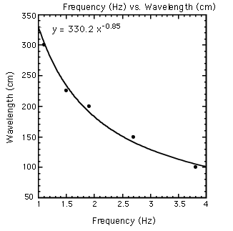
The Spring Knows!
Conclusion:
Wavelength and frequency are inversely related.

Slide 22
EM Radiation Carries Energy
• Quantum mechanics tells us that for photons E = hf
• But we learned today that f = c/λ
• Putting these equations together, we see that
E = hc/λ
high frequency = high energy = short wavelength
low frequency = low energy = long wavelength

Slide 23
Waves Bring Us Information About our Universe
• Different energies/frequencies/wavelengths produced by different physical processes
• From making observations at different wavelengths, we can “get the big picture”
mass, temperature, spin period, orbital period, chemical composition, age, magnetic field strength, distance, velocity, size

Slide 24
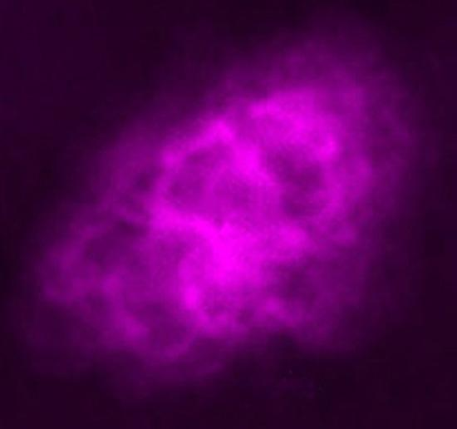
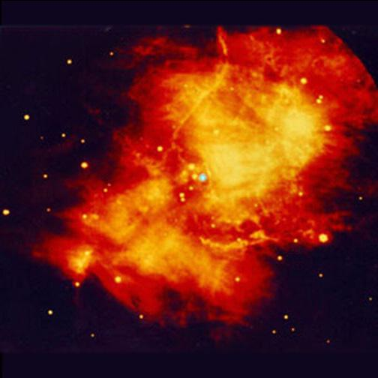
Crab Nebula
Radio/VLA
Infrared/Keck

Slide 25
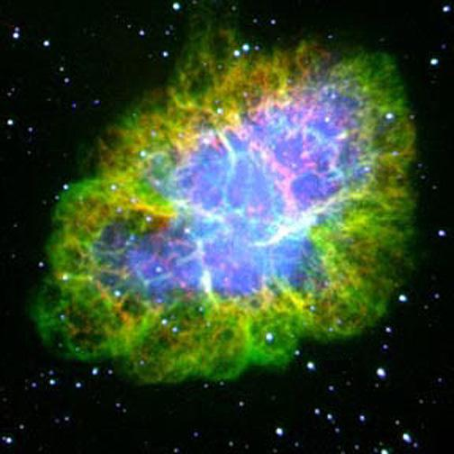
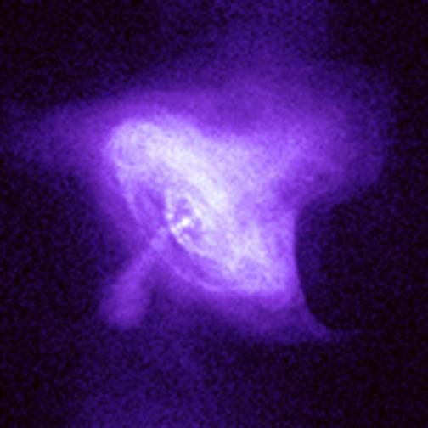
Crab Nebula
Optical/Palomar
X-ray/Chandra

Slide 26

Oh, Baby, I Love Your Wave!
From Bill Nye, Episode 51, “Waves”

