Slide 1
Swift Education and Public Outreach Program
Presentation at the Swift Team meeting
Lynn Cominsky
Sonoma State University
August 2, 2002

Slide 2
Program Overview
Swift Web site (http://swift.sonoma.edu)
Printed materials
GEMS guide (Lawrence Hall of Science)
Teacher’s activity booklets and posters
Educator training
Conference workshops (NSTA, NCTM, etc.)
Penn State Science Teacher Workshops
Informal Education
What’s in the News? (PSU)
SEU Museum Exhibit slides
Program Evaluation

Slide 3

Swift E/PO web site
E/PO web site has now been updated and moved to http://swift.sonoma.edu
Coordinated with Project site (http://swift.gsfc.nasa.gov) to avoid duplication of information
Now has links to E/PO products from all Swift partners – including Italian short story, WITN? Videos and scripts, and classroom materials
Has been captured on CD – copies available

Slide 4

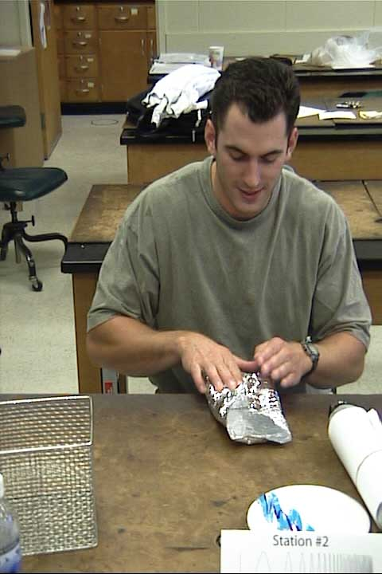
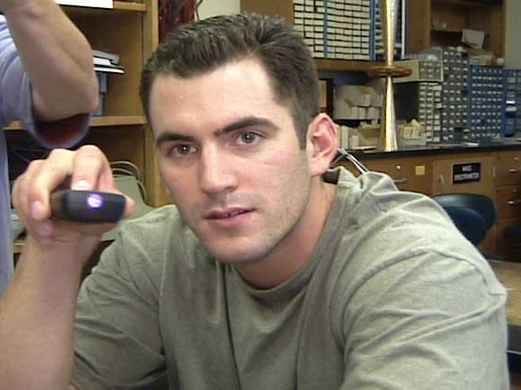
Almost final release of Activity #2 tested with NASA EAs
Final guide on schedule for release in Fall ‘02
Seeing a near IR beam
Blocking radio waves

Slide 5
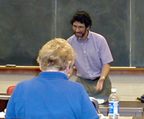
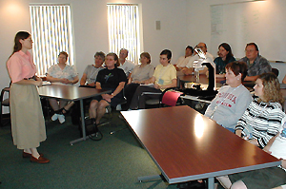
PSU Science Teacher Workshops
Space Astronomy
June 24-28, 2002 – 21 attendees
Galaxies & Cosmology
July 15-19, 2002 – 18 attendees
Swift funding supported 12 rural teachers
(9 PA, 2 WV, 1 WA)

Slide 6
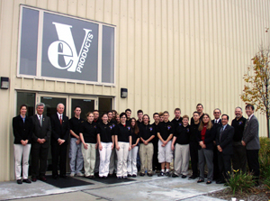
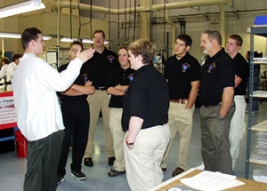
Keystone Oaks High School
Pittsburgh, PA
Part of the GSFC-sponsored Cooperative Satellite Learning Project (CSLP) - C.J. Rodkey, teacher
The self-appointed “official Swift High School”
At eV Products - celebrating delivery of BAT CZT detectors
October 2001

Slide 7
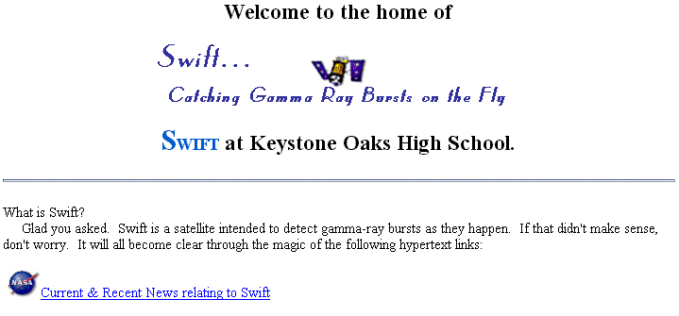
Keystone Oaks High School
Pittsburgh, PA
Class website: http://www.kosd.org/~swift

Slide 8
Reaching Teachers
Laura Whitlock gave workshops at NSTA and NCTM using Swift materials in Spring 2002
Swift Spin-a-Spectrum guide distributed in 5000 Seeing and Exploring the Universe kits in Spring 2002 (with 5000 more in progress)
Swift/GLAST booth will be at CSTA in October, 2002 in San Francisco
Newton’s Laws posters are going through the GPO printing approval process – 5000 of each will be printed for future distribution

Slide 9
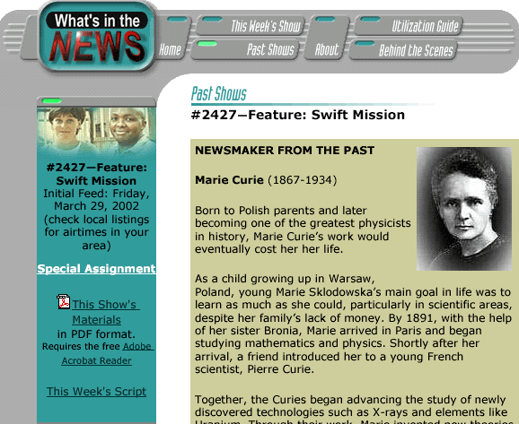
WPSX Public Television
In FY02, 2 short pieces and one 15 minute segment were produced:
4/26/02 Swift Mission Extreme Clean
3/29/02 BAT and the Swift Mission featuring Dr. John Nousek (15 minute feature)
3/8/02 Gamma-rays and the Swift Mission
For FY03, 3 short pieces will focus on Newton’s Laws materials, subject of 15 minute piece is TBD – space environmental testing?

Slide 10
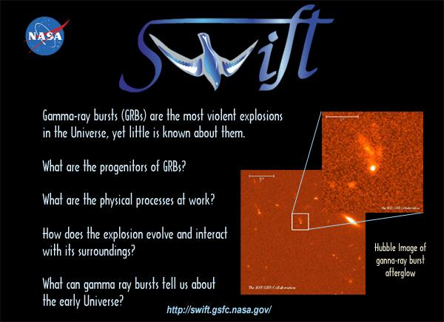
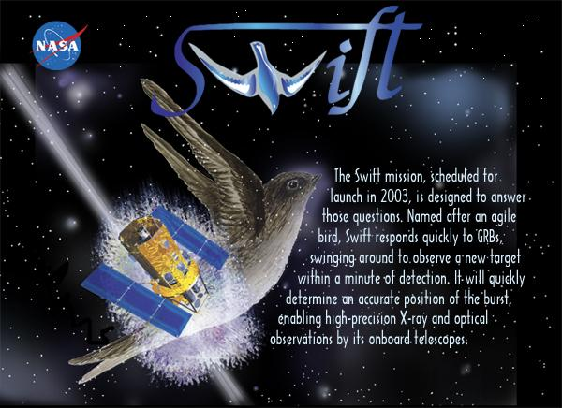
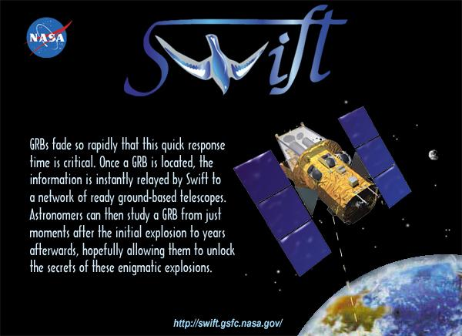
Swift Museum Slides
3 slides created for the “Multi-mission” kiosk in the Cosmic Questions museum exhibit, opening 9/02 in Boston

Slide 11
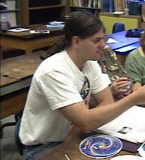
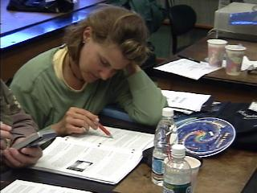
Program Evaluation
WestEd
Contract lapsed during FY02
2 Swift materials evaluated by Educator Ambassadors (Activity 2 from GEMS and Spin-a-Spectrum)
GEMS tested extremely well
New statement of work in progress for FY02-3 with WestEd (Ted Britton) – will include evaluation of these activities

Slide 12
Program Evaluation
Swift Education Committee
Being restructured due to 2 resignations – 2 Swift Educator Ambassadors are being added to improve testing and dissemination
Chosen in a national competition – were originally “GLAST Alternates”
Join 5 GLAST and 3 SEUEF Eas
Trained at SSU July 15-19, 2002
Role of Educator Ambassadors is to help develop, test and disseminate classroom materials

Slide 13
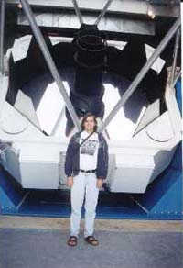
Meet the Swift Educator Ambassadors
Rob Sparks
BS and MS in Physics
Fermilab Teacher Fellow in 2001-02, worked on SDSS
IDEAS grant from STScI
now teaching high school at the Prairie School in Racine, Wisconsin
eager to participate in coordinated observations between students and scientists working on Swift

Slide 14
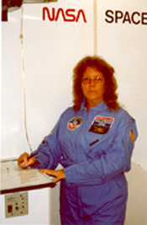
Meet the Swift Educator Ambassadors
Rae McEntyre
BS in Biology, MS in Secondary Science Education
Environmental Science teacher (includes Astronomy) at Gallatin County HS in Warsaw, KY
National Board certified in Adolescent/Young Adult Science
collaborates with Astronomers at Western Kentucky University

Slide 15
Near-Future Plans
Field Testing of classroom materials in classrooms to improve instructional design
Increased scientific review and error correction of existing materials
Increased involvement of Swift team scientists
Improved coordination with GLAST E/PO and Educator Ambassador programs, including participation in the GLAST Telescope Network of amateurs and high school students

