Slide 1






SEU E/PO at Sonoma State University
SEU Forum Support Activities
Lynn Cominsky
Sonoma State University

Slide 2




Swift/GLAST EPO
Goal: to use the observations and scientific discoveries of the Swift and GLAST missions to improve the understanding and utilization of science and mathematics concepts for grades 7-12 (Swift) or grades 9-12 (GLAST)
Major Program Elements in common:
EPO Web Sites – both newly redesigned for LHEA CD
http://swift.sonoma.edu
http://www-glast.sonoma.edu
Monthly NASA Quest WebChats (8 so far)
Poster and Teacher’s Guide sets, Manipulatives
Swift will focus on concepts (e.g., EM spectrum)
GLAST will focus on objects (e.g., AGN)
Educator Training at National and Regional Conferences
Gamma 2001: sponsored by GLAST
NSTA, NCTM, CSTA, CMC, NBSP
Independent Assessment by WestEd
From the K-12 viewpoint – a gamma-ray is a gamma-ray!

Slide 3
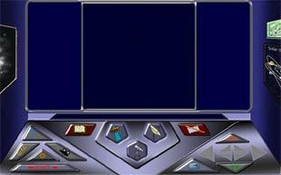
Swift/GLAST EPO
Space Mysteries – a planned series of 6 interactive, web-based modules that teach physical science and math at the high school level
Major Partners: Videodiscovery, Inc., NASA LEARNERS program
Alpha release of our first module now available!!
http://perry.sonoma.edu/learners
LEARNERS is funding 3 modules in 2000-2002
Swift will fund one module in 2003
GLAST will fund two modules in 2004-2005
Alien Bandstand – try it!
Escape from the Doomed Planet – coming soon
Star Market Scandal

Slide 4

Swift Unique Program Elements
Major partners: Pennsylvania State University, NASA/GSFC,
Lawrence Hall of Science (GEMS)
What’s In the News?
Multi-media current events program produced at Pennsylvania State University that reaches over 5 million middle-school students
First 15 minute show aired January, 2001
Second segment in progress – taped in April
Appalachian Regional Project
Astronomy teacher in-service workshops held every summer at PSU
Swift content of workshops will increase 🡪 Space astronomy workshop
Great Explorations in Math and Science (GEMS) Guide
Printed lesson plans and activity guides used by thousands of teachers
Beyond the Visible Universe – now being tested in pilot schools

Slide 5
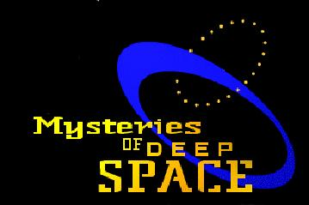
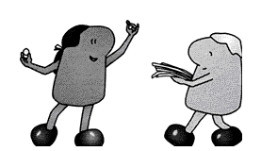
GLAST Unique Program Elements
Major partners: TL Productions, SEU Forum, Hands On Universe, AAVSO, Maryland Science Center, SLAC, TOPS Science, NASA/GSFC, NASA/MSFC
PBS Television Special with Tom Lucas Productions
Museum Exhibit with SEU Forum
Telescope Network
High schools and amateurs
Will observe GRBs and AGNs
SLAC Virtual Visitor’s Center
Web site upgrade
Gamma-ray detector interactive pages
TOPS Science Printed Lesson Plans and Activities
GLAST Ambassadors Program
10 educators who will help develop, test and disseminate materials
Planetarium Show with Maryland Science Center (on hold)

Slide 6

SEU Forum Support Activities
Started in March, 2001 to work with SEU Forum at Harvard-Smithsonian Center for Astrophysics to plan and coordinate mission EPO activities
Produced 5000 folders of mission EPO flyers (in 2 weeks!)
Feature mission information, EPO information and educational activities representing 9 current or planned SEU missions
Promote Cosmic Journeys idea
2500 distributed at NSTA on 3/22/01
1000 distributed at NCTM on 4/3/01
Some are being shipped to individual missions, NASA/GSFC HEASARC and Forum at CfA for dissemination at regional workshops (e.g., CSTA)
Lesson plans and classroom activities developed to accompany PBS show Live from the Edge of Space and Time (aired 4/3/01)
Five new activities about Cosmology by Dr. Laura Whitlock, high school teacher Kara Granger (Swift) and Lindsay Clark (MAP)
All materials available through http://universe.sonoma.edu

Slide 7
Backups Follow

Slide 8
12 Months of Educator Workshops
When Who Where Attendees Mtg Size
April NSTA Orlando 15, 25 12,000
April NCTM Chicago 25 13,000
July NBSP Rohnert Park, CA 16, 12 -
October CSTA Sacramento, CA 30, 14 3,000
November HEAD Honolulu, HI 35 -
December CMC - North Asilomar, CA 65, 117 3,000
March NSTA St.Louis. MO 30, 30 11,300
April NCTM Orlando, FL 80, 50 13,000
April GAMMA 2001 Baltimore, MD 25 -

Slide 9



What’s in the News?
WHAT'S IN THE NEWS? is an award-winning multi-media instructional series that uses current events as a springboard for exploring history, geography, government, world cultures, science, language arts, and all other areas of the curriculum.
Utilized in 4th-to-7th grade classrooms around the country, WHAT'S IN THE NEWS? is a comprehensive and challenging instructional tool that combines 15-minute television programs with computer-based resources and print materials.
For Kids Only!
Teacher Materials
http://www.outreach.psu.edu/EdComm/WITNweb/

Slide 10
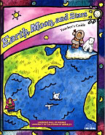
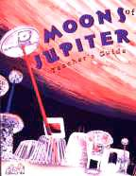
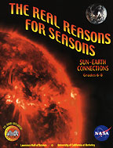
GEMS at the LHS
Over 70 GEMS teachers’ guides and handbooks now available
Recent new addition – by SEC Forum – Real Reasons for Seasons
http://www.lhs.berkeley.edu/GEMS/GEMS.html

Slide 11

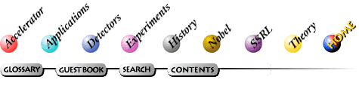


SLAC Virtual Visitor’s Center
http://www2.slac.stanford.edu/vvc/home.html

Slide 12
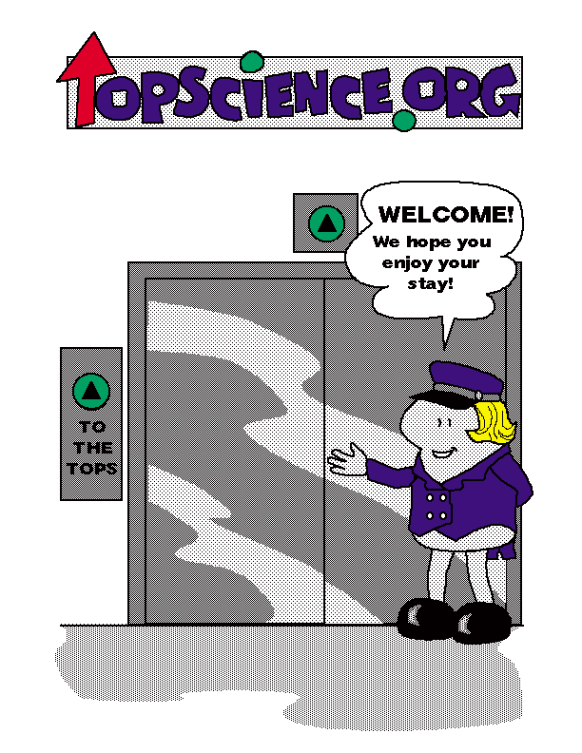
TOPS Learning Systems, Inc.
These are fun-loving folk of no particular age, race, political affiliation, or size. Because they are clever and brave, can change sizes and defy gravity, we let them demonstrate the "how to's" in all the books we publish. Their purpose in life is to help young people achieve success one step at a time.

