Slide 1
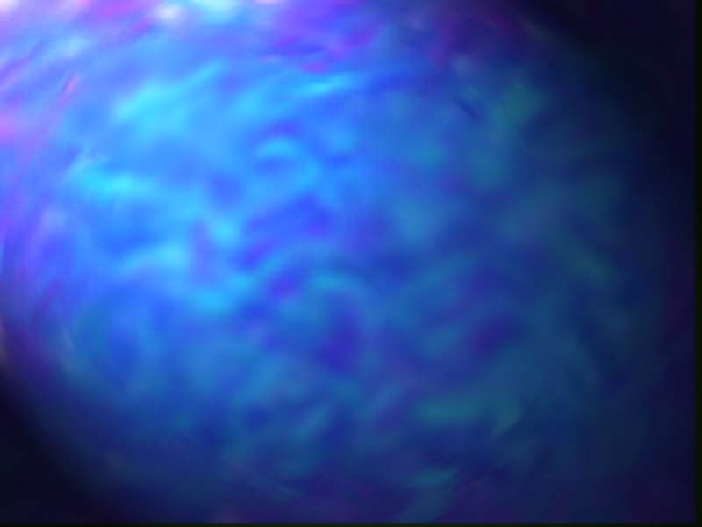
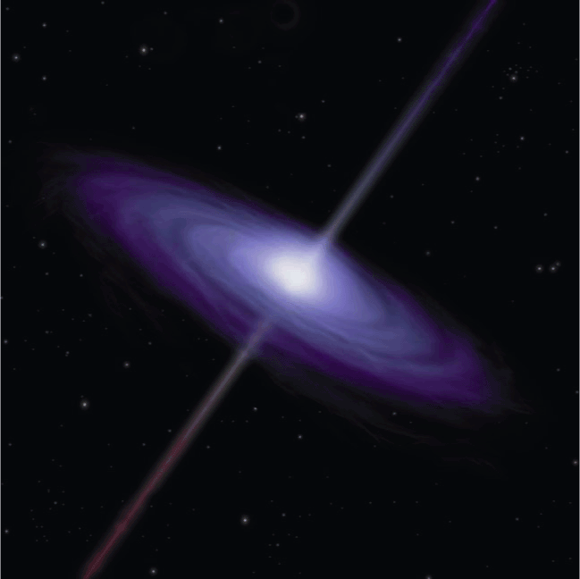
The Supernova, the Black Hole and
the Gamma Ray Burst
Phil Plait, beaming proudly
July 17, 2002

Slide 2
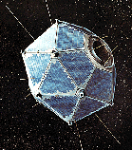
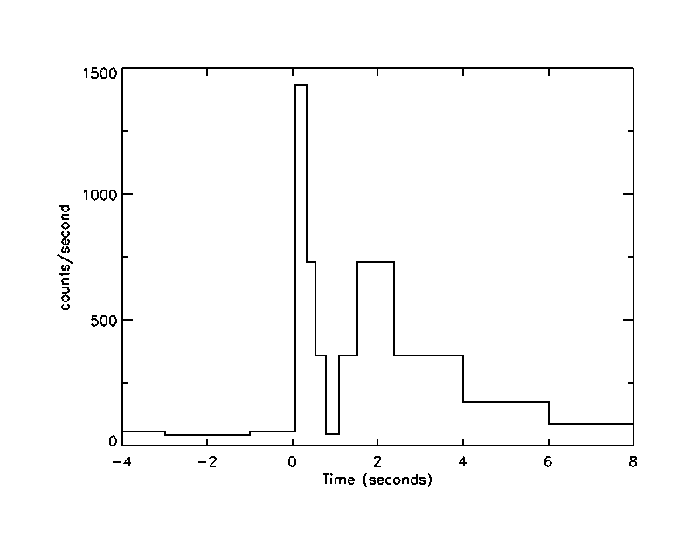
The First Burst
Vela satellite fleet launched to detect
nuclear weapons test in late 60s
Multiple satellites flown:
  allowed crude position
  determination and could
  test for coincidence
  In 1969, data from 1967 found
  which showed a burst that was
  clearly not a clandestine bomb
  test (plot on right)
  16 bursts found between 1969 and 1972

Slide 3
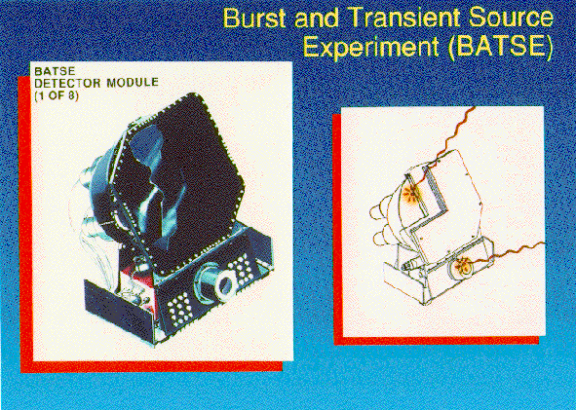
Compton Gamma Ray Observatory-
BATSE (1991 – 2000)
8 instruments on corners of spacecraft
NaI scintillators
Notes:
Each detector module contains two NaI(Tl) scintillation detectors: a Large Area Detector (LAD) optimized for sensitivity and directional response, and a Spectroscopy Detector (SD) optimized for energy coverage and energy resolution.

Slide 4
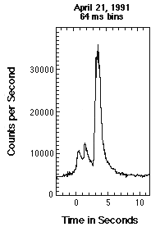
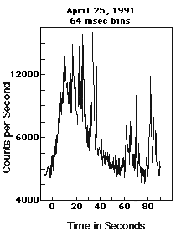
Flash Forward
Over time, it became clear that nothing was clear.
Some show the single rapid burst followed by
a longer secondary burst
Some are relatively smooth, others spiky
Durations range from 30 milliseconds to 1000 seconds

Slide 5
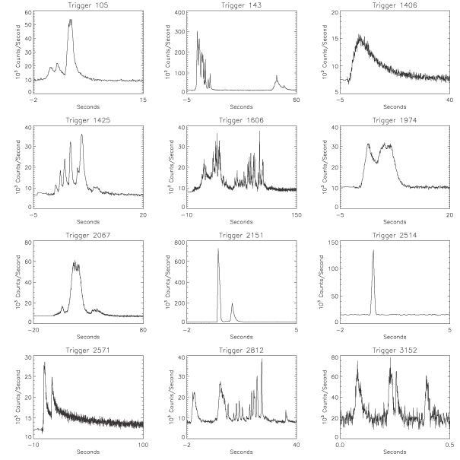
The GRB Gallery

Slide 6
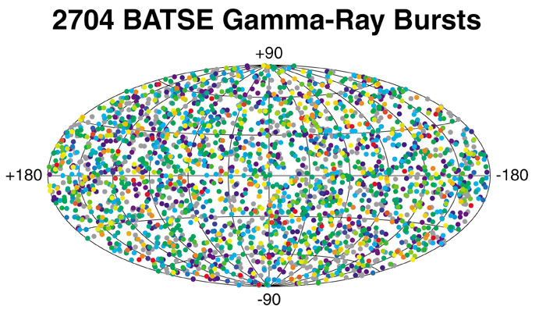
The Big Questions: What and Where
Sparse data makes for guessing games
Clearly, dealing with high energy events
But, a clue eventually became apparent:
GRBs are evenly spread
across the whole sky!

Slide 7
Near or Far?
Isotropic distribution implications:
Very close: within a few parsecs of the Sun
Why no faint bursts?
Very far: huge, cosmological distances
What could produce such a vast amount of energy?
Sort of close: out in the halo of the Milky Way
A comet hitting a neutron star fits the bill
Silly or not, the only way to be sure was to find
the afterglow.

Slide 8
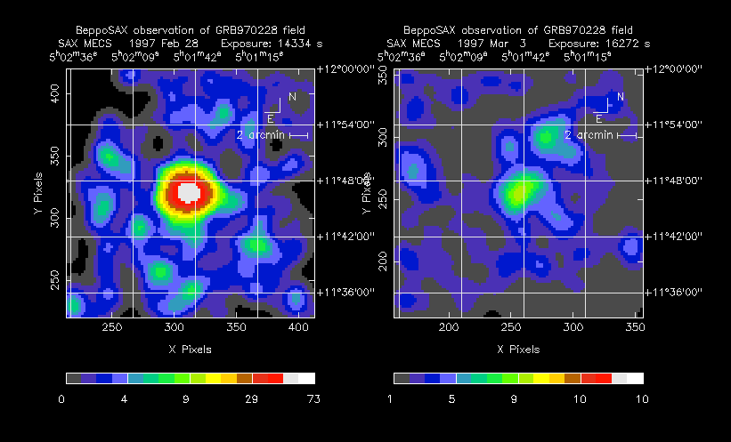
Breakthrough!
In 1997, BeppoSAX detects X-rays from a GRB
afterglow for the first time, 8 hours after burst

Slide 9
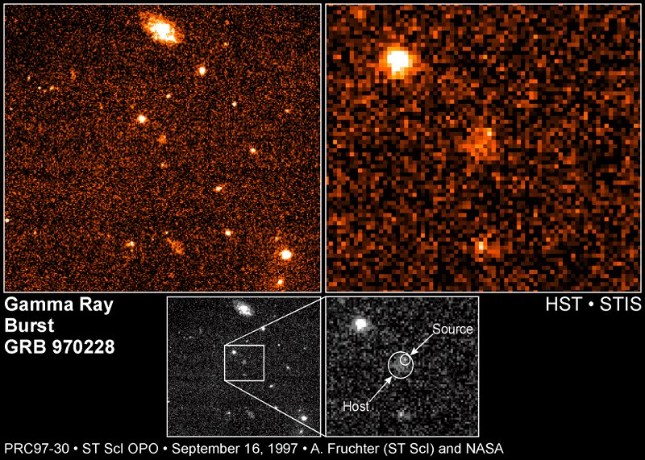
The View From Hubble/STIS, 7 months later

Slide 10
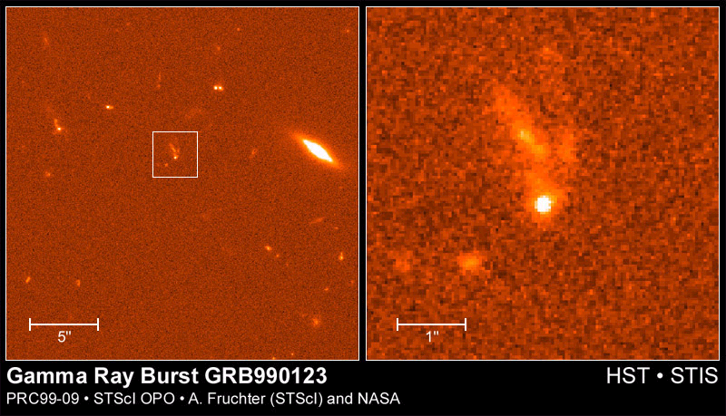
On a clear day, you really can see forever
990123 reached 9th magnitude for a few moments!
First optical GRB afterglow detected simultaneously

Slide 11
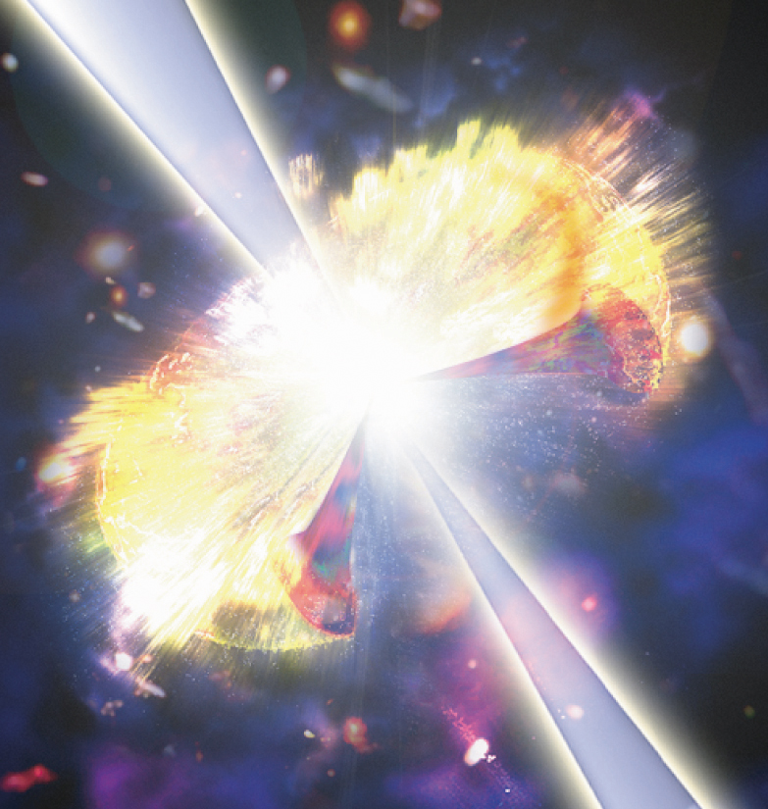
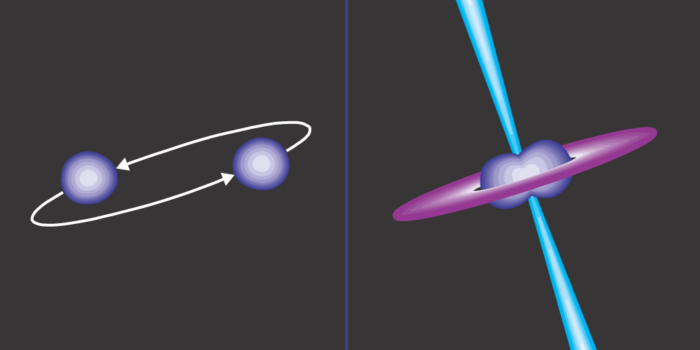
The new problem
Lack of very faint bursts implied they are not close by,
eventually confirmed by redshifts
So: They really are far away! What can do that?
Hypernova
Binary neutron star merger

Slide 12
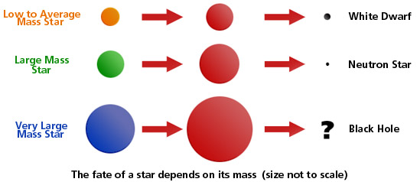
Stellar evolution made simple
Puff!
Bang!
Bang!
Stars like the Sun go gentle into that good night
More massive stars rage, rage against the dying of the light

Slide 13
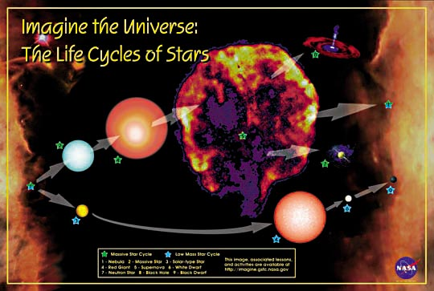
A more complicated view…

Slide 14
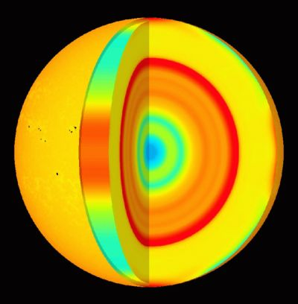
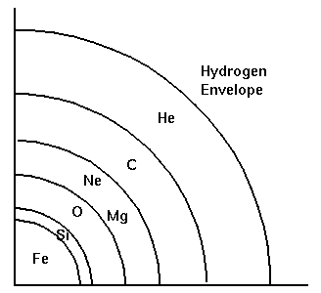
Disaster: creating a supernova
Massive star (>8 solar masses)
Fusion generates heat
Gravity inward balances pressure outward
Core fusion builds up “onion layers”
Iron builds up in core
Iron fusion robs core of electrons, heat
Collapse: Kaboom! Huge energies released:
  10⁵³ ergs, > Sun’s lifetime emission
Result: neutron star or black hole, expanding
  shell of radioactive matter which fades
  over months

Slide 15
Neutron Stars: Dense cinders
Mass: about 1.4 to 2.8 solar masses
Radius: 5 kilometers
Density: 10¹⁴ g/cm³ = atomic nucleus
Magnetic field: 10¹² gauss (Earth = 1 gauss)
Rotation rate: from 1000Hz to 0.08 Hz

Slide 16
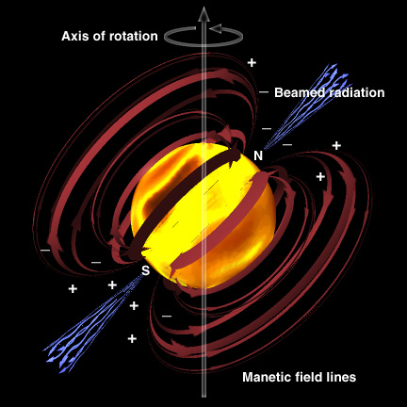
Pulsars are neutron stars

Slide 17
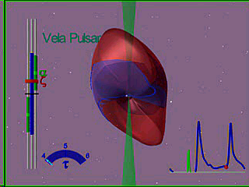
Radio and gamma ray pulses

Slide 18

Black holes
Defined: an object where the escape velocity
Is greater than the speed of light
V_{e} = (2 G m / r)^{1/2}
Schwarzschild radius = 2 G m/c²
R_{s} = 3 km for the Sun
Mass: > 3 to a few x 10⁹ solar masses

Slide 19
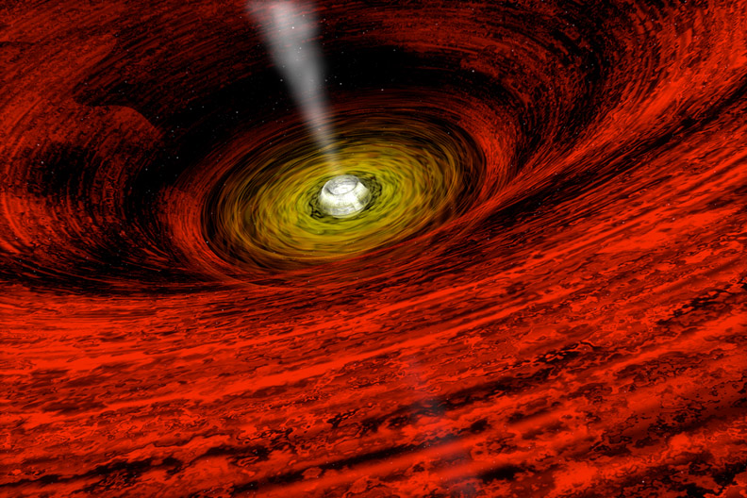
If they’re black, how come they’re so bright?
Accretion disks! Powered by gravity, heated by friction
An object falling in can create about 10% of rest mass into energy
1 marshmallow
= atomic bomb
(about 10 kilotons)

Slide 20
So, a supernova creating a neutron star
or black hole is a natural candidate for a
GRB progenitor
Energetics problem is even better if energy
is beamed! Don’t need as much energy, but
do need more GRBs

Slide 21
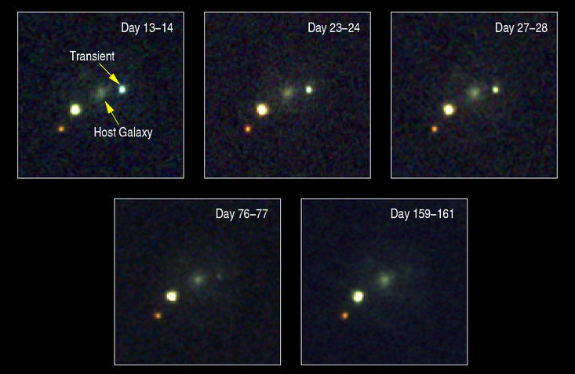
The Supernova Connection
GRB011121
Afterglow faded like supernova
Data showed presence of gas like a stellar wind
Indicates some sort of supernova and not a NS/NS merger

Slide 22
Not so fast, pardner!
The data seem to indicate two kinds of GRBs
Those with burst durations less than 2 seconds
Those with burst durations more than 2 seconds
Short bursts tend to produce “harder” gamma rays,
as predicted by the NS/NS merger model
Long bursts tend to produce “softer” gamma rays,
as predicted by the hypernova merger model
Clearly, more info is needed

Slide 23
How exactly does a supernova or
NS/NS merger turn into a GRB?
Good question. Wanna win the Rossi prize?
What we know:
Huge energies available for tapping
Gamma rays created in explosion through
interaction of shock wave and charged particles
Matter accelerated from 99.99% to 99.99999%
of speed of light
Beaming?

Slide 24
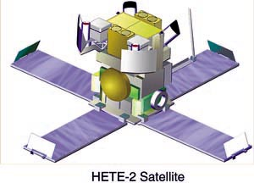
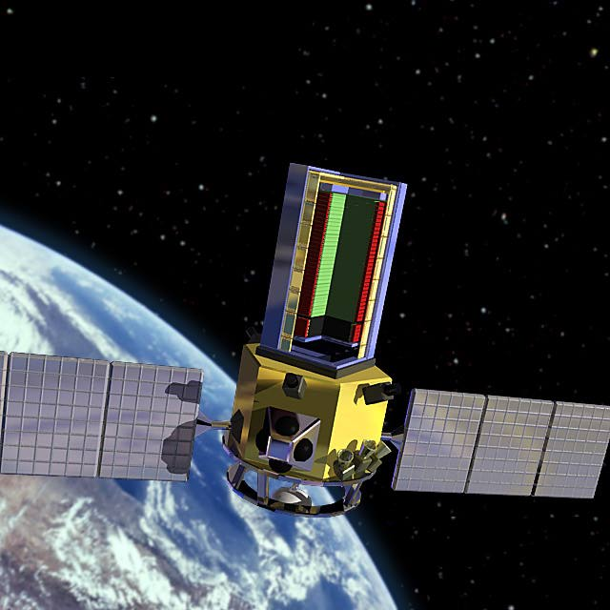
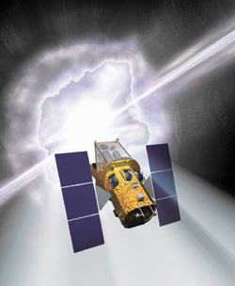
The high view: getting a better look
HETE-2
GLAST
Swift

