Slide 1


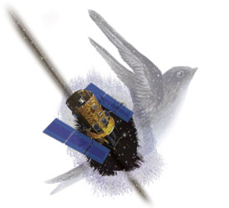
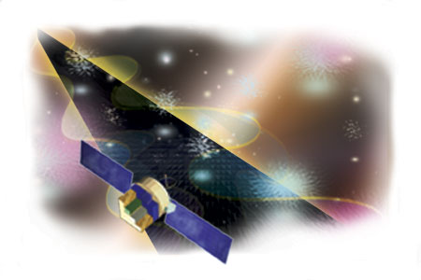
Swift and GLAST EPO at SSU
Lynn Cominsky
Sonoma State University

Slide 2






Swift/GLAST EPO
Goal: to use the observations and scientific discoveries of the Swift and GLAST missions to improve the understanding and utilization of science and mathematics concepts for grades 7-12 (Swift) or grades 9-12 (GLAST)
From the K-12 viewpoint – a gamma-ray is a gamma-ray!

Slide 3
Swift/GLAST EPO
Major Program Elements in common:
EPO Web Sites – both newly redesigned for LHEA CD
http://swift.sonoma.edu
http://www-glast.sonoma.edu
Monthly NASA Quest WebChats (9 in 00/01)
Poster and Teacher’s Guide sets, Manipulatives
Swift will focus on concepts (e.g., EM spectrum)
GLAST will focus on objects (e.g., AGN)
Educator Training at National and Regional Conferences
Gamma 2001: sponsored by GLAST - featured Swift materials on EM spectrum
NSTA, NCTM, CSTA, CMC, NBSP
Independent Assessment by WestEd

Slide 4
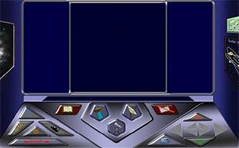
Swift/GLAST EPO
Space Mysteries – a planned series of 6 interactive, web-based modules that teach physical science and math at the high school level – http://mystery.sonoma.edu
Three more modules will be developed by
Swift and GLAST in 2003-2005
Alien Bandstand – try it!
Escape from the Doomed Planet – coming soon
Star Market Scandal

Slide 5
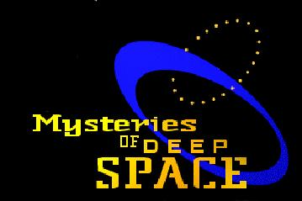
GLAST Unique Program Elements
PBS Television Special with Tom Lucas Productions
Telescope Network
High schools and amateurs
Will observe GRBs and AGNs
SLAC Virtual Visitor’s Center
Web site upgrade
Gamma-ray detector interactive pages
TOPS Science Printed Lesson Plans and Activities
GLAST Ambassadors Program
5🡪10 educators who will help develop, test and disseminate material

Slide 6

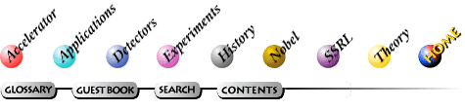


SLAC Virtual Visitor’s Center
http://www2.slac.stanford.edu/vvc/home.html

Slide 7
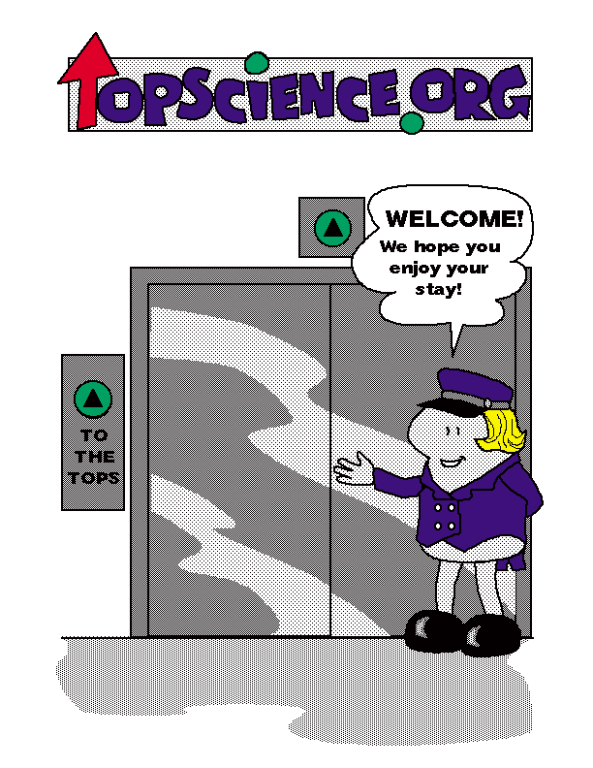
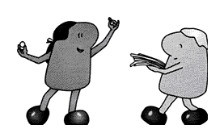
TOPS Learning Systems, Inc.
These are fun-loving folk of no particular age, race, political affiliation, or size. Because they are clever and brave, can change sizes and defy gravity, we let them demonstrate the "how to's" in all the books we publish. Their purpose in life is to help young people achieve success one step at a time.

