Slide 1
Swift Education Committee Meeting
Sonoma State University
Rohnert Park, CA
August 3, 2001

Slide 2
Mission Status

Slide 3
Mission Status Overview
• Last Critical Design Review held 12-13 July 2001
• Appraisal very positive
• “Now is the time to actually build the telescopes,
put them on the spacecraft, and launch!”
• Biggest challenge: getting everything built on time

Slide 4
Mission Status Overview
• Swift Science Team Meeting at the University of Leicester
held last week
• UVOT and XRT had pictures of real flight hardware to show
• BAT is being built from scratch
- ~ 29000 of the total 40,000 CZT detectors received
- detector order completed by mid-October 2001
- produce Engineering Test Unit detector blocks
Fall 2001
- deliver a total of 16 flight blocks by May 2002

Slide 5
Mission Status Overview
• XRT and UVOT will be delivered for integration into the instrument module in Spring 2002
• BAT will deliver mid-summer 2002

Slide 6
Mission Status Overview
• From August 2002 - launch, the various pieces of the mission will be put together and environmental tests performed
- integrate the BAT, XRT, and UVOT into the
instrument module
- Swift spacecraft will be shipped to GSFC from Spectrum Astro's Arizona facility
- instrument module inserted into the spacecraft
- perform integration and environmental testing at GSFC

Slide 7
Mission Status Overview
• Scientists are now transitioning from "how shall we build Swift?" to "how shall we USE Swift?"
• Work has begun on data analysis software
• Detailed discussions being held about how we will actually operate the instrument, how we will archive and release the data, and what we will do in the performance/verification phase of the mission right after launch.

Slide 8
Current Launch Date
September 30, 2003

Slide 9
Status of EPO Program

Slide 10
Program Components
Classroom materials
Teacher workshops
Web site
GEMS guide
ARP support
What’s in the News? Segments
Evaluation
Miscellaneous Stuff

Slide 11

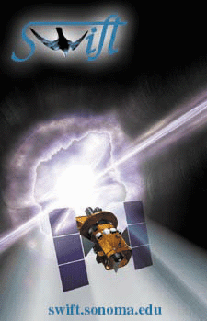
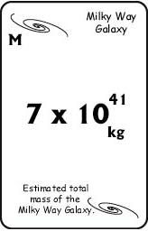
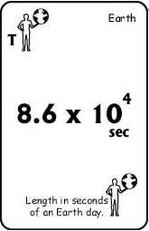
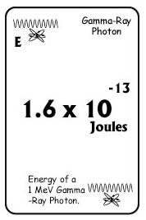
Status of EPO Projects
• Classroom Materials
- First materials are done; focus on “Waves and Wave Motion”
- Initial Evaluations completed
- Serve as focus of workshops Fall 01-Spring 02
- Material manufacturer includes us in marketing packet
- Submitted for blessing to OSS materials review

Slide 12

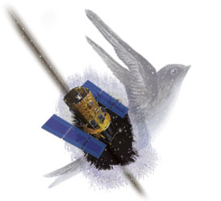
Status of EPO Projects
• Teacher Training
2000-2001 Workshops
done at
NCTM, NSTA, CMC,
CSTA, Gamma 2001,
HEAD, CAPI Hayward
Initial Evaluation results
In Your Classroom

Slide 13
Educator Workshops
When Who Where Attendees Mtg Size
Apr NSTA Orlando 15, 25 12,000
Apr NCTM Chicago 25 13,000
July NBSP Rohnert Park, CA 16, 12 -
July ARP State College, PA 25 -
Oct CSTA Sacramento, CA 30, 14 3,000
Nov HEAD Honolulu, HI 30 -
Dec CMC - North Asilomar, CA 65, 117 3,000
Mar NSTA St.Louis. MO 30, 30 11,300
Apr NCTM Orlando, FL 80, 50 13,000
Apr GAMMA 2001 Baltimore, MD 25 -
Jun CAPI Hayward, CA 200 -
Jun NASA/MSS Charleston, SC 30 -

Slide 14

Status of EPO Projects
GEMS Guide
Working title: The Invisible Universe
Authors:
Stephen Pompea and
Alan Gould
First draft completed;
on schedule for
publication Spring 03
Field testing in northern
CA competed
National field testing
begins Fall 01

Slide 15
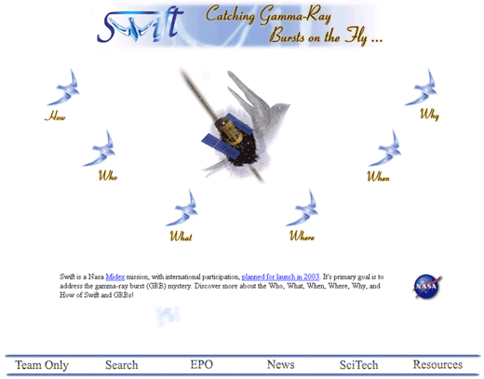
Status of EPO Projects
• Web Site
- NASA Quest Chats held monthly
(alternating with GLAST)
9/00-6/01
- New web site put online April 01
- EPO section contains new
classroom materials
- Cosmic Lottery activity online
Fall 01
- Statistics being collected
starting May 01

Slide 16
Status of EPO Projects
EPO program is on track and moving forward (cont)
Appalachian Region Project
GRB materials included on a day in Summer 00
Swift plays a larger role in Summer 01
On track to have 1-week workshop by 03
What’s in the News? Programs
First programs have aired: January and April 01
New Season begins in August 01

Slide 17
Evaluation
Surveys created, administered, and analyzed by WestEd
Workshops on Black Holes
NSTA, NCTM Spring 01
Workshops on Waves and Wave Motions
Gamma 2001
Classroom Observations of use of Materials
Who’s Got the Power? Cards
9th graders in Santa Rosa, CA

Slide 18
Near-Term Plans
Joint exhibit with GLAST
Southern Regional NSTA
Memphis, TN, 6-8 December 2001
California Science Teachers Association
Palm Springs, CA 24-26 October 2001
Online Evaluation
Survey developed by WestEd
Will allow educators who access materials online to submit feedback
Online August 01

Slide 19
Near-Term Plans
Scheduled Workshops
CSTA
Palm Springs, CA; Oct 01
CMC
Asilomar, CA; Dec 01
NSTA
San Diego, CA; Mar 02
NCTM
Las Vegas, NV; Apr 02
NSTA Western Regional
Portland, OR; Nov 02

Slide 20
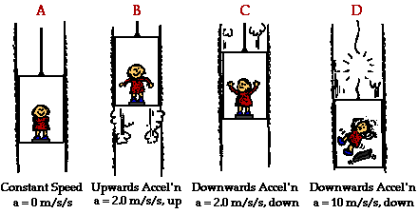
Near-Term Plans
New Classroom Materials
Ready in late-Spring 2002
Focus on “Forces and Motion”
Will serve as seed of workshops for Fall 02-Spring 03

Slide 21
Future Materials
• 2003 materials focus on
“interaction of matter and energy”
• Later materials based on post-launch data, results

Slide 22
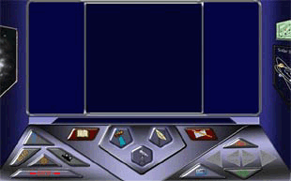
Near-Term Plans
• Space Mystery
- Will join 3 existing
modules funded by
NASA LEARNERS
- Work begins
October 2002
- Beta test version
Fall 03
- Final version
online Spring 04
- Project completed by 2 modules funded by GLAST 04 - 06
http://mystery.sonoma.edu

Slide 23
Summary
All parts of the EPO program are underway
Materials are on the street
Evaluations are being done
Initial results are positive
Long-term EPO plan is in place
Focus of materials is set
Collaboration with GLAST
Participation with SEU Forum, other missions is strong
Communication within EPO team is established

