Slide 1
The Swift Education and Public Outreach Program
Lynn Cominsky
Sonoma State University
October 20, 2003

Slide 2
Program Overview
Swift E/PO Web site (http://swift.sonoma.edu)
Printed materials
Teacher’s activity booklets and posters
Educator training
Conference workshops
Educator Ambassadors
Informal Education
What’s in the News? (PSU)
Program Evaluation
Future Plans

Slide 3
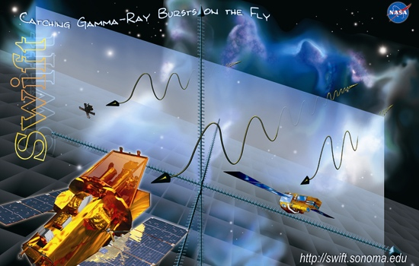
Swift mini-plot pads
Newest Giveaway –at Santa Fe GRB meeting
Graphic is going to be used for new Swift educational wallsheet that accompanies GRB Educator’s Guide
Plot goes here

Slide 4
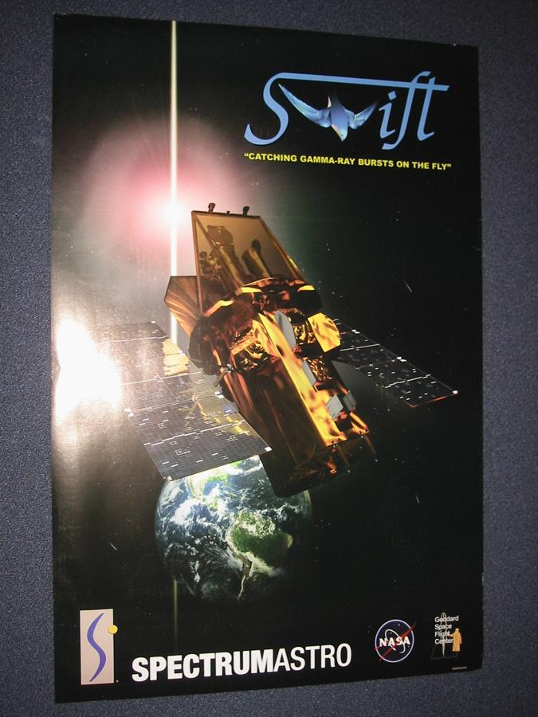
Swift spacecraft poster
Produced by Spectrum Astro
Debuted at Santa Fe GRB meeting

Slide 5
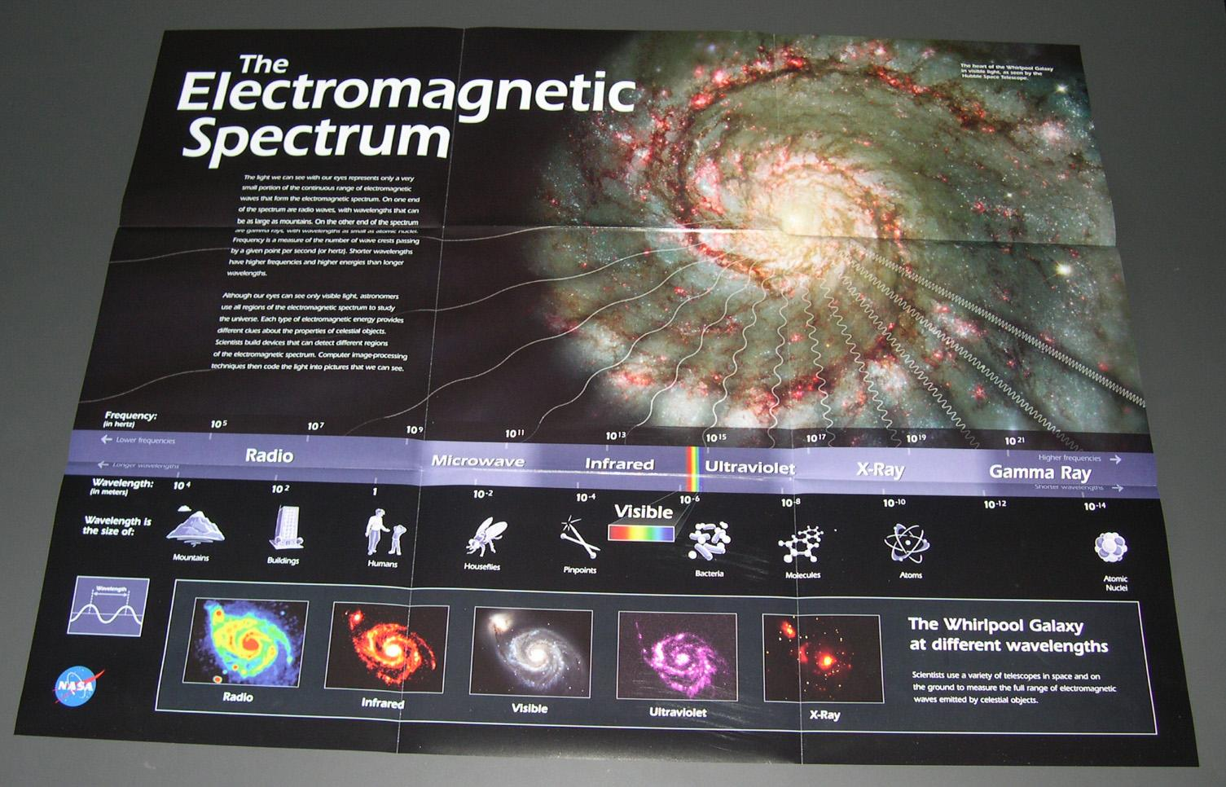
EM Spectrum poster
Produced by Origins Education Forum
Has Swift GEMS #2 activity on the back
Distributed in the 10/03 NSTA Science Teacher (High School)
Distributed in the 5/03 NSTA Science Scope (middle school)
40,000 teachers!

Slide 6
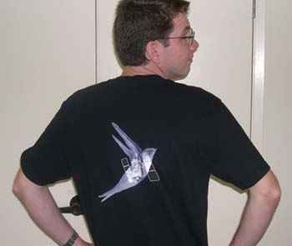
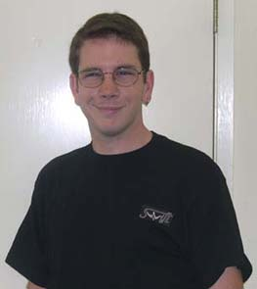
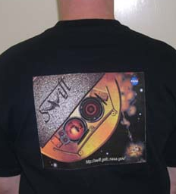
Swift T-Shirts
Ready for launch
Will be available at cost
We need to finalize design!

Slide 7
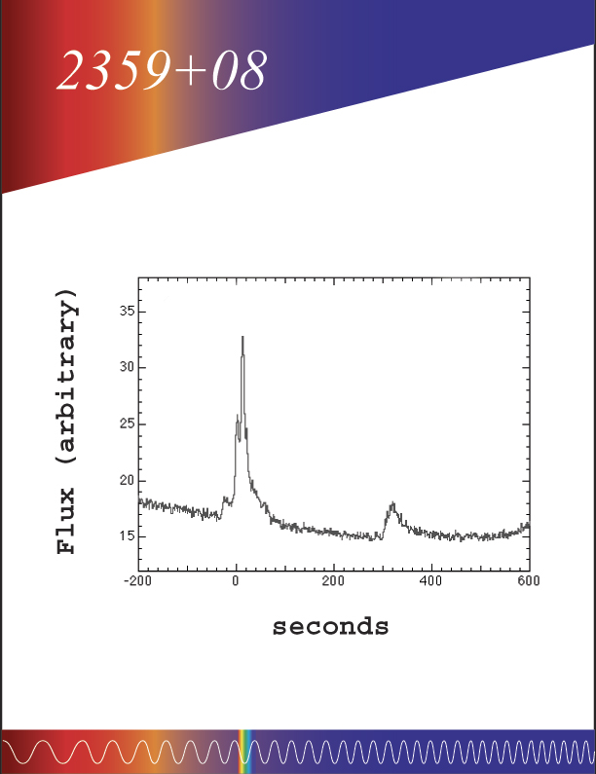
New Educator’s Guide
Gamma-ray Burst Educator’s Guide in progress
Aligned with mathematics standards
All activities now tested in classrooms or by SwEC – revisions underway

Slide 8
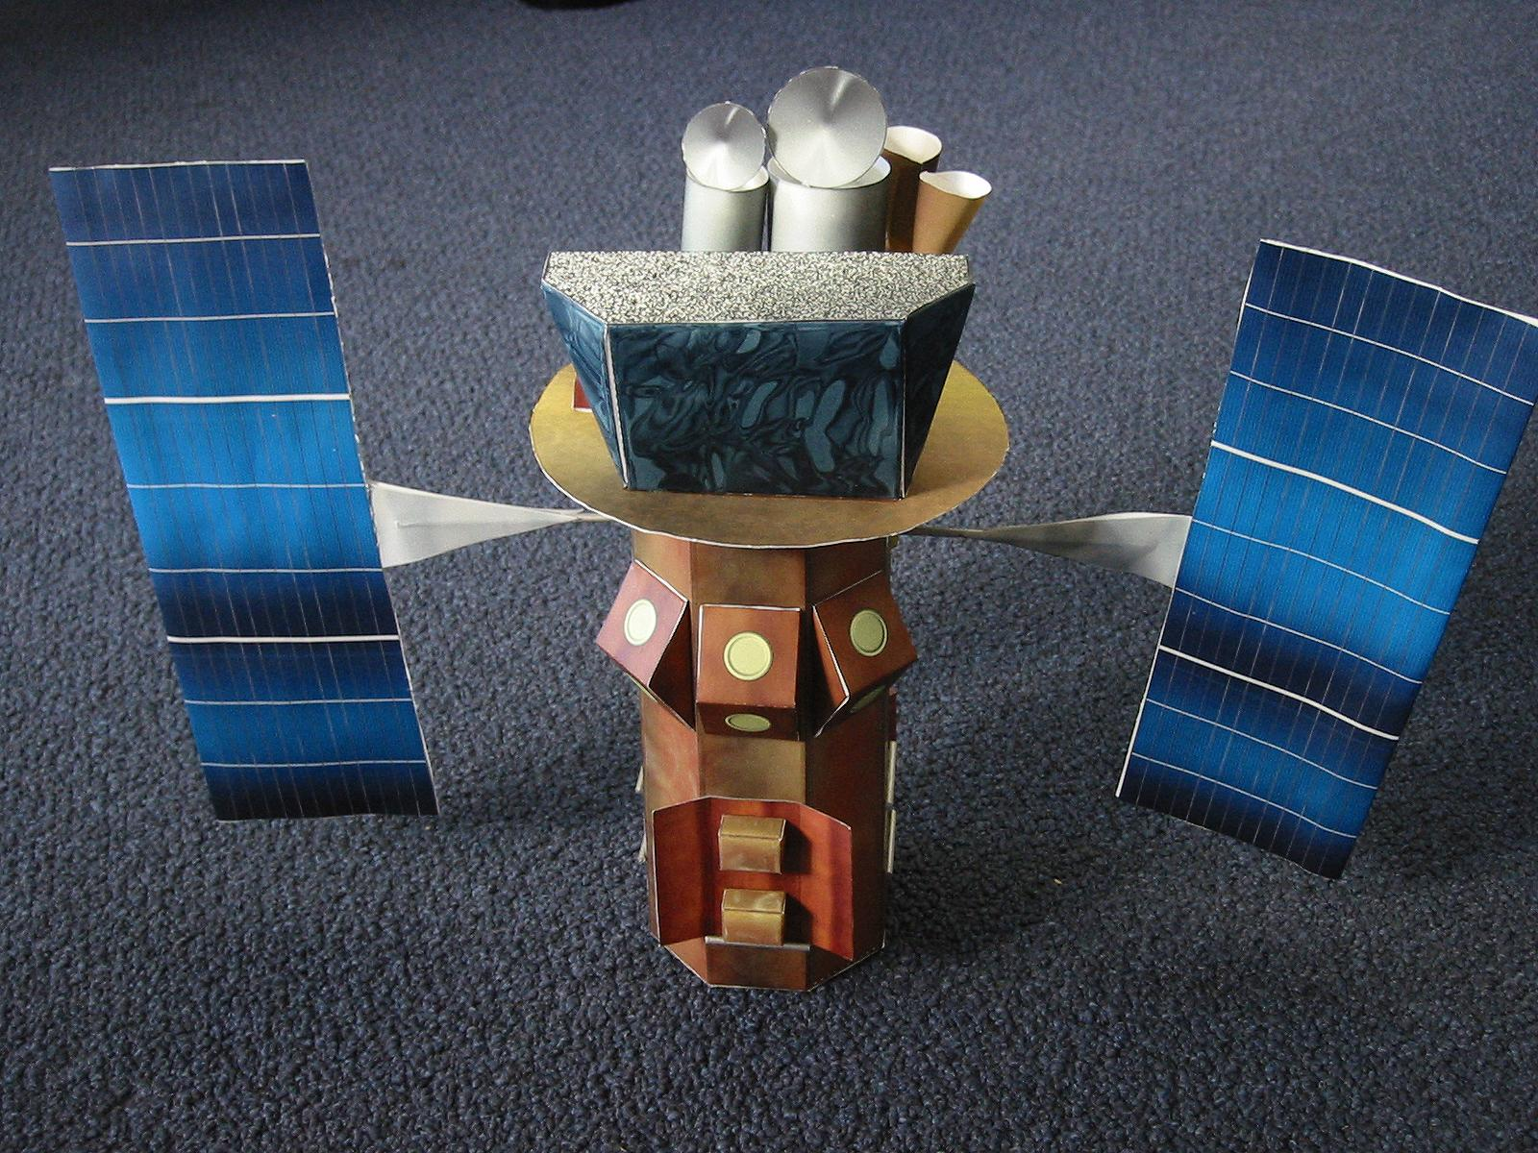
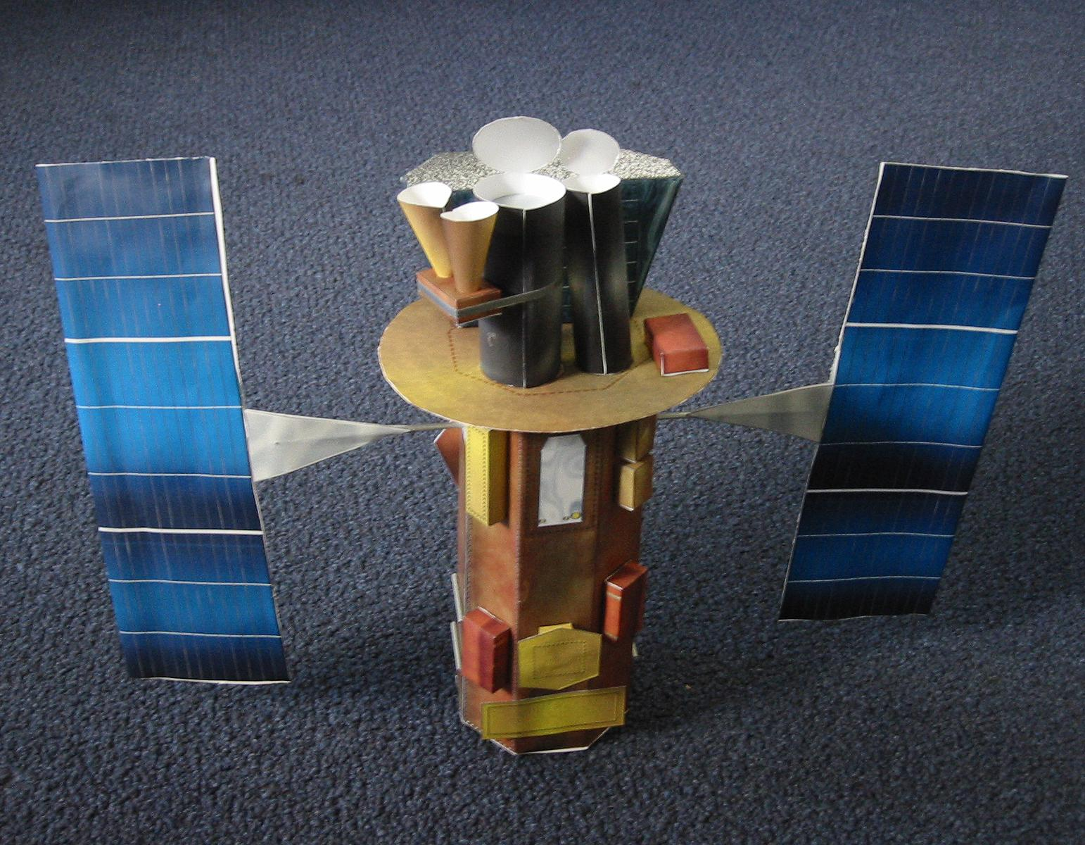
Swift model booklet
Based on Monica Sperandio’s concept (Italian)
Now ready for review

Slide 9
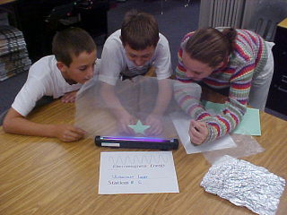
Reaching OUT – CSTA 10/03
GEMS #2 presented 10/11/03 by Cominsky and Silva
Cosmic Zoo presented 10/12/03 by Plait and Silva
About 40 teachers in attendance for each
Both workshops evaluated by WestEd (Cathy Ringstaff)
Swift materials handed out at CSTA booth
Beier’s students doing GEMS #2 activity

Slide 10
Reaching OUT
Swift/GLAST booth at:
AAS (Nashville) (5/03)
GRB conference in Santa Fe (9/03)
California Science Teachers Association Meeting (10/03)
Totals for FY2003
15 Presentations to students and the public 🡪
1569 participants
26 Teachers workshops 🡪 2369 participants
Origins EM posters 🡪
40,000 teachers
4 Swift WITN?🡪 20,000,000

Slide 11
Materials Distributed (FY2002-FY2003)
Newton's Laws Poster Sets 4500
Spin A Spectrum Booklets 7300
Spin a Spectrum Wheels 4850
Waves booklets & Slinkies 5000
Who’s got the power booklets and card sets 5000
Mousepads 1950
Miniplots 300
GEMS 1700
E/PO Flyers 800
Our web order form has sent 10,903 Swift items to date

Slide 12
Educator Ambassador Presentations (since 04/03)
04/05/03: McEntyre presented, "NASA's Swift Mission and Gamma Ray Astronomy" to the National Congress on Aviation and Space Education in Cincinnati, National HQ Civil Air Patrol /TW to ~16 K-12 teachers.
04/05/03: Sparks presented "Bringing Modern Astronomy Into the Classroom“ at the AAPT- Spring Meeting 2003 in Florida to ~51 teachers.
04/15/03: Beier presented “Invisible Universe” at Rockhurst University in Kansas City, MO to ~24 teachers.

Slide 13
Educator Ambassador Presentations (since 04/03)
05/03/03: Sparks presented "Swift and SEU Missions in Education," at the North Central Region of the Astronomical League Annual Convention in WI to ~31 teachers.
05/23/03: Beier presented “Invisible Universe” at Rockhurst University in Kansas City, MO to ~28 teachers
05/31/03: McEntyre did a workshop at Challenger Learner Center in KY with ~ 11 teachers.
07/24/03: McEntyre did a Space and Astronomy Workshop in Western Kentucky University at Bowling Green, Kentucky with ~22 teachers.

Slide 14
Educator Ambassador Presentations (since 04/03)
09/12/03: Sparks presented "Swift: Catching Gamma Ray Bursts on the Fly" at Skokie Valley Astronomy Club in WI to ~31 teachers.
09/15/03: Beier presented “Adventures in Air and Space,” an Invisible Universe and Gems Workshop in Liberty, MO to ~25 teachers.
09/20/03: Sparks attended Astrofest: A panel discussion about the SEU Outreach and the GTN in Kanakee, IL with ~80 teachers.

Slide 15
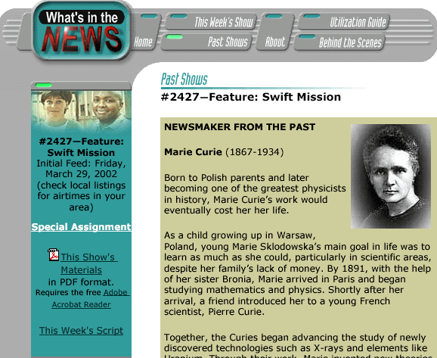
For FY03, 4 pieces focused on GRBs
05/09/03: Hunt for Gamma Ray Bursts
05/02/03: The birth and death of stars and Swift observations
04/04/03:Gamma Ray Burst History
03/21/03: Mapping of Ancient Universe
First segment for FY04 already drafted, and under production
Deals with Swift environmental testing

Slide 16
Program Evaluation
WestEd evaluations during FY2003
AAPT workshop at the AAPT in January 2003
The Swift Gamma-ray burst activities draft
Newton’s Laws Poster set (focus group telecon in 11/03)
Preliminary Swift Launch plans
SwEC
Met at SSU in 8/03 – report now available
Two master teachers have agreed to become Educator Ambassadors, joining existing two EAs

Slide 17
Program Evaluation
SwEC evaluated old Swift E/PO products
Who’s got the power? – will not be continued
Spin a Spectrum – may be useful for language arts/literacy integration
Waves Light Up the Universe – superceded by GEMS
Newton’s Laws posters
Evaluated by NASA OSS Education Review process
7 reviewers included teachers and scientists
Several errors were found in content – not recommended for distribution – Major revisions were required
Poster art is very popular, however.
SwEC will advise about the future of this product

Slide 18
Status of Near-Future Plans
Draft of Educator’s Guide will be circulated for review by 1/04
Swift Model Booklet now ready for review
Swift team members needed to review both
PLEASE HELP!!
Swift launch plans still in progress – contest?
Essay contest for students – winner attends launch?
Drawing contest instead?

Slide 19
Preliminary Launch Plans
GRB Educator’s Guide available
New Swift poster with GRB activity on back
Public outreach program that focuses on launch
Swift model booklet available
Swift launch filmed for PBS Nova show by Tom Lucas (in conjunction with GLAST)
Tee-shirts!

