Slide 1
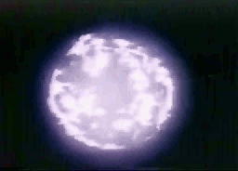
Gamma-ray Astronomy
(The Short Story…)

Slide 2
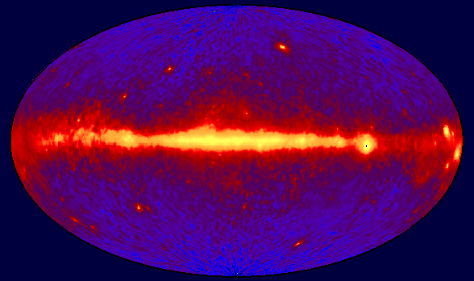
The Big Picture
Whole sky glows
Extreme environments
Probes of the Universe
CGRO/EGRET All Sky Map

Slide 3
Early Gamma-ray Astronomy
• Gamma-ray Bursts
  Vela Program : A Bomb or Not a Bomb?
  A few hundred events, a few hundred theories
Gamma-ray Sources
  SAS-2 – discovered 2 pulsars (1972)
  COS-B – about 25 sources (1975-82)
  Most unidentified, but 1 quasar
  Diffuse extra-galactic background

Slide 4
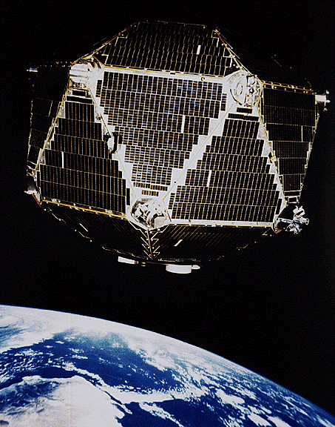
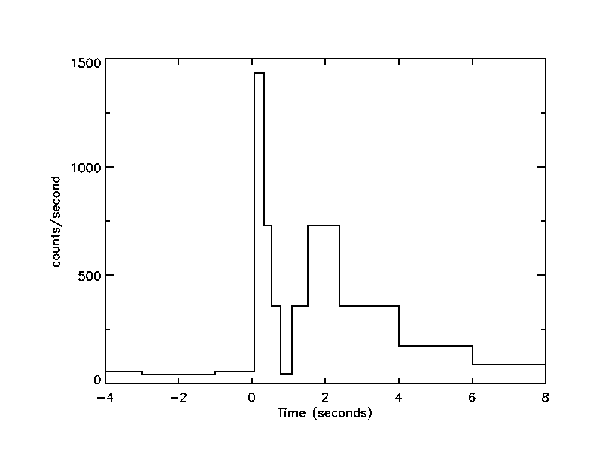
Vela Program (1969-1979)

Slide 5
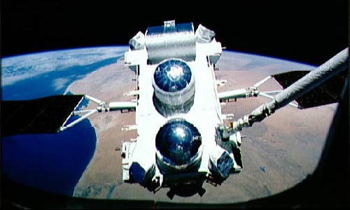
CGRO (1991-2000)

Slide 6
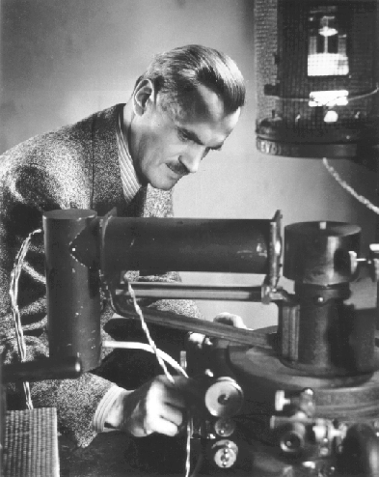
Dr. Arthur Holly Compton
1927 Nobel Prize for Compton Effect
First experimental proof of dual wave and particle nature of light

Slide 7

Sources of γ-ray Emission
• Black holes
• Active Galaxies
• Pulsars
• Gamma-ray bursts
• Diffuse emission
• Supernovae
• Unidentified

Slide 8
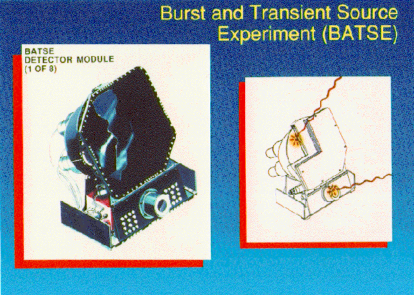
BATSE
Notes:
Each detector module contains two NaI(Tl) scintillation detectors: a Large Area Detector (LAD) optimized for sensitivity and directional response, and a Spectroscopy Detector (SD) optimized for energy coverage and energy resolution.

Slide 9
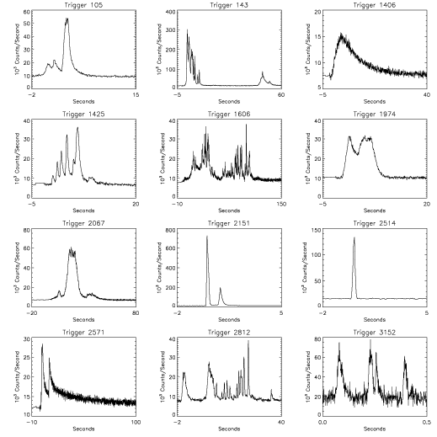
Gamma-Ray Bursts

Slide 10
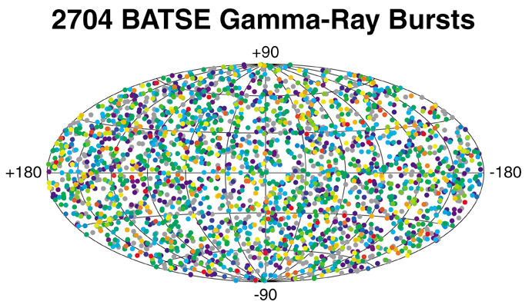

Distribution of GRBs in the Sky

Slide 11
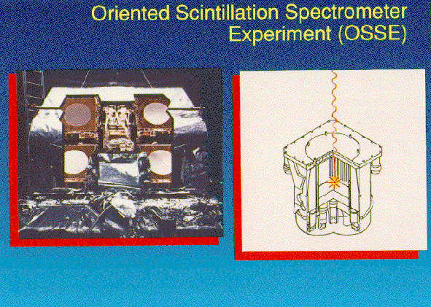
OSSE
Notes:
The primary element of each of the four detector systems is the NaI(Tl) portion of a 330-mm diameter NaI(Tl)-CsI(Na) phoswich consisting of a 102-mm thick NaI(Tl) crystal optically coupled to a 76-mm thick CsI(Na) crystal. Each phoswich is viewed from the CsI face by seven 89-mm diameter photomultiplier tubes (PMTs), providing an energy resolution of 8% at 0.661 MeV.

Slide 12
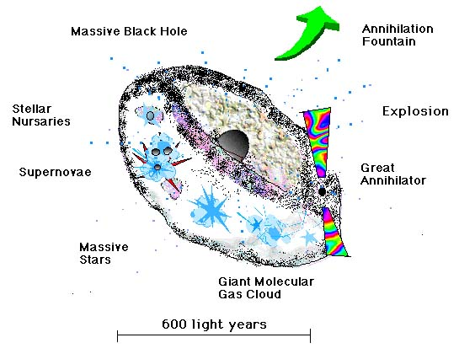
The Galactic Center Region

Slide 13
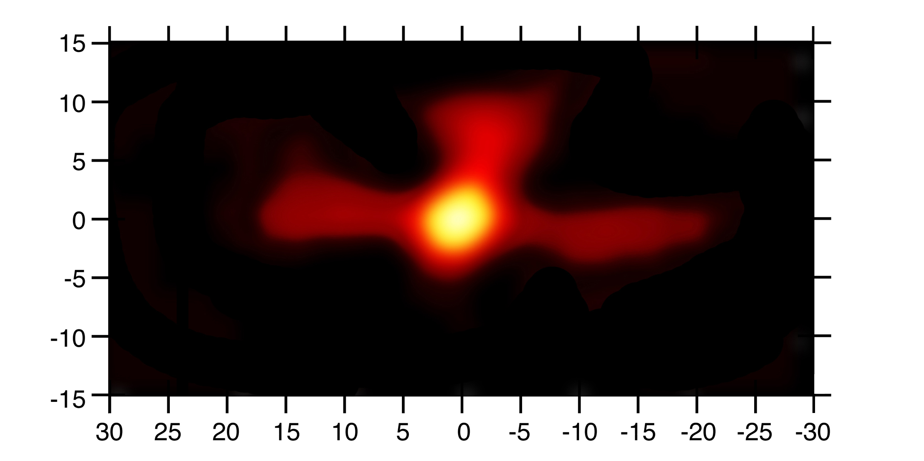
Antimatter Fountain in the Center of Milky Way

Slide 14
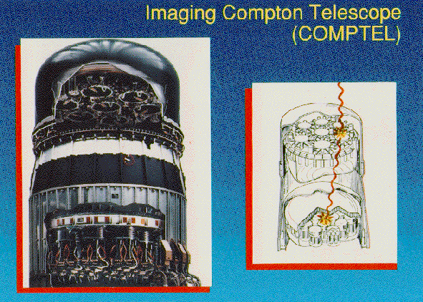
COMPTEL
Notes:
COMPTEL consists of two detector arrays. In the upper (D1) array, a liquid scintillator, NE 213A, is used and, in the lower (D2) array, NaI crystals. Gamma-rays are detected by two successive interactions: an incident cosmic gamma-ray is first Compton-scattered in the upper detector, then totally absorbed in the lower. The locations of the interactions and energy losses in both detectors are measured.

Slide 15
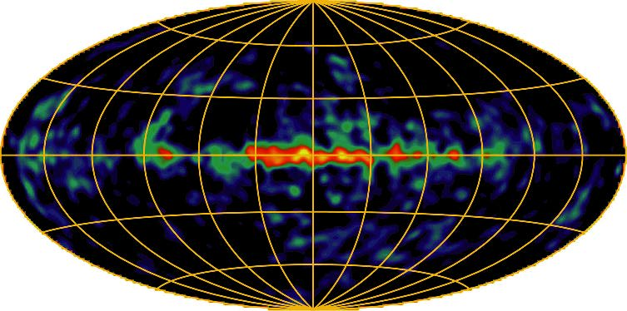
²⁶Al COMPTEL sky map
Notes:
First COMPTEL map of the plane of the Milky Way Galaxy in the emission of 1.809-MeV gamma-rays from the radioactive decay of 26-Aluminum. This high-energy emission traces nucleosynthesis in our Galaxy over the last few million years. The irregular and asymmetric appearance suggests that localized regions contribute substantially to the observed emission, in addition to the smooth distribution expected from at least 10,000 Galaxy-wide nucleosynthetic events (i.e., novae and supernovae).

Slide 16
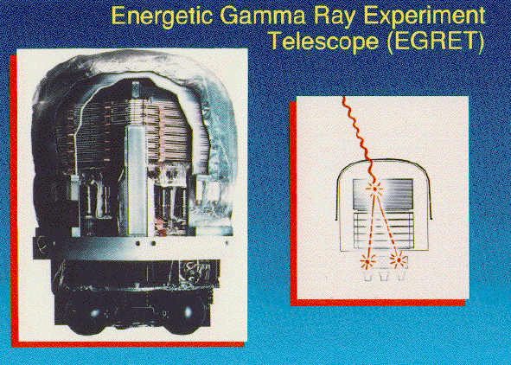
EGRET

Slide 17
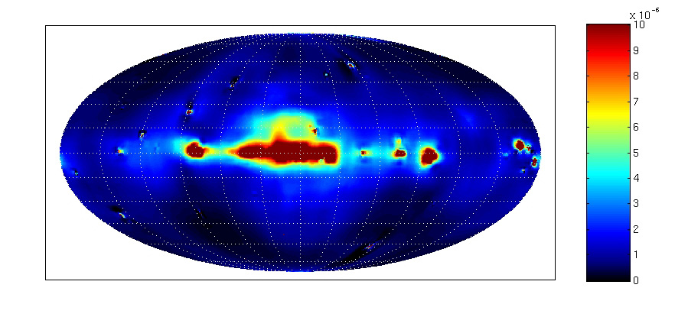
High Energy Halo around
Milky Way
Courtesy of D. Dixon, University of California, Riverside

Slide 18
Gamma-ray Burst Progress
Beppo/SAX finds evidence for X-ray afterglow from several GRBs (2/28/97)
Jan van Paradijs finds optical afterglow
Redshifts indicate cosmological distances (Keck, HST)
ROTSE catches GRB in the act at visible wavelengths (1/23/99)
Evidence mounts for two types of GRBs

Slide 19
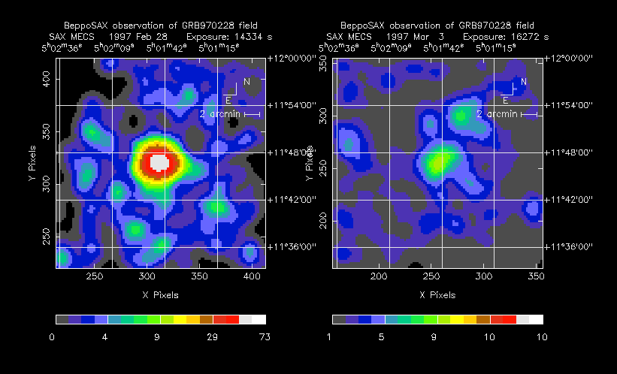
What BeppoSAX Saw

Slide 20
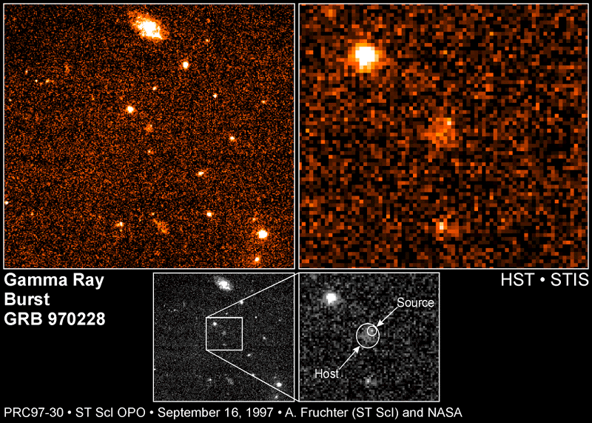
What HST Saw (Much Later)

Slide 21
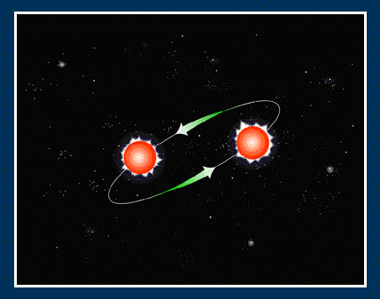
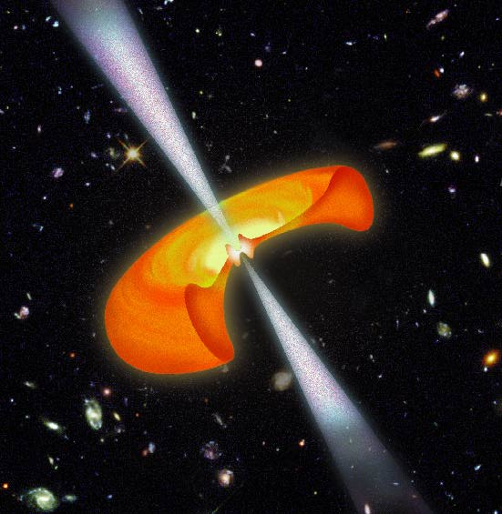
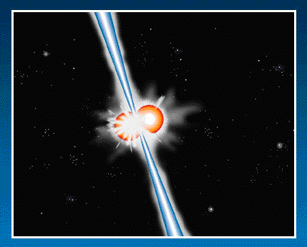
Models for GRBs
Hypernova
Merging Neutron Stars

Slide 22
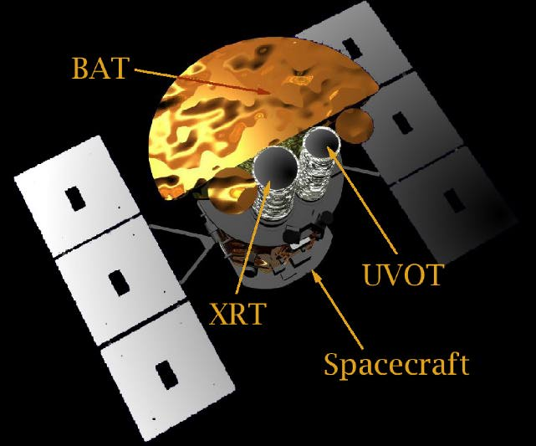
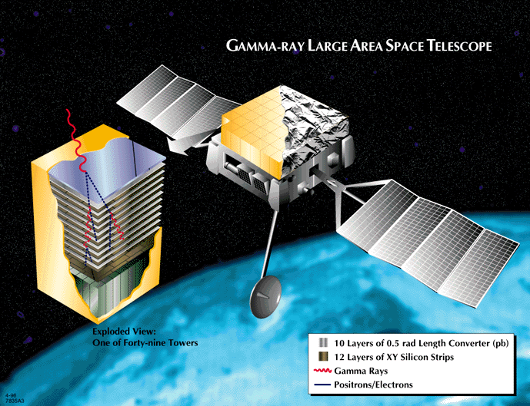
New Missions = Better Data
HETE II (launched 10/9/00)
INTEGRAL (2001)
Swift (2003)
GLAST (2005)
Swift

Slide 23

Repoints within 50 s after detecting GRB to obtain X-ray and optical data
Detects about 300 GRBs per year and their afterglows
Sends initial coordinates of burst to ground within 15 s
Sends high resolution coordinates of GRB to ground within 50 s
Determines distance to burst within 1000 seconds
Notes:
The Swift Gamma Ray Burst Explorer has a complement of three coaligned instruments: the BAT, XRT, and UVOT. The XRT and UVOT are an X-ray and a UV/optical focusing telescope which will produce arcsecond positions and multiwavelength lightcurves for gamma ray Burst (GRB) afterglows. Broad band afterglow spectroscopy will produce redshifts for the majority of GRBs. BAT is a wide Field-Of-View (FOV) coded-aperture gamma ray imager that will produce arcminute GRB positions onboard within 10 seconds. The spacecraft will execute a rapid autonomous slew that will point the focusing telescopes at the BAT position in typically ~ 50s.

Slide 24

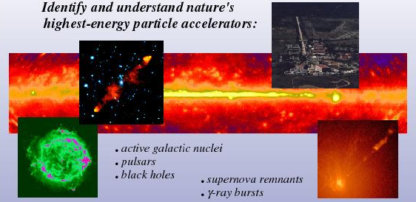
Science
Explore the era of star formation in the universe, the physics of dark matter and the creation and evolution of galaxies

Slide 25
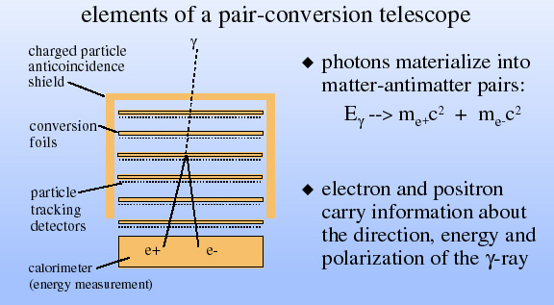
GLAST design

Slide 26
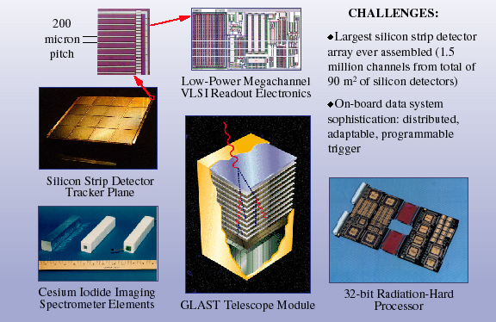
GLAST Technologies

Slide 27
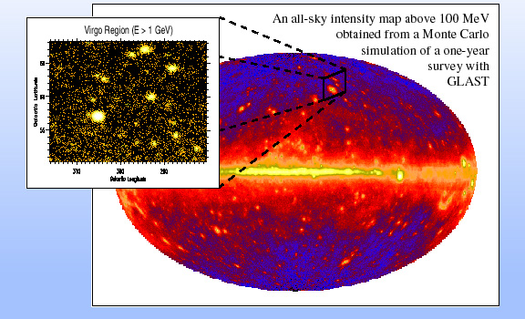
GLAST All Sky Map

Slide 28
For More Information
Imagine the Universe! - http://imagine.gsfc.nasa.gov/
Swift Mission - http://swift.sonoma.edu/
GLAST Mission - http://ww-glast.sonoma.edu/
CGRO Mission - http://cossc.gsfc.nasa.gov

