Slide 1
Waves Light Up the Universe!
Dr. Phil Plait
Sonoma State University
Dr. Laura A. Whitlock
Sonoma State University
Kara C. Granger
Maria Carrillo HS

Slide 2
The Universe is a VERY Big Place
13 billion light-years
(or about 100,000,000,000,000,000,000,000 kilometers)
It is full of VERY big numbers!
2.7 - 10,000,000,000 Kelvin temperatures
0.000000001 - 1,000,000,000,000 Gauss magnetic fields
100,000,000,000 - 1,000,000,000,000 stars in a galaxy
1,000,000,000,000 galaxies

Slide 3
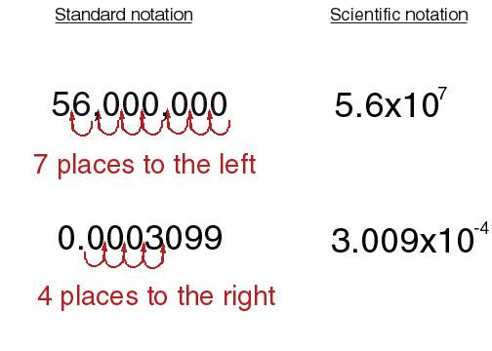
Scientific Notation is Required!

Slide 4
Rules for Scientific Notation
10^{n} means 10 x 10 x 10 x 10 … [n times]
10^{-n} means 1/(10 x 10 x 10 ….) [n times]
To Multiply & Divide
10ª •10^{b} = 10 ^{a + b}
10ª ÷10^{b} = 10 ^{a - b}

Slide 5
So now, we can say….
• 10¹¹ - 10¹² stars in a galaxy
• 10¹² Gauss magnetic fields
• 10⁻⁷ m wavelengths
• 10²⁰ Hz frequencies
And now, we can ask….
Who's Got the Power?

Slide 6
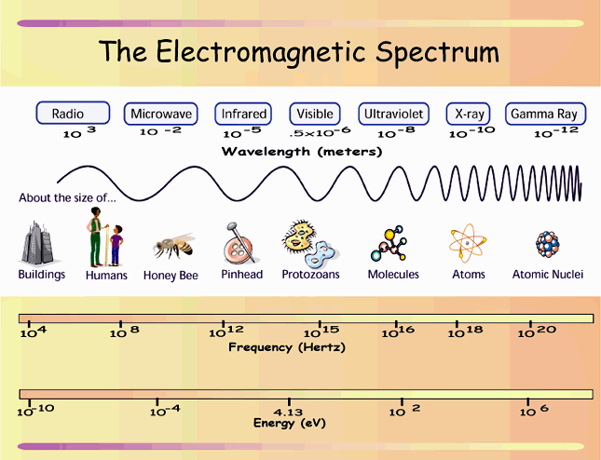
EM Spectrum Probes the Universe

Slide 7
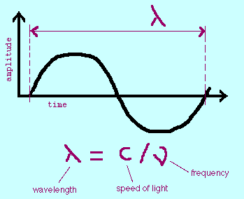
EM Radiation Travels as a Wave
c = 3 x 10⁸ m/s
It’s not just a good idea, it’s the law!

Slide 8
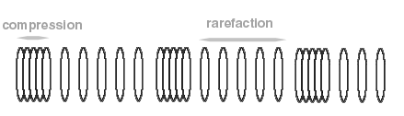
Understanding Waves
• Longitudinal waves - displacement is in same direction
as the wave motion
• Example: sound waves
• Obeys the equation λν = v, where λ is the wavelength,
ν is the frequency, and v is the velocity.

Slide 9
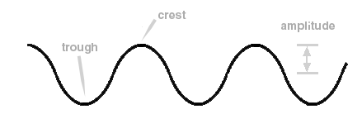
Understanding Waves
• Transverse Waves - displacement is perpendicular to
the direction of motion of the wave
• Example: Light
• Obeys the equation λν = v, where λ is the wavelength,
ν is the frequency, and v is the velocity.

Slide 10
Special Things About a Light Wave
• It does not need a medium through which to travel
• It travels with its highest velocity in a vacuum
• Its highest velocity is the speed of light, c,
equal to 300,000 km/sec
• The frequency (or wavelength) of the wave determines
whether we call it radio, infrared, visible, ultraviolet,
X-ray or gamma-ray.

Slide 11
Time for the Slinky!
Procedure:
The experiments described below are best done in groups of 3 :
"shaker", "holder" and "observer/recorder".
I. Longitudinal Waves
Pull the spring out to a length of about 2 meters. With your free hand, grasp
the stretched spring about 50 cm from one end. Pull the meter of spring together
toward yourself and then release it. Notice the single wave, called a pulse, travel
along the spring. In such a longitudinal pulse, the spring coils move back and forth
along the same direction as the wave travels. The wave carries energy, but the
spring remains stationary after the pulse has passed through it and reflected from
the other end.

Slide 12
More Fun With the Slinky
II. Transverse Waves
• Practice moving your hand very quickly back and forth at right angles to the stretched
spring until you can produce a pulse that travels down only one side of the spring
(that is, the bump on the spring due to the pulse is only on the right or left side of the
spring).
Does the pulse reflected from the far end return to you on the same side of the
spring as the original, or on the opposite side? Why?
• Have your partner send a pulse on the same side at the same instant you do, so
that the two pulses meet. The interaction of the two pulses is called interference.
(It will be easier to see what happens in the interaction if one pulse is larger than
the other. )
What happens when the two pulses reach the center of the spring?
Describe the size, shape, speed and direction of each pulse during and after the
interaction.

Slide 13
End of the Slinky Fun
• Send a pulse down the right side and have your partner send another down the
left side at the same time.
What happens when two pulses on opposite sides of the spring meet?
From your observations, what can you say about the displacement caused by
the addition of two pulses at the same point?
• By vibrating your hand steadily back and forth, you can produce a train of pulses,
or a periodic wave. The distance between any two neighboring crests on such a
periodic wave is the wavelength. The rate at which you vibrate the spring will
determine the frequency of the periodic wave. Produce various short bursts of
periodic waves so that you can answer the following question.
How does the wavelength depend on the frequency?
Feel It, Remember It!

Slide 14
EM Radiation Carries Energy
• Quantum mechanics tells us that for photons E = hν
• But remember that ν = c/λ
• Putting these equations together, we see that
E = hc/λ
high frequency = high energy = short wavelength
low frequency = low energy = long wavelength

Slide 15
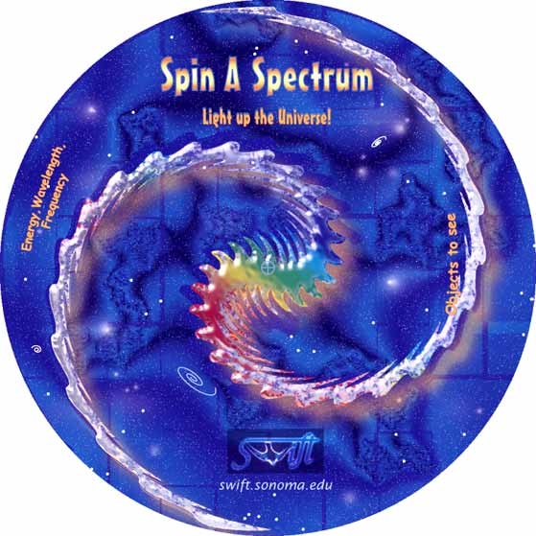
Spin-A-Spectrum
• Regions of the
EM spectrum
• Energy, Frequency,
Wavelength of each
region
• Objects in the universe
best observed in each
region

Slide 16
Mystery #1
The North Point broadcasting bureau was about to bring the
local radio station, FM100.3 on the radio dial, back on-air after
a short period of maintenance and updating during the Fall of
2000. As it approached twelve, radios were switched on all over
town. The police chief dialed into the radio station’s frequency,
as he was waiting at a stop light, but the reception was distorted.
“How disappointing,” he thought, “the updating was supposed
to improve things - but I think this is clearly worse!” The Chief
radioed into the station to see if anyone else had reported any
problems. The dispatcher laughed, then said, “Try pulling the
car forward a couple of meters.” Has the dispatcher lost his mind
(and probably his job)? Or is there a method to his madness?

Slide 17
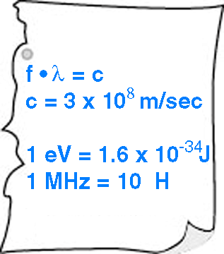
Hints

Slide 18
Solution #1
A radio wave at a frequency of 100.3 MHz corresponds to
a wavelength of 2.99 meters. Usually, you lose the signal
when your antenna is sitting where the wave you are trying
to detect is destructively interfering with itself. So, to increase
your signal, you just need to pull forward about 1/2 a
wavelength, or about 1.5 meters in this case.

Slide 19
Mystery #2
The Swift satellite had reported a major gamma-ray burst, with
a total radiant energy of over 10⁴⁷ Joules, occurred at a location
only 5 x 10¹³ km away from the AstroFleet outpost on planet Beta Omega. Knowing such an event would be catastrophic to life there, the Emergency Recovery Crew was dispatched.
Arriving at the planet, the scene was overwhelming. Even inside
the protective confines of the outpost lab, the short wavelength
waves (gamma rays are less than _______m) had penetrated
and killed. The energy of each photon (a 5 x 10⁻¹⁴ m gamma
ray has ______eV of energy) was just too much. “Why didn’t
they evacuate before this happened?”, cried Engineer Rowell.
“I guess there was just not enough time to react.”

Slide 20
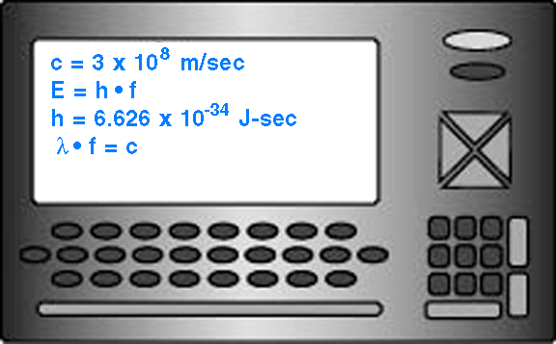
Hints

Slide 21
Solution #2
10⁻¹² m
2.5 x10⁷ eV or 25 MeV

Slide 22
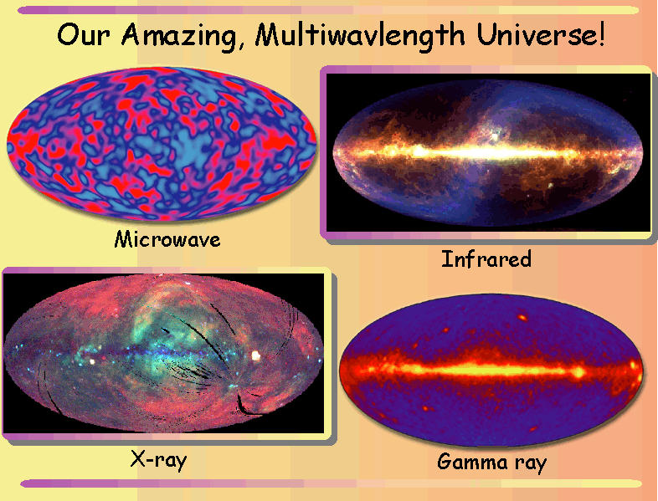
Waves Light Up the Universe!

