Slide 1

Data Carpentry
Data Organization in Spreadsheets

Slide 2
Introduction

Slide 3
Introduction
Good data organization is the foundation of any research project. Much of your time as a researcher is spent in ‘data wrangling’.

Slide 4
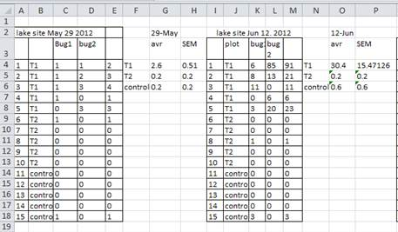
Data entry and organization is the start of any computational project
We often start by entering data into spreadsheets
or getting tabular data from others or instruments
Notes:
How many people use spreadsheets in their work?
How many people have done something with spreadsheets that made them frustrated or sad?

Slide 5
How many people use spreadsheets in their work?

Slide 6
How many people have done something in spreadsheets that made them frustrated or sad?

Slide 7


How many people have done something in spreadsheets that made them frustrated or sad?
We all use spreadsheets, but already know some of their limitations

Slide 8
What this lesson teaches
Principles of data organization, cleaning, saving and sharing
We’ll teach how to think about data organization and some practices for more effective data wrangling.

Slide 9
What this lesson doesn’t teach
How to do analysis, plotting, statistics or write code in spreadsheets

Slide 10
Why don’t we teach this?
This lesson is designed to help you move beyond spreadsheets to use other tools that allow you to work more effectively and reproducibly
Data analysis in spreadsheets usually requires a lot of manual work. If you want to change a parameter or run an analyses with a new dataset, you usually have to redo everything by hand. (We do know that you can create macros, but see the next point.)
It is also difficult to track or reproduce statistical or plotting analyses done in spreadsheet programs when you want to go back to your work or someone asks for details of your analysis.

Slide 11
Lesson overview
Principles of data organization in spreadsheets for computational work
Guidelines for data cleaning
Saving and sharing data

Slide 12
Data organization

Slide 13
The tools we’ll teach in this workshop will let you do more effective and reproducible work

Slide 14
But it all starts with good data organization…
We organize data like humans
We need to organize data for computers

Slide 15
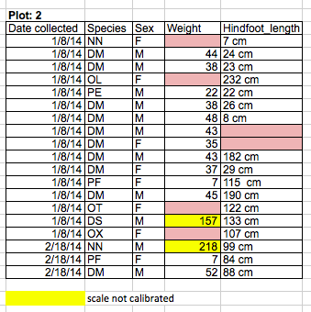
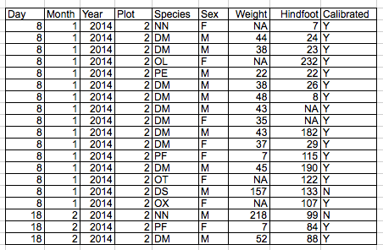
Humans
Computers

Slide 16
Rules for structuring data in spreadsheets
Put all your variables in columns
the thing you're measuring, like 'weight' or
'temperature'.
Put each observation in its own row.
Don't combine multiple pieces of information in one cell.
Sometimes it just seems like one thing, but think if
that’s the only way you'll want to be able to use or
sort that data.
Meaningful column names with no spaces or special characters

Slide 17
Exercise
Download our messy spreadsheet
Pair with a person next you and look for the things that are wrong with the spreadsheet.

Slide 18
Exercise
Download our messy spreadsheet
Pair with a person next you and look for the things that are wrong with the spreadsheet.
Discuss as a group: What problems did people find? See more information on the ‘common-mistakes’ page.

Slide 19
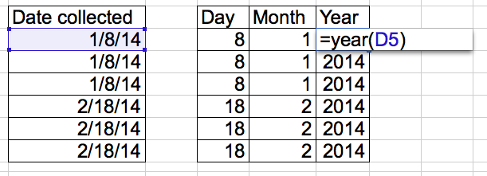
Dates as data
Instead of using one column for dates, treat it as three separate sets of information
Day, Month and Year
No date formatting issues and easier access to elements of the date

Slide 20
Guidelines for data cleaning

Slide 21
Humans
?
Computers
Notes:
Now we know the rules for structured data, but what are the rules while you’re cleaning data from human readable to computer readable?

Slide 22
Guidelines for data cleaning
Leave the raw data raw
If you don’t have an original of the data you can never replicate your analyses to know they’re correct
Keep track of the cleaning steps
Take notes, or have a script
Save the cleaned data in a text based format like comma separated values (CSV)
This ensures that anyone can use the data, and is the format required by most data repositories.

Slide 23
Exercise
With the messy spreadsheet, start to clean up one section of the data following the data cleaning guidelines.

Slide 24
Exercise
With the messy spreadsheet, start to clean up one section of the data following the data cleaning guidelines.
Trade notes with the person next to you. Imagine them as the you of 6 months from now. Can they figure out what you did? (Past you is terrible at answering email)

Slide 25
Data saving and sharing

Slide 26
Guidelines for data saving and sharing
Export your data as comma or tab separated values (CSV or TSV). This format is the one that can be read by other programs and does not rely on particular software.
Raw data, and anything you don’t want to have to redo, should be backed up.
Give data meaningful file names. Using dates in the names helps for making them unique and findable.
Data about the data (metadata) also should be tracked and saved.
Data should be available to someone other than just you. (Pass the ‘decide to bike around the world’ test)

Slide 27
Exercise
Think about the data you have right now. Is it backed up? If so, how? Do people other than you have access to the data and could they understand what it is?

Slide 28
Exercise
Think about the data you have right now. Is it backed up? If so, how? Do people other than you have access to the data and could they understand what it is?
Discuss as a group: What were some options you had for saving and sharing data? (There’s no one solution and it depends on data type and size)

Slide 29
Questions or comments?

