Slide 1
Leaflet maps in R Gene Leynes
R Meetup
Saturday 2017-10-14

Slide 2
Outline for today
This is more or less a guided tour of my map repository, which is something I put together for myself when I need to make a map.
https://github.com/geneorama/wnv_map_demo
Main topics for today
Data acquisition
Working with shape files
Basic leaflet map making
Making a heat map
Making a leaflet app

Slide 3
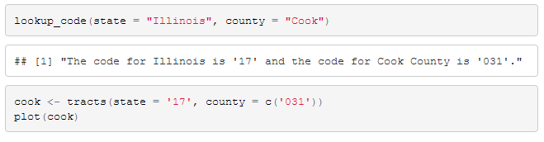
Data acquisition
Thanks to the wonderful people who wrote the tigris and acs packages, it’s a lot easier to get census tract maps and census tract data
You can use tigris to find the appropriate state and county codes, and download census map data
Source: choropleth/leaflet_example.R

Slide 4
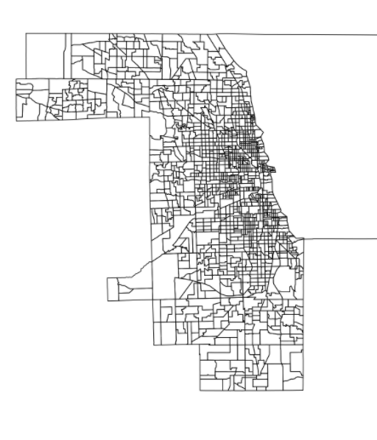
The Shapefile
Plotting the shapefile doesn’t give you much, but you can see the data’s there
Source: choropleth/leaflet_example.R

Slide 5
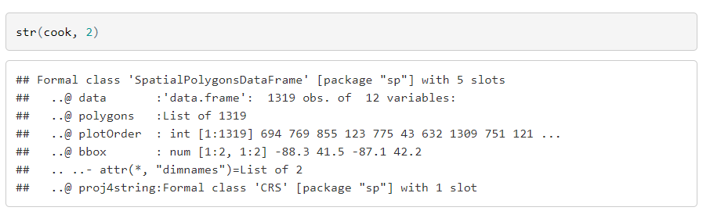
Shapefile
What’s in the shape file?
Data
Polygons (the actual shapes)
Metadata
Source: choropleth/leaflet_example.R

Slide 6
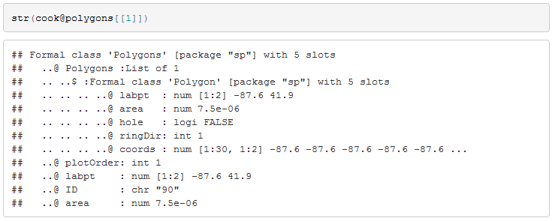
Shapefile
What’s in the polygons slot?
An object called “Polygon”
The most important component is “coords” which contains the actual points that defines the polygon
I don’t know why it’s necessary to have this second nested level… maybe it’s not necessary.
Metadata, the ID, area, a point for labels, etc

Slide 7
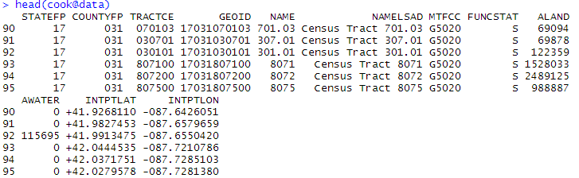
Shapefile data
The @data slot is where the magic happens…
If you want to assign attributes (say average income per census tract) to the polygons, you do it here

Slide 8
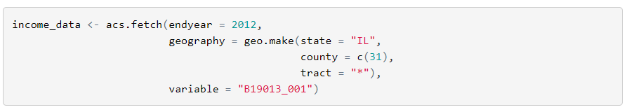
Getting income data
Thanks to the authors of the acs package, getting American Community Survey data is a lot easier (but still not easy because you need to find the right variable names yourself)
After some fussing… you can join the income data to the shapefile using the geo_join and merge on GEOID
You can also use base R merge, but you have to be careful

Slide 9
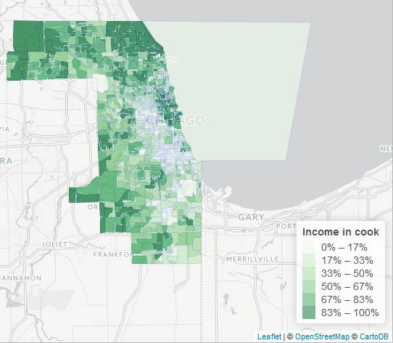
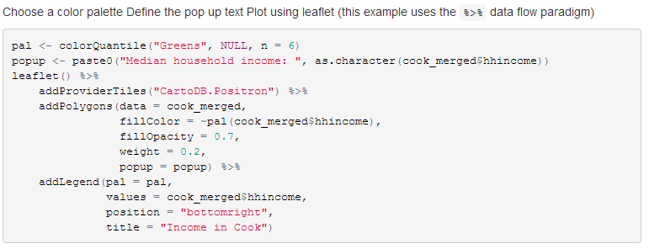
The Leaflet Plot
The actual leaflet plot:
choropleth/leaflet_example.R

Slide 10
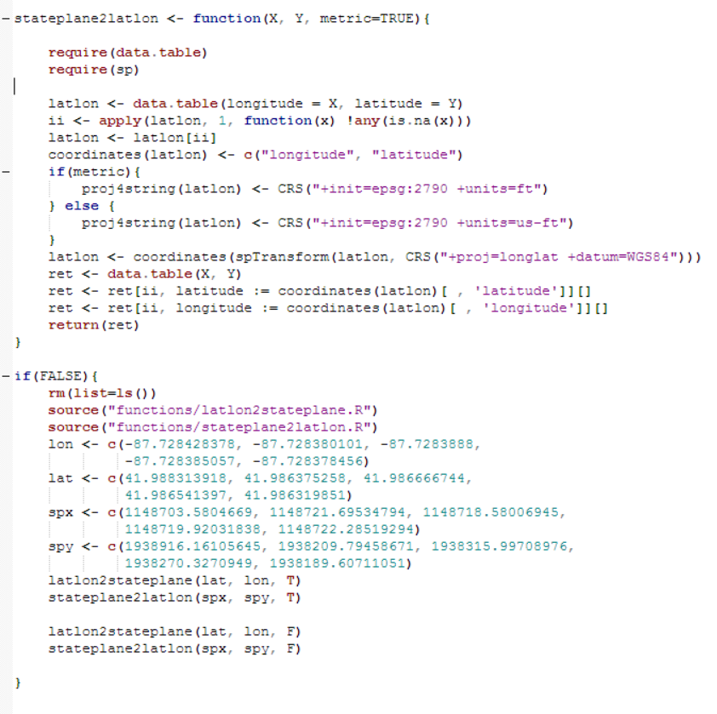
State Plane?
FYI: Coordinate conversion functions are sometimes helpful…
I have a couple of converters in the ./functions directory

Slide 11
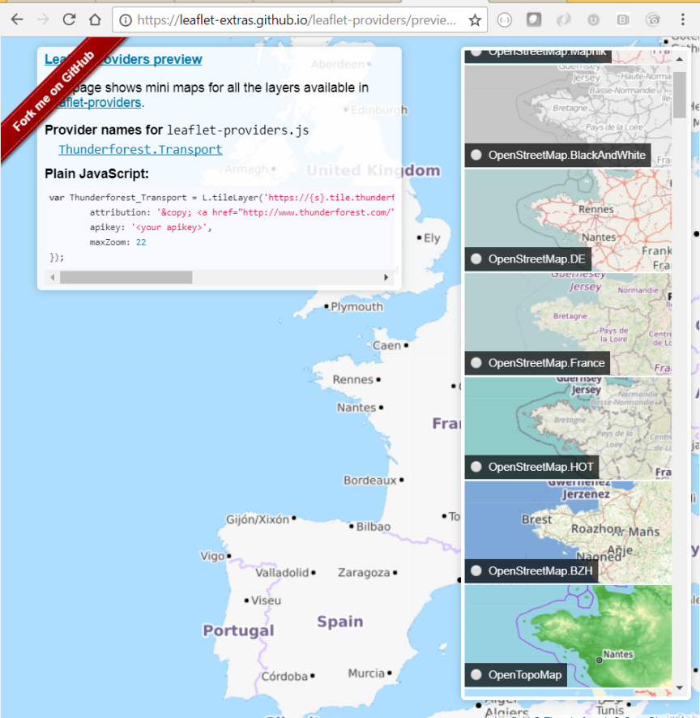

Leaflet Tiles
Within leaflet you can choose a myriad of backgrounds, or create your own
Choose a background: https://leaflet-extras.github.io/leaflet-providers/preview/
Create a background: https://www.mapbox.com/

Slide 12
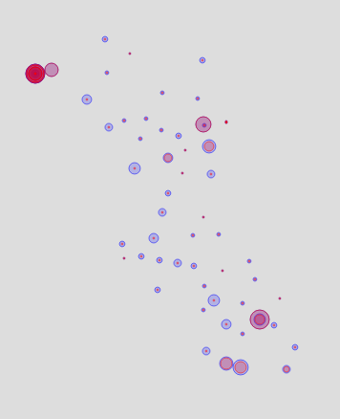
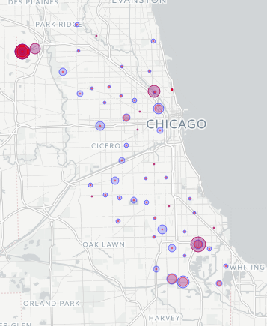
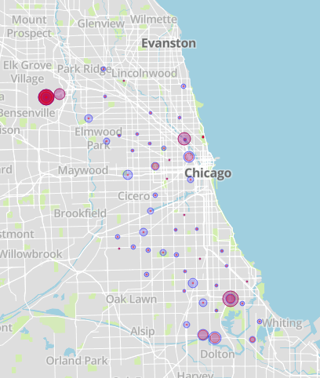
Tile Examples
wnv_trap_map/20_Map_dev_v1.R
(No background)
Custom Mapbox Template
(see code)
m %>%
addProviderTiles("CartoDB.Positron")

Slide 13
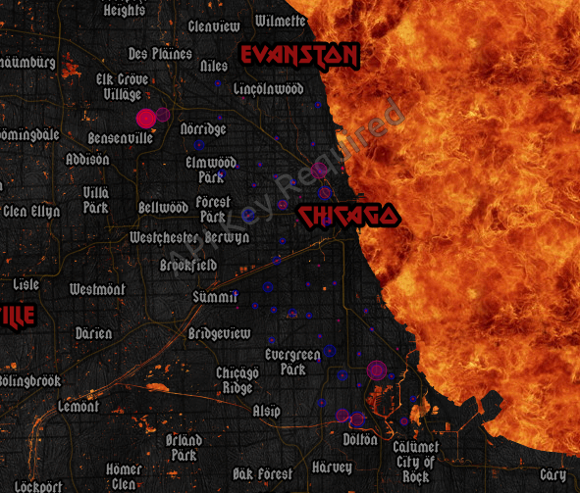
Awesome Tile Example
m %>% addProviderTiles("Thunderforest.SpinalMap")

Slide 14
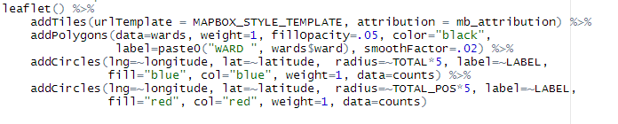
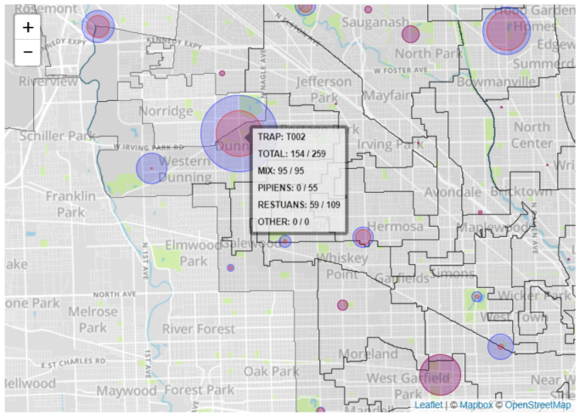
Layering Components
wnv_trap_map\map_demo.Rmd

Slide 15
Advanced Examples
In the repo there are some examples
How to create heat maps that show point densities that don’t change with the zoom level
Putting leaflet into a basic application

Slide 16
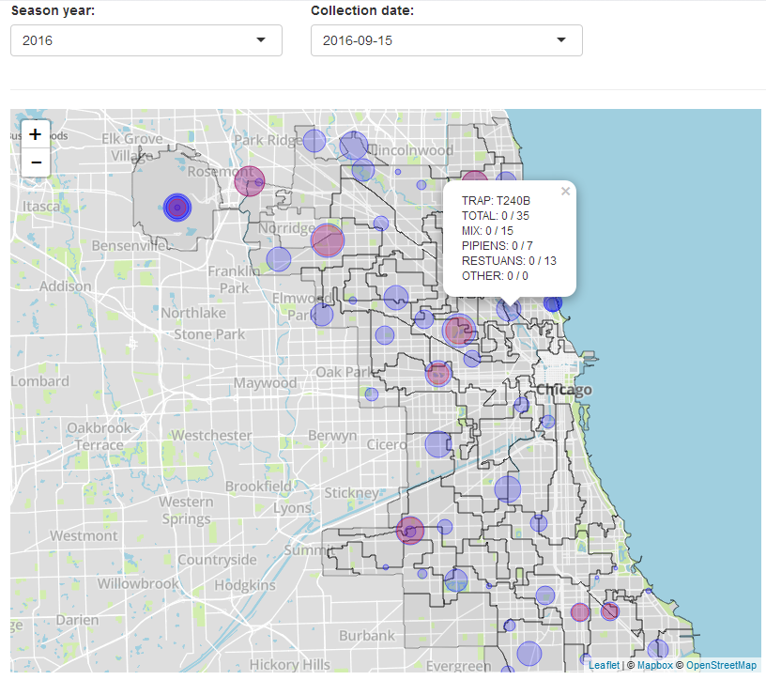
Putting leaflet into shiny
Automating the map:
Add controls to select different season years and collection periods
.\app\app.R

Slide 17
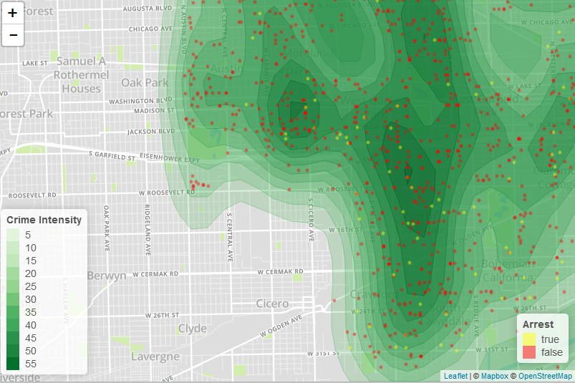
Method 1: KDE
heatmap\mv_thefts.R

Slide 18
Method 1: KDE
Outline of process for creating KDE map:
Acquire point data
Calculate a KDE using the MASS function bkde2D (only tricky part is choosing bandwidth, which is all trial and error)
Calculate contour lines based on KDE using contourLines
Convert the list of contour lines into a shape file… This part is looks magical, but is really just calls to
sp::Polygon
sp::Polygons
sp::SpatialPolygons
heatmap\mv_thefts.R

Slide 19
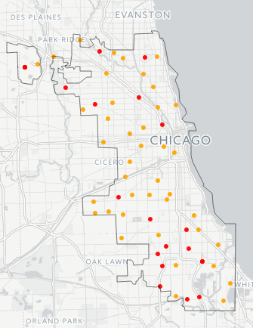
Method 2: GAM
Start off with a nice simple plot of the positive / negative traps and an outline of the city (created with gUnaryUnion)
wnv_trap_map\20_Map_dev_v2_GAM.R

Slide 20
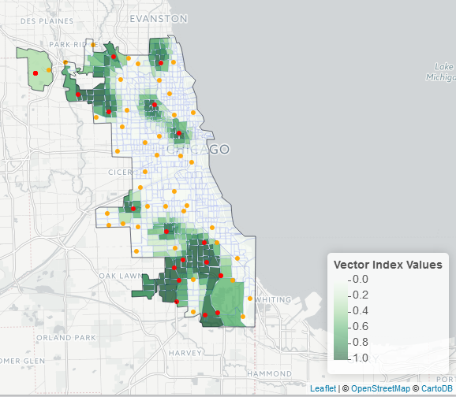
Method 2: GAM
Outline of process for creating GAM map:
Use base pos/neg data to calculate a GAM model
Create a prediction grid that spans the entire city
Predict on each point in the grid
Calculate the average prediction value for each census tract
Attach the color of the prediction to the shape file
wnv_trap_map\20_Map_dev_v2_GAM.R

Slide 21
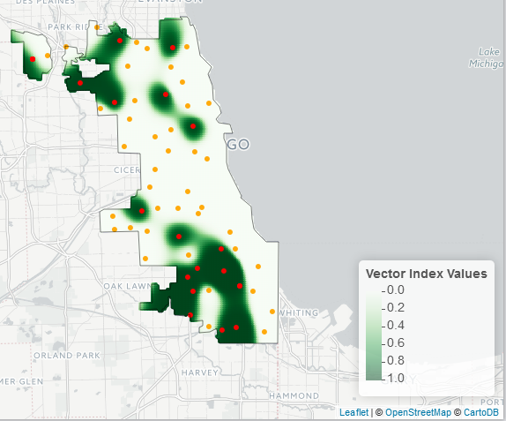
Method 2: GAM
This is what the underlying prediction grid looks like
wnv_trap_map\20_Map_dev_v2_GAM.R

