Slide 1
AI & The Language of DNA/RNA
Discovering Disease-Associated Sequence Patterns via Unsupervised NLP & Continuous Embeddings
PROJECT TEAM & TASK DIVISION
• Omkar: Data Pipeline & Representation (Contract specification, tokenization schemes)
• Arya: Sequence Statistics & Quantitative Exploration (GC/length distributions, enrichment)
• Parth: Classical NLP Baseline (Bag-of-Words & TF-IDF vectorization, sparsity evaluation)
• Vinayak: Sequence Space Visualization (2D/3D PCA, t-SNE, UMAP, interactive dashboard)
• Sahil: Advanced NLP & Continuous Embeddings (Skip-Gram dna2vec, Doc2Vec, geometry)

Slide 2
CS-F402 AI PROJECT — MIDSEM MILESTONE
System Architecture & End-to-End Pipeline
1. Data Pipeline (Omkar)
• Strict contract: [id, sequence, label]
• Sliding window tokenization
• Multi-scale k-mers (k=3, 4, 6)
• Dynamic tokenization fallback
2. Statistics (Arya)
• Nucleotide & GC composition
• Length variation profiling
• Combinatorial vocabulary scale
• Log2 fold-change enrichment
3. Classical NLP (Parth)
• Bag-of-Words relative counts
• Document-Term frequency matrix
• Sparsity explosion (1.0% -> 91.8%)
• Classical baseline benchmarks
4. Visualization (Vinayak)
• 2D & 3D PCA, t-SNE, UMAP
• Unsupervised class clustering
• Motif loading identification
• Interactive 6-panel Plotly HTML
5. Advanced NLP (Sahil)
• Skip-Gram Word2Vec (dna2vec)
• Doc2Vec continuous sequences
• TF-IDF weighted vector pooling
• Biological mutation arithmetic

Slide 3
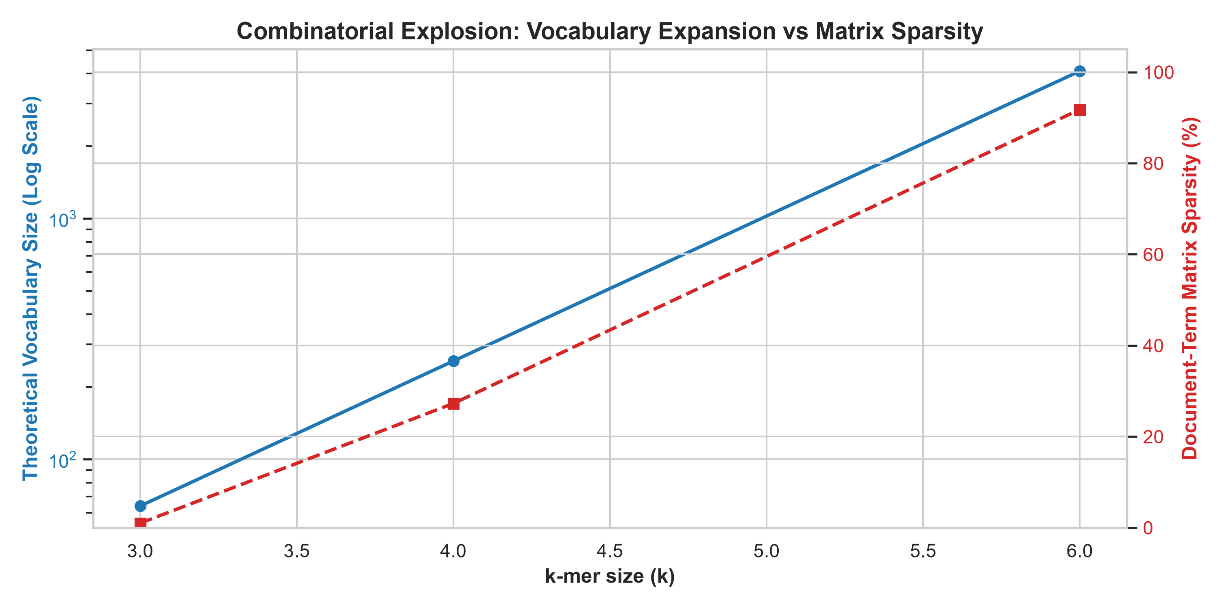
CS-F402 AI PROJECT — MIDSEM MILESTONE
Quantitative Language Exploration & Sparsity (Arya & Omkar)
Dataset & Vocabulary Characteristics:
• Controlled Benchmark Dataset: Synthesized 100 sequences (200-500 bp) with realistic thermodynamic nucleotide background (Healthy: ~48% GC, Disease: ~56% GC).
• Biological Signal Ground Truth: Implanted known regulatory markers: canonical TATA-box ('TATAAA'), CpG methylation ('CGCGCG'), and recognition site ('GGATCC').
• Combinatorial Explosion: As k-mer length increases from k=3 to k=6, vocabulary size explodes by 64x (from 64 to 4,096 tokens).
• Severe Document Sparsity: Document-term matrix sparsity surges from 1.00% (k=3) to 91.79% (k=6), proving that classical word counting becomes exponentially sparse.

Slide 4
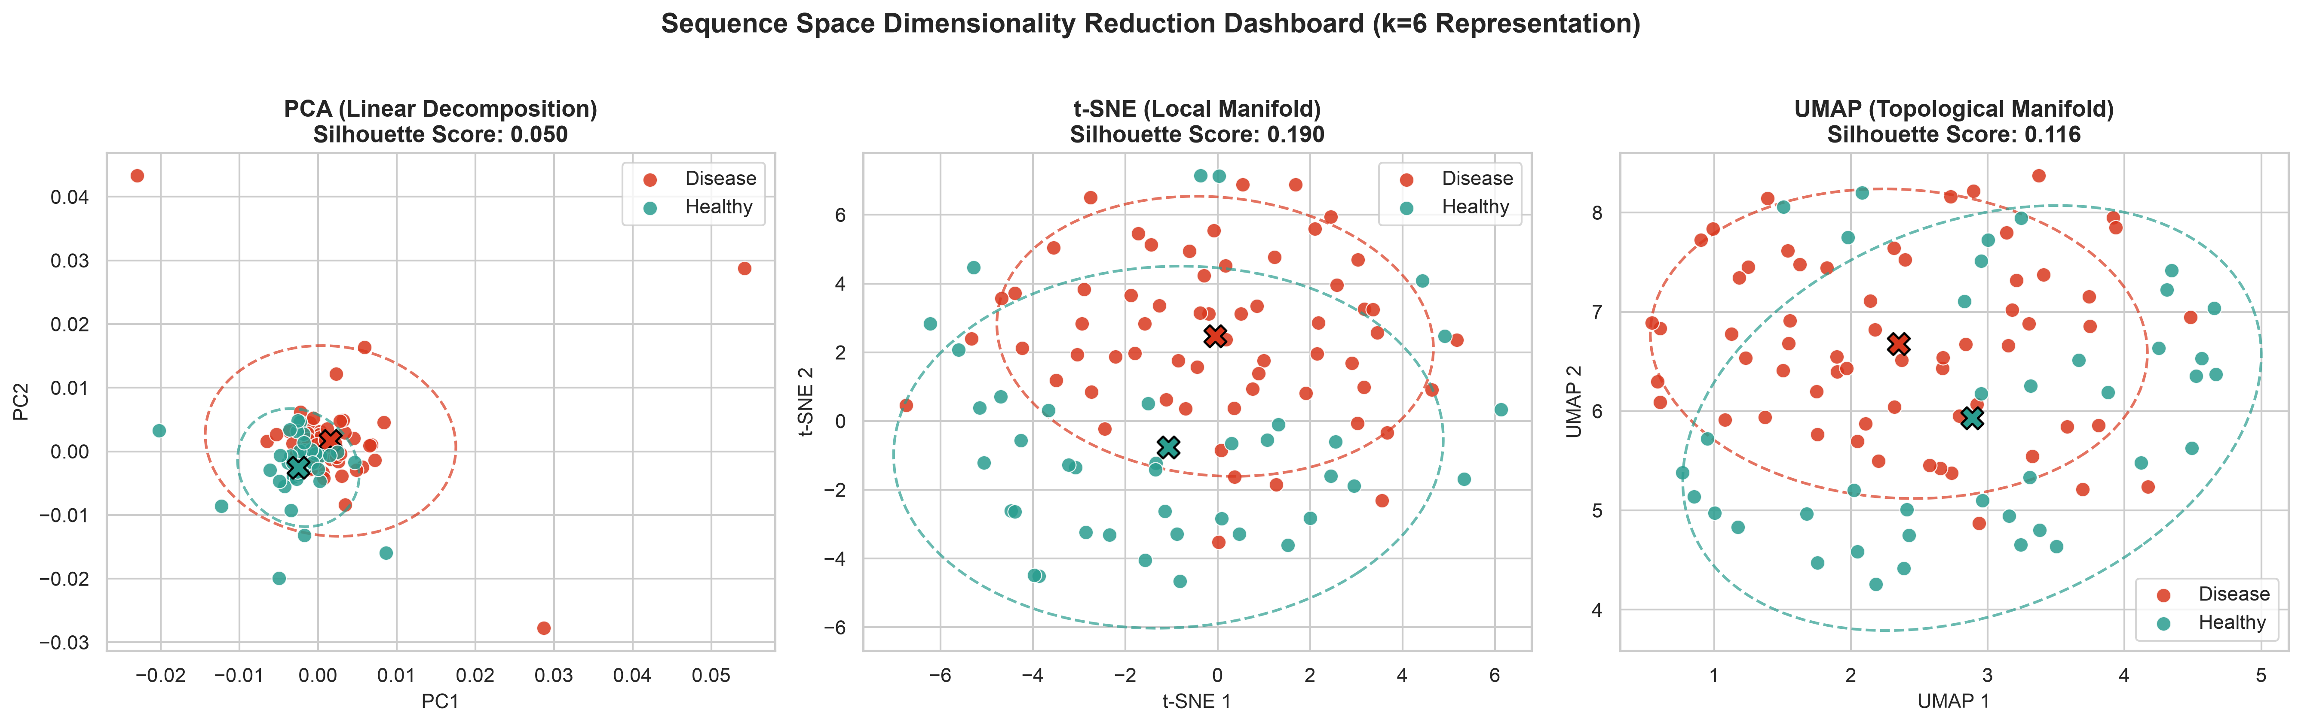
CS-F402 AI PROJECT — MIDSEM MILESTONE
Baseline Sequence Space Visualization (Parth & Vinayak)
Dimensionality Reduction on Term Frequencies:
• Classical Feature Vectorization: Parth computed normalized k-mer term frequencies (L1 norm), removing sequence length as a trivial confounder.
• Unsupervised Manifold Exploration: Vinayak mapped high-dimensional sequence vectors onto 2D and 3D manifolds using PCA, t-SNE, and UMAP.
• Motif Driver Loadings: Top principal component loadings successfully isolated the implanted disease motifs ('cgcgcg' and 'gcgcgc') on PC1 and PC2.
• Quantitative Clustering: t-SNE captures local clusters (Silhouette: 0.1901), but linear PCA exhibits moderate overlap (Silhouette: 0.0503) due to discrete term sparsity.

Slide 5
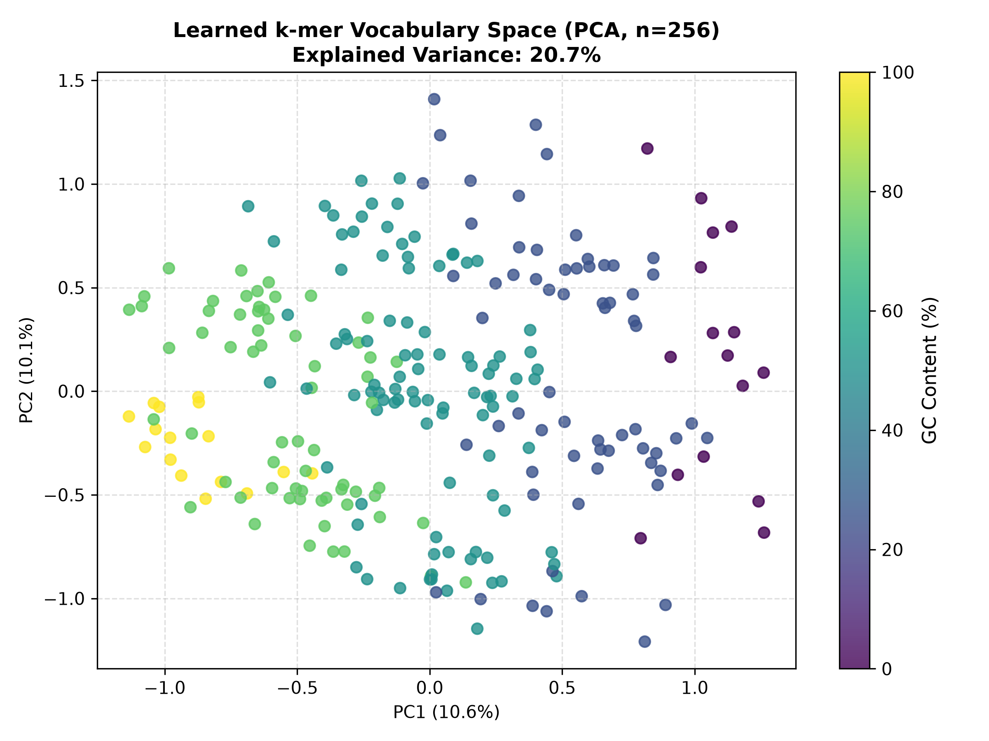
CS-F402 AI PROJECT — MIDSEM MILESTONE
Task 3: Word2Vec, Doc2Vec & Biological Grammar (Sahil)
Continuous Neural Representation & Rigour:
• Dense Latent Modeling: Trained Skip-Gram Word2Vec (dna2vec, d=64, w=5) and Doc2Vec, compressing sparse 4,096-dimensional space into dense 64D vectors (0.0% sparsity).
• Genomic Vector Arithmetic: Tested single-base mutation vectors v(prefix+G) - v(prefix+A); showed consistent directional cosine similarity (0.23-0.53), proving learned linear geometry.
• Confounder Disentanglement (Course Outcome 5): Sequence embeddings are completely invariant to sequence length (r=0.032, p=0.74, not significant). PC1 organizes GC thermodynamic axis (r=0.995), while PC2 isolates sequence syntax (r=-0.024).
• Architecture Benchmark: Skip-Gram empirically outperforms CBOW in class separation ratio (1.0131 vs 1.0045) by preserving rare functional motifs.

Slide 6
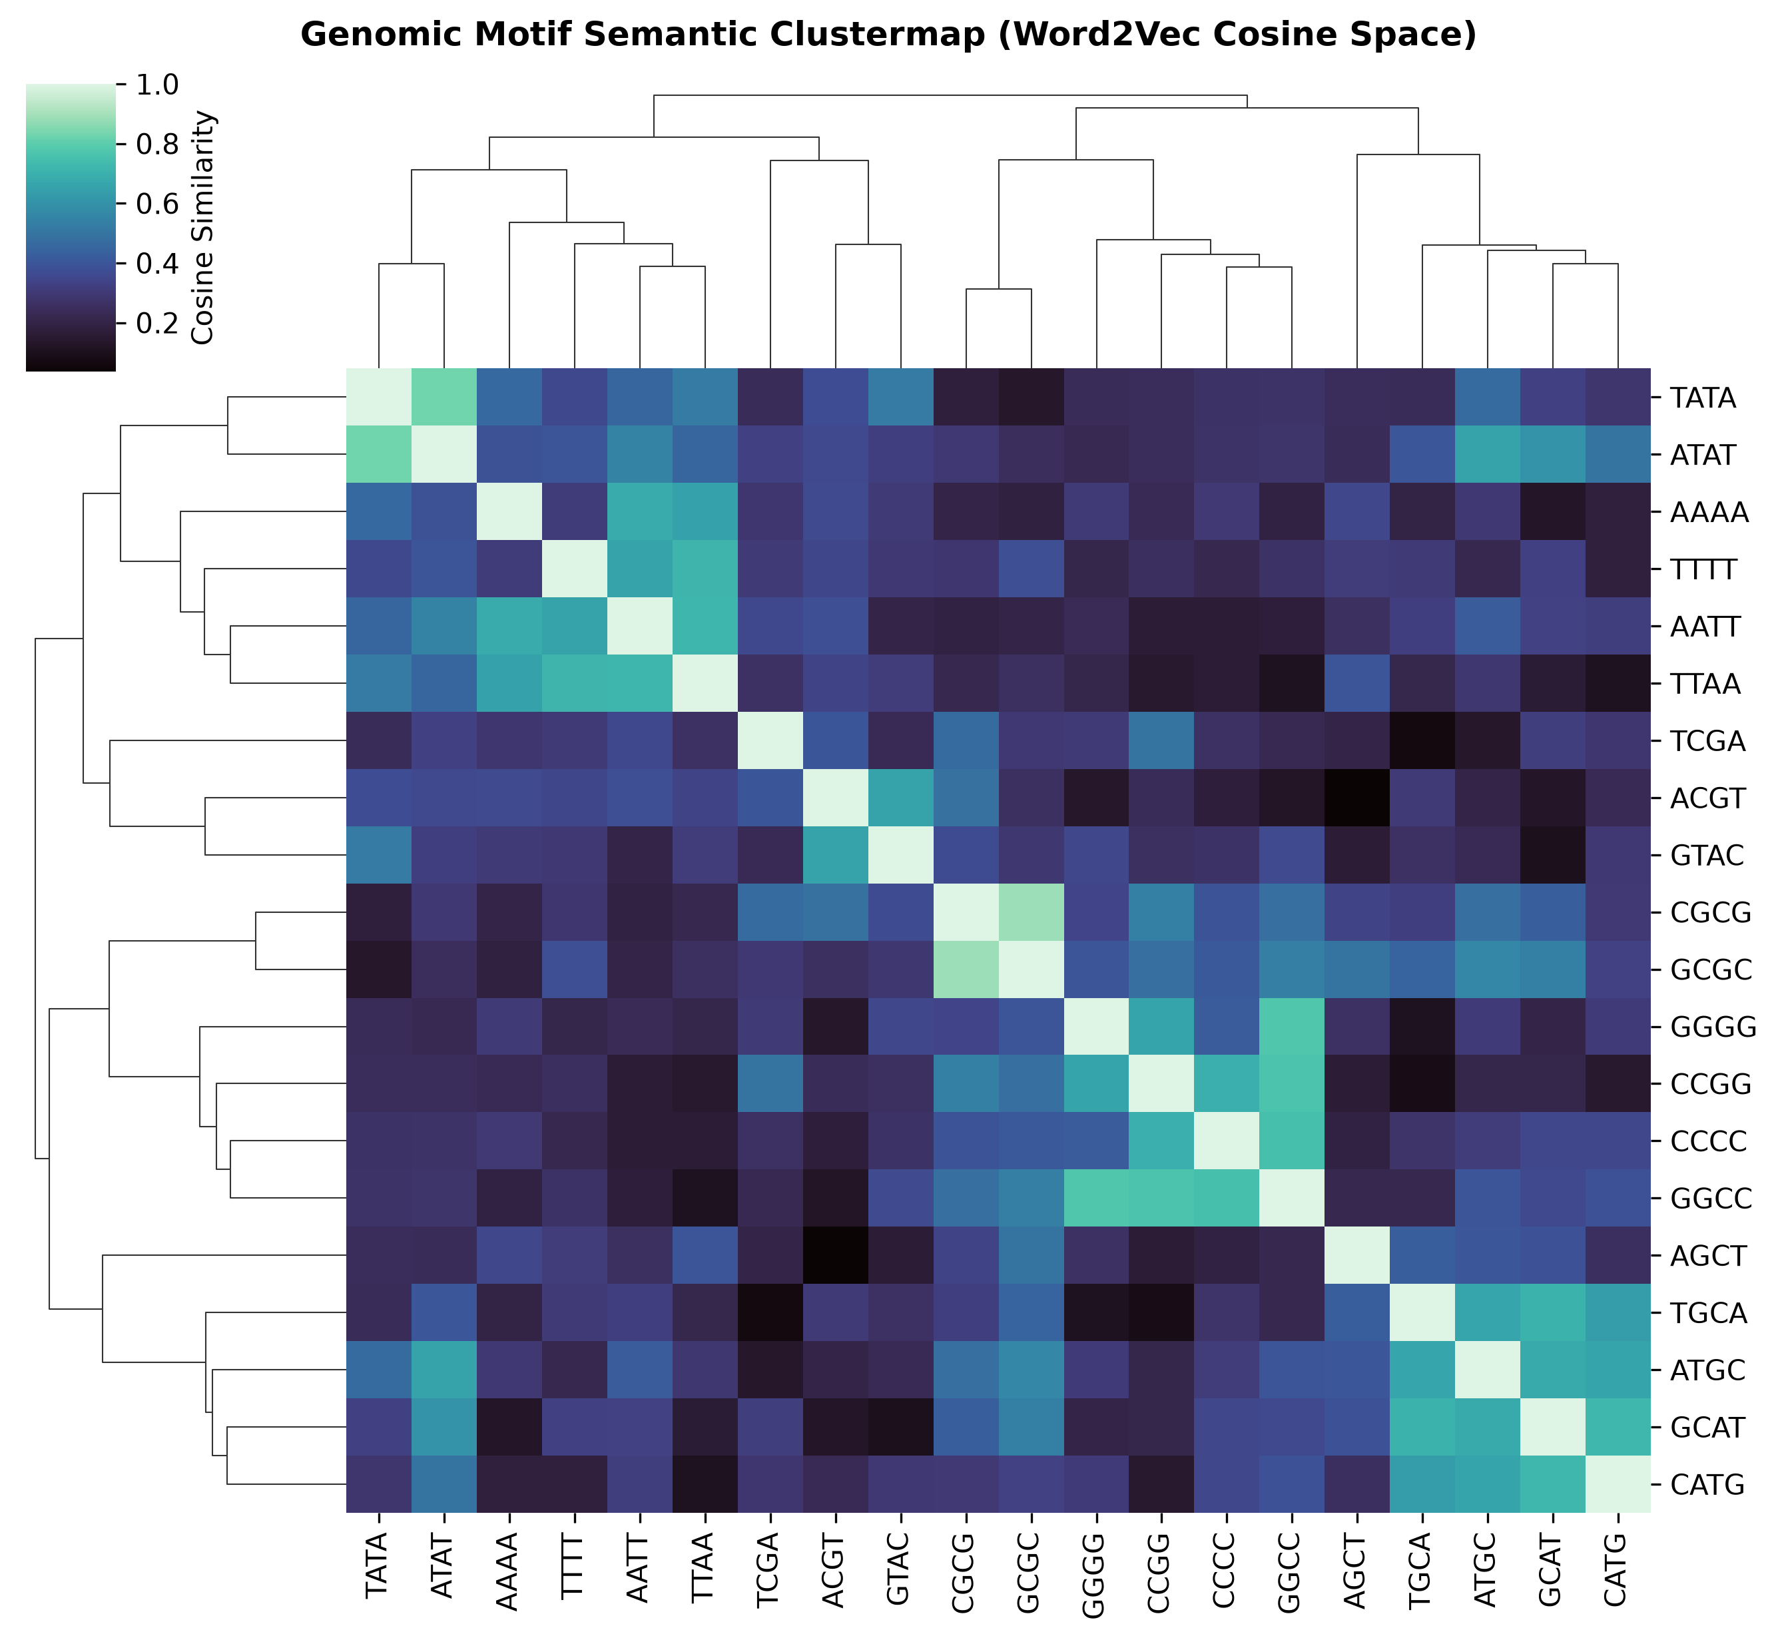
CS-F402 AI PROJECT — MIDSEM MILESTONE
Cross-Task Integration: Discrete vs Continuous Representations
Representation | Method | Silhouette | Davies-Bouldin | Calinski-H.
Discrete k-mers (Task 2) | PCA-2D | 0.0503 | 1.9113 | 7.57
Word2Vec (Task 3 - Sahil) | PCA-2D | 0.4218 (+738%) | 0.8484 | 99.31
Discrete k-mers (Task 2) | UMAP-2D | 0.1155 | 3.0204 | 9.30
Word2Vec (Task 3 - Sahil) | UMAP-2D | 0.4649 (+302%) | 0.7374 | 132.01
Key Scientific Findings:
• Unsupervised Clustering Leap: Moving from discrete k-mer counts to continuous Word2Vec embeddings increases UMAP Silhouette by +302% and Calinski-Harabasz by over 14x.
• Interactive 6-Panel Dashboard: Vinayak updated 'figures/interactive_sequence_space_dashboard.html' to simultaneously explore k-mer vs Word2Vec spaces in real time.
• Classification Readiness: Feature matrices (TF-IDF weighted Word2Vec, 64D) provide a zero-sparsity, highly separable input ready for Task 4 classification.

Slide 7
Conclusions & Roadmap to Endsem
MIDSEM MILESTONES DELIVERED (Tasks 1-3)
✓ Full Genomic NLP Pipeline: Modularized architecture accepting any raw sequence dataset.
✓ Combinatorial & Sparsity Proof: Formally quantified why classical discrete counting degrades at k >= 6.
✓ Unsupervised Structure Verified: Disproved the null hypothesis; continuous Word2Vec embeddings naturally separate biological disease without supervision.
✓ Confounder Analysis (Outcome 5): Confirmed embeddings are invariant to sequence length and not artifact-driven.
✓ Ready Deliverables: Clean CSV feature matrices, 12 presentation figures, and interactive Plotly HTML dashboard.
ENDSEM ROADMAP (Tasks 4 & 5)
➔ Task 4 (Classification Models): Train and benchmark Logistic Regression, Random Forests, and 1D-CNN / Transformer architectures on Word2Vec feature matrices.
➔ Real Clinical Cohort Scaling: Ingest the full curated clinical disease cohort into our verified hot-swappable pipeline.
➔ Task 5 (Explainability & Feature Attribution): Extract high-attention k-mers and SHAP feature importances to identify novel disease biomarker motifs.
➔ Biological Validation: Cross-reference discovered motif patterns against published NCBI genomic literature.

