Slide 1





Steam Game Analysis
Analyzing game features, release trends, and key factors behind high-popularity games on Steam
Presented by: Nguyen Thanh Truc
Mentor: Ms Vo Tran Vy Thao and Mr Nguyen Chi Cuong
➜

Slide 2
Table of contents
I
IV
II
III
Introduction
Conclusion
Cleaning
EDA

Slide 3

01
Introduction
Index
Objective
Expected
Sources
➜

Slide 4
I. Introduction
01
Objectives
Analyze release trends and seasonal patterns of games on Steam
Explore relationships between game attributes such as:
• Price
• Popularity Score
• Review Ratio
• Release Year
Identify top-performing genres, developers, and publishers
Evaluate value-for-money through metrics like Popularity per Dollar
Investigate how price correlates with perceived quality and genre competitiveness

Slide 5
I. Introduction
02
Expected outcome
Discover when (seasonally) games are most likely to succeed
Understand what features most strongly influence popularity and reviews
Identify which genres and studios consistently deliver high performance
Highlight games that offer the best value for money
Clarify if premium pricing leads to higher quality or market reach
Find a key to survive in an increasingly competitive and saturated market

Slide 6
I. Introduction
03
Data sources
Source: Kaggle 🔗 (Steam Games Dataset– fronkongames)
Description: This dataset has been created with MIT code and use the API provided by Steam, the largest gaming platform on PC. Data is also collected from Steam Spy.
Size: 111,452 rows x 39 columns

Slide 7
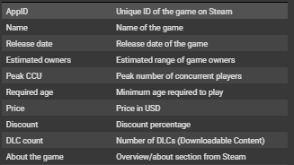
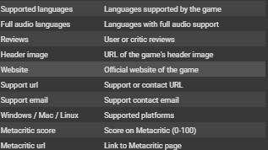
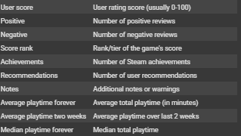
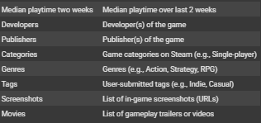
I. Introduction

Slide 8
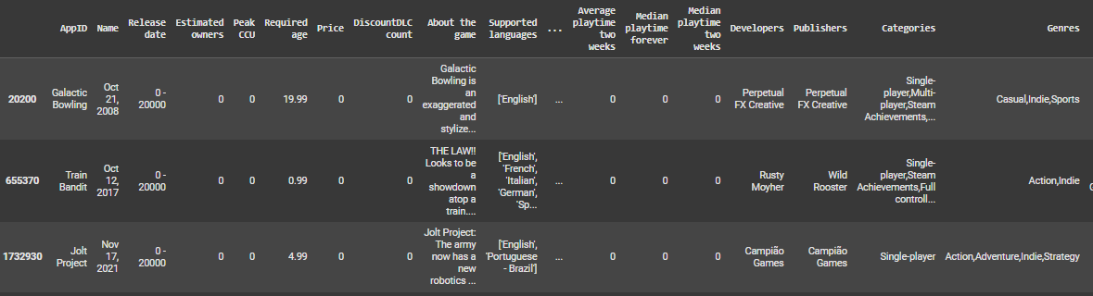
I. Introduction
Check raw dataset

Slide 9
02
Cleaning
Index
Basic
Features
Outliers
➜

Slide 10
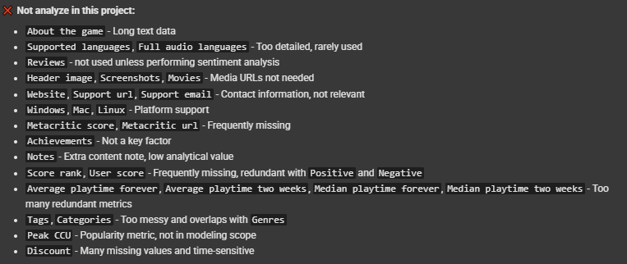
II. Cleaning
01
02
Corrected data misalignments
Removed irrelevant columns

Slide 11
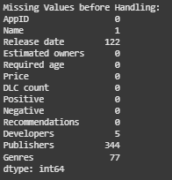

II. Cleaning
03
Handle ‘Estimated owners’ column
04
Convert data types
05
Fill missing and check duplicate

Slide 12
II. Cleaning
06
Filter out
Non-game entries
Games released before 2003 or in 2025
07
Feature Engineering
Total reviews
Review ratio
Game age
Price category
Popularity score
Value score
Popularity quintile
One hot encoded ‘Genres’

Slide 13
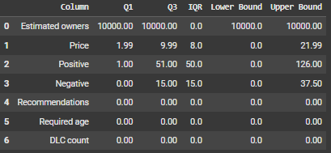
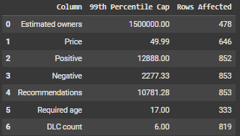
II. Cleaning – 08. Outlier
01
02
IQR
Capping

Slide 14
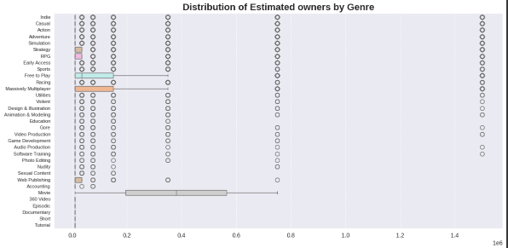
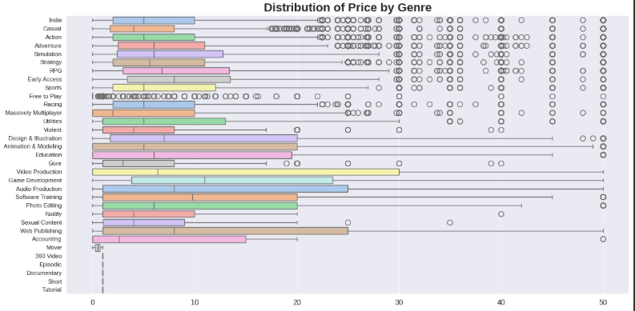
II. Cleaning – 08. Outlier

Slide 15
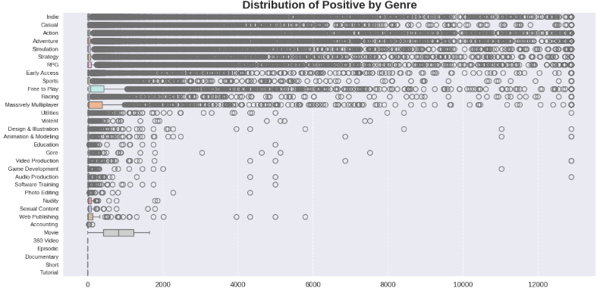
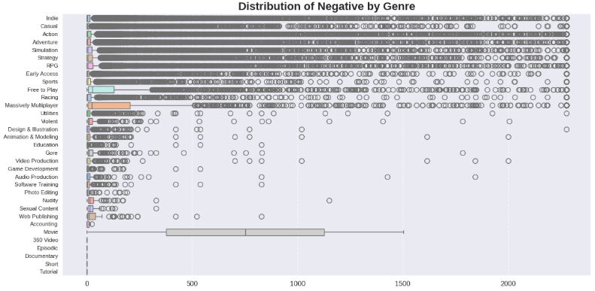
II. Cleaning – 08. Outlier

Slide 16
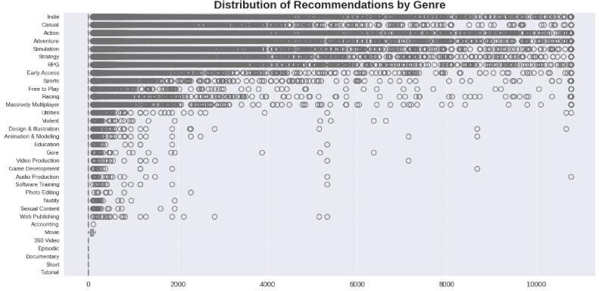
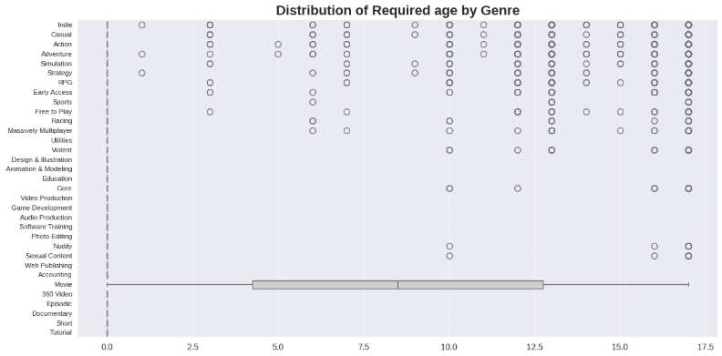
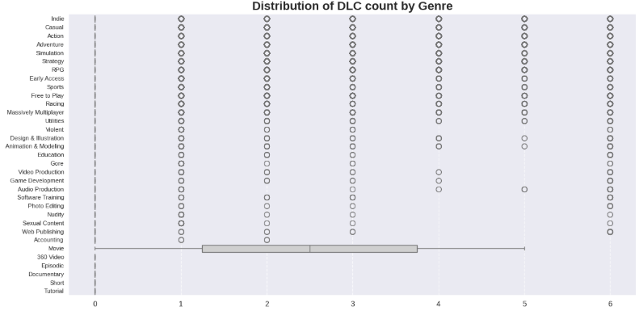
II. Cleaning – 08 Outlier

Slide 17
03
EDA
Index
Overview
Evolution
Price and Value
Genres
Studios
Legend Games
Correlations
➜

Slide 18
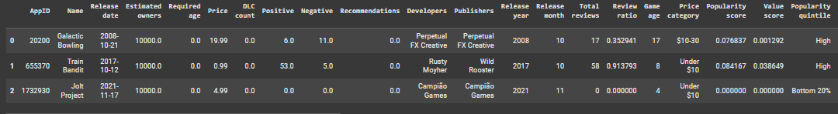
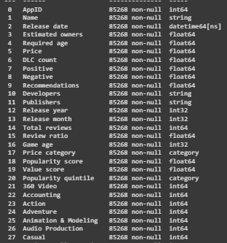
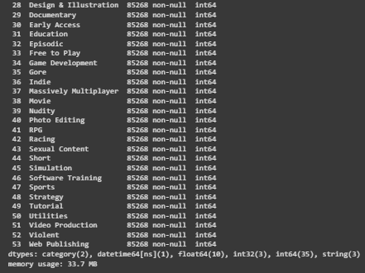
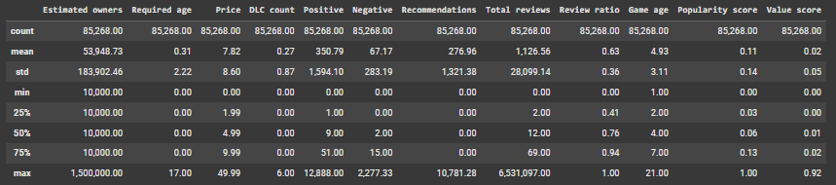
III. EDA
Data overview
Total Games: 85,268
Total Features: 54

Slide 19
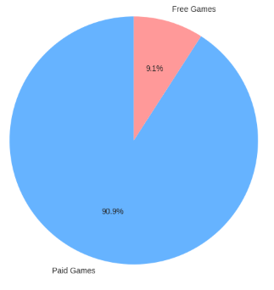
III. EDA – 01. Overview
🎯
📈
🚚
Scale
Economic
Distribution
• Total Games: 85,268
• Unique Genres: 33
• Average Games per Genre: 2584
• Average Price: $7.82
• Median Price: $4.99
• Average Reviews: 1,127

Slide 20
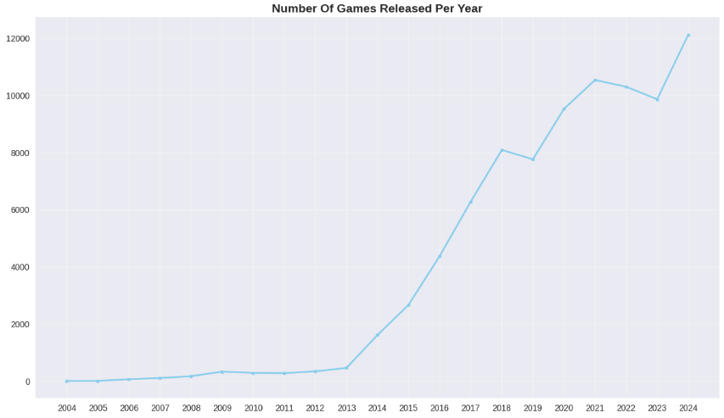
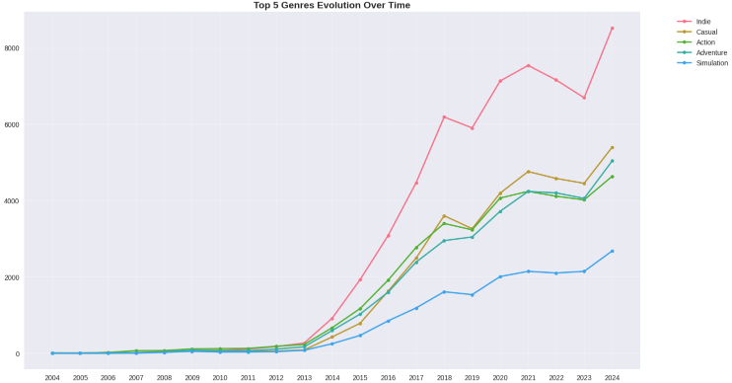
III. EDA – 02. Evolution
📅
🏆
Release Trends
Top genres (2022 – 2024)
• Indie: 60,139
• Casual: 35,912
• Action: 35,088
• Adventure: 33,307
• Simulation: 17,190
Peak Year: 2024 (12,128 games)
Growth Rate 2014-2024: 650%

Slide 21
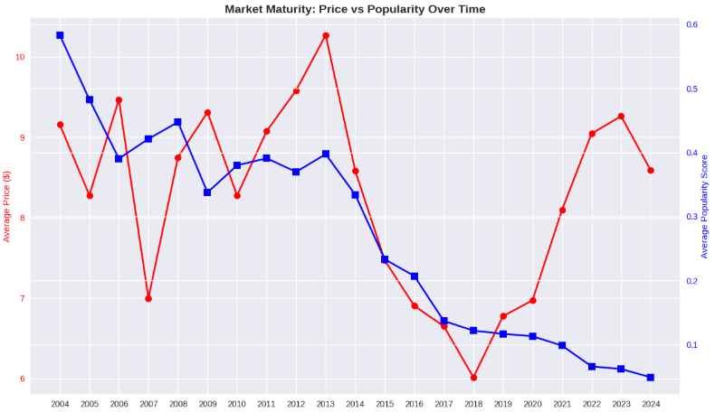
III. EDA – 02. Evolution
📈
Market Maturity

Slide 22
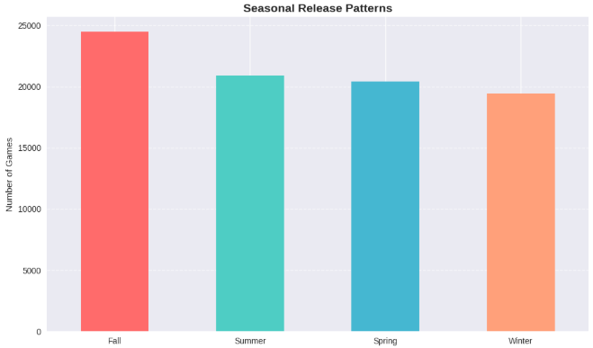
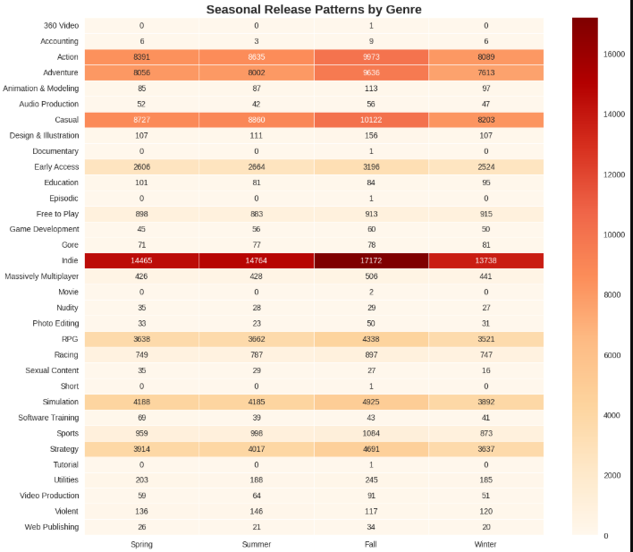
III. EDA – 02. Evolution
🍁
Seasonal
❄
Seasonal by Genres

Slide 23

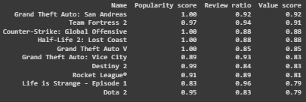
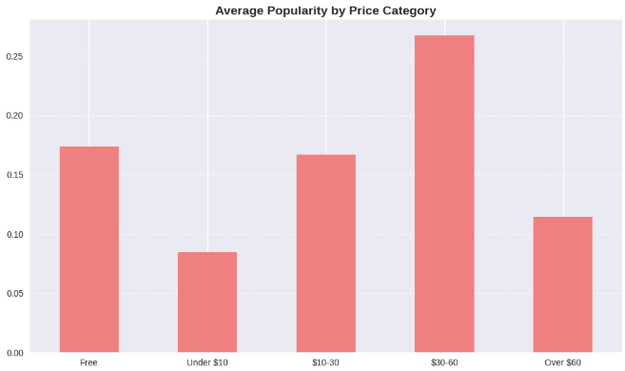
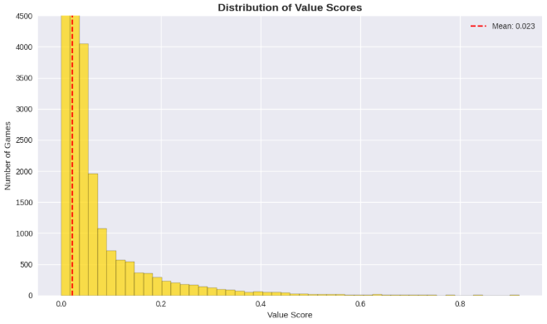
III. EDA – 03. Price and Value
💸
Price Segment
🏆
Top Value-for-Money

Slide 24

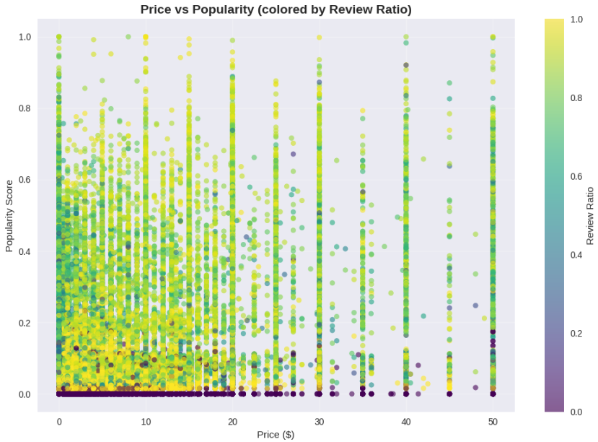

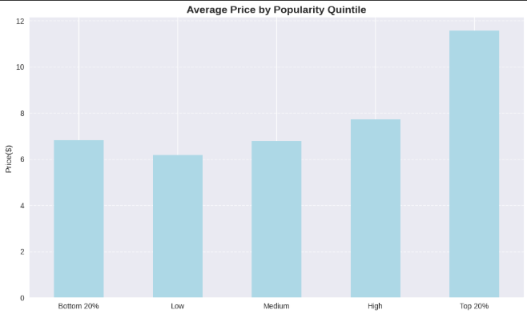
III. EDA – 03. Price and Value
Price vs Quality
⚜
Premium vs Budget

Slide 25
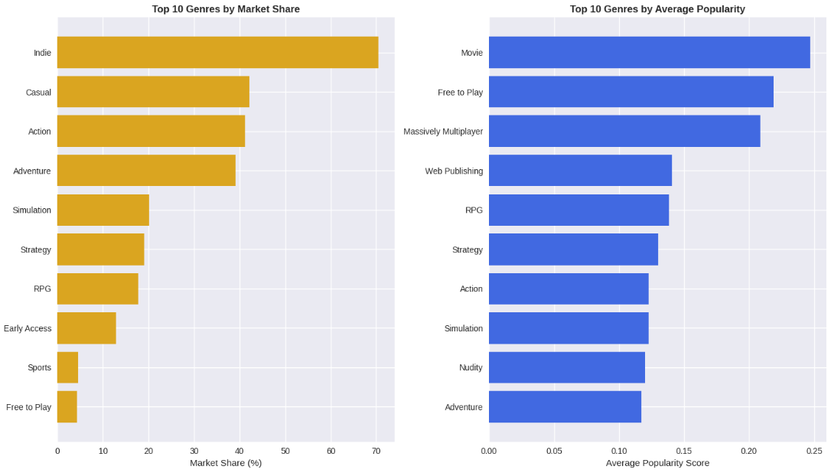
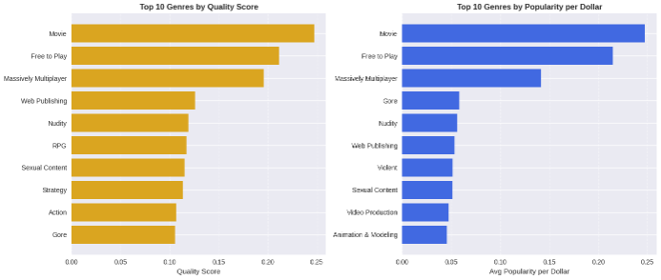
III. EDA – 04. Genres
👑
Top genres

Slide 26

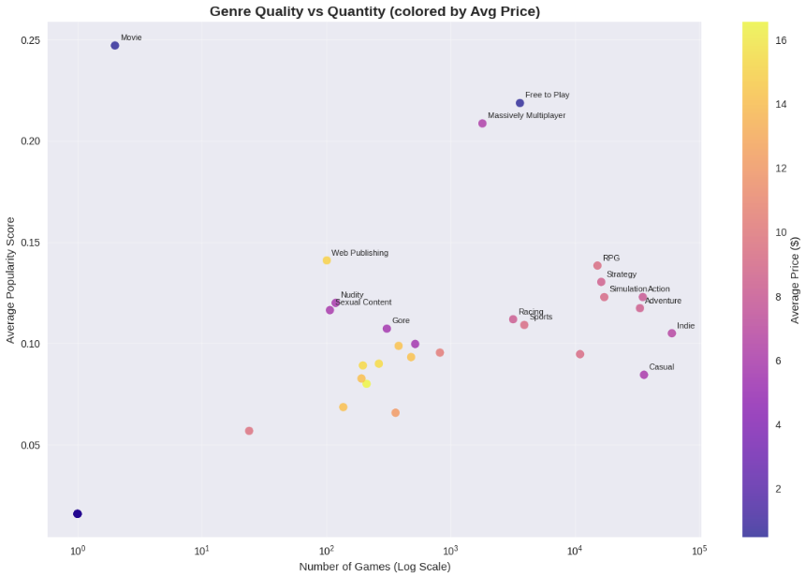
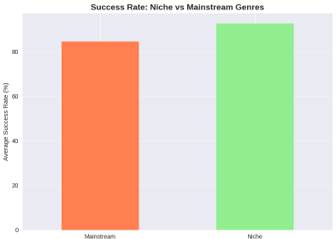

III. EDA – 04. Genres
Quantity vs Quality
🔥
📝

Slide 27
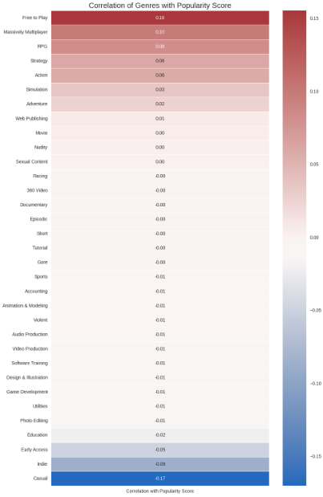

III. EDA – 04. Genres
Combinations
🔗
Popularity vs Genres

Slide 28
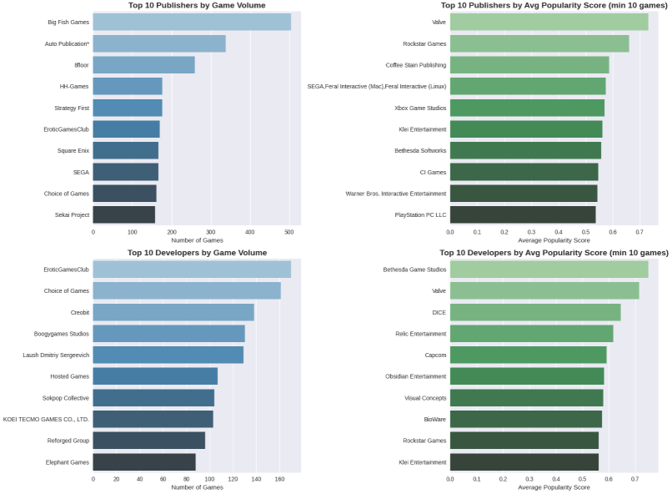

III. EDA – 05. Studios
🏆
Top studios

Slide 29


III. EDA – 05. Studios
⚖
Indie vs AAA

Slide 30

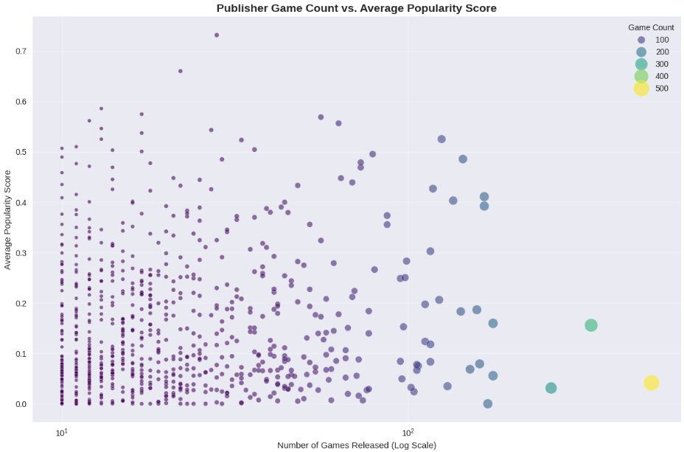
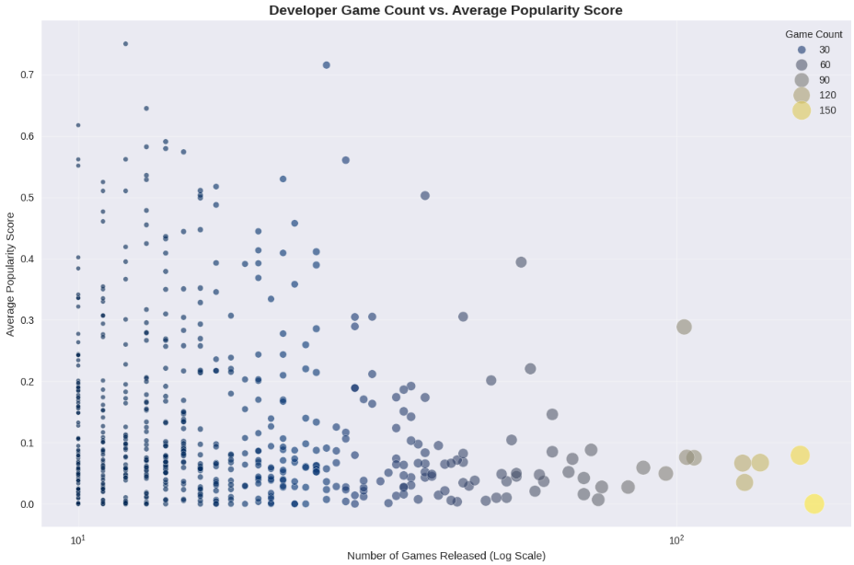
III. EDA – 05. Studios

Slide 31
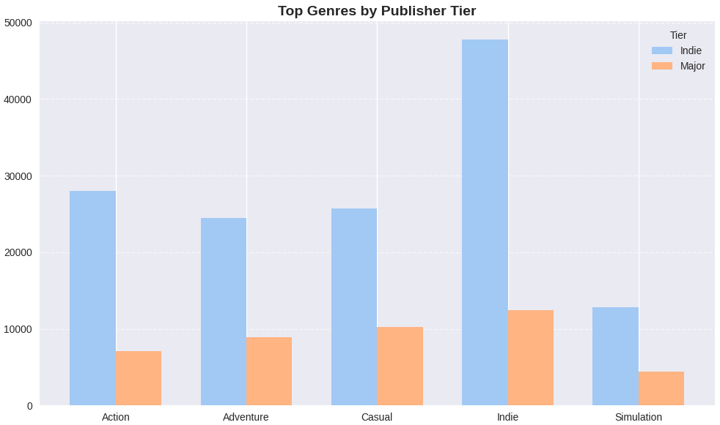
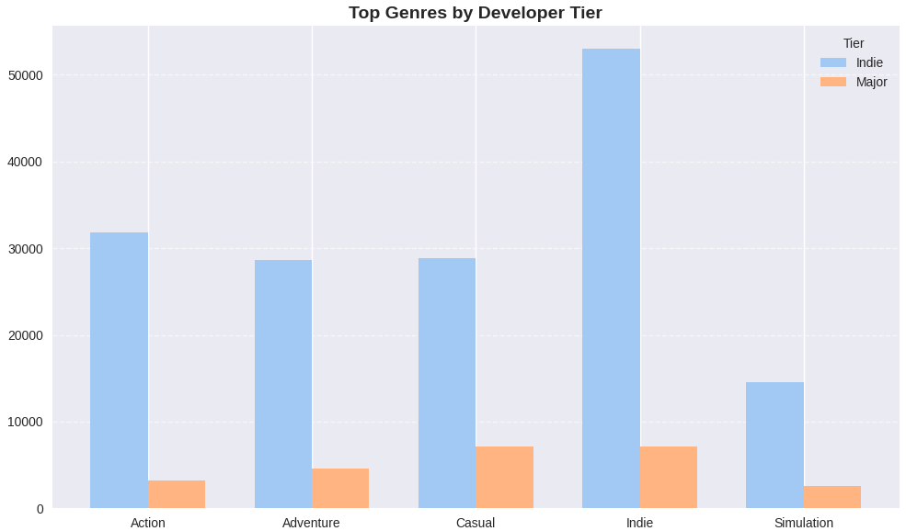
III. EDA – 05. Studios
𓆩🔝
Studios top Genres

Slide 32
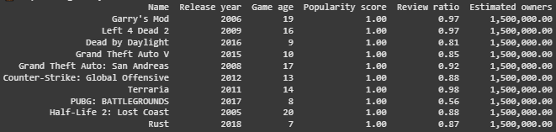
III. EDA – 06. Legend Games
✨
👑
Criteria for Legendary Games
Age: > 5 years
Popularity: Top 5% (Score > 0.434)
Reviews: > 1,000
Top 10 Legendary Games:

Slide 33
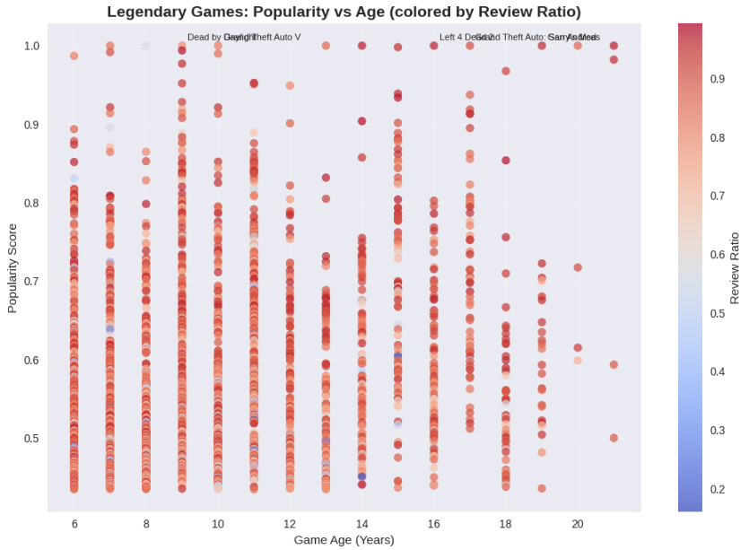
III. EDA – 07. Legend Games

Slide 34
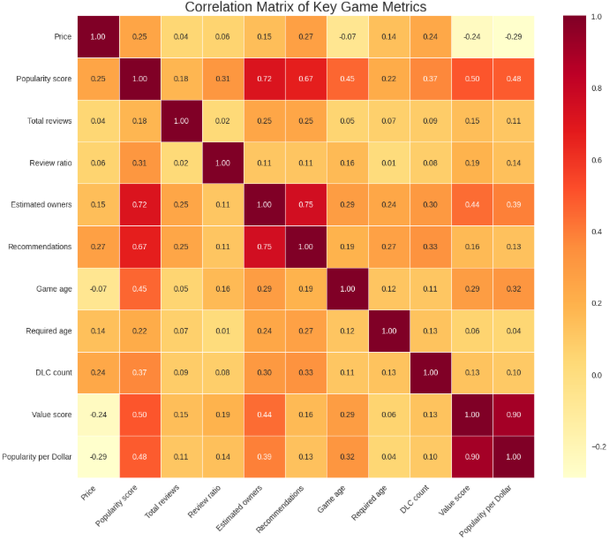
III. EDA – 07. Correlations

Slide 35
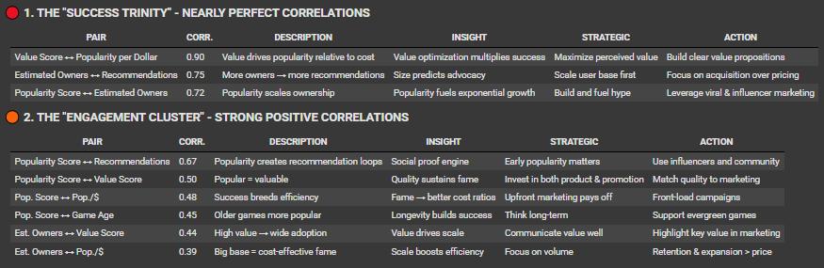
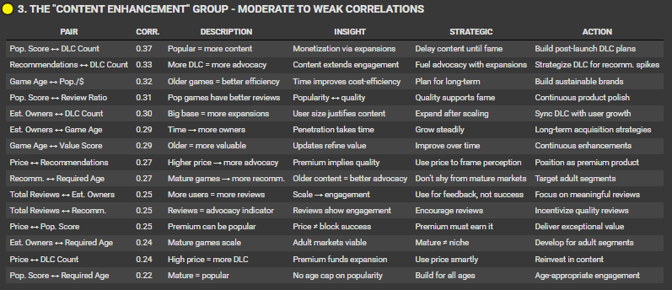
III. EDA – 07. Correlations

Slide 36
04
Conclusion
Index
Strategics
Key factors
➜

Slide 37
IV. Conclusion – 01. Strategics
✔ Positioning
✔ Quality over Quantity
✔ Value-Based Approach
Focus on a few high-quality games.
Indies have better review ratios.
Fragmented market = big opportunity.
Best price: $5–8.
Value > price (r = 0.90).
Avoid low pricing without visibility.
Action, Adventure, Casual = high reach.
Niche focus = high success.
F2P shows strong results.
✔ Timing and Marketing
✔ Long-Term Value
✔ Prepare for future
Fall = max exposure.
Early marketing boosts momentum.
Avoid winter fatigue.
Longer lifespan = more popular.
Major updates every 3–6 months.
DLC works better after success.
Steam Deck leads handheld PC.
Portable PC gaming is rising.
Ensure cross-platform support.

Slide 38
IV. Conclusion – 01. Strategics
🆕
🏢
💼
New studios
Old Studios
Publishers & Investors
Leverage indie credibility
Focus on niche opportunities
Build early community engagement
Price based on delivered value
Use pricing power strategically
Invest in strong marketing
Avoid quantity-over-quality traps
Build lasting IP and brand value
Balance niche and mainstream titles
Support long-term content updates
Evaluate teams by quality KPIs
Develop in-house F2P capabilities

Slide 39
IV. Conclusion – 02. Key factors
💡 Value Wins
🚀 Momentum Matters
Value is the strongest success driver
(Focus on what players get, not just what they pay)
Scale and player advocacy fuel growth
(Early traction builds long-term success)
🎯 Market Reality
❤ Player-Centric Design
Few hit games dominate the charts
(Success is concentrated — quality over volume)
Satisfaction drives reviews
(Focus on delighting players, not chasing ratings)

Slide 40


Niche Focus (92.5% success rate)
+
F2P Model (0.21 quality score)
+
Quality-First Approach
+
Deep Engagement Systems
+
Community Building
=
Sustainable Success
🌟 Critical Success Formula
➜

Slide 41
Thanks!
Does anyone have any questions?
thanhtruc034@freepik.com
github.com/Truc034
➜

Slide 42
Fonts & colors used
This presentation has been made using the following fonts:
Roboto
(https://fonts.google.com/specimen/Roboto)
Turret Road
(https://fonts.google.com/specimen/Turret+Road)
#ffffff
#090827
#090a67
#214fc0
#73b3e3
#e4d0f5
#8c4bc4

