Slide 1
Project story: Use AI to Import Data from PDF to D365FO
Denis Trunin
Technical Architect, Sonata Software

Slide 2


Use case: Import complex PDF
Possible options:
Online PDF to Excel converters: can’t handle complex structure
Microsoft Invoice capture solution: Complex setup(65 pages install guide), based on Microsoft AI Foundry Document Intelligence OCR, can’t handle custom documents
Power App Sales Order Agent: A separate Power App that reads the document and creates records via Odata calls. Hard to customize with integration involved
External Integration Framework
Native X++ implementation, fully customized solution with custom logic and validations

Slide 3
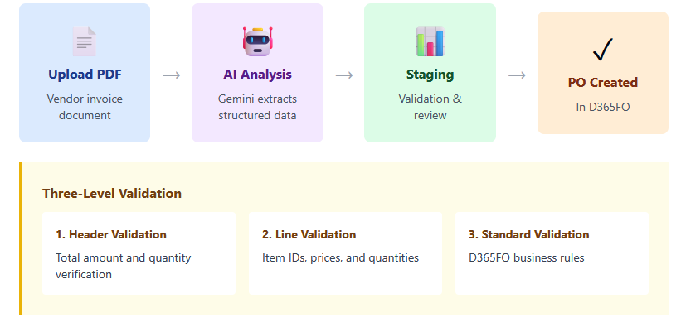
AI Processing Workflow

Slide 4
External Integration module
Standardized approach for X++ based integrations
Free open-source framework to simplify integration development and support
1. Design
Ready-to-use templates for integration planning:
Inbound,
Outbound Event-based, Outbound Periodic,
Service-based
2. Load data
Connectors for:
Service Bus, SFTP, Azure File share, Rest API, AI (LLM), Manual
3. Process data
Import documents from: CSV, Excel, XML, JSON & PDF
Sample implementations for: Sales lines, Ledger journals, Purchase lines, Vendors
4. Test
Sample template for performance testing up to 1m journal lines
Run any document in manual mode without a connector

Slide 5
Advantages Over Standard Microsoft Tools
vs. DMF (Data Management Framework)
Support custom transactions
Easily link a Document to the Original file
Custom Business logic, not linked to data entity
Native X++ code - no external dependencies
A standard approach to error types and how to handle them
vs. Business Events
Data creation timing: document created at the time of export, not at the time of the event
Event Frequency and Uniqueness: Messages are unique per document and do not duplicated
Response Processing: Can process response
Full logs (BE doesn’t support success logs)
vs. Message Processor
Enhanced Logging
Tracing
Manual message processing
Can be run in ttsbegin-ttsabort block for testing scenario
Processing and format flexibility

Slide 6
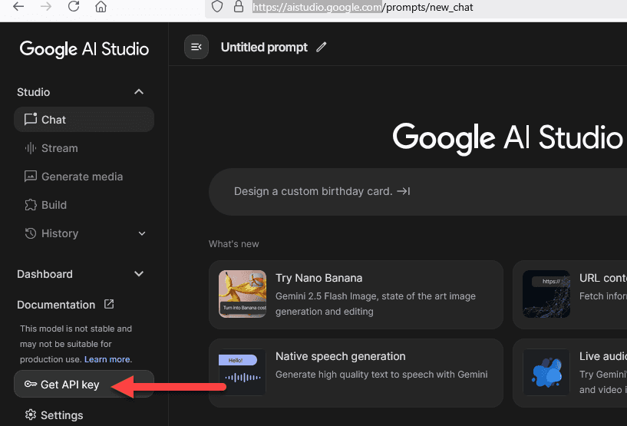
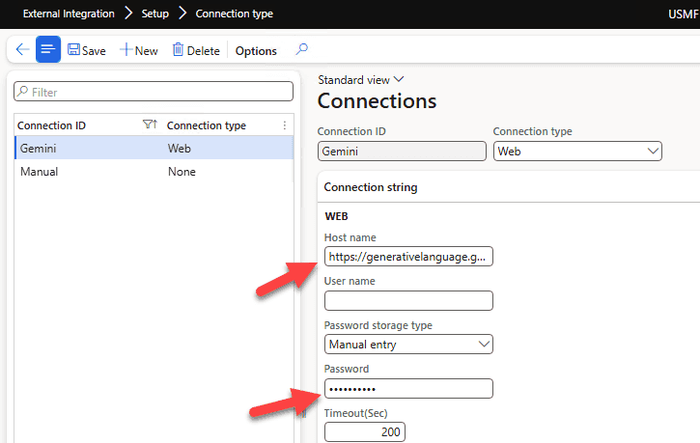
1.Define a connection and a key

Slide 7
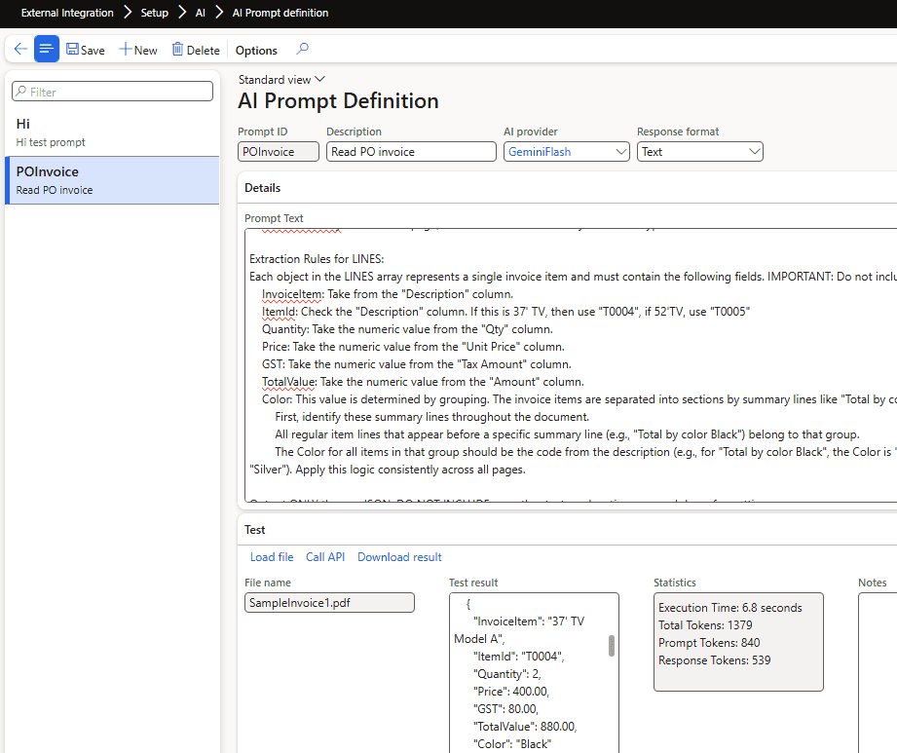
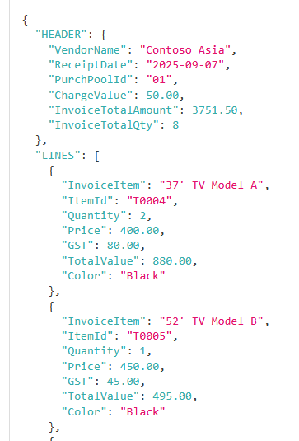
2.Define and test a prompt

Slide 8
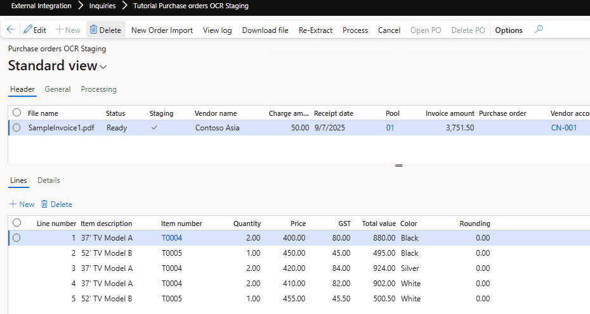
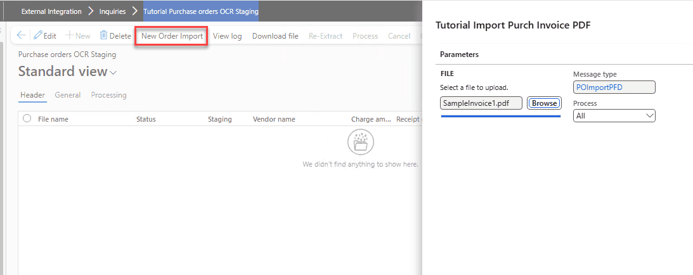
3.Load files

Slide 9
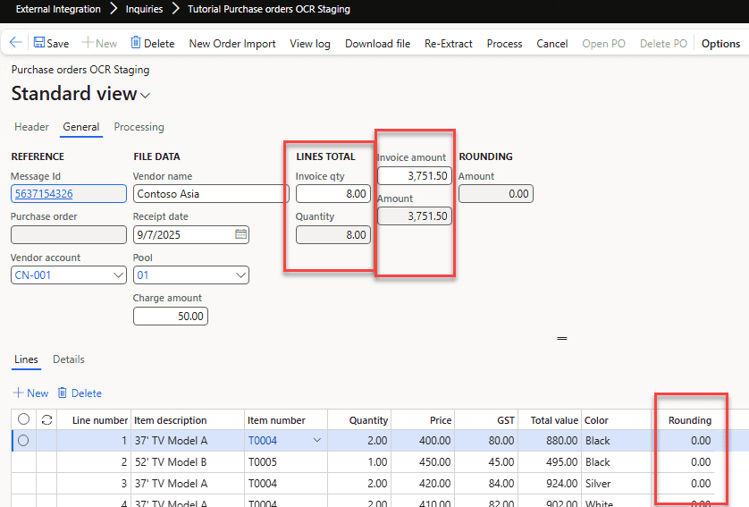
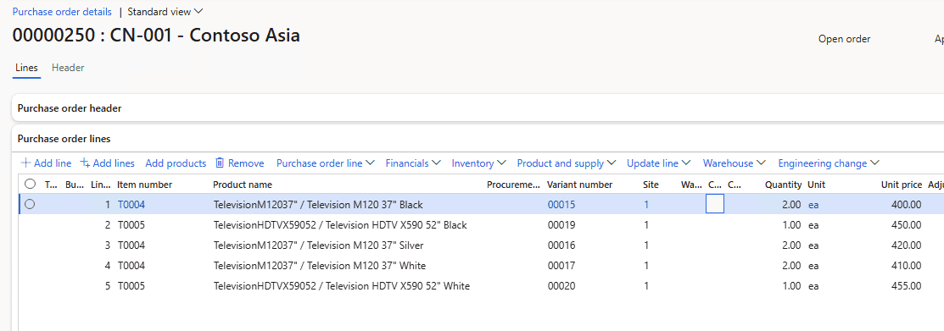
4.Validate and process results

Slide 10
AI usage challenges
Speed.
Top models are currently too slow to process documents. Best results achieved with Google Gemini 2.5 Flash, about 2 minutes per 5-page invoice
Accuracy
Models may work perfectly on small files, but start producing wrong results on large datasets. Very sensitive to prompt structure
Results Validation
Need to build automatic result validation from the start
Price
5-page document is about 10k-15k tokens, so ~1 cent per document

Slide 11
Questions
Let’s connect:
LinkedIn: Denis Trunin https://www.linkedin.com/in/denis-trunin-3b73a213/
Blog: https://denistrunin.com/integration-importpurchpdf/
GitHub: https://github.com/TrudAX/XppTools/tree/master?tab=readme-ov-file#devexternalintegration-submodel

