Slide 1





External Integration Framework
Dynamics 365 Finance & Operations
Module Overview
Design
Requirements
Sample
Integrations
Performance
[1] [2]

Slide 2




Supported Integration Types
Inbound
Event‑Based Export
Import data from external systems into D365FO. Supports complex documents like sales orders, purchase orders and ledger journals.
Real‑time exports triggered by business events (e.g. PO confirmation). Ensures immediate delivery and accurate status.
Periodic Export
Service‑Based
Scheduled exports of datasets to files or SFTP on a regular cadence for reporting or integrations.
Asynchronous integrations leveraging queues (e.g. Azure Service Bus) for reliability and decoupling.
[3] [4] [5] [6]

Slide 3









Data Formats & Channels
Formats
Channels
CSV
Service Bus
EDI
SFTP
Excel
Azure File Share
XML
REST API
JSON
AI (LLM)
Manual
[7] [8] [9] [10]

Slide 4


Why Choose External Integration?
Standard tools (DMF/Business Events)
External Integration Framework
Limited format support (mostly DMF)
Supports CSV, Excel, XML, JSON & PDF via AI
Harder to customise behaviour
Extensible X++ classes & templates
Minimal error visibility & logging
Unified logging & error handling
Batch‑oriented, not real‑time
Real‑time, periodic & asynchronous
High performance for large volumes
Key Benefits:
• Streamlined, reusable design
• Multiple transport & format options
• Better performance & stability
[11] [12] [13] [14]

Slide 5





Design & Requirements
Kickoff & Data Mapping
Select Type & Channel
Configure Connections
Define data mapping & reference data; align teams & scope.
Choose inbound/outbound & the right transport media.
Set up connection types & message parameters.
Develop & Validate
Test & Tune
Implement mapping in X++, stage data & apply business validations.
Run performance tests, monitor logs & iterate.
[15] [16] [17]

Slide 6
Sample Integrations & Scenarios
Scenario | Type | Format | Channel | Notes
Sales Order Import | Inbound | JSON | REST API | Parent/child mapping; supports incremental load
Purchase Order Import (XML) | Inbound | XML | Azure File Share | Reads complex XML using helper class
Ledger Journals Import | Inbound | CSV/Excel | Azure File Share | Processes millions of lines via staging tables
Purchase Order Export | Event‑Based | JSON | REST API | Sends confirmed POs immediately on confirmation
Data Export to SFTP | Periodic | CSV | SFTP | Scheduled exports for on‑hand & customer lists
Service Bus Import | Service‑Based | JSON | Service Bus | Reliable message queue integration
AI PDF Import | Inbound | PDF→JSON | AI Provider | Parses PDF invoices to JSON using LLM
[18] [19] [20] [21] [22] [23] [24]

Slide 7
Performance Testing
Performance Test: Ledger Journal Import
• 1 M lines (1 k files × 1 k lines) imported via Azure File Share
• D8 Standard VM: ~4.7 h
• D16s VM: ~3.1 h
• Increase VM size and tune batch threads for faster processing
[25]

Slide 8

AI‑Driven Purchase Order Import
Overview
• Connect to Gemini 2.5 via AI Provider setup
• Define a prompt & extraction rules to read invoice header and lines
• Produce JSON output and create a purchase order using inbound mapping
• Validate totals, charges and line values; handle multi‑line PDFs
• Reusable classes for AI provider, processing & manual import forms
[26] [27]

Slide 9
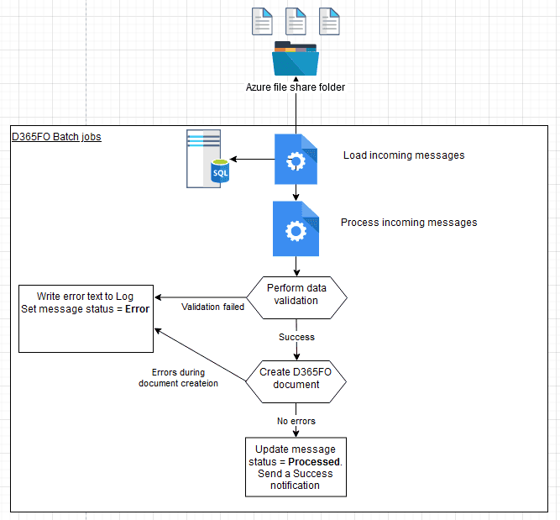
File‑Based Inbound Flow
Process Overview
1. Incoming messages are stored on Azure File Share or SFTP.
2. Batch job loads messages into the Incoming queue.
3. Processing job stages data, validates and creates documents (PO, sales order or journal).
4. On success: update status & send notifications. On failure: log details and mark as Error.
[28] [29] [30]

Slide 10
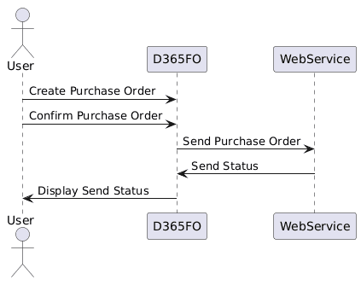
Event‑Based Outbound Flow
Integration Mechanics
• Triggered by confirming a Purchase Order.
• Framework checks conditions: PO in Confirmed state, correct vendor group, not sent before.
• Builds JSON payload and calls partner Web API in real time.
• Logs export status and handles responses to ensure traceability.
[31] [32]

Slide 11

Conclusion & Next Steps
The External Integration framework delivers a powerful, modular and extensible platform for connecting D365FO with the outside world.
• Supports inbound, event‑driven, periodic and service‑based integrations
• Handles multiple data formats and channels, from CSV & XML to AI‑driven PDF processing
• Provides comprehensive error handling, logging and performance tuning
• Comes with sample implementations to accelerate your projects
Explore the documentation and sample code to build your own integrations!
[33] [34]

