Slide 1
Using and teaching GPU Accelerated Image Analysis
Technologies used and lessons learned at the 2023 PoL (Physics of Life) BioImage Analysis GPU Image Analysis course.

Slide 2
PoL BioImage Analysis Symposium 2023
Dresden Aug 28th - Sep 1st 2023
2.5 day training school
Early Career track
GPU Track
Followed by 2.5 day symposium

Slide 3
GPU Accelerated Track
Repository is here https://github.com/BiAPoL/PoL-BioImage-Analysis-TS-GPU-Accelerated-Image-Analysis
Jupyter Book

Slide 4
GPU Accelerated Track
Software installation
Clesperanto (OpenCl bio-imaging)
Cupy (Cuda math and signal processing)
Deconvolution

Slide 5
GPU Accelerated Track
High Performance Computing
Deep Learning
Pytorch
AI Segmentation, Denoising
Dask (chunk based distributed processing)

Slide 6
Background Needed
Python
Github
Jupyter notebooks
Conda environments

Slide 7
Course preparation
Instructors teamed up with partner from Technische Universität Dresden
Partner helps review and test material
Instructors encouraged to test using Dresden HPC infrastructure
Students given setup instructions week before

Slide 8
Clesperanto/CLIJ
CLIJ OpenCL for ImageJ
Clesperanto (prototype)
Python/Matlab wrappers
Clesperanto (c++ version)
Pure c++ version that can be wrapped for Python/Java/etc

Slide 9
Clesperanto/CLIJ
OpenCL based so works on Macs/AMD
(Mac M1 does not support Cuda)
Biology/Microscopy focused

Slide 10
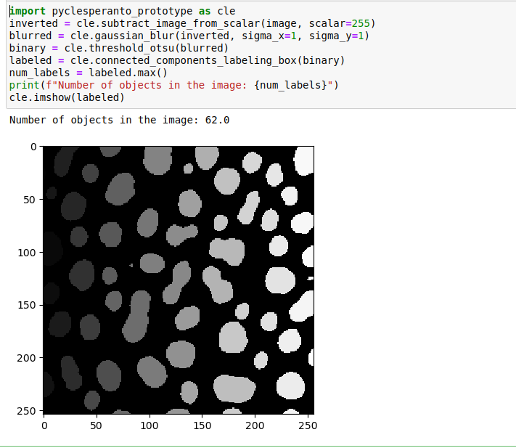
Clesperanto

Slide 11
Cupy
Cuda based GPU-accelerated image and data processing in Python
Dropin replacement for numpy and scipy
API of Cupy is "close" to numpy and scipy so dropin strategy can potentially be used

Slide 12
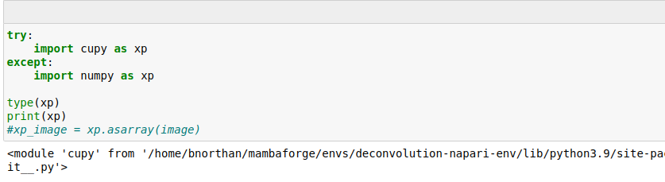
Cupy ‘Dropin’

Slide 13
GPU Deconvolution
GPU greatly accelerates deconvolution calculations
Reviewed CLIJ2, Redlionfish libraries
Looked at several simulations and real images
Showed how deconvolution leads to better measurements.
Deconvolution and Deep learning
Important to understand deconvolution before doing 3D Deep learning

Slide 14
GPU Deconvolution
With GPU feasible to do 1000s of iterations to get dramatic deblurring

Slide 15
GPU Deconvolution
Parameter exploration much faster

Slide 16
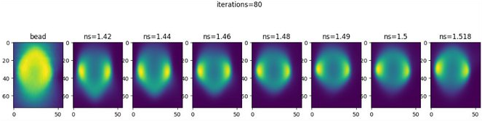
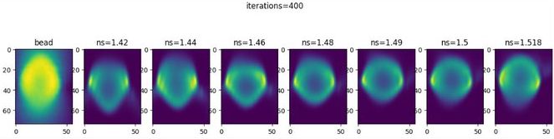
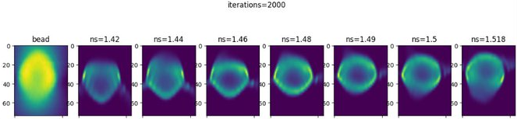

Slide 17
High Performance Computing (HPC)
HPC Machine
Collection of computer nodes (CPUs and/or GPUs)
Dresden ZIH high performance cluster
Learned how to use cluster via
Jupyter notebooks
Command line
All examples used in course could be run on cluster
Cons: Some connection issues

Slide 18
High Performance Computing (HPC)
Course material was very specific to Dresden infrastructure
Con: Non-Dresden students did not have long term buy in
Pro: Good overview of ‘what question to ask’

Slide 19
How do people access GPU?
Most powerful
HPC Cluster
Good
Cloud VMs (AWS etc.)
Professional Workstation (ie Dell Precision)
Multi-GPU Gaming PC
Acceptable
Laptop with modern GPU
Not as good
Older laptop with no/limited GPU

Slide 20
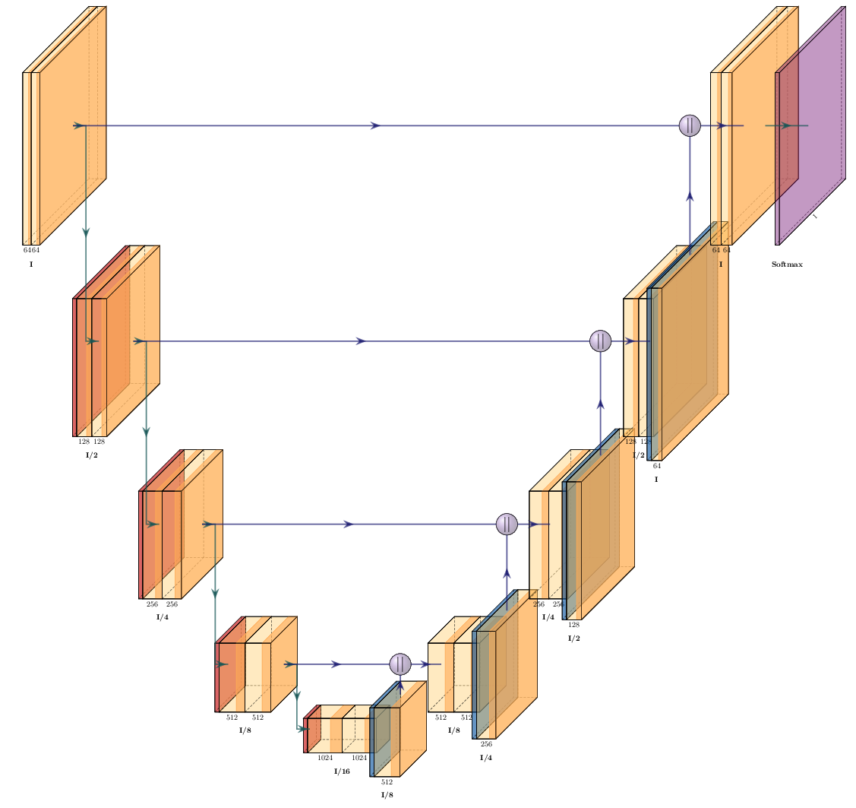
Deep Learning
UNET architecture: Figure courtesy of Peter Steinbach

Slide 21
Deep learning
Pytorch Overview
Segmantic Segmentation with Pytorch unet
Denoising with noise2void

Slide 22
Deep Learning
Could also consider CSB-Deep
CARE
Stardist

Slide 23
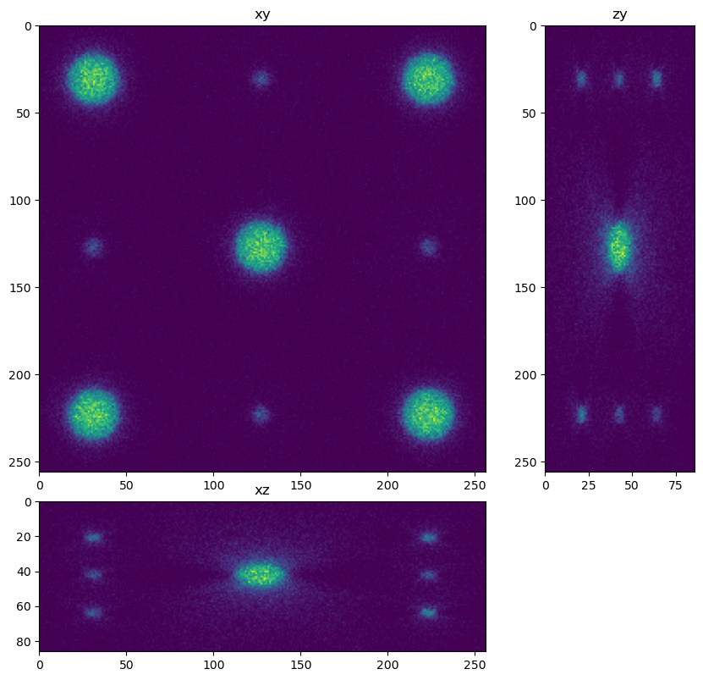
CARE

Slide 24
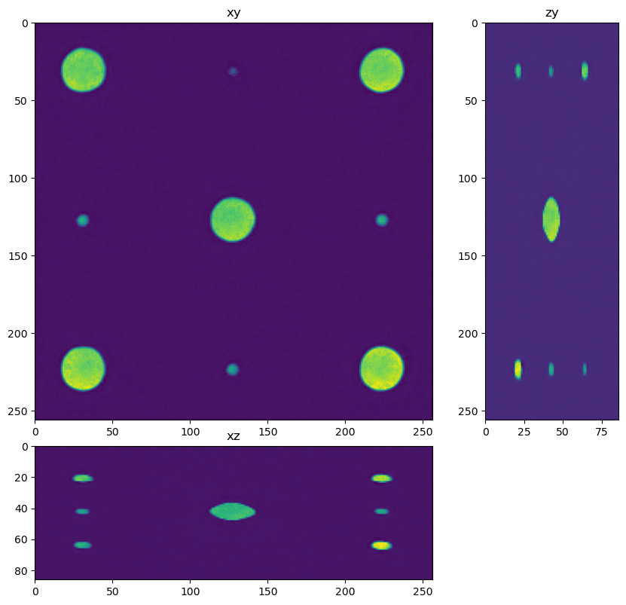
CARE

Slide 25
Deep Learning with GPU
GPU needed to make DL training feasible
For 2D ‘decent’ gaming GPU OK
For 3D SOTF GPU (IE RTX 4090) needed
HPC cluster
Needed for large training set sizes

Slide 26
Dask
an open-source Python library for parallel computing
Image processing extension that makes it easy to process large images in blocks

