Slide 1

Using and teaching GPU Accelerated Image Analysis
Brian Northan
Contract R&D
True North Intelligent Algorithms LLC

Slide 2
Using and teaching GPU Accelerated Image Analysis
Technologies used and lessons learned at the 2023 PoL (Physics of Life) BioImage Analysis GPU Image Analysis course.

Slide 3
PoL BioImage Analysis Symposium 2023
Dresden Aug 28th - Sep 1st 2023
2.5 day training school
  Early Career track
  GPU Track
Followed by 2.5 day symposium

Slide 4
GPU Accelerated Track
Repository is here https://github.com/BiAPoL/PoL-BioImage-Analysis-TS-GPU-Accelerated-Image-Analysis
Jupyter Book

Slide 5
GPU Accelerated Track
Software installation
Clesperanto (OpenCl bio-imaging)
Cupy (Cuda math and signal processing)
Deconvolution
High Performance Computing (HPC)
Deep Learning
Dask

Slide 6
Background Needed
Python
Github
Jupyter notebooks
Conda environments

Slide 7
Course preparation

Slide 8
Course preparation
Instructors teamed up with partner from Technische Universität Dresden
Partner helps review and test material
Instructors encouraged to test using Dresden HPC infrastructure
Students given setup instructions week before

Slide 9
Software Setup

Slide 10
Software Setup
First session of course
  Mamba
  devbio/napari

Slide 11
Clesperanto/Clij

Slide 12
Clesperanto/CLIJ
CLIJ OpenCL for ImageJ
Clesperanto (prototype)
  Python/Matlab wrappers
Clesperanto (c++ version)
  Pure c++ version that can be wrapped for Python/Java/etc

Slide 13
Clesperanto/CLIJ
OpenCL based so works on Macs/AMD
  (Mac M1 does not support Cuda)
Biology/Microscopy focused

Slide 14
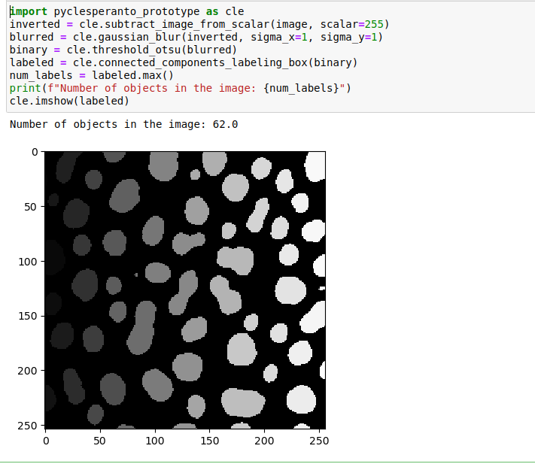
Clesperanto

Slide 15
Cupy

Slide 16
Cupy
Cuda based GPU-accelerated image and data processing in Python
Dropin replacement for numpy and scipy
API of Cupy is "close" to numpy and scipy so dropin strategy can potentially be used

Slide 17
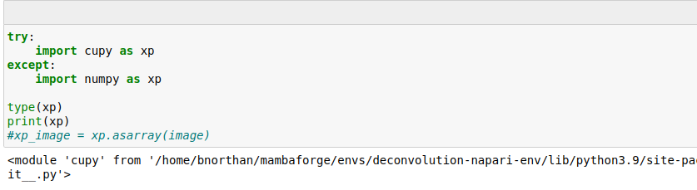
Cupy ‘Dropin’

Slide 18
GPU Deconvolution

Slide 19
GPU Deconvolution
GPU greatly accelerates deconvolution calculations
Reviewed CLIJ2, Redlionfish libraries
Looked at several simulations and real images
Showed how deconvolution leads to better measurements.
Deconvolution and Deep learning
  Important to understand deconvolution before doing 3D Deep learning

Slide 20
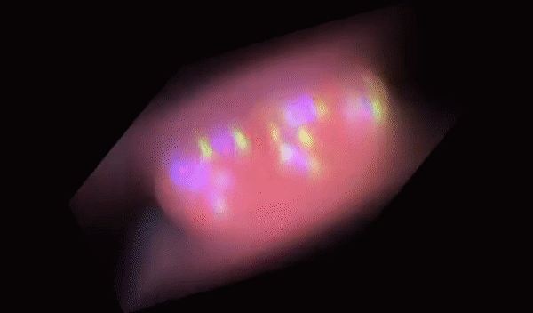
GPU Deconvolution
With GPU feasible to do 1000s of iterations to get dramatic deblurring

Slide 21
GPU Deconvolution
Parameter exploration much faster

Slide 22
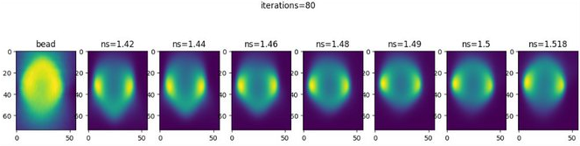
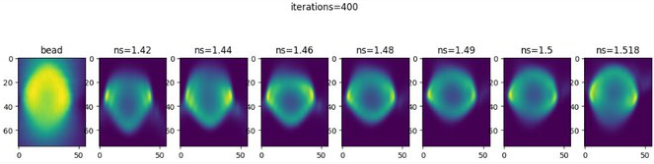
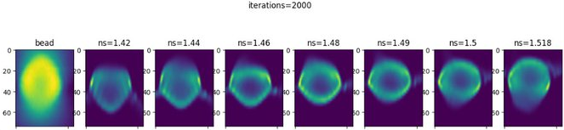

Slide 23
GPU Image Simulation
Create simulated objects and PSF
Used cupy for fast blur and noise simulation (forward)
GPU deconvolution for fast decon parameter testing
Simulations can also be used for DL training and testing

Slide 24
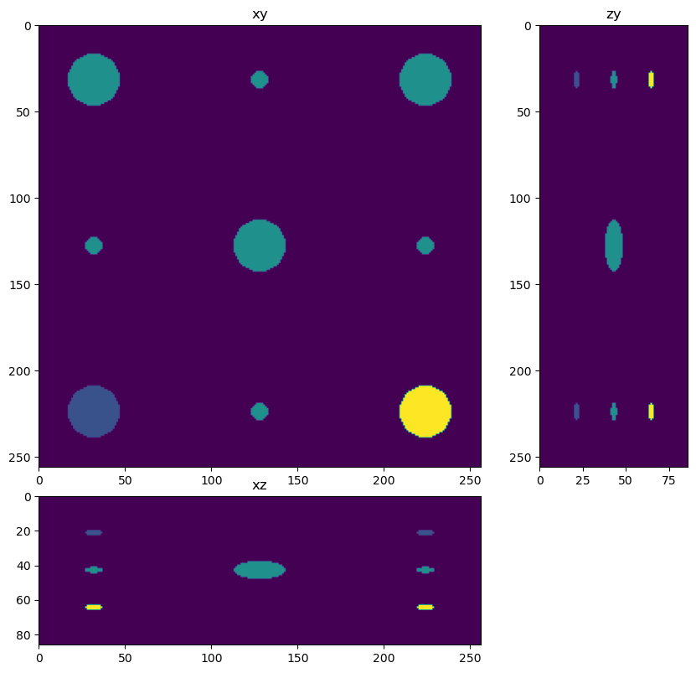

Slide 25
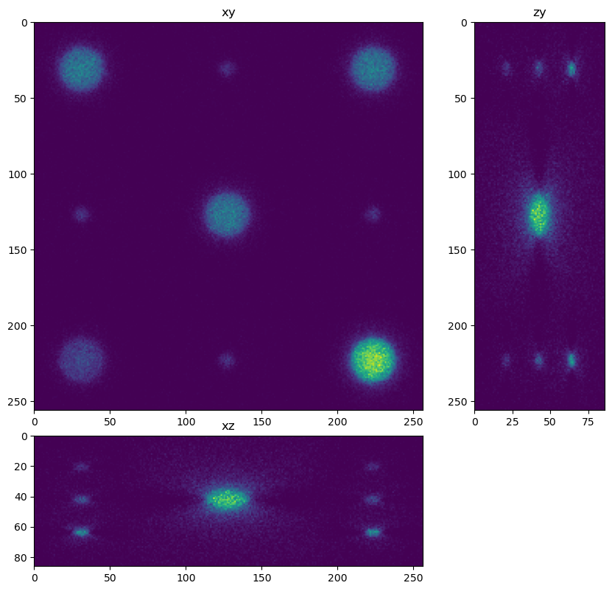

Slide 26


Slide 27
High Performance Computing (HPC)

Slide 28
High Performance Computing (HPC)
HPC Machine
  Collection of computer nodes (CPUs and/or GPUs)
Dresden ZIH high performance cluster
Learned how to use cluster via
  Jupyter notebooks
  Command line
All examples used in course could be run on cluster

Slide 29
High Performance Computing (HPC)
Course material was very specific to Dresden infrastructure
  Con: Non-Dresden students did not have long term buy in
  Pro: Good overview of ‘what questions to ask’
  Pro: Most skills were transferable (ie connecting to cluster through Linux terminal)

Slide 30
Deep Learning

Slide 31
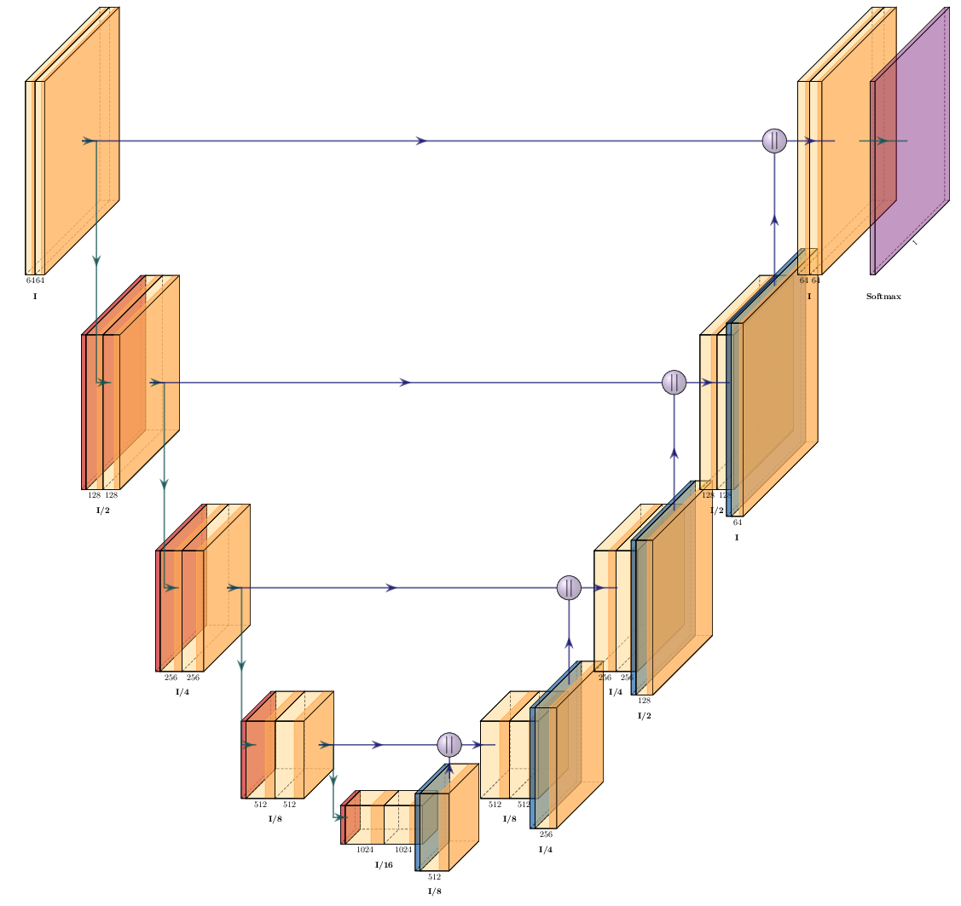
Deep Learning
UNET architecture: Figure courtesy of Peter Steinbach

Slide 32
Deep learning
Pytorch Overview
Segmantic Segmentation with Pytorch unet
Denoising with noise2void

Slide 33
Deep Learning
Could also consider CSB-Deep
  High level wrapper around Unets
  CARE (image-image transformation)
  Stardist (instance segmentation)

Slide 34
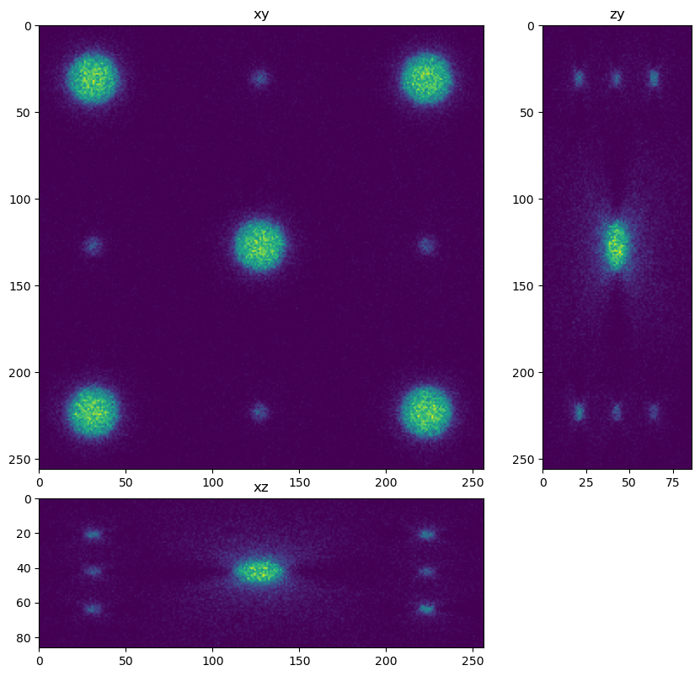
CARE

Slide 35
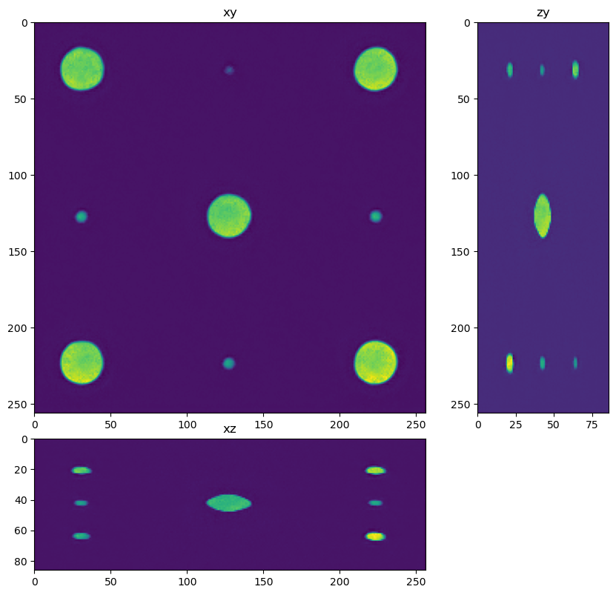
CARE

Slide 36
Dask

Slide 37
Dask
an open-source Python library for parallel computing
Image processing extension that makes it easy to process large images in blocks

Slide 38
Dask
an open-source Python library for parallel computing
Image processing extension that makes it easy to process large images in blocks

Slide 39
Iteration 2

Slide 40
Iteration 2
5 day course instead of 2.5
Show relationships between classical and DL
  Cupy/Clij segmentation and DL segmentation
  Deconvolution and AI restoration
Software installation/HPC
  Focus on ‘accessing GPU’
  Customize solutions
More time for personal projects

Slide 41
Acknowledgments
Stephane Rigaud, Till Korten, Neringa Jurenaite, Apurv Deepak Kulkarni, Peter Steinbach, Sebastian Starke, Johannes Soltwedel, Marvin Albert and Robert Haase

