Slide 1



WALMART SALES
FORECASTING
Notes:
"Good afternoon], we are Group 7, and today we will present our Walmart Sales Forecasting Project."
"Our team members are Aryan Jain, Rupesh Rangwani, Devesh Talreja, and Akshay Thambipillai."
"This project aims to analyze Walmart’s sales data to improve forecasting accuracy, optimize inventory, and inform strategic
decisions."
"Let’s start with the business problem and objectives."

Slide 2






BUSINESS PROBLEM
Walmart faces challenges in meeting consumer demand due to unpredictable sales trends.
Poor sales forecasting leads to:
Overstocking or understocking of inventory
Inefficient workforce allocation
Missed opportunities during high-demand periods
Objective: Identify how external factors like holidays, fuel prices and economic conditions impact sales and improve forecasting accuracy
Notes:
“Walmart faces challenges in accurately predicting sales, leading to inefficiencies such as overstocking, understocking, and suboptimal staffing during peak periods.”
“The business problem centers on addressing this unpredictability by analyzing historical data and external factors such as holidays, economic conditions, and trends.”
“The objective is to implement models that not only forecast sales accurately but also provide actionable insights to help Walmart optimize inventory, staffing, and promotional strategies.”
“Let’s now take a look at the dataset and feature engineering process.”

Slide 3


Project Overview: Data to Models
DATASET
Data Preprocessing
6435 rows, 8 features
from multiple Walmart stores
Key Features:
Weekly_Sales: Target variable.
Fuel_Price,CPI, Unemployment, Holiday_Flag: Predictors.
Temporal features: Date column (converted to Year, Month, Week)
Converted Date to datetime format and extracted temporal features (Year, Month, Week).
Created lagged features (Lag_1, Lag_2) and rolling mean (Rolling_4) for time series insights.
Encoded Holiday_Flag to differentiate holiday weeks.
No missing values detected, ensuring a complete dataset
Exploratory Data Analysis
Modeling Approach
Four models implemented:
Linear Regression: Baseline model for simple relationships.
Decision Tree: Captures nonlinear interactions between predictors.
ARIMA: Handles seasonality and time-series trends.
XGBoost: Advanced model for complex relationships.
Sales exhibit seasonality, with spikes during holidays.
Boxplot: Holiday weeks show significantly higher sales compared to non-holidays.
Scatterplot: Sales have moderate correlations with CPI and Unemployment
Notes:
“We used Walmart’s sales dataset, which contains over 6,000 rows and features such as weekly sales, holidays, temperatures, fuel prices, CPI, and unemployment rates.”
“To enhance the dataset, we created new features, including lagged values (Lag_1, Lag_2) to incorporate past trends and a rolling average (Rolling_4) to capture smoothed sales trends.”
“We also added a Holiday_Indicator to differentiate holiday weeks, which are critical for Walmart’s sales.”
“These engineered features formed the foundation for the models we built.”
"Aryan will now walk us through the exploratory data analysis."

Slide 4
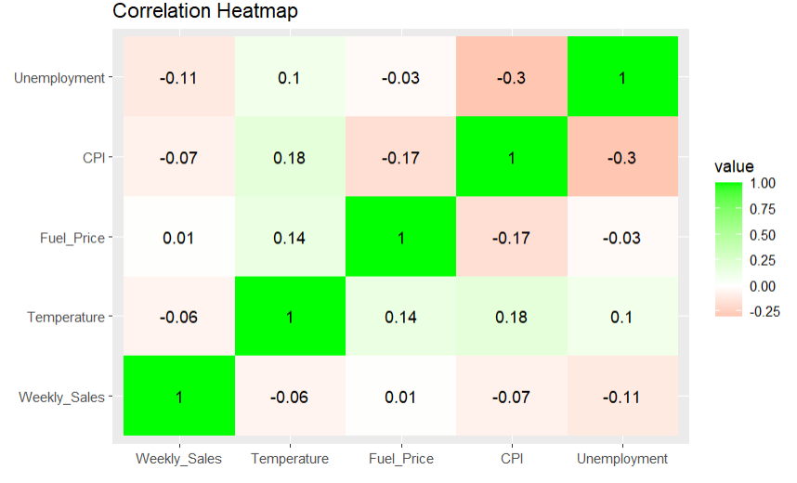
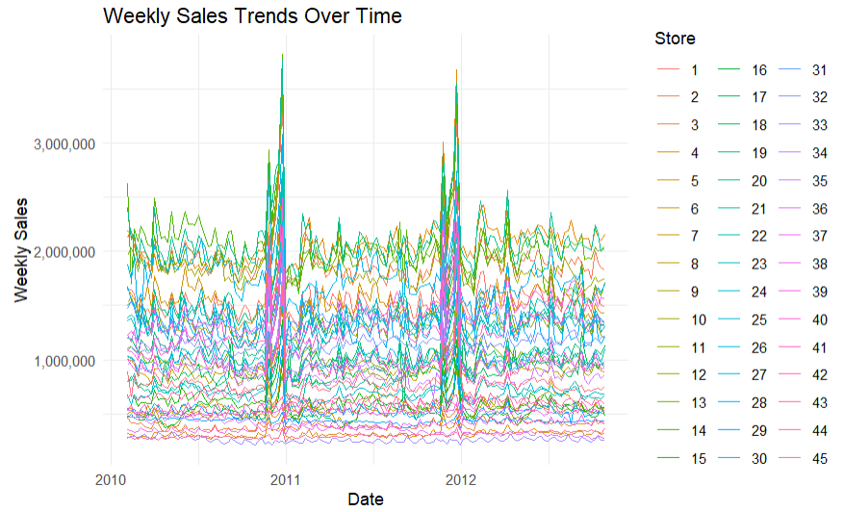
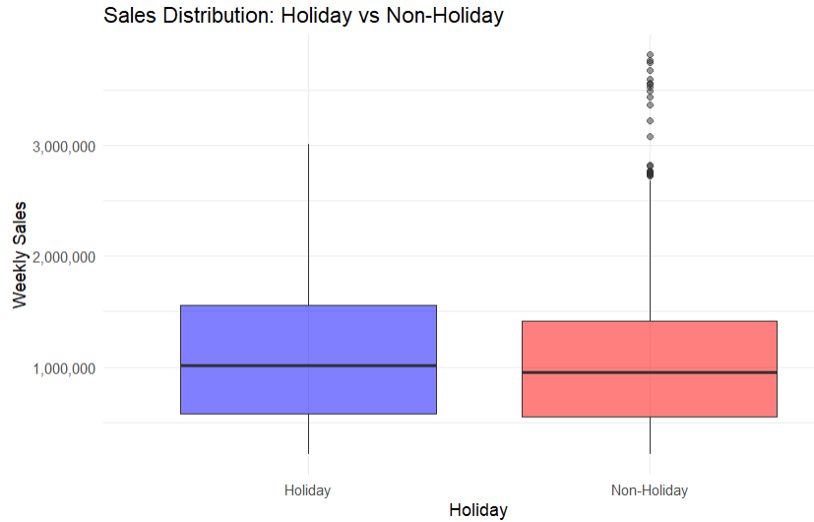
EXPLORING SALES RELATIONSHIPS
& TRENDS
Notes:
"Our EDA revealed significant insights into Walmart’s sales patterns."
"For instance, sales exhibit clear seasonality with spikes during major holidays like Thanksgiving and Christmas."
"The boxplot shows that holiday weeks have significantly higher sales than non-holiday weeks, underscoring the importance of these periods."
"The correlation matrix highlights how CPI and Unemployment negatively impact sales, reflecting broader economic influences."
"Now, let’s move on to our modelling approach."

Slide 5
MODELS
Notes:
We employed four models for this project: Linear Regression, Decision Tree, ARIMA, and XGBoost.

Slide 6
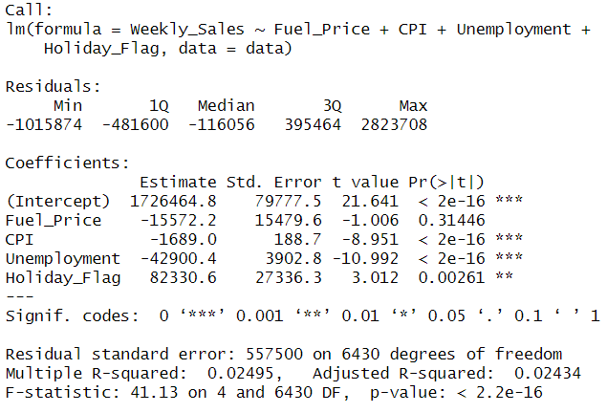
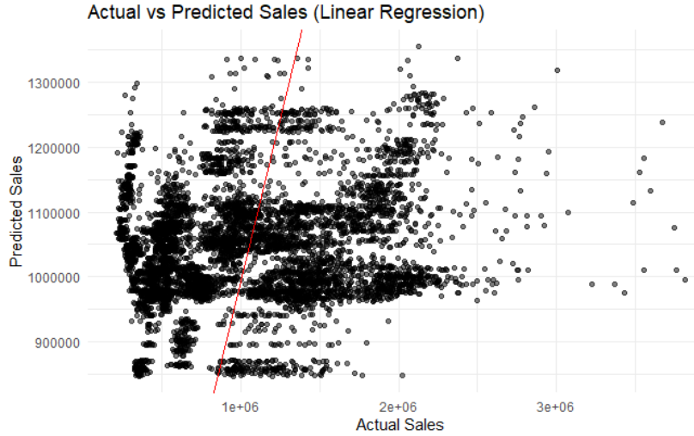
Linear Regression Analysis
Overview
1
Predictive model analyzing the impact of Fuel Price, CPI,
Unemployment, and Holiday Flag on Weekly Sales.
Model Fit
2
Weekly_Sales ~ Fuel_Price + CPI + Unemployment + Holiday_Flag
Coefficient : CPI: -1689 |Unemployment: -42,900 |Holiday Flag: +82,330
Performance
3
RMSE: 557,238.96| MAE: 467,137.46 | MAPE: 0.66%
Visualization
4
Scatterplot: Actual vs Predicted Sales with red ideal fit line
for comparison.
Notes:
Introduction:
"We Started with Linear Regression as a baseline model. It analyzed how variables like Fuel Price, CPI, Unemployment, and Holiday Flag influence Weekly Sales."
Model Insights:
"Holidays boosted sales by around 80,000 units, while higher CPI and unemployment negatively impacted sales, with coefficients of -1689 and -42,900 respectively. These findings align with the business fact that holidays drive demand, while economic downturns suppress it."
Performance:
"Linear Regression had an RMSE of around 550,000, indicating significant prediction errors. Its low R-squared of 0.0245 shows it failed to explain much variance in sales."
Transition:
"Now, Akshay will explain how Decision Tree addresses these limitations."

Slide 7
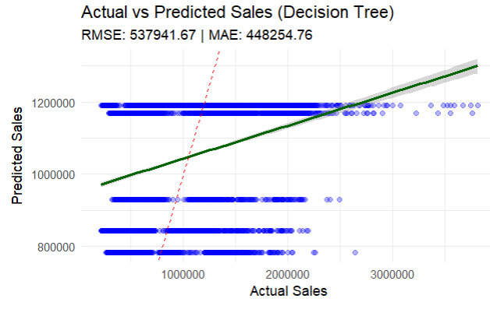
Decision Tree Analysis
Overview
1
The decision tree model predicts weekly sales by analyzing the impact
of Fuel Price, CPI, Unemployment, and Holiday Flag
Model Fit
2
The decision tree splits sales data hierarchically based on
influential variables like Unemployment and CPI
Key splits: Unemployment ≥ 9, CPI ≥ 189
Performance
3
RMSE: 537,941.67 | MAE: 448,254.76 | MAPE: 0.63%
Visualization
4
Scatterplot: Decision tree predictions align well with actual sales
for mid-range values but show variance at extremes
Notes:
Overview:
"Decision Tree predicts sales by hierarchically splitting data. Key splits, like 'Unemployment ≥ 9%' and 'CPI ≥ 189,' highlight how economic factors shape sales performance."
Performance:
"This model improved accuracy, with an RMSE of 537,942 and MAPE of 0.63%. However, it struggled with variance at extremes, leading to some inaccuracies."
Business Insights:
"The Decision Tree revealed that low CPI and unemployment drive higher sales. These insights can guide Walmart’s promotional and staffing strategies."
Visualization:
"Here, the Decision Tree structure and scatterplot show how sales predictions align with actual data."
Transition:
"Next, let’s look at the actual Decision Tree structure."

Slide 8
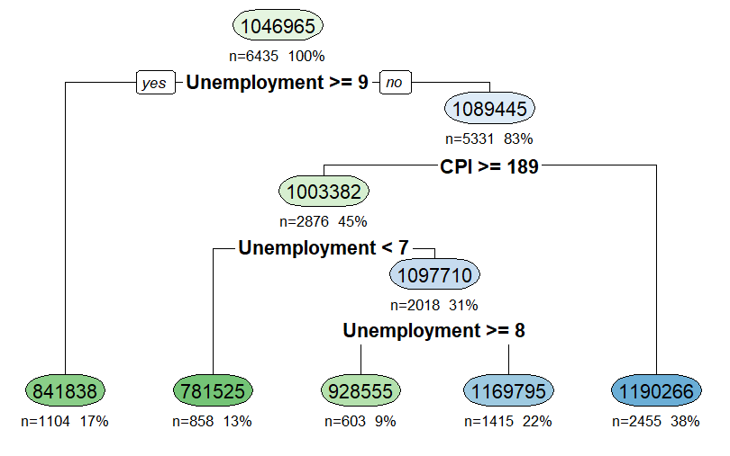
Decision Tree Visualization
Notes:
Overview:
"This is the Decision Tree structure generated by our model. It starts with the entire dataset at the root node, where the average weekly sales are 1,046,965."
"The first split occurs at Unemployment >= 9, showing its significant impact on sales."
Key Insights:
"On the left, for regions where Unemployment is higher, the sales are much lower, with averages around 841,838."
"On the right, for regions where CPI is greater than 189, sales improve, averaging around 1,190,266."
"Each node represents a subset of the data, with the n value showing the number of observations and the percentages highlighting the split proportions."
Business Relevance:
"This visualization helps Walmart identify patterns in economic factors like unemployment and CPI, which can inform decisions on promotions and inventory in different regions.
I will now walk you through ARIMA, our time-series model that captures seasonal patterns

Slide 9
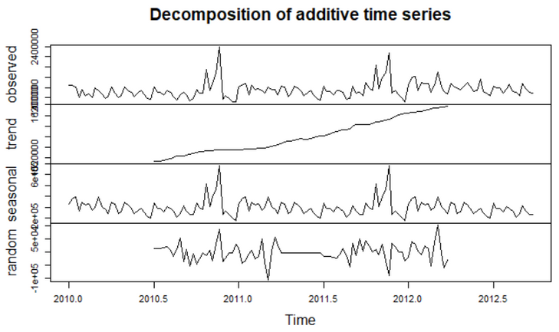
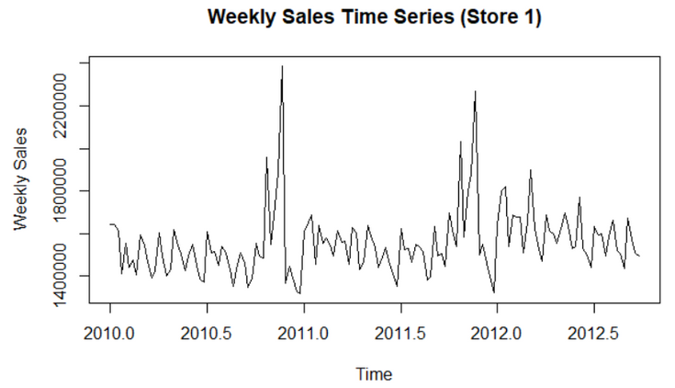
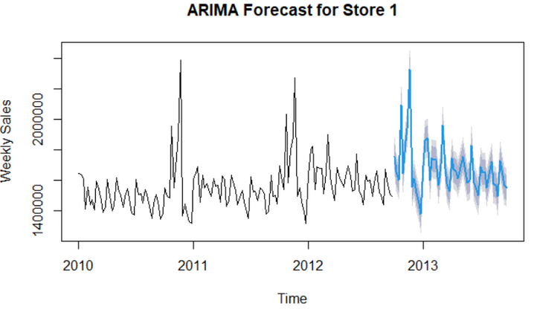
Time Series Analysis With ARIMA
Decomposition
1
Sales show an increasing trend over time
with clear seasonal spikes
Model Fit
2
ARIMA(0,1,0) with drift, modelling data as random walk
with constant drift
Performance
3
RMSE: 51,245, MAE: 33,222.97, MAPE: 2.02% indicating
a reasonably accurate model
Forecast
4
52-week forecast aligns with recent sales trend,
showing seasonality with widening confidence intervals
Notes:
Decomposition:
"ARIMA captures trends and seasonality in sales. The decomposition shows sales peaks during major holidays, such as Thanksgiving."
Performance:
"ARIMA delivered the best results among all models, with an RMSE of 51,245 and MAPE of 2.02%. It’s ideal for forecasting seasonal trends and planning inventory."
Forecast:
"The 52-week forecast aligns with historical trends, though confidence intervals widen over time, emphasizing uncertainty in long-term predictions."
Business Insights:
"ARIMA’s ability to predict seasonal demand makes it invaluable for managing holiday inventory and staffing."
Transition:
"Finally, Rupesh will explain XGBoost, our machine learning approach."

Slide 10
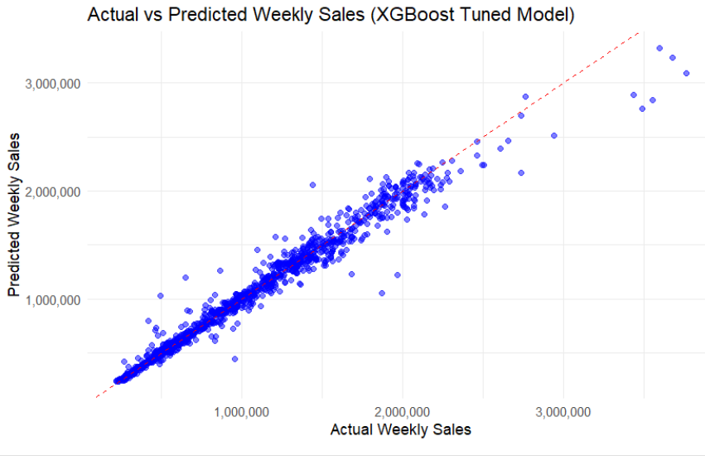
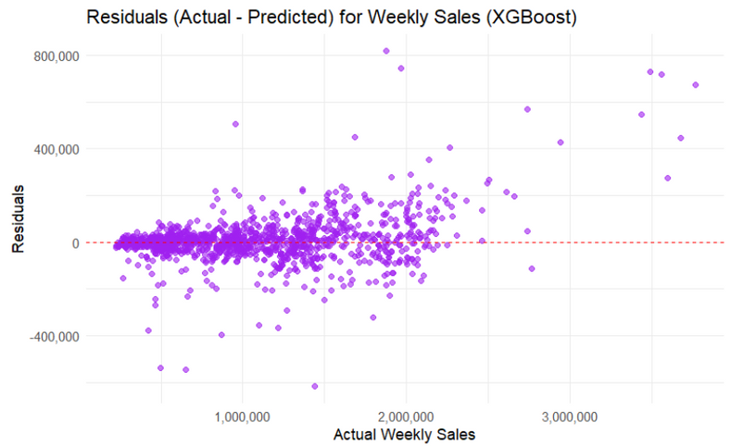
XGBoost Analysis
Overview
1
Predictive model leveraging gradient-boosted decision trees
for accurate weekly sales forecastings.
It incorporates historical data (Lag_1, Lag_2), trends (Rolling_4),
and external factors (CPI, Unemployment, Fuel Price, Holiday_Flag).
Model Fit
2
Tuned XGBoost model with:
Max Depth: 6
Learning Rate (Eta): 0.1
Number of Trees (Best Rounds): Optimized using Cross-Validation
Features include Lag_1, Lag_2, Rolling_4, and economic indicators.
3
Performance
RMSE: 98,151| MAE: 54,827 |MAPE: 5.10%
Outperformed other models in precision
Visualization
4
Actual vs Predicted Sales
Residual Plot

Slide 11
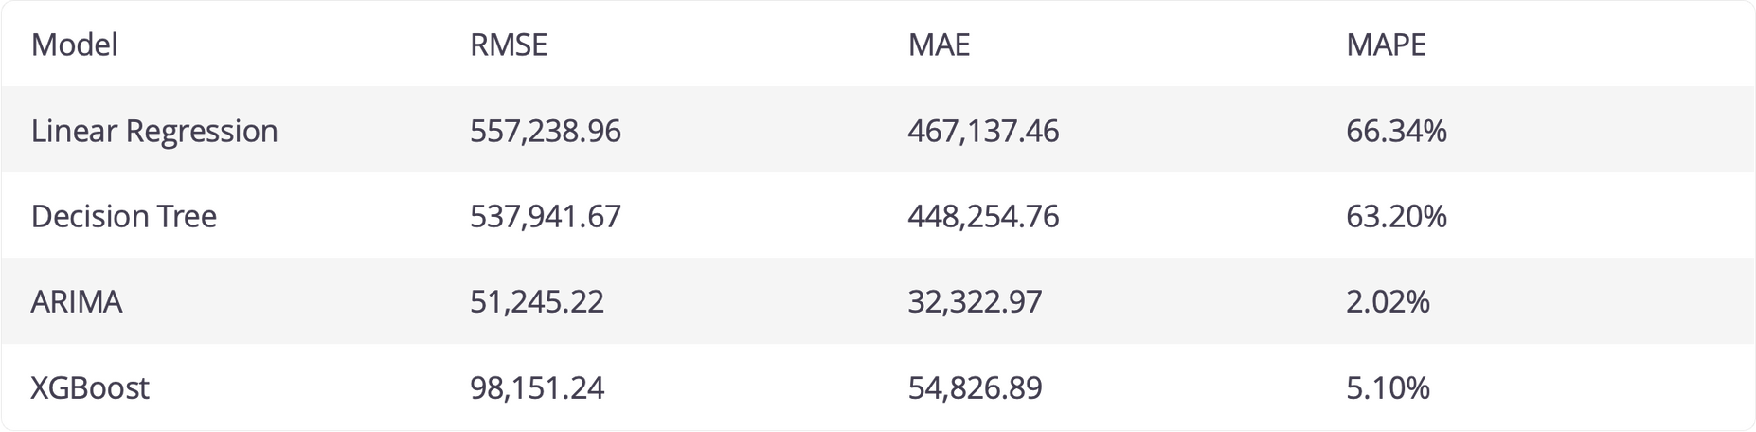
MODEL PERFORMANCE COMPARISON
KEY METRICS
INSIGHTS

Slide 12
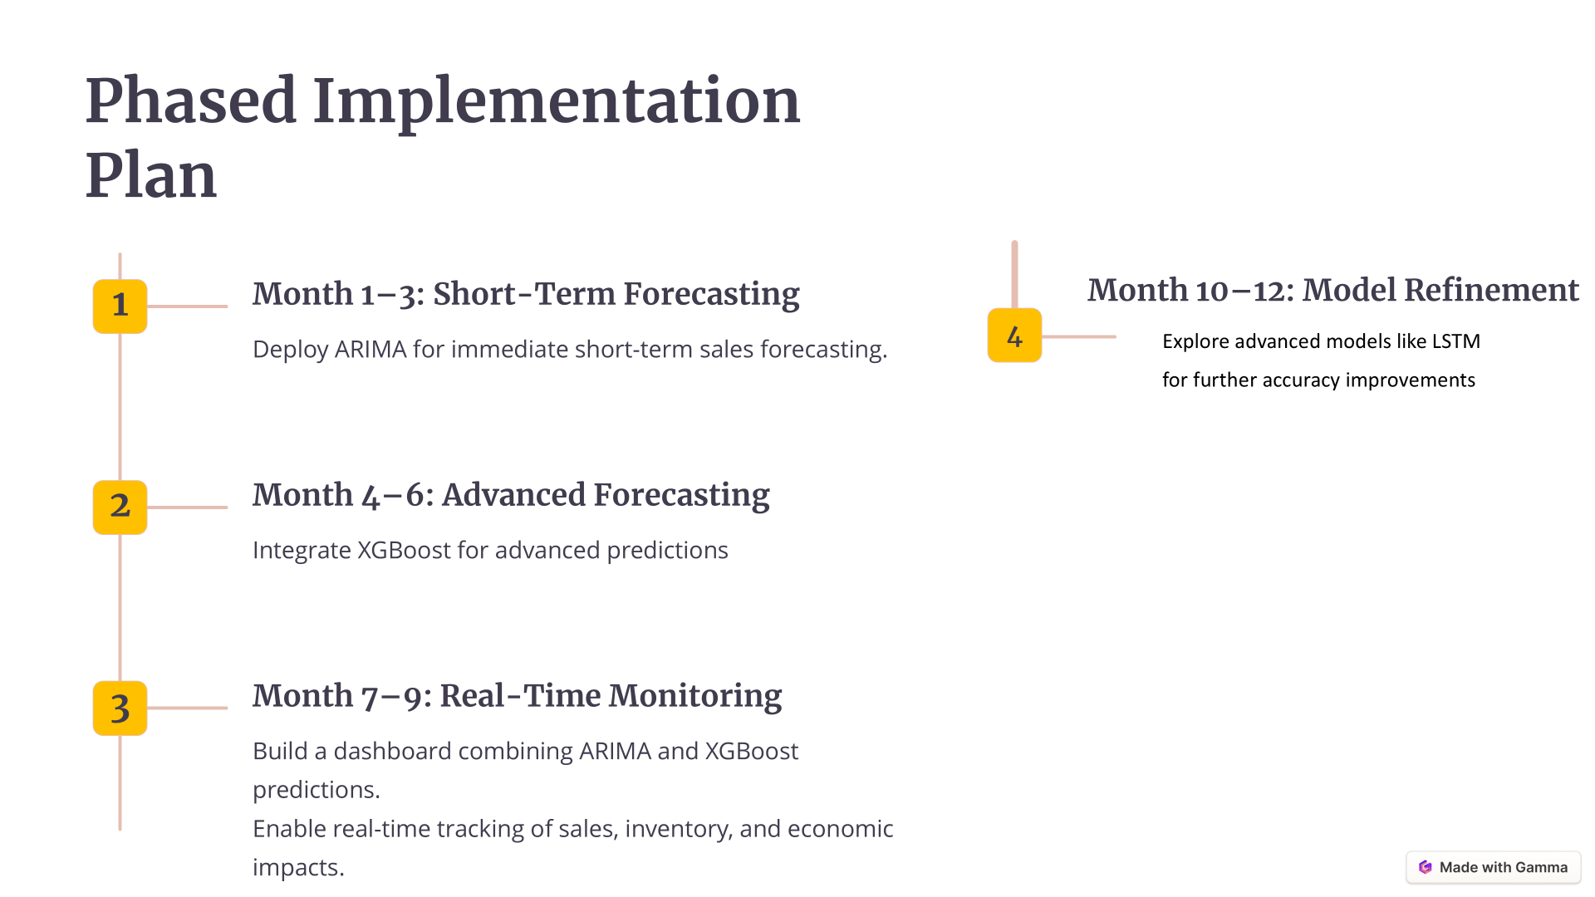

Slide 13



STRATEGIC RECOMMENDATIONS
For Short-Term Planning:
Use ARIMA for operational needs like inventory and staffing based on predictable trends.
For Long-Term Strategy:
Use XGBoost to analyze and leverage external factors for promotions and pricing.
Integrated Solution:
Combine ARIMA’s strengths in trend forecasting with XGBoost’s ability to incorporate external factors for robust predictions.
Why It Matters:
Improve operational efficiency and maximize sales during high-demand periods.
Notes:
Hey there

Slide 14
THANK YOU

