Slide 1
单图上的频繁子图挖掘
陈乐偲 19307130195
袁鑫凤 19307110525
张冀 19300180021

Slide 2
目录
问题定义
主要思路，难点及经典方法
我们的方法及实验介绍
其它方法及可能探索的方向

Slide 3
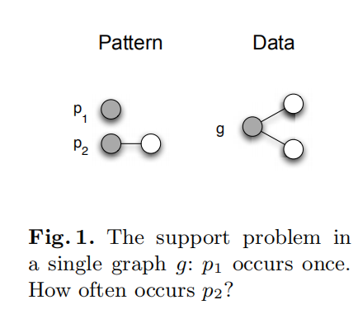
问题定义
如何计数，Overlap的问题
为了满足单调性

Slide 4
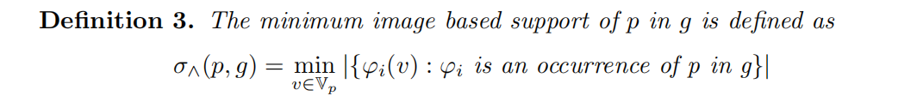
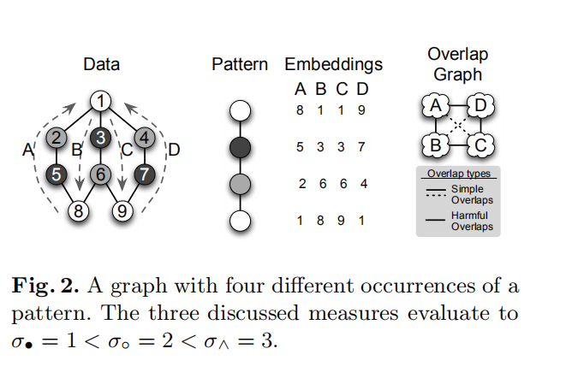
问题定义[What is Frequent in a Single Graph[1]]
不基于独立集MIS的方法，同样满足单调性得MNI
[1] Bringmann B., Nijssen S. (2008) What Is Frequent in a Single Graph?. In: Washio T., Suzuki E., Ting K.M., Inokuchi A. (eds) Advances in Knowledge Discovery and Data Mining. PAKDD 2008.

Slide 5
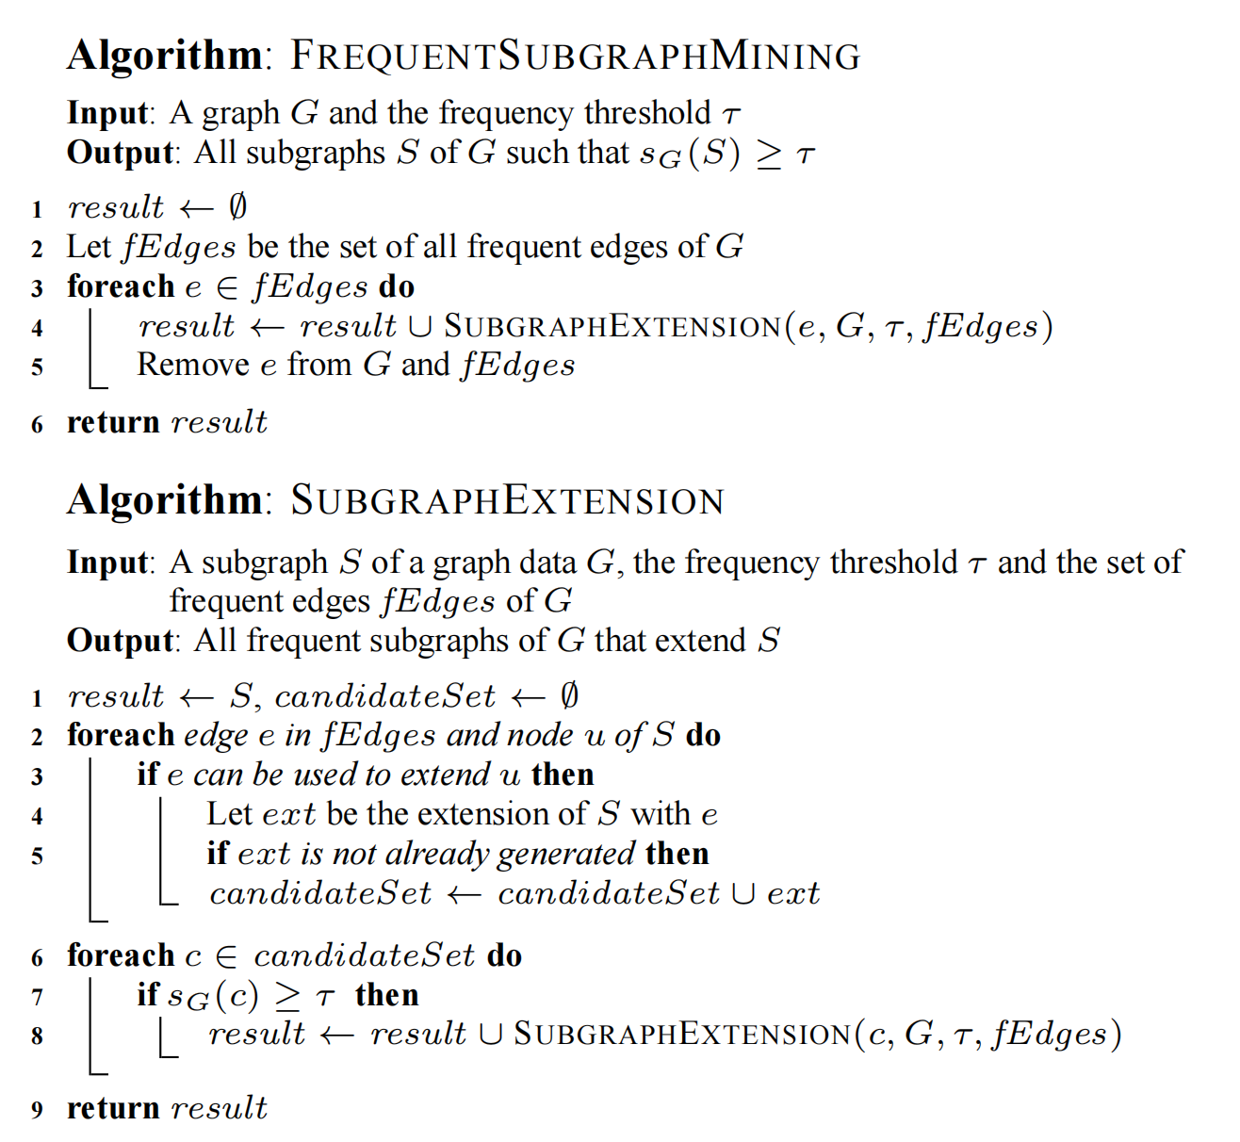
主要思路
基于Pattern Grow的方法的Search

Slide 6
基于搜索的难点
如何知道该图已经搜过，避免重复搜索？：图的编码与记录
对于一个固定子图，如何判断它是否频繁：图同构的判断
Gspan[2002[1]]中使用DFS code解决了重复搜索的问题
还需要解决：如何快速判断一个子图是否频繁
[1] Xifeng Yan and Jiawei Han, "gSpan: graph-based substructure pattern mining," 2002 IEEE International Conference on Data Mining, 2002. Proceedings., 2002, pp. 721-724, doi: 10.1109/ICDM.2002.1184038.

Slide 7
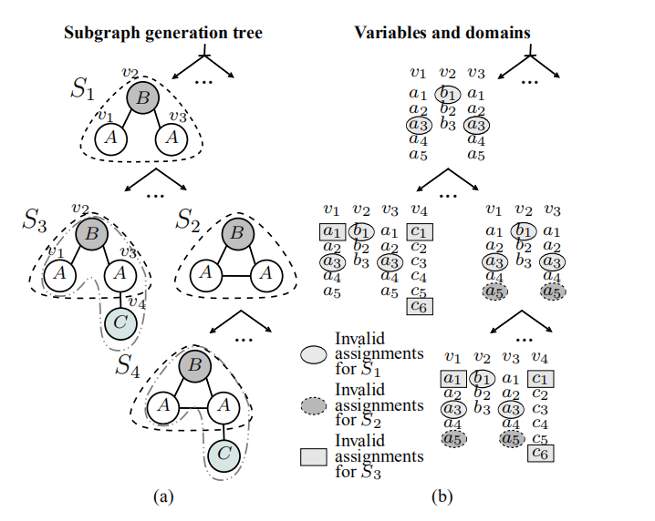
GraMi[2014’VLDB[1]]
将问题看作约束满足问题CSP
频繁的子图可以满足k次
关键在于利用反单调性
对CSP的赋值进行剪枝
[1] Mohammed Elseidy, Ehab Abdelhamid, Spiros Skiadopoulos, and Panos Kalnis. 2014. GraMi: frequent subgraph and pattern mining in a single large graph. Proc. VLDB Endow. 7, 7 (March 2014), 517–528. DOI:https://doi.org/10.14778/2732286.2732289

Slide 8
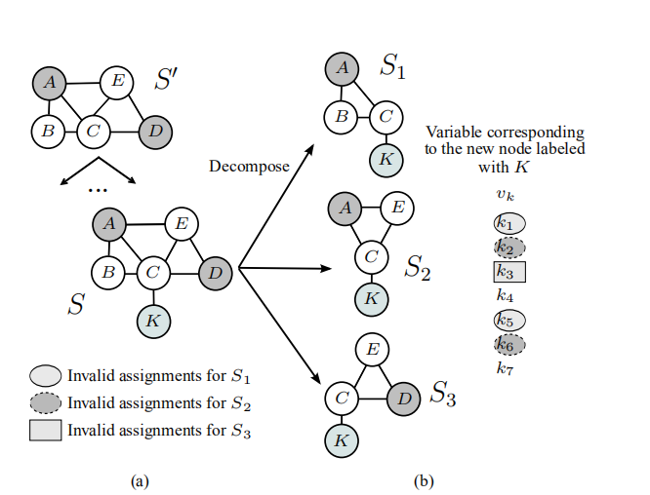
GraMi的其他优化
分解，小图不满足则大图不满足，看作想BFS方法的过度
自同构，识别出自同构
LazySearch，对搜的很久的，认为其不是答案，以后再搜
针对特殊图的优化（单标签，树）

Slide 9
想法
结合子图同构算法
基于候选的思想，加入剪枝

Slide 10
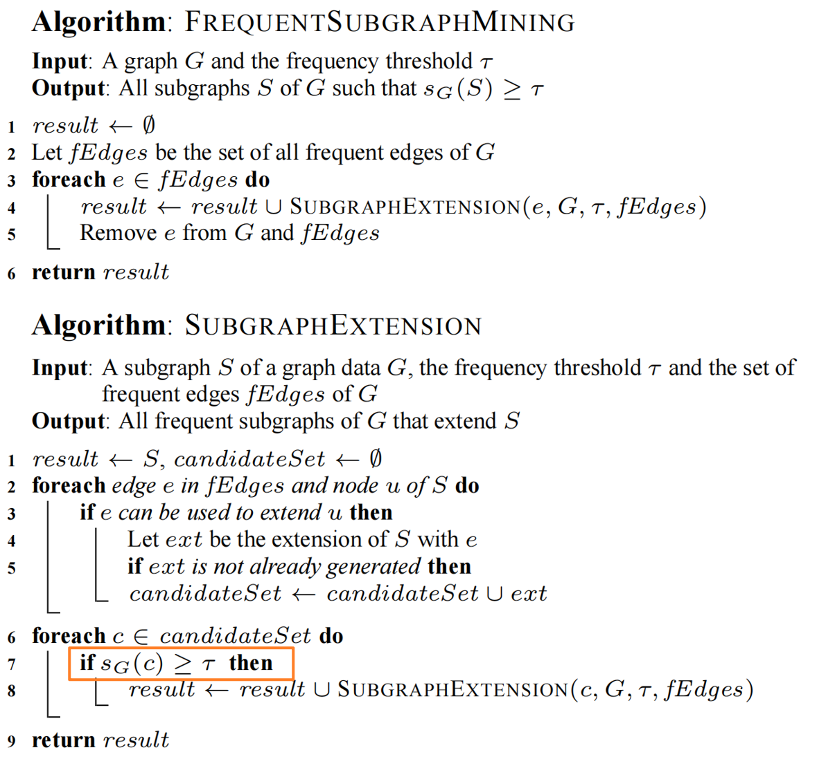
我们的想法
在判断一个子图是否频繁时先采取Filter进行Domain的筛选

Slide 11
Sub-Graph Matching
u1
v1
v2
A
A
A
v3
v4
v6
v7
u2
B
C
u3
B
C
B
C
D
D
D
u4
v8
v9
Pattern/Query
Graph

Slide 12
Candidate Generation
u1
v1
v2
v1
v2
A
A
A
v3
v4
v6
v7
u2
B
C
u3
B
C
B
C
D
D
D
u4
v8
v9
Pattern/Query
Graph

Slide 13
Candidate Generation
u1
v1
v2
v1
v2
A
A
A
v3
v4
v6
v7
u2
v3
v6
B
C
u3
v4
v7
B
C
B
C
D
D
D
u4
v8
v9
v8
v9
Pattern/Query
Graph

Slide 14
Filter
u1
v1
v2
v1
v2
A
A
A
v3
v4
v6
v7
u2
v3
v6
B
C
u3
v4
v7
B
C
B
C
D
D
D
u4
v8
v9
v8
v9
Pattern/Query
Graph

Slide 15
Filter
u1
v1
v2
v1
v2
A
A
A
v3
v4
v6
v7
u2
v3
v6
B
C
u3
v4
B
C
B
C
D
D
D
u4
v8
v9
v8
v9
Pattern/Query
Graph

Slide 16
Filter
u1
v1
v1
v2
A
A
A
v3
v4
v6
v7
u2
v3
B
C
u3
v4
B
C
B
C
D
D
D
u4
v8
v8
v9
Pattern/Query
Graph

Slide 17
Search
u1
v1
v1
v2
A
A
A
v3
v4
v6
v7
u2
v3
B
C
u3
v4
B
C
B
C
D
D
D
u4
v8
v8
v9
Pattern/Query
Graph

Slide 18
Support Filter
u1
v1
v1
v2
A
A
A
v3
v4
v6
v7
u2
v3
B
C
u3
v4
B
C
B
C
D
D
D
u4
v8
v8
v9
Pattern/Query
Min Support = 2
Graph

Slide 19
Support Filter
u1
v1
v2
A
A
A
v3
v4
v6
v7
u2
B
C
u3
B
C
B
C
D
D
D
u4
v8
v9
Pattern/Query
Min Support = 2
Graph
No Frequent Pattern！

Slide 20
u1
v1
u1
v1
v2
A
A
A
A
v3
v4
v6
v7
u2
v3
B
C
u3
v4
u2
B
C
u3
B
C
B
C
D
D
D
D
u4
v8
u4
v8
v9
With Filter
With Support Filter
Graph

Slide 21
u1
v1
v2
v1
v2
A
A
A
v3
v4
v6
v7
u2
v3
v6
B
C
u3
v4
v7
B
C
B
C
D
D
D
u4
v8
v9
v8
v9
Without Filter
Graph

Slide 22
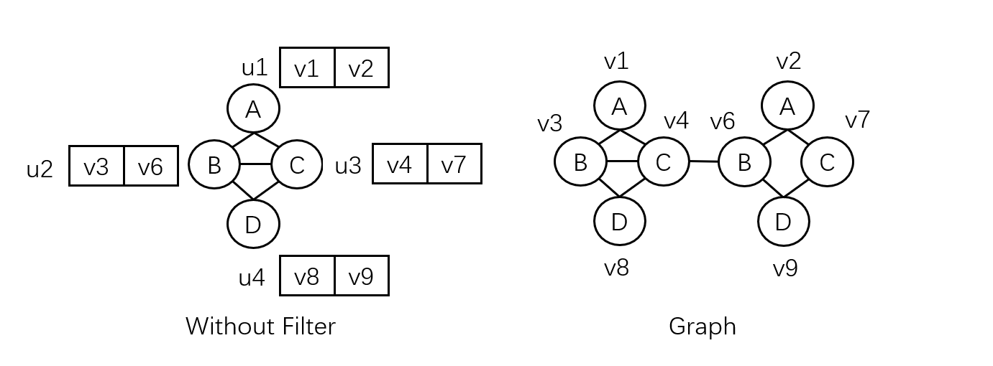
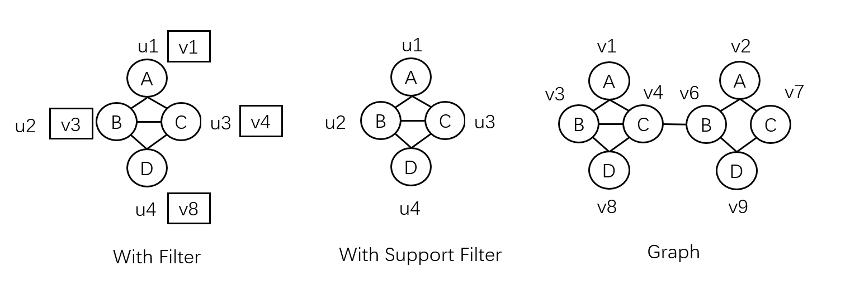

Slide 23
Experiment (With Python)
Mining Time on YEAST Dataset
Naive | Filter | Support Filter
25.09s | 18.45s | 13.95s
YEAST Dataset[1]
V | E | Degree | Support
3112 | 12519 | 8 | 470
[1]:https://github.com/RapidsAtHKUST/SubgraphMatching

Slide 24
Pattern Grow
u1
A
u2
B
C
u3
v1
v2
D
u4
A
A
v3
v4
v6
v7
Pattern/Query
B
C
B
C
u1
D
D
A
v8
v9
u2
B
C
u3
D
Graph
u4
E
u5
Pattern/Query

Slide 25
Static Candidate Generation
u1
v1
v2
v1
v2
A
A
A
v3
v4
v6
v7
u2
v3
v6
B
C
u3
v4
v7
B
C
B
C
D
D
D
u4
v8
v9
v8
v9
E
u5
Pattern/Query
Graph

Slide 26
Dynamic Candidate Update
u1
v1
A
u2
v3
B
C
u3
v4
D
v1
v2
A
A
u4
v3
v4
v6
v7
u1
Pattern/Query
B
C
B
C
A
D
D
u2
B
C
u3
v8
v9
D
u4
E
Graph
u5
Pattern/Query

Slide 27
Dynamic Candidate Update
u1
v1
v1
v2
A
A
A
v3
v4
v6
v7
u2
v3
B
C
u3
v4
B
C
B
C
D
D
D
u4
v8
v8
v9
E
u5
Pattern/Query
Graph

Slide 28
Dynamic Candidate Update
u1
v1
A
u2
v3
B
C
u3
v4
D
v1
v2
A
A
Inherit
u4
v8
v3
v4
v6
v7
u1
Pattern/Query
B
C
B
C
A
D
D
u2
B
C
u3
v8
v9
D
u4
E
Graph
u5
Pattern/Query

Slide 29
Sample
通过在图上采样获得高质量的近似解(2021‘KDD[3])
将项集的出现次数看作示性函数，通过概率和统计学习理论分析
采样的近似率可以由VC维相关的理论给出(2014’TKDD[1]）
采样的方式可以是随机游走等(2010’[2])
[1] Riondato, Matteo, and Eli Upfal. "Efficient discovery of association rules and frequent itemsets through sampling with tight performance guarantees." ACM Transactions on Knowledge Discovery from Data (TKDD) 8.4 (2014): 1-32.
[2] Zou, Ruoyu, and Lawrence B. Holder. "Frequent subgraph mining on a single large graph using sampling techniques." Proceedings of the eighth workshop on mining and learning with graphs. 2010.
[3] Preti, Giulia, Gianmarco De Francisci Morales, and Matteo Riondato. "MaNIACS: Approximate Mining of Frequent Subgraph Patterns through Sampling." Proceedings of the 27th ACM SIGKDD Conference on Knowledge Discovery & Data Mining. 2021.

Slide 30
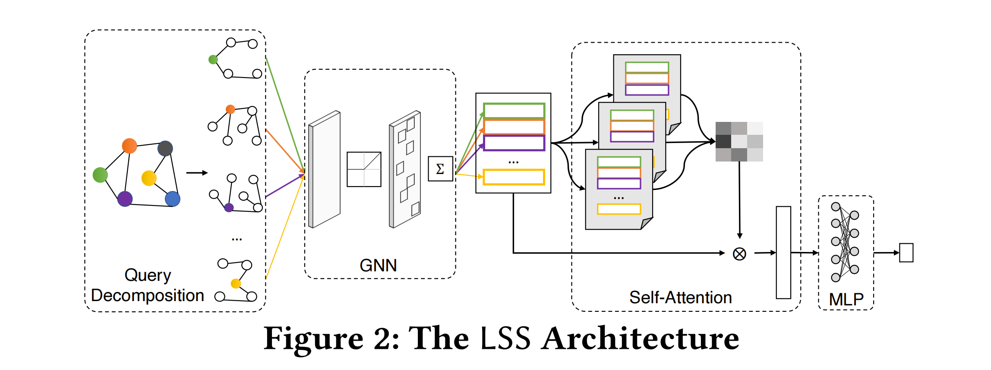
A Learned Sketch for Subgraph Counting
[1] Zhao K, Yu J X, Zhang H, et al. A Learned Sketch for Subgraph Counting[C]//Proceedings of the 2021 International Conference on Management of Data. 2021: 2142-2155.

Slide 31
Approximation With Neural Networks
u1
A
u2
B
C
u3
GCN
Encoding of Query
D
u4
Pattern/Query
v1
v2
A
A
v3
v4
v6
v7
B
C
B
C
GCN
Encoding of Graph
D
D
v8
v9
Graph

Slide 32
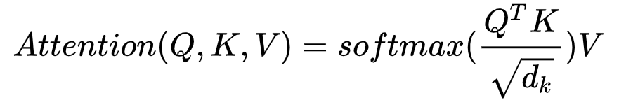
How to compute similarity
Intuitive search
Find a short vector from a long vector given a good order
Attention
Similarity

Slide 33
Attention
Encoding of Query
u1
A
Attention / Similarity
u2
B
C
u3
GCN
Q
D
u4
Pattern/Query
Encoding of Graph
K
v1
v2
MLP
A
A
Frequency
v3
v4
v6
v7
B
C
B
C
GCN
D
D
V
v8
v9
Graph

Slide 34
Attention and Candidate
u1
A
u1
u2
u2
B
C
u3
u3
D
u4
u4
v1
v2
v3
v4
v5
v6
v7
v8
Pattern/Query
v1
v2
A
A
v3
v4
v5
v6
B
C
B
C
D
D
v7
v8
Graph

Slide 35
Attention and Candidate
u1
A
u1
u2
u2
B
C
u3
u3
D
u4
u4
v1
v2
v3
v4
v5
v6
v7
v8
Pattern/Query
v1
v2
A
A
v3
v4
v5
v6
B
C
B
C
D
D
v7
v8
Graph

Slide 36
Attention and Candidate
u1
A
u1
u2
u2
B
C
u3
u3
D
u4
u4
v1
v2
v3
v4
v5
v6
v7
v8
Pattern/Query
v1
v2
A
A
v3
v4
v5
v6
B
C
B
C
D
D
v7
v8
Graph

Slide 37
Attention
Encoding of Query
u1
A
Attention / Similarity
u2
B
C
u3
GCN
Q
D
u4
Pattern/Query
Encoding of Graph
K
v1
v2
MLP
A
A
Frequency
v3
v4
v6
v7
B
C
B
C
GCN
D
D
V
v8
v9
Sampled Graph

Slide 38
What we’ve done:
改进Gspan使得该算法可以用于单图。
借鉴子图同构中的filter优化算法并提出针对该任务的support filter，并进行代码实现和实际检验。
提出将pattern grow中的过程看作动态子图同构过程。
借鉴Attention 神经网络架构，提出将注意力机制运用到该问题的思路与实现路径。
What we will do in the future:
完善Attention的神经网络架构并实现代码。

Slide 39
Thanks for attention!

Slide 40
分工
共同阅读论文、讨论算法、设计算法
陈乐偲实现代码、做实验
共同制作ppt，讨论完善算法细节

