Slide 1
Worst-case Optimal Join
张志杰 2021/11/25

Slide 2

What’s Join?
One of the most important operator in relational database
Retrieve data from two or more tables based on logical relationships between the tables.
$⋈$

Slide 3

Join
$$⋈$$

Slide 4
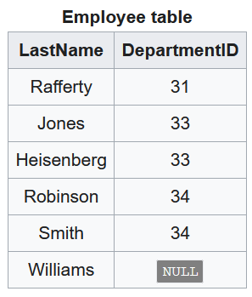
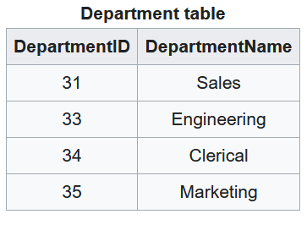

Join
Inner join
$Employee ⋈Department$

Slide 5
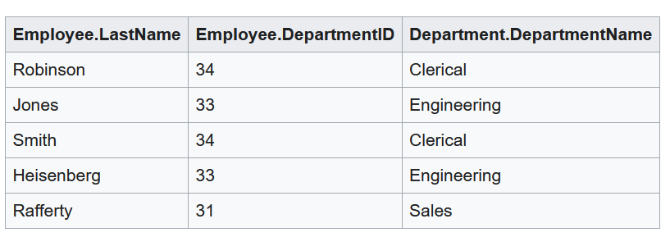
Join
Inner join
$Employee ⋈Department$

Slide 6

Projection
$π_{attr}(table)$
$π_{DepartmentID}(Employee)$
31
33
34
NULL

Slide 7

Selection
$σ_{condition}(table)$
$σ_{DepartmentID=33}(Employee)$
Jones | 33
Heisenberg | 33

Slide 8
Join Strategy
Nested Loop Join
Merge Join
Hash Join

Slide 9

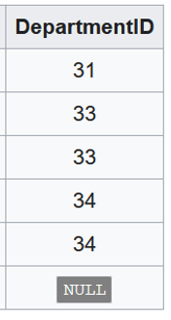
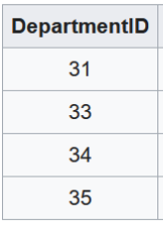

Merge Join
Sort table A & table B
Merge the results
Unsorted
$O\left(M+N+NlogN+MlogM\right)$
Sorted
$O\left(M+N\right)$

Slide 10
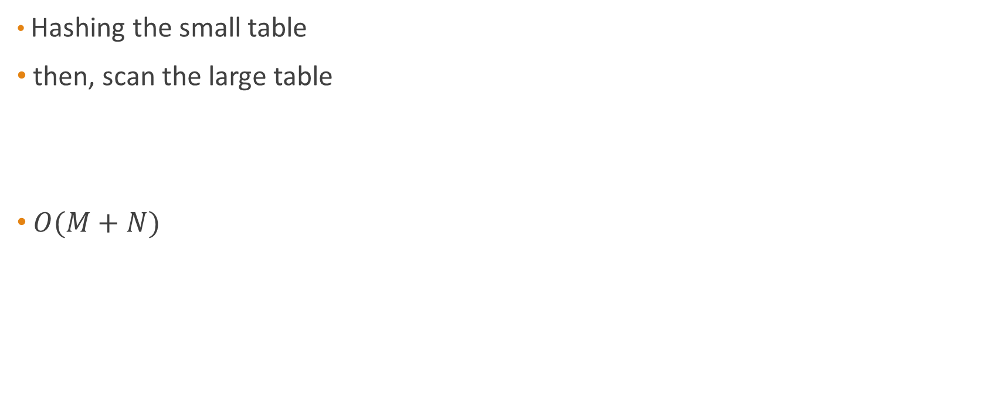
Hash join
Hashing the small table
then, scan the large table
$O(M+N)$
Hash key
31
33
34
35
Hash

Slide 11
Why WCOJ is needed?
The complexity of Hash Join is linear!
But join is still expensive!

Slide 12















Expensive Join
Increasing exponentially!
$Q=⋈_{i}^{n}R_{i}$
$$R_{1}$$
$$R_{2}$$
$$R_{3}$$
$$R_{n−1}$$
$$R_{n}$$
$$⋈$$
$$⋈$$
$$⋈$$
……
……
$$⋈$$
$$⋈$$
$$N$$
$$N^{2}$$
$$N^{3}$$
……
$$N^{n−1}$$

Slide 13
Worst-case optimal join
“Worst-case optimal join is a join algorithm evaluating a full conjunctive query in time that is proportional to the worst-case output size of the query”

Slide 14


Full conjunctive query
“A full conjunctive query is a conjunctive query where every variable in the body appears in the head.”
$A_{i}$ denotes attributes of $R_{i}$
$q=\left\{t \right| t_{A_{i}}∈R_{i} for each i\}$
$$π_{Employee}\left(Q\right)⊂Employee$$

Slide 15
Worst-case output size
Given output size bound (rarely)
Computed output size bound (AGM bound – usually)

Slide 16
AGM bound
Atserias, Grohe, & Marx
A. Atserias, M. Grohe, and D. Marx. Size bounds and query plans for relational joins. In FOCS, pages 739–748. IEEE, 2008.

Slide 17

Q as hypergraph
The join query $Q$ is modeled as a hypergraph $ℋ=(𝒱,ℰ)$
$𝒱$ denote the set of attributes
for each hyperedge $e∈ℰ$, there is a relation $R_{e}$ on attribute set $F$

Slide 18
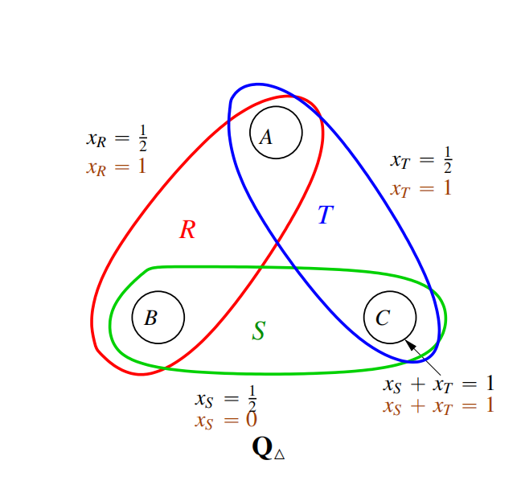
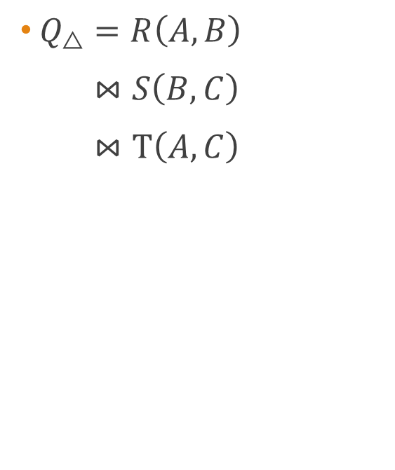
Q as hypergraph
$Q_{△}=R\left(A,B\right)$
$⋈S\left(B,C\right)$
$⋈T\left(A,C\right)$

Slide 19
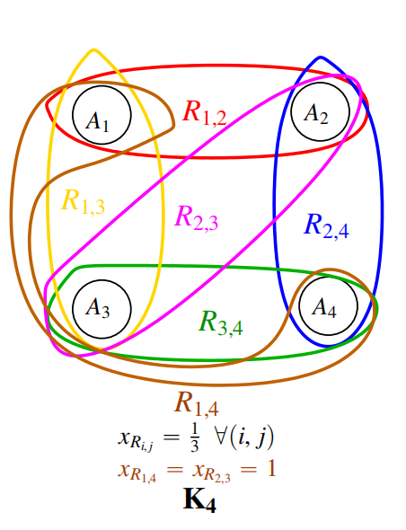

Q as hypergraph
$K_{4}=R_{1,2}\left(A,B\right)$
$⋈R_{2,3}\left(B,C\right)$
$⋈R_{3,4}\left(C,D\right)$
$⋈R_{1,4}\left(A,D\right)$
$⋈R_{1,3}\left(A,C\right)$
$⋈R_{2,4}\left(B,D\right)$

Slide 20
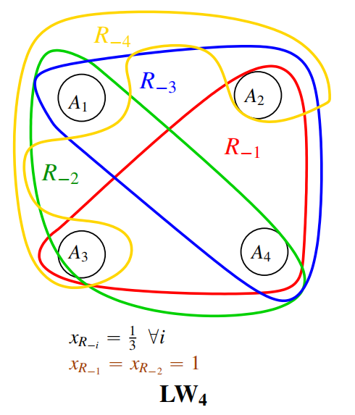

Q as hypergraph
${LW}_{4}=R_{−4}\left(A,B, C\right)$
$⋈R_{−3}\left(A,B, D\right)$
$⋈R_{−2}\left(A,C, D\right)$
$⋈R_{−1}\left(B,C, D\right)$

Slide 21

Fractional Edge Cover
The fractional edge cover polytope by $ℋ$ the set of all points $x={\left(x_{e}\right)}_{e∈ℰ}∈ ℝ^{ℰ}$ , satisfies:
$$\sum_{e:v∈e}{x_{e}}≥1, for any v∈𝒱$$
$$x_{e}≥0, for any e∈ℰ$$

Slide 22
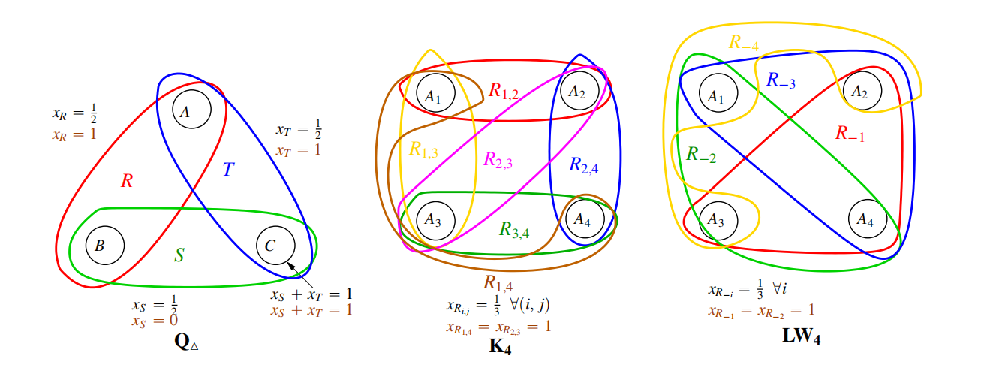
Fractional Edge Cover

Slide 23

AGM bound
For any Fractional Edge Cover $x$, AGM’s inequality states that the join size can be bounded by
$$\left|Q\right|=\left|⋈_{e∈ℰ}R_{e}\right|≤\prod_{e∈ℰ}{{\left|R_{e}\right|}^{x_{e}}}$$

Slide 24

Worst-case output size
Solve the optimization problem
$$\min_{x}{\prod_{e∈ℰ}{{\left|R_{e}\right|}^{x_{e}}}}$$
Subject to
$$\sum_{e:v∈e}{x_{e}}≥1, for any v∈𝒱$$
$$x_{e}≥0, for any e∈ℰ$$

Slide 25

Triangle counting
$Q_{△}=R\left(A,B\right)⋈S\left(B,C\right)⋈T\left(A,C\right)$
$\left|R\right|=\left|S\right|=\left|T\right|=N$
$$\min{{\left|R\right|}^{x_{R}}{\left|S\right|}^{x_{S}}{\left|T\right|}^{x_{T}}}$$
Subject to
$$x_{R}+x_{S}≥1$$
$$x_{s}+x_{T}≥1$$
$$x_{R}+x_{T}≥1$$
$$x_{R},x_{S},x_{T}≥0$$
A
B
C

Slide 26

Triangle counting
$Q_{△}=R\left(A,B\right)⋈S\left(B,C\right)⋈T\left(A,C\right)$
解得 $x_{R}=x_{S}=x_{T}=\frac{1}{2}$
$\left|Q_{△}\right|≤N^{\frac{3}{2}}$
A
0.5
0.5
B
C
0.5

Slide 27
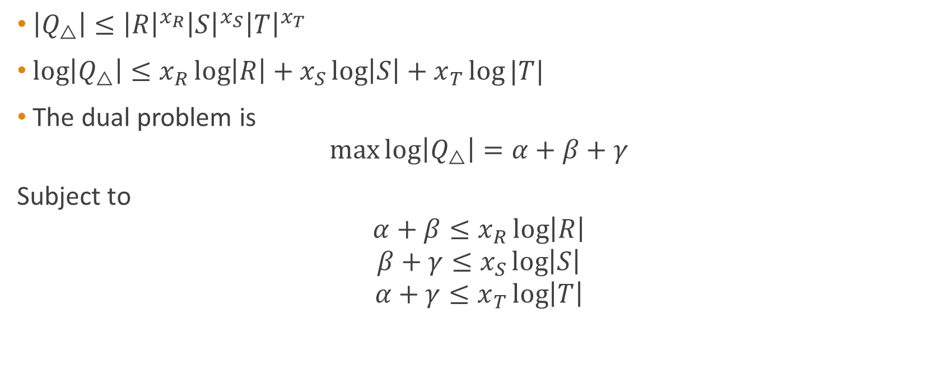
Dual Problem
$\left|Q_{△}\right|≤{\left|R\right|}^{x_{R}}{\left|S\right|}^{x_{S}}{\left|T\right|}^{x_{T}}$
$log\left|Q_{△}\right|≤x_{R}\log\left|R\right|+x_{S}\log\left|S\right|+x_{T}\log{|T|}$
The dual problem is
$$\max{log\left|Q_{△}\right|=α+β+γ}$$
Subject to
$$α+β≤x_{R}\log\left|R\right|$$
$$β+γ≤x_{S}\log\left|S\right|$$
$$α+γ≤x_{T}\log\left|T\right|$$

Slide 28

Dual Problem
直观理解
$Q=[2^{α}]×[2^{β}]×[2^{γ}]$, $α,β,γ$ can be interpreted as the average number of bits to represent variables
$R⊇\left[2^{α}\right]×\left[2^{β}\right]$
$S⊇\left[2^{β}\right]×\left[2^{γ}\right]$
$T⊇\left[2^{α}\right]×\left[2^{γ}\right]$
A
P
C
B

Slide 29

Dual Problem
解得 $α=β=λ=\frac{1}{2}\log{n}$
$\left|Q_{△}\right|≤N^{\frac{3}{2}}$
A
P
C
B

Slide 30
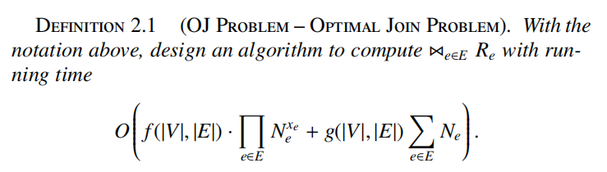
WCOJ problem

Slide 31







Join-only is suboptimal
$\left|Q_{△}\right|≤N^{\frac{3}{2}}$
Three pair-wise join plans for$\left|Q_{△}\right|$
$$⋈$$
$$⋈$$
$$⋈$$
$$⋈$$
$$⋈$$
$$⋈$$
S
T
R
R
T
R
S
S
T

Slide 32
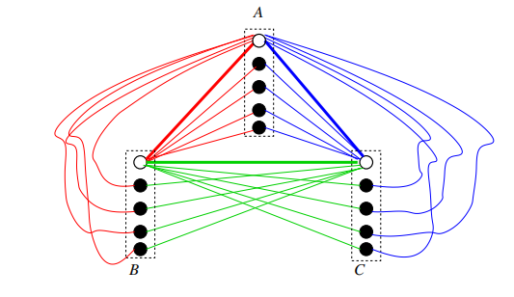

Counter example
consider
$R=\left\{a_{0}\right\}×\left\{b_{0},⋯,b_{m}\right\}∪\left\{a_{0},⋯,a_{m}\right\}×\{b_{0}\}$
$S=\left\{b_{0}\right\}×\left\{c_{0},⋯,c_{m}\right\}∪\left\{b_{0},⋯,b_{m}\right\}×\{c_{0}\}$
$T=\left\{a_{0}\right\}×\left\{c_{0},⋯,c_{m}\right\}∪\left\{a_{0},⋯,a_{m}\right\}×\{c_{0}\}$
$N=2m+1$

Slide 33
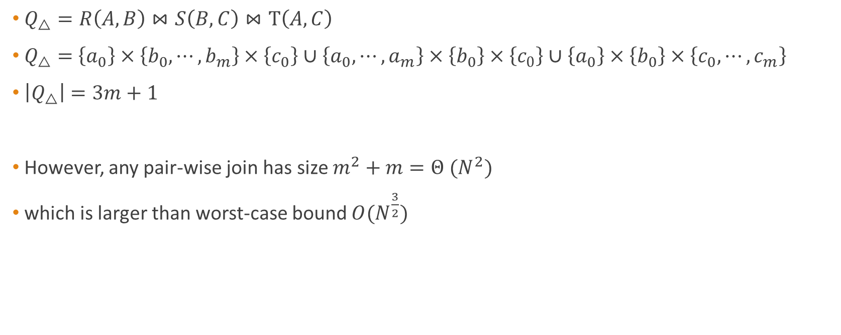
Counter example
$Q_{△}=R\left(A,B\right)⋈S\left(B,C\right)⋈T\left(A,C\right)$
$Q_{△}=$ $\left\{a_{0}\right\}×\left\{b_{0},⋯,b_{m}\right\}×\left\{c_{0}\right\}∪\left\{a_{0},⋯,a_{m}\right\}×\left\{b_{0}\right\}×\left\{c_{0}\right\}∪\left\{a_{0}\right\}×\left\{b_{0}\right\}×\left\{c_{0},⋯,c_{m}\right\}$
$\left|Q_{△}\right|=3m+1$
However, any pair-wise join has size $m^{2}+m=Θ (N^{2})$
which is larger than worst-case bound $O(N^{\frac{3}{2}})$

Slide 34

Analysis
Why so large intermediate results?
1. $a_{0}(or b_{0},c_{0})$ with too large degree
2. the generated intermediate result would be invalidated under other constraints

Slide 35
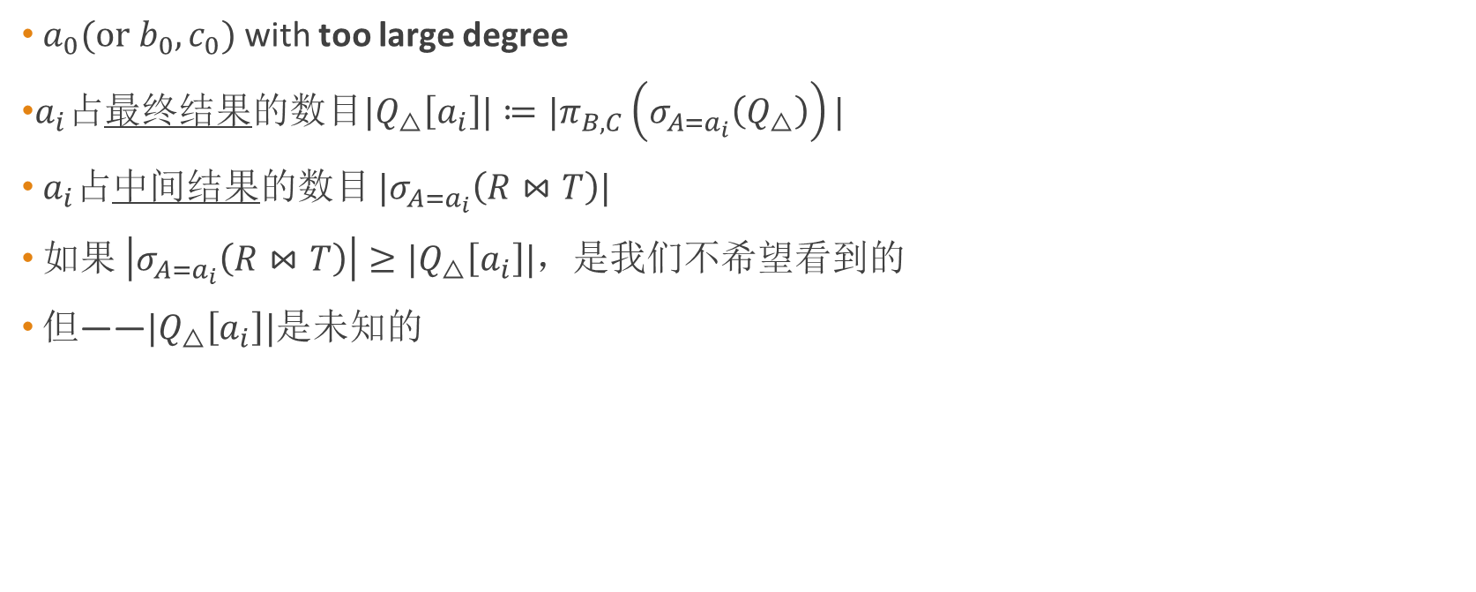
A1: Two choices
$a_{0}(or b_{0},c_{0})$ with too large degree
$a_{i}$占最终结果的数目$|Q_{△}\left[a_{i}\right]|≔|π_{B,C}\left(σ_{A=a_{i}}\left(Q_{△}\right)\right)|$
$a_{i}$占中间结果的数目 $|σ_{A=a_{i}}\left(R⋈T\right)|$
如果 $\left|σ_{A=a_{i}}\left(R⋈T\right)\right|≥|Q_{△}\left[a_{i}\right]|$，是我们不希望看到的
但——$|Q_{△}\left[a_{i}\right]|$是未知的

Slide 36

Two choices
设置阈值$τ$，将join keys分为“heavy”和“light”
Heavy join keys：$D=\{t_{B}∈π_{B}\left(R\right):\left|R\left[t_{B}\right]\right|>τ\}$
Light join keys: $G=\{\left(t_{A},t_{B}\right)∈R:t_{B}∉D\}$
Heavy join keys
Light join keys

Slide 37

Two choices
Observe that $Q_{△}⊆\left(D×T\right)∪(G⋈S)$
根据划分，分类讨论
For heavy join keys, $\left|D\right|<\frac{N}{τ}, \left|D×T\right|≤\frac{N}{τ}N=\frac{N^{2}}{τ}$
For light join keys, $\left|G⋈S\right|=\sum_{t_{B}∈π_{B}\left(G\right)}{\left|R\left[t_{B}\right]\right|S\left[t_{B}\right]|}≤τN$
Let $τ=\sqrt{N}$, the time complexity is $O(N^{\frac{3}{2}})$

Slide 38
NPRR
Ngo-Porat-Ré-Rudra
Ngo, H. Q., Porat, E., Re´, C., and Rudra, A. Worst-case optimal join algorithms: [extended abstract]. In PODS (2012), pp. 37–48.
最早的WCOJ算法

Slide 39

LW inequality
首先考虑一种特殊的情形
LW instance
边集为$n−1$ size的超边，i.e. $R_{e} for e∈\left({V \atop \left|V\right|−1}\right) N_{e}=\left|R_{e}\right|$

Slide 40
Framework
Two-stage
First we compute a tuple set (candidate set) C(u) containing the output J such that C(u) has a relatively small size (at most the size bound times n)
Second, we prune those tuples that cannot participate in the join (which takes only linear time in the size of C(u)).

Slide 41



Data structure
For leaves, $LABEL\left(x\right)=V/\{x\}$
For inner node, $LABEL\left(x\right)=LABEL\left(LC(x)\right)∩LABEL\left(RC(x)\right)$
$$⋈$$
$$⋈$$
S
C
R
T
A
B

Slide 42
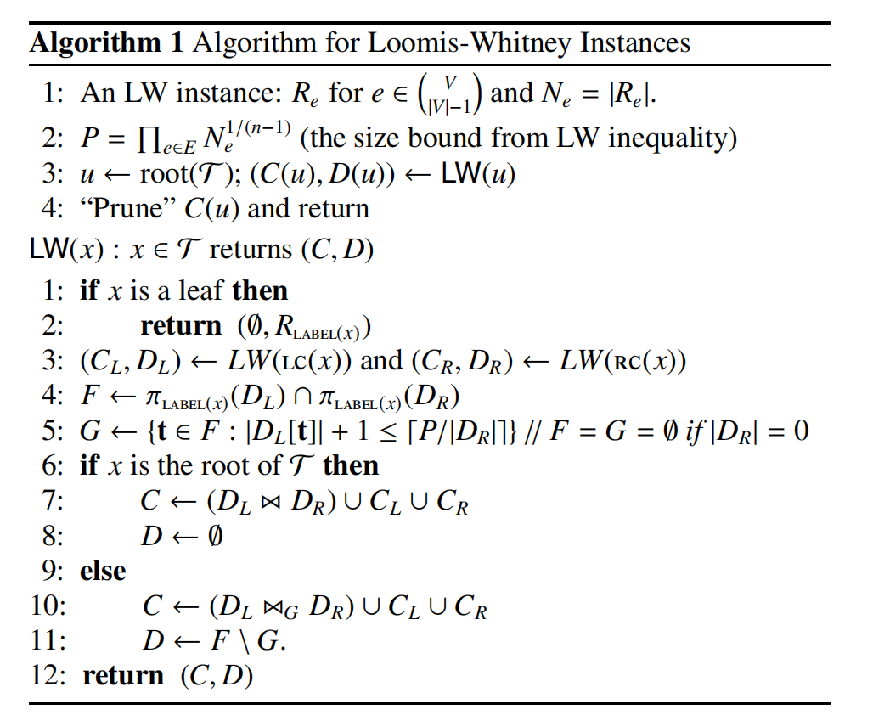

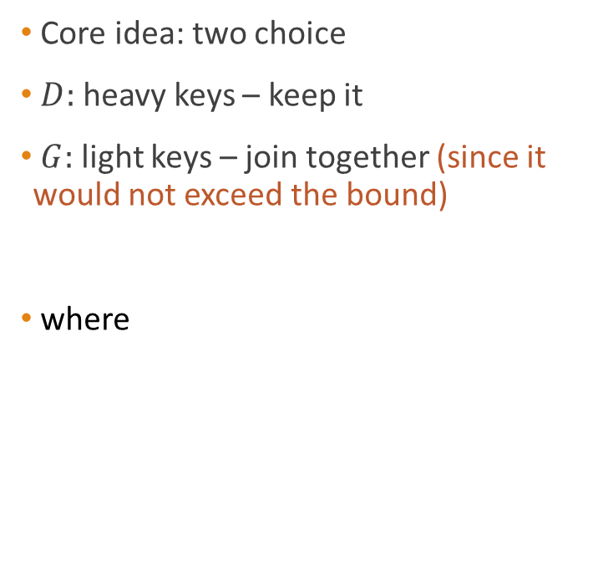
Algorithm
Core idea: two choice
$D:$ heavy keys – keep it
$G:$ light keys – join together (since it would not exceed the bound)
where

Slide 43

Example
LW4
$\left|Q\right|≤N^{4/3}$

Slide 44
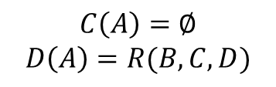
Example
Init the leaf nodes
$$C\left(A\right)=∅$$
$$D\left(A\right)=R(B,C,D)$$
A
B
C
D

Slide 45
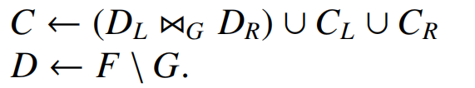
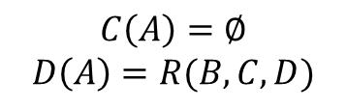


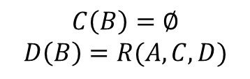
Example
Recursively update $C(x)$ and $D(x)$ of inner product
1. Compute F
$$F⟵π_{C,D}(R\left(B,C,D\right)∩R\left(A,C,D\right))$$
2. Select G
A
B
$$C\left(A\right)=∅$$
$$D\left(A\right)=R(B,C,D)$$
$$C\left(B\right)=∅$$
$$D\left(B\right)=R(A,C,D)$$
3. Two choices

Slide 46
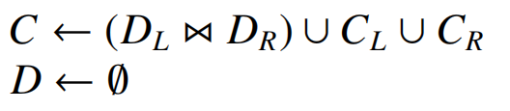

Example
To the root node
Join all the left result together
Prune the $C$ and return
(the pruning step takes $O(|C|)$ time)

Slide 47
Comment
Worst-case optimal
could be extended to arbitrary full conjunctive query

Slide 48
A2: Delay Computation
Exploration like
Directly consider all join keys as “heavy”
Check attributes one by one

Slide 49

Triangle counting
Compute $L_{A}=π_{A}\left(S\right)∩$ $π_{B}\left(S\right)$
$L_{A}=\left\{a_{0},⋯,a_{m}\right\}$
$|L_{A}|≤N$

Slide 50

Triangle counting
For specific a, select b values
$a_{0}:π_{B}\left(σ_{A=a_{0}}\left(R\right)∩π_{B}\left(S\right)\right)$
$=\left\{a_{0}\right\}×\left\{b_{0},⋯,b_{m}\right\}$
$L_{A,B}=\left\{a_{0}\right\}×\left\{b_{0},⋯,b_{m}\right\}∪\left\{a_{0},⋯,a_{m}\right\}×\left\{b_{0}\right\}$
$|L_{A,B}|≤N$

Slide 51

Triangle counting
For specific a, b, select c values
$L_{A,B,C}=Q$
$\left|L_{A,B,C}\right|≤N^{\frac{3}{2}}$

Slide 52
Leapfrog triejoin
Veldhuizen
Veldhuizen, T. L. Leapfrog Triejoin: a worst-case optimal join algorithm. In ICDT (2014)

Slide 53
Unary Leapfrog Join
Consider Unary Relations
i.e. intersection of multiple sets
unary relations could be presented as linear iterator

Slide 54


Linear iterator
$C=\left\{2,4,5,8,9\right\}$
key()=2
atEnd()=false
2
4
5
8
9
current
seek(6)
next()

Slide 55

Unary Leapfrog Join
Tracking the smallest & largest iterator
Process in turn

Slide 56

Complexity
The running time of unary leapfrog join is
$O(N_{min}\log{\frac{N_{max}}{N_{min}}})$
accelerate intersection of multiple sets

Slide 57

Example
A, B, C where A = {0, · · · , 2n − 1}, B = {n, · · · , 3n − 1},
and C = {0, · · · , n − 1, 2n, . . . , 3n − 1}
pairwise has n results
however, $A∩B∩C=∅$

Slide 58


Trie iterator
Relations could be presented as trie operator

Slide 59


Leapfrog triejoin
triangle counting

Slide 60
Comment
Worst-case optimal
Easier to understand and implement (than NPRR)
Exploration-like

Slide 61
Conclusion
Join: 作为方法的Join (exploration-based v.s. join-based) 和作为问题的Join (join operator)
AGM bound
Institution to achieve WCO
Two choices
Delay computation

Slide 62
Further work
Worst-case Optimal Join on graph query
Less cost to guarantee worst-case optimal
Hybrid method
Worst-case Optimal Join with no space

Slide 63
Q & A
THANK U FOR Listening

