Slide 1
Leveraging Web Services APIs to Create a Custom Login User Control for WPF
Daniel Koman

Slide 2
Key Takeaways
Understanding 3DEXPERIENCE authentication
Building custom WPF login controls
Leveraging authenticated sessions for API calls

Slide 3
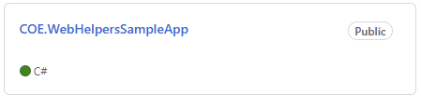
Demo
github.com/TrueNorthPLM
👇

Slide 4
Why Custom User Controls?
Seamless integration with existing applications
Consistent branding and user experience
Workflow optimization
Enhanced security features
Performance improvements
Most importantly, avoiding code duplication means easier maintenance and less work overall

Slide 5
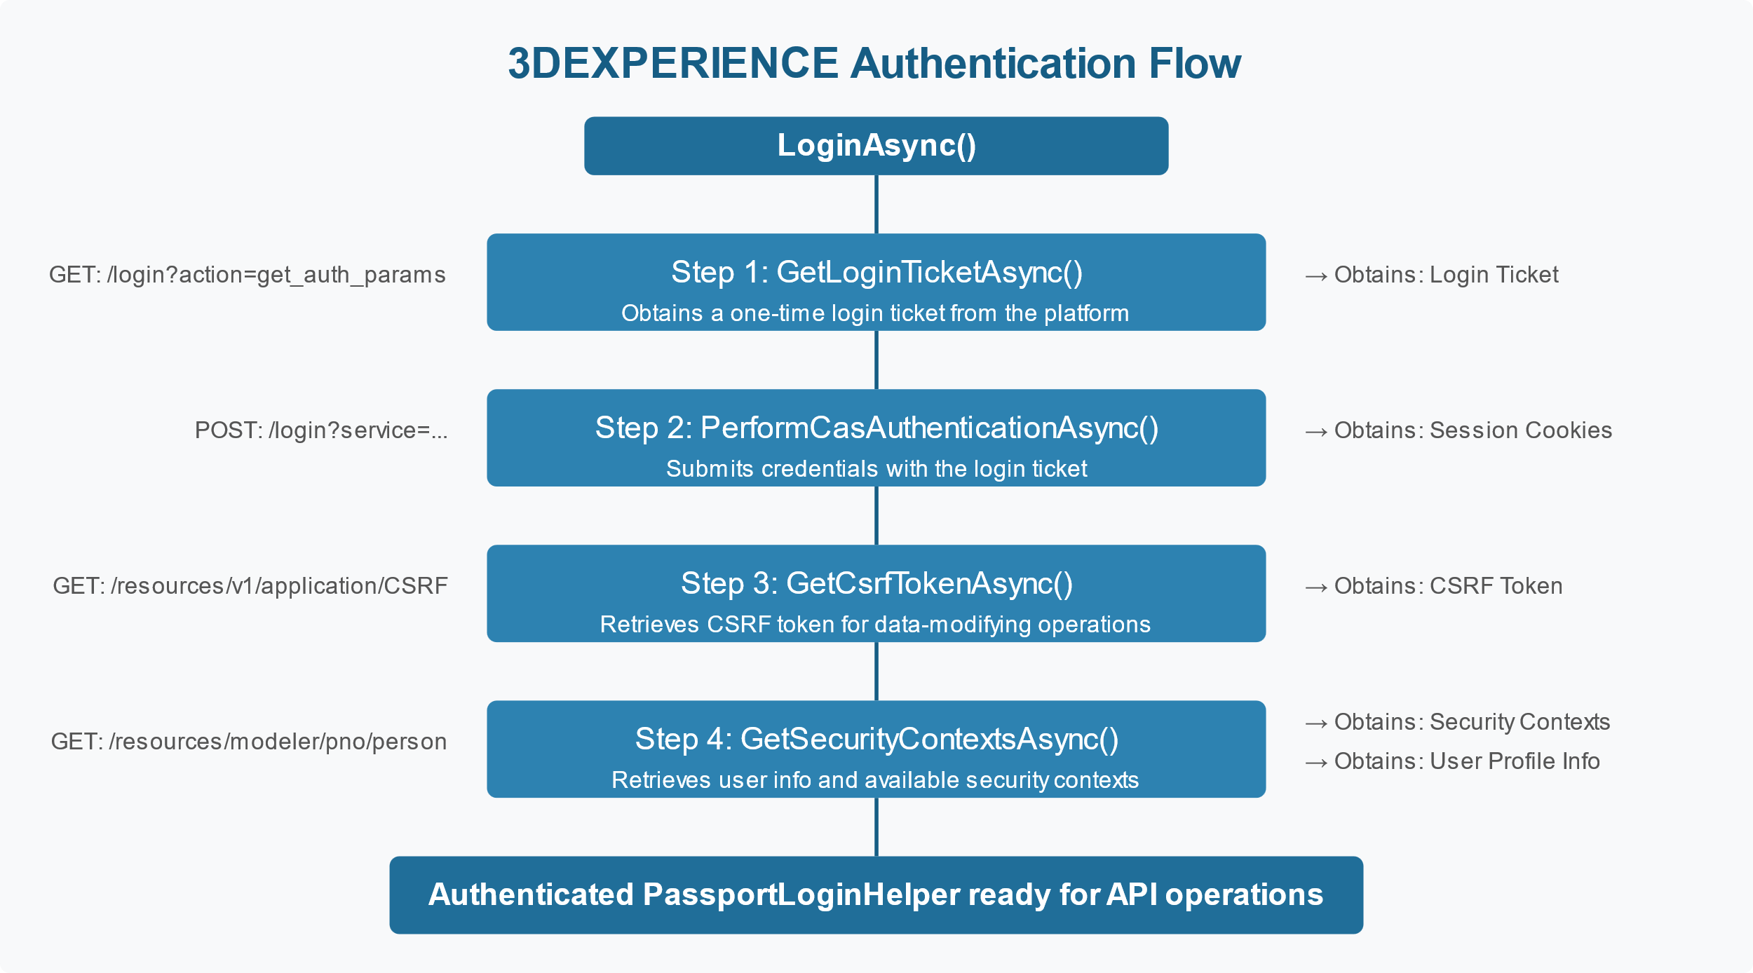
3DEXPERIENCE Platform Architecture

Slide 6
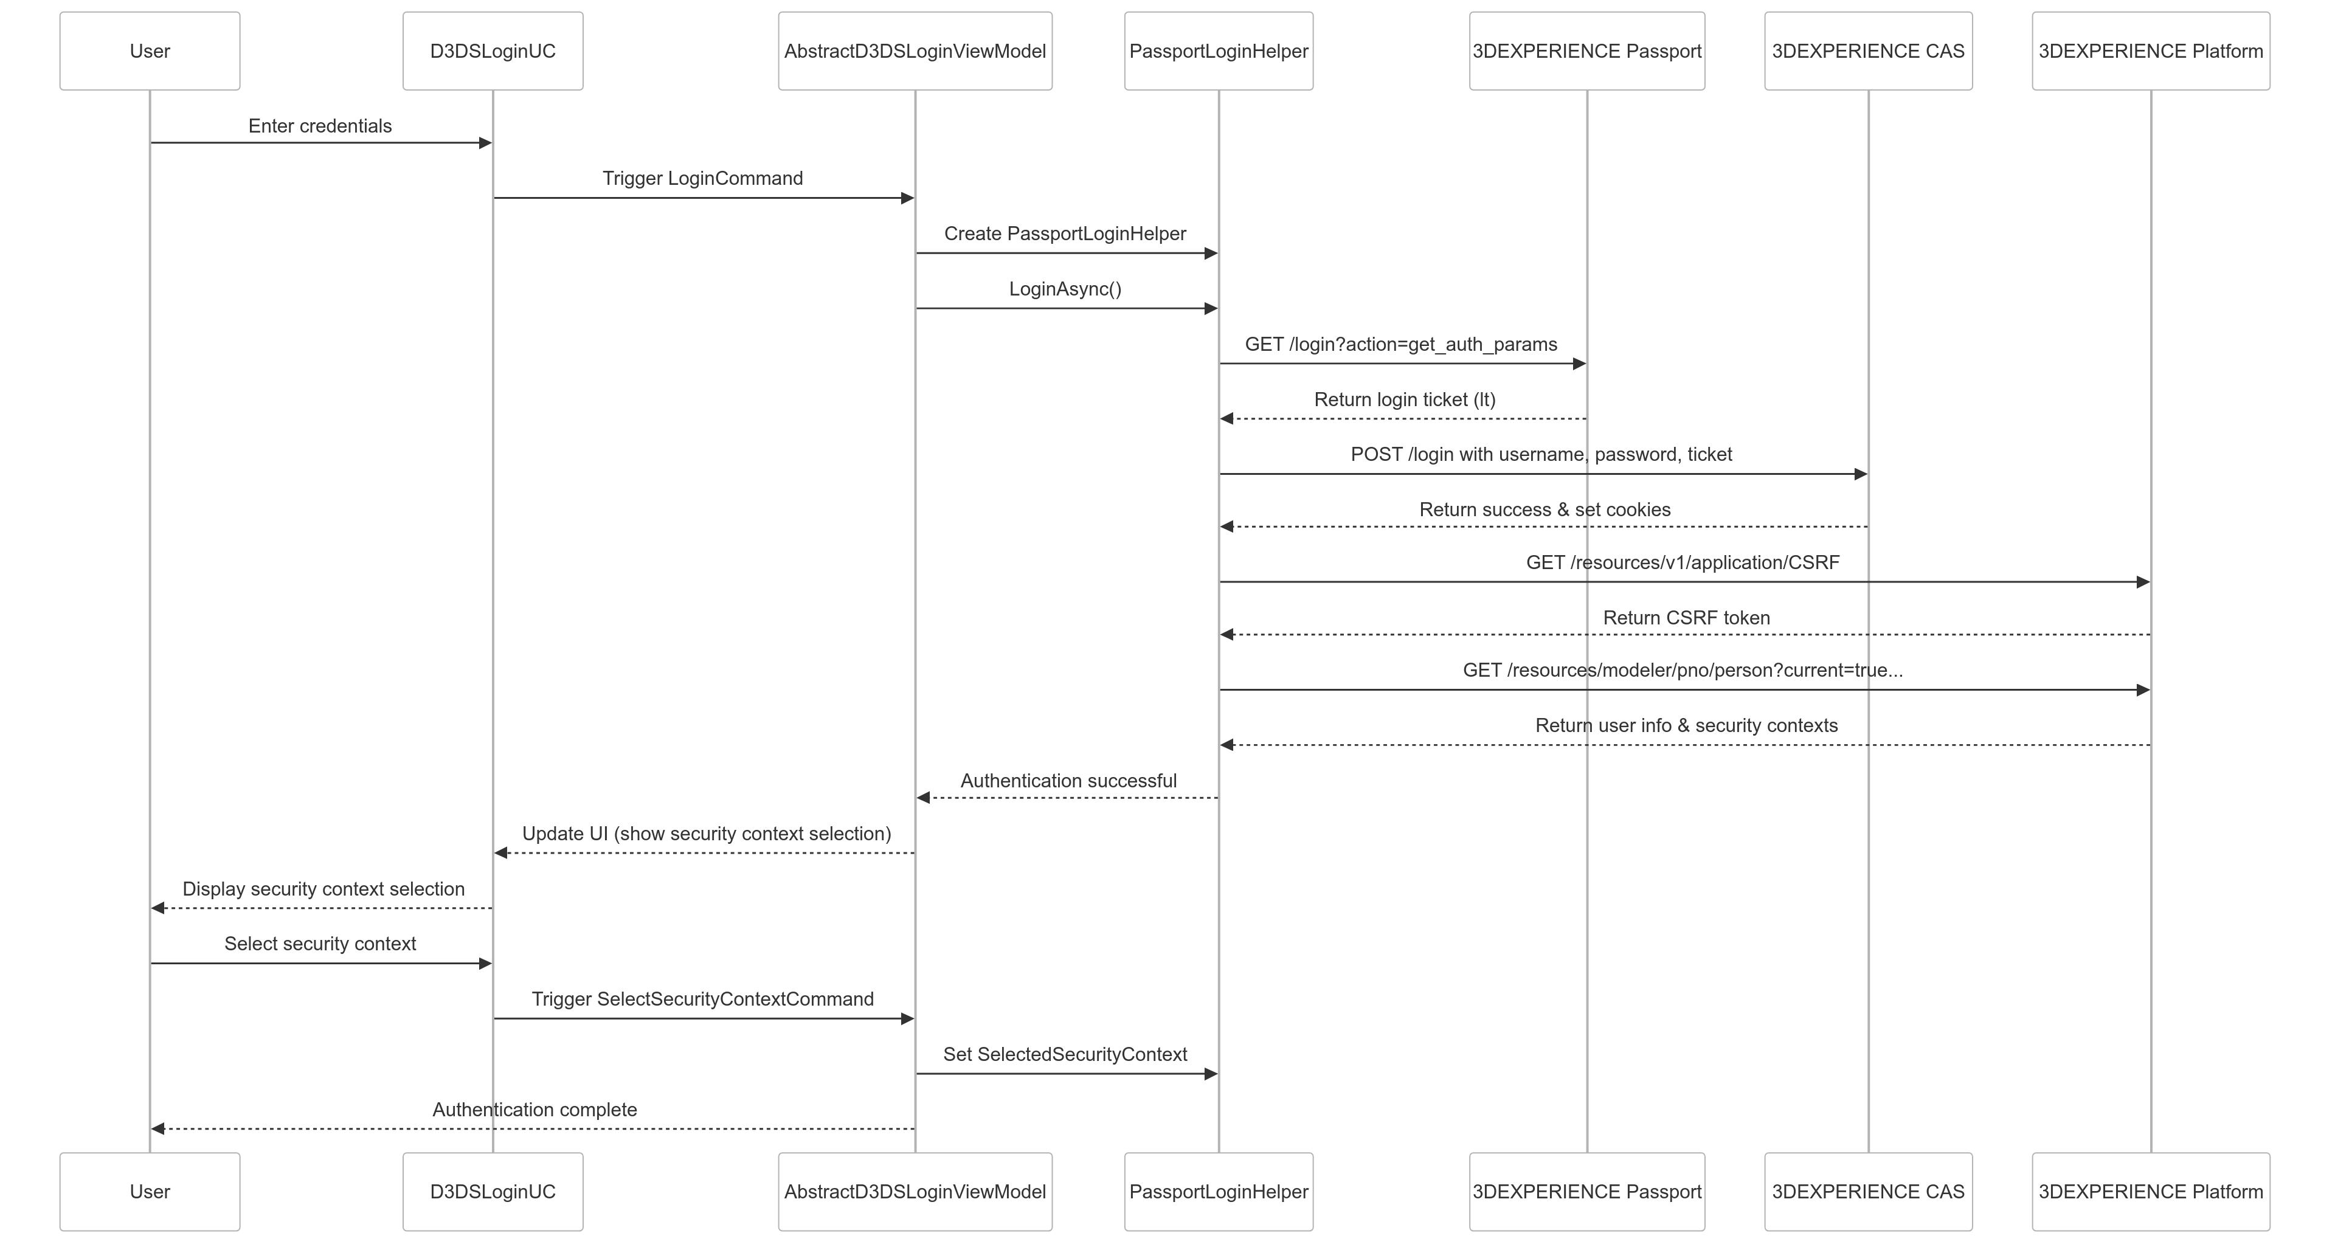
Authentication Flow

Slide 7
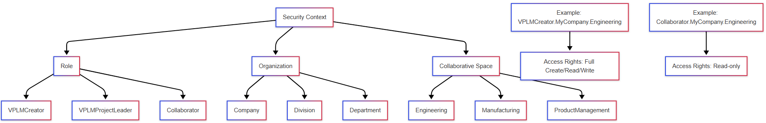
Security Context Explained

Slide 8
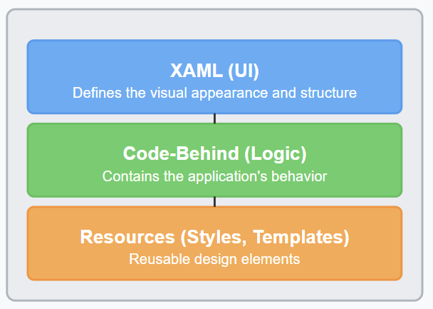
Intro to WPF Architecture

Slide 9
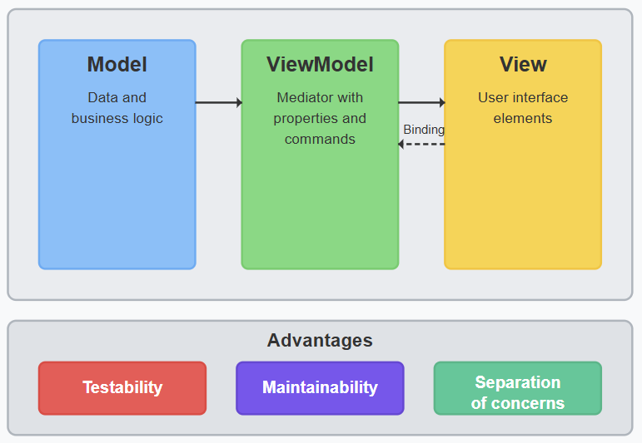
MVVM Pattern

Slide 10
Secure Credential Handling
SecureString for password protection
Optional encrypted storage
Memory cleanup
Safe password visibility toggle

Slide 11
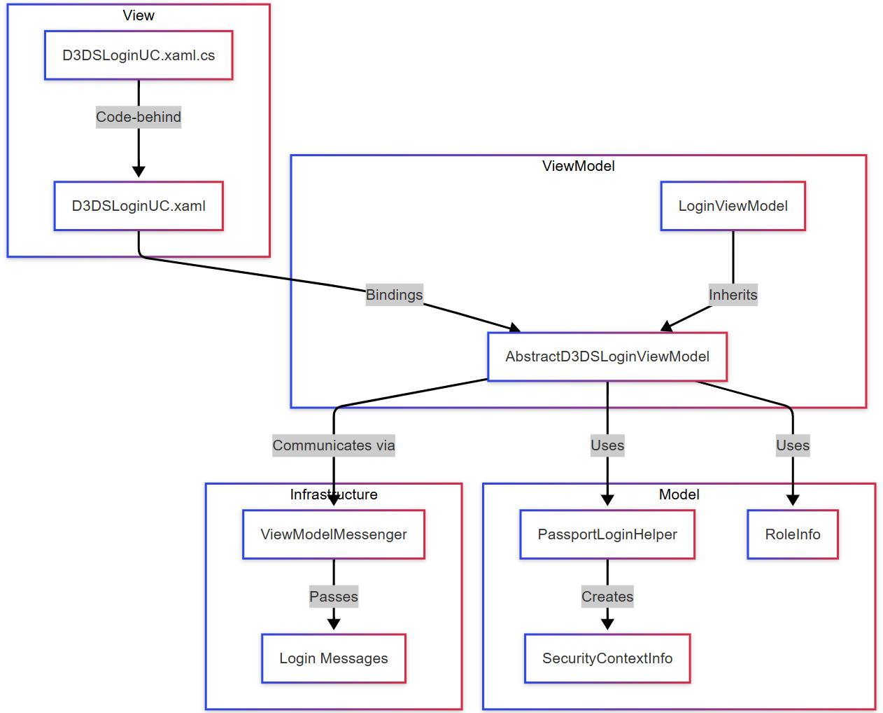
Custom Control Components

Slide 12
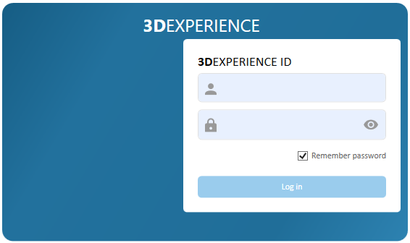
D3DSLoginUC - UI Component
Features:
Username/password fields
Remember password option
Show/hide password toggle
Login button with loading indicator
Security context selection view

Slide 13
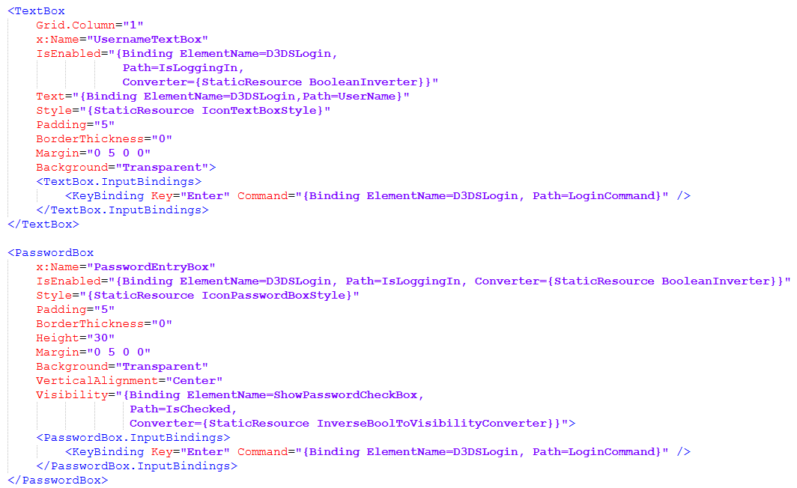
D3DSLoginUC - UI Component

Slide 14


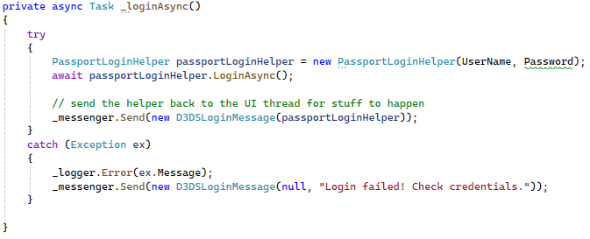
Error Handling and User Feedback
Best Practices:
Clear error messages
Loading indicators
Graceful fallbacks
User guidance

Slide 15
PassportLoginHelper
Key Properties:
HttpClient
CookieContainer
CsrfToken
SecurityContexts

Slide 16
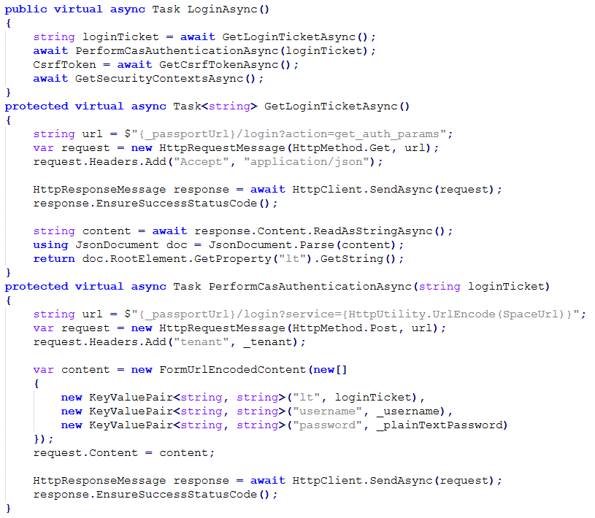
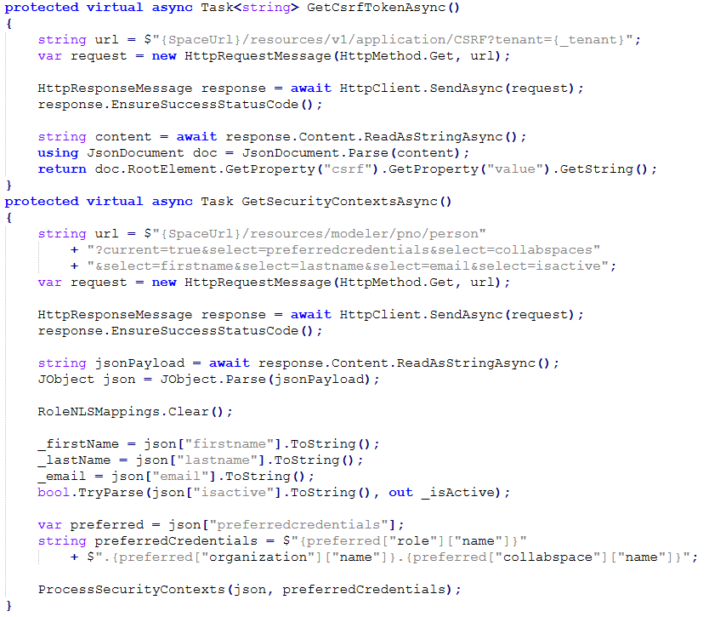
PassportLoginHelper

Slide 17
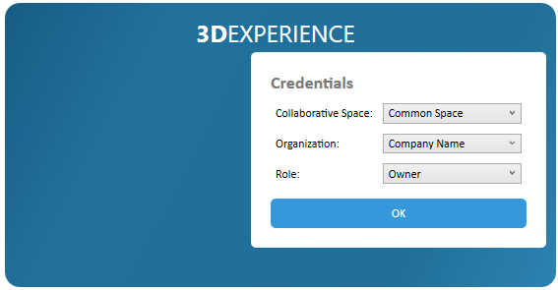
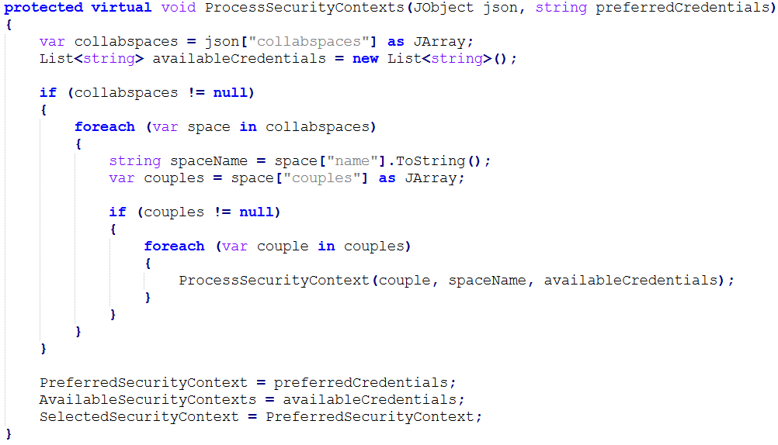
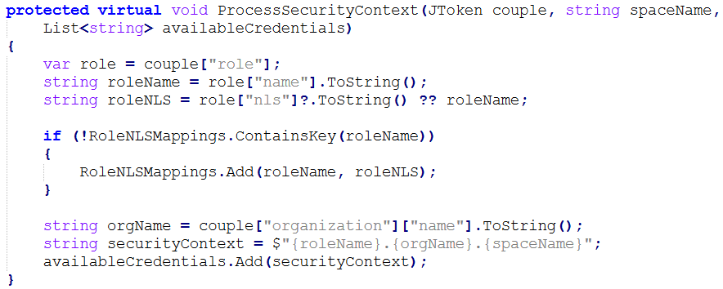
Security Context Handling

Slide 18
Authentication Flow Walkthrough
User enters credentials
LoginCommand triggers PassportLoginHelper. LoginAsync()
Helper retrieves login ticket
Helper submits credentials to CAS
Helper obtains CSRF token and security contexts
UI updates to show context selection
User selects security context

Slide 19
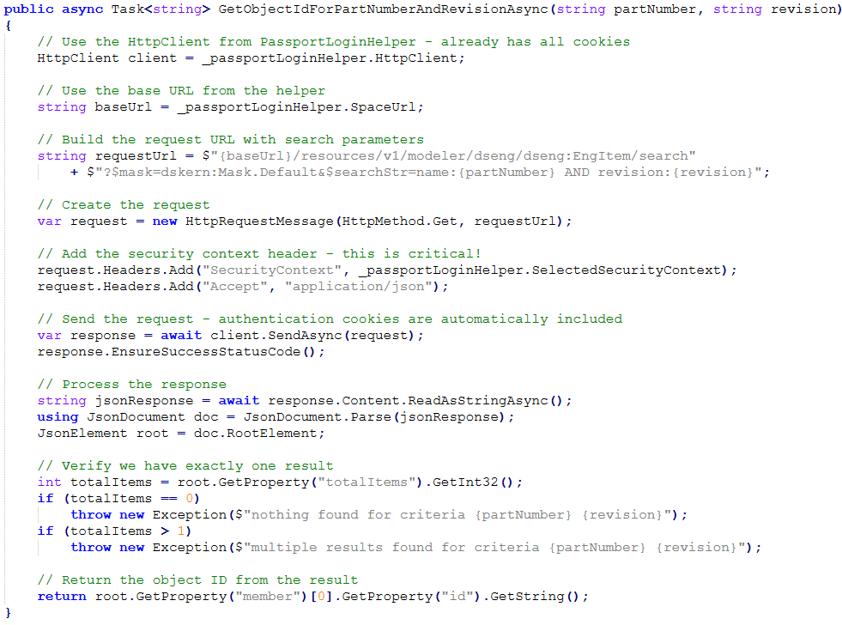
Using the Established Session
Uses authenticated HttpClient with cookies already included
SecurityContext header determines data access permissions
Search by part number and revision to find ObjectID
Returns platform's internal ID needed for subsequent calls
Pattern applies to all 3DEXPERIENCE API operations

Slide 20
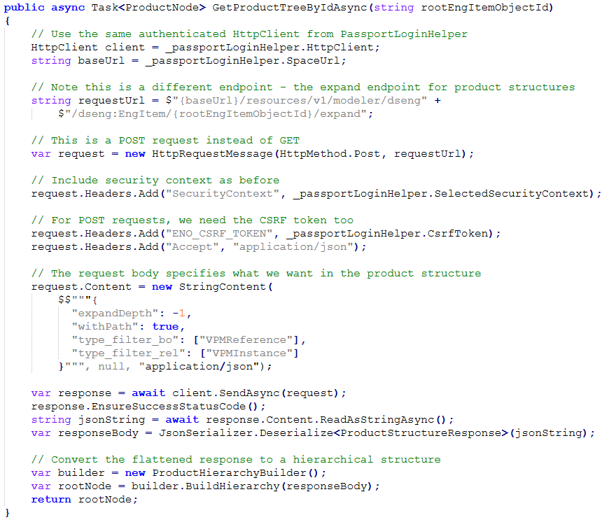
Product Structure Retrieval Example
Requires SecurityContext + CSRF token from PassportLoginHelper
Key parameters:
expandDepth: -1 (complete)
withPath: true
Response contains flattened References (parts) + Instances (usages)
Reconstructs hierarchical tree from path information
Enables BOM generation, visualization, analysis

Slide 21
Key Takeaways
Authentication flow with 3DEXPERIENCE
Custom UI with WPF and MVVM
Secure credential handling
Session management for API calls
Separation of concerns for maintainability

Slide 22

Want to learn more?
Reach out to us!
www.truenorthplm.com
Follow us on LinkedIn
Shop our Merchandise

