Slide 1
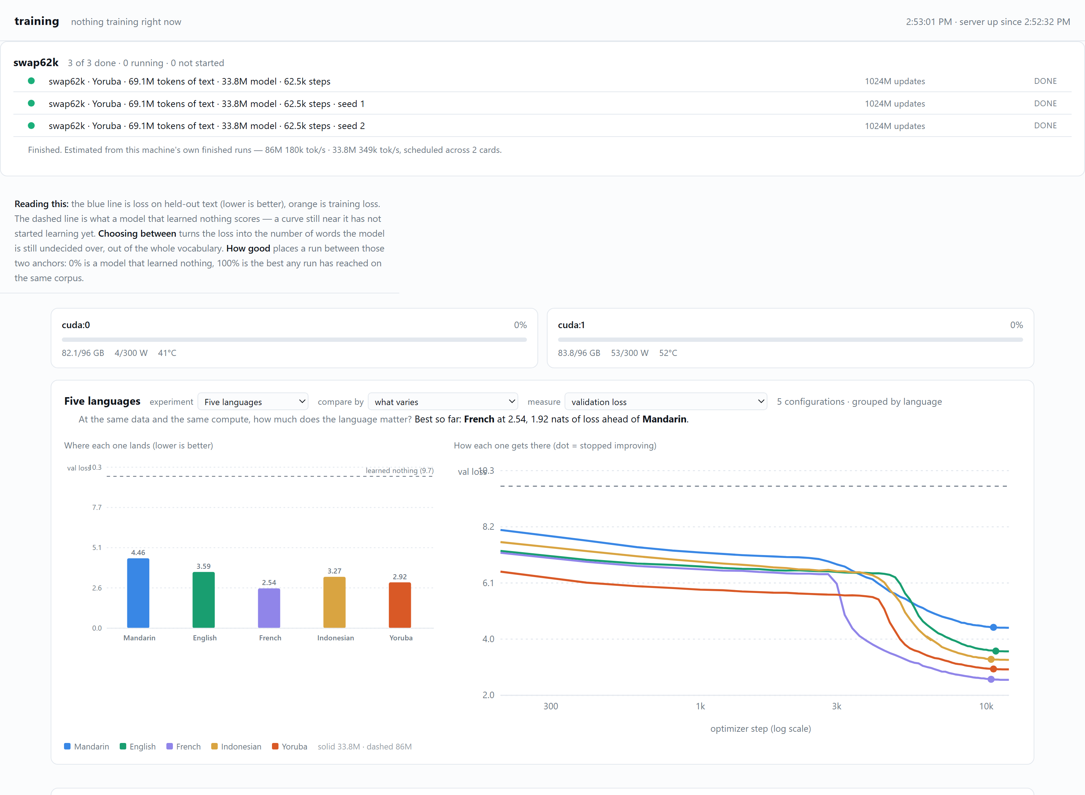
Building a Model Factory
From one-off notebooks to repeatable, challengeable experiments
A2-NLP Project Team · CSED 504 · University of Washington · Summer 2026
TAKEAWAY
The factory made hundreds of model comparisons affordable and auditable—then gave collaborators enough control to disprove results that initially looked convincing.
SYSTEM GOAL
MEASURED SPEEDUP
Why a factory?
A scaling study varies data, compute, model size, language, seed and learning rate. Managing that grid by notebook state and filenames is not reproducibility. The factory turns each cell into a self-describing job, checkpoint and result record. Prepare once → inspect and fingerprint → estimate on the actual GPU → pretrain one cell or queue a fleet → read curves and results through the same API. Interactive exploration stays in notebooks; expensive work moves to restartable processes.
Efficiency and parallelism are reported separately.
NOTEBOOK / QUEUE BOUNDARY
PUBLIC SURFACE
Cheap stages stay interactive; training becomes a job.
Nine stable calls hide the machinery.
OPERATIONS
What made it trustworthy
Every setting that can move a number belongs in the record. Corpora and vocabularies carry fingerprints; run reuse refuses mismatched settings. The current evidence base contains 197 pretraining runs, 278 fine-tuning records and 892 individual fine-tuning runs. At three seeds per arm, a mean difference must be about 2.27× the pooled sample spread to clear a two-sided 0.05 t-threshold. An exact permutation test cannot return below p=0.10 with 3 vs 3. A pre-registered sample size limits what a run grid is allowed to claim. The claims gate currently reports 6 supported, 2 unsupported and 1 underpowered claim. That is a feature: numbers regenerate from records, comparative claims are tested against their nulls, and failed claims remain visible instead of being silently rewritten.
Queue, GPU state and comparable run records.
Source: reports/09-the-poster.md and reports/12-poster-build-sheet-v2.md · Counts and figures regenerate from committed runs/ records · 12 Aug 2026
A2-NLP · 2026

