Slide 1
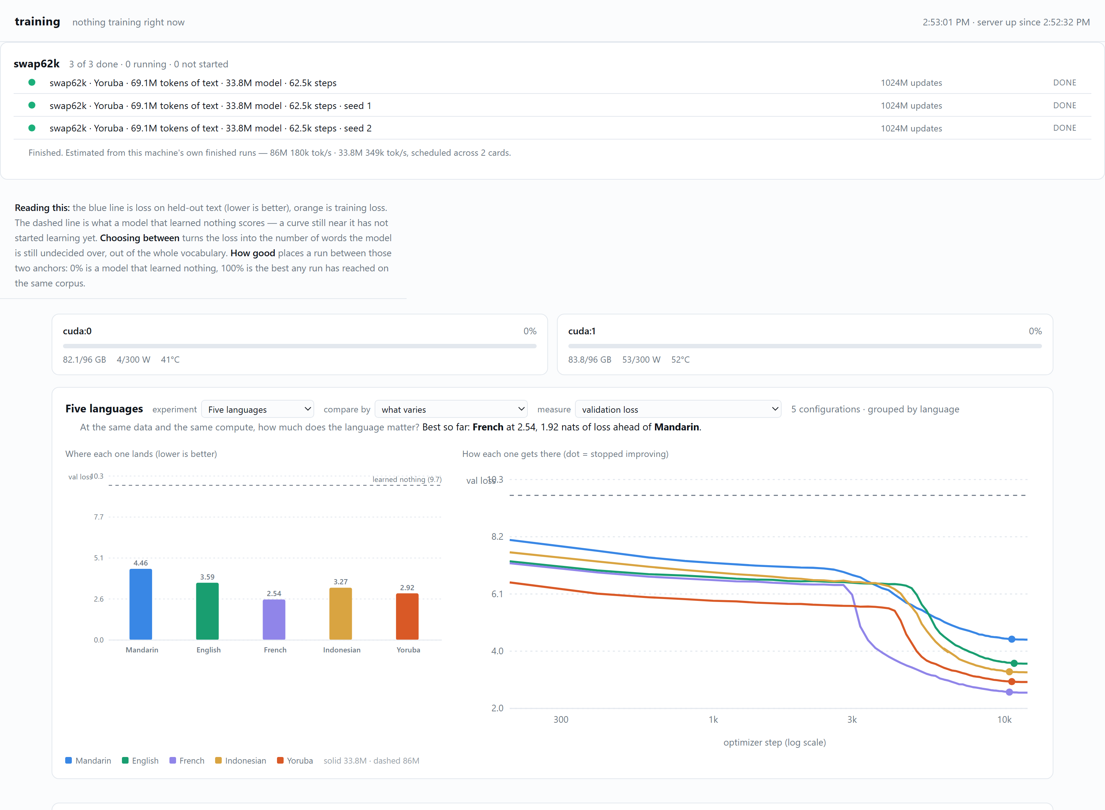
Building a Model Factory
From one-off notebooks to repeatable, challengeable experiments
A2-NLP Project Team · CSED 504 · University of Washington · Summer 2026
TAKEAWAY
The factory made hundreds of model comparisons affordable and auditable—then gave collaborators enough control to disprove results that initially looked convincing.
MEASURE THE SPEEDUP
THE FACTORY LOOP
NINE-FUNCTION SURFACE
01
PREPARE
tokenize once; fingerprint
02
ESTIMATE
measure this GPU
Split by cost
03
PRETRAIN
On the Yoruba corpus, reading, fitting the BPE, encoding 260M characters and moving the flat token store to GPU took 53 seconds. One 98M-parameter training run took 85 minutes—a 96× ratio that defines the boundary between interactive work and unattended queues.
one cell or a fleet
Records survive
Every setting that can move a number belongs in the record. Corpora and vocabularies carry fingerprints; run reuse refuses mismatched settings. The current evidence base contains 197 pretraining runs, 278 fine-tuning records and 892 individual fine-tuning runs.
04
READ
curves and result records
INTERACTIVE → UNATTENDED
THE RESULT The claims gate reports 6 supported, 2 unsupported and 1 underpowered claim. Failures stay visible. THE STANDARD A result must be reproducible enough for another person to challenge and overturn it. That happened twice—and is evidence the tooling worked.
ONE OPERATIONAL VIEW
Source: reports/09-the-poster.md and reports/12-poster-build-sheet-v2.md · Counts and figures regenerate from committed runs/ records · 12 Aug 2026
A2-NLP · 2026

