Slide 1
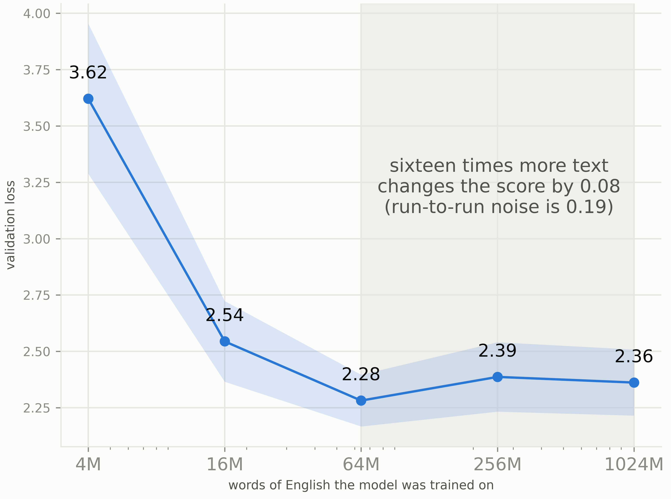
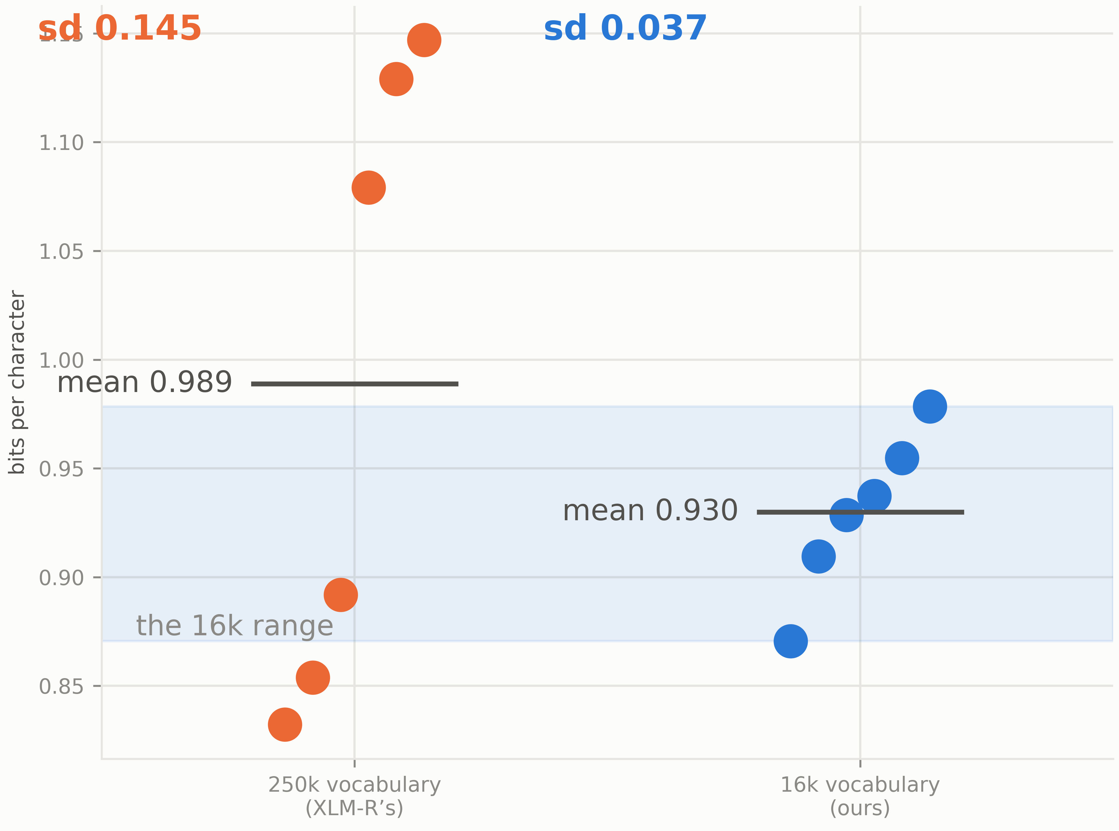
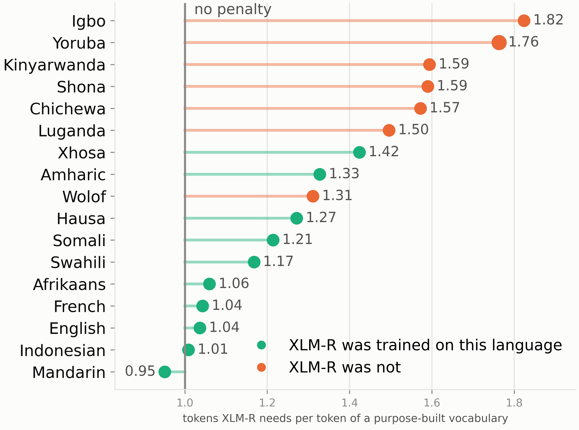
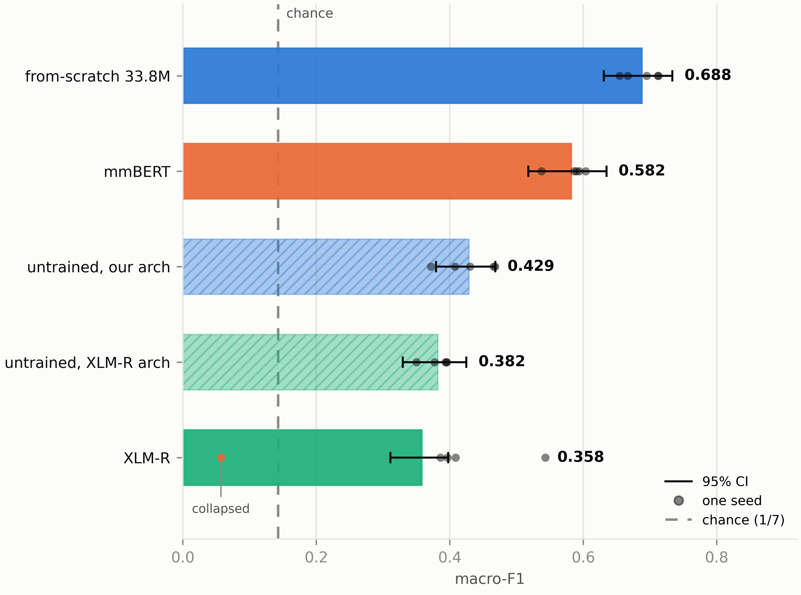
STARTING FROM SCRATCH: BUILDING AROUND LOW-RESOURCE LANGUAGES
Patrick Kwok · Jeffrey Stall · Leon Wan · CSED 504
GOALS
KEY DETAILS
DISCUSSION
Baselines against a reproduced published floor · from-scratch quality against pretraining budget on two tasks · separate labelled-data quantity from task type, the proposal's decisive experiment · locate where from-scratch overtakes transfer · test whether it generalizes across languages · does MLM loss predict downstream quality?
Yorùbá is interesting for NLP because it combines linguistic richness, limited digital resources, and challenging orthography, making it a good test case for NLP systems. The tone is linguistically important but often omitted in text. It is also a low-resource language relative to other languages like English and French. However, millions of people speak it as their native language.
Low-resource NLP usually defaults to transfer: take a multilingual encoder and fine-tune it. For Yorùbá we tested the alternative — pretrain a small encoder on in-language text with a vocabulary fitted to that text.
Language: Yorùbá · ~47M speakers · Latin script with tone
Corpus: All of FineWeb-2 Yorùbá has 69.1M tokens (260M characters)
33.8M RoBERTa-style MLM · 16k BPE (yor-bpe16k) · pretrained on 64M tokens
Transfer: XLM-R base (277M, 100 languages, Yorùbá not included) · mmBERT base (246M, ~1,800 languages, ~3T tokens, Yorùbá included)
Tasks: SIB-200 topic (701 / 99 / 204, 7 classes) · MasakhaNER (6,876 / 983 / 1,964)
SIB-200 macro-F1: 0.688 vs mmBERT 0.582 vs XLM-R 0.358
Fertility: XLM-R uses 1.76 tokens per fitted Yorùbá token (2nd of 17 languages)
Window: 128 tokens ≈ 77 Yorùbá words (16k BPE) vs 44 (XLM-R)
A 33.8M-parameter encoder trained only on Yorùbá can outperform mmBERT on topic classification (0.688 vs 0.582).
Label count vs. task type: NER’s flatter spread is not explained by its larger label set (6,876 vs. 701). Reducing NER to 2,000 sentences barely changes the spread; reducing it to 701 widens it only ~43% of the way toward topic classification. Both task type and label count matter, but neither explains the full gap.
Evidence limitations: SIB-200 has only 204 test items, so the 0.106 margin is larger than seed noise but still imprecise. MasakhaNER learning rates were tuned on the evaluation items. The only causal downstream evidence is the Yoruba vocabulary swap (4 seeds/side); the 17-language fertility gradient concerns tokenizers and has not yet been tested downstream.
Scaling: At AfriBERTa scale, the 86M model never outperformed the 33.8M model at any stable training-data rung, so scaling up is not the next step.
Data Saturation at Fixed Compute & Run-to-Run Spread by Vocabulary
RESULTS
On SIB-200 topic classification, the from-scratch model is the overall leader. A 33.8M encoder trained on 64M tokens of Yorùbá reaches 0.688 macro-F1; mmBERT stops at 0.582 and XLM-R at 0.358. Every arm was swept over the same nine learning rates, with the winner picked on the 99-item dev split and scored on test at five seeds. The gap over mmBERT is 0.106 — well above seed noise, though the bootstrap intervals still overlap by 0.004.
A randomly initialized model of our architecture scores 0.429; one matching XLM-R’s size and vocabulary scores 0.382. XLM-R itself lands below that untrained XLM-R control. One of its five seeds collapsed below chance. MasakhaNER tells a different story. mmBERT (0.863), XLM-R (0.851), and from-scratch (0.837) sit close together, while an untrained encoder already reaches 0.626. Most of the substance on that chart is surface form, such as capitalization and name shape, and not Yorùbá semantics. That is why the multilingual models lead on entities but not on topics.
Across 17 languages, covered languages cost about 1.15× tokens relative to a purpose-built 16k BPE; uncovered languages cost about 1.59×. Yorùbá is 1.76×, 2nd highest in the set. When we pretrain from scratch on the same languages, learnability does not split the same way, as noted by the overlapping ranges. Yorùbá is under-served, but not inherently harder to model.
Downstream, from-scratch is ahead for the semantic task. Thus, pretraining on 100 languages does not give rise to better Yorùbá topic classification. SIB-200, dev-selected, five seeds on test:
Pretraining a model from scratch compared to mmBERT and XLM-R. Dashed line is what the same architecture scores with no pretraining at all.
INTRODUCTION
For a language with little web text and few labels, let's consider the following two options.
1. Fine-tune a public multilingual encoder. XLM-R base (Conneau et al., 2020) is 277M parameters, 250k SentencePiece, 100 languages; Yorùbá is not among them. mmBERT base is 246M parameters, trained on about 3 trillion tokens across ~1,800 languages, with Yorùbá included. Transfer inherits that compute — and a vocabulary built mostly for other languages. 2. Pretrain a 33.8M RoBERTa-style masked LM (Liu et al., 2019) on FineWeb-2 Yorùbá with a 16k BPE trained on that text. The tradeoff is that you do not inherit 100-language pretraining.
Two downstream tasks are used because they are expected to reveal different strengths. SIB-200 (Adelani et al., 2024) is 7-way topic classification and needs sentence meaning. MasakhaNER 2.0 (Adelani et al., 2022) is entity recognition and can lean on capitalization and name shape, which transfer from any language. If from-scratch only wins the semantic task, this would suggest that language-specific pretraining matters most when the task requires genuine semantic representations, whereas transferred multilingual representations retain an advantage on tasks that can exploit surface-level cues.
Above: English control, same model and compute, more unique text. Loss falls from 4M to 64M tokens, then levels off. Going from 64M to 1,024M (16x more text) changes the score by 0.08, which is inside run-to-run noise (0.19).
Below: Vocabulary swap, 6 runs each. XLM-R’s 250k vocabulary and our 16k BPE, same Yorùbá text and compute. Average quality is close (0.989 vs 0.930 bits/char). The 16k runs stay in a tight band; the 250k runs scatter from about 0.83 to 1.15.
ETHICAL IMPACT & AI USAGE
No one on the team is fluent in Yorùbá, so all quality assessments are based on benchmark metrics. We therefore avoid making claims about whether the generated output constitutes high-quality Yorùbá. We did not use translation-based augmentation because we could not reliably audit whether translations preserved the original meaning.
We used Claude Code throughout this project to turn ideas and action points into working code.
SOURCES
A. Conneau et al., “Unsupervised cross-lingual representation learning at scale,” ACL, 2020, pp. 8440–8451.
M. Marone et al., “mmBERT: A modern multilingual encoder with annealed language learning,” arXiv:2509.06888, 2025.
Y. Liu et al., “RoBERTa: A robustly optimized BERT pretraining approach,” arXiv:1907.11692, 2019.
J. Devlin et al., “BERT: Pre-training of deep bidirectional transformers for language understanding,” NAACL-HLT, 2019, pp. 4171–4186.
K. Ogueji, Y. Zhu, and J. Lin, “Small data? No problem! …,” MRL @ EMNLP, 2021, pp. 116–126.
D. I. Adelani et al., “SIB-200 …,” EACL, 2024, pp. 226–245.
D. I. Adelani et al., “MasakhaNER 2.0 …,” EMNLP, 2022, pp. 4488–4508.
G. Penedo et al., “FineWeb2: One pipeline to scale them all …,” arXiv:2506.20920, 2025.
FineWeb — G. Penedo et al., “The FineWeb datasets …,” NeurIPS Datasets and Benchmarks, 2024.
Ranked based on tokenizer fertility, the penalty tends to be larger when XLM-R never trained on the language. What matters is whether XLM-R saw the language or not. The vocabulary appears to be more wasteful when coverage is missing.

