Slide 1
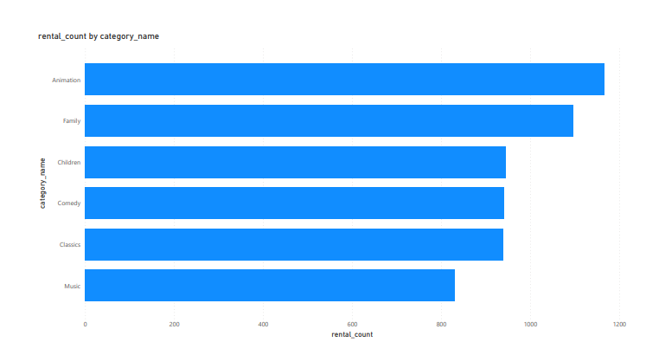
What movies are families watching?
The Top Family Movies the Customers are Watching Was Movies In the Animation Film Category.

Slide 2
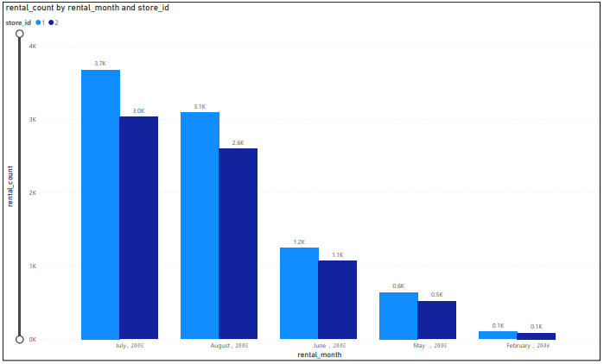
How the Performance Of Store 1 compared with Store 2 Count Of Rental per Month in 2005/2006
<visualization>
In All the Months In the Year 2005/2006, Store 1 Had more Rentals than Store 2.

Slide 3
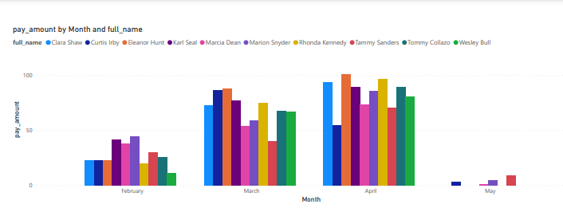
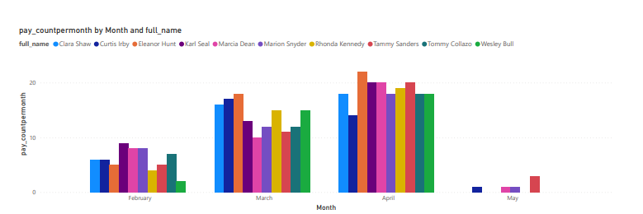
Who are the Top Paying Customers, Sum And Count Of their Payment Per Month In 2007
<visualization>
For the Top Paying Customers, their Total Payments and their respective Frequency Of payment(Count) Increased Progressively between the Month Of February and April, However Decreased in the Month Of May.

Slide 4
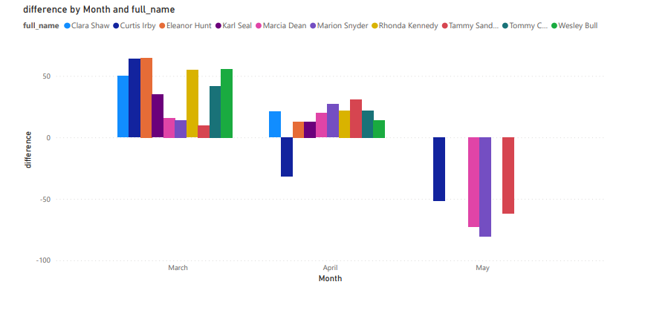
Top Paying Customers Payment Differences Per Month in 2007
In 2007, The Monthly Payments made by the top 10 Paying Customers in March and April Were More Than the respective previous Month’s Payment(With Exception Of Curtis Irby). However, in May All The Customers Payments were Less than April’s Payments.

