Slide 1

The 15th ACM International Conference on Multimedia Retrieval 2025
Latency-Aware Split Learning Optimization via Genetic Algorithms
Presenter: Le Hoang Trung
Affiliation: Software Engineer, LG Electronics R&D Center - Vietnam

Slide 2
The 15th ACM International Conference on Multimedia Retrieval 2025
Problem and Context
Proposed Solution: GA-Split
Methodology and Formulation
Experimental Setup
Results: Performance Insights
Analysis and Comparison
Conclusions and Future Work
Questions and Discussion
Notes:
OUTLINE
(Just take a look)

Slide 3
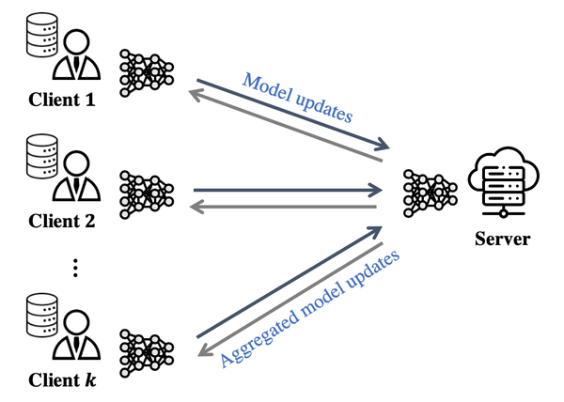
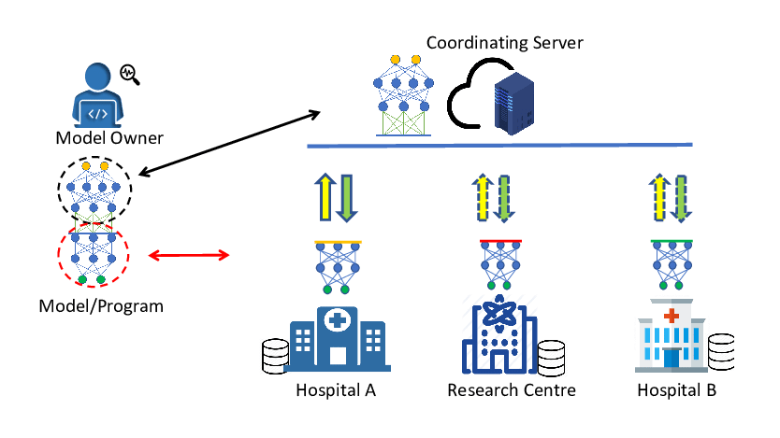
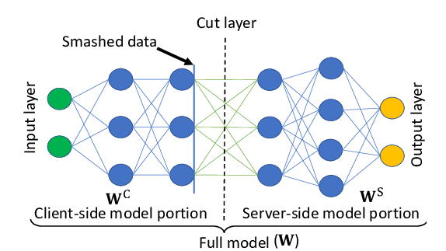
The 15th ACM International Conference on Multimedia Retrieval 2025
Hình ảnh mang tính minh hoạ, em sẽ chọn hình ảnh đúng với ý nghĩa slides hơn
Problem and Context
Context:
- Split Learning for edge AI
- Efficient DNNs on IoT devices
Challenges:
- Limited computation, bandwidth
- Optimal split point selection
- Heuristic methods: inefficient
Research Question:
- Minimize inference latency dynamically
Notes:
1. Introduce a little bit: Split Learning (Full-offloading, Local computing, Split computing)
2. Introduce Context and Problem
Just Example: (sẽ điều chỉnh lại để phù hợp và ngắn gọn hơn)
Let’s start with the context. Split Learning (SL), is a powerful approach to deploy deep neural networks (DNN) on resource-constrained edge devices, like IoT or mobile systems, by splitting computation between the device and a server.
This enables efficient AI in real-world applications, such as smart homes or healthcare.
However, there are significant challenges. Edge devices have limited computational power and network bandwidth, making it tough to run complex DNNs efficiently.
The key problem is selecting the optimal split point to balance local computation and communication costs, minimizing end-to-end inference latency.
For instance, in a smart camera system, high latency can delay real-time object detection.
So that why, we need a optimal split point !!!
Current methods, like heuristics or brute-force search, are either inefficient or lack adaptability to changing network conditions, such as fluctuating bandwidth.
This leads to our research question: how can we dynamically optimize split points to achieve minimal latency in diverse, real-world scenarios? That’s where our solution, GA-Split (Latency-Aware Split Learning Optimization via Genetic Algorithms), comes in, which I’ll introduce next.
Ref: https://www.researchgate.net/figure/Split-learning-in-a-simple-setup_fig2_346511008

Slide 4
The 15th ACM International Conference on Multimedia Retrieval 2025
Chỗ này em sẽ trình bày Đề xuất giải pháp của paper
Proposed Solution: GA-Split
[Proposed Solution: GA-Split]
[Left: GA Flowchart]
[Initialization: 60 split points]
↓
[Evaluate Fitness: Minimize T_l]
↓
[Select Best Split Points]
↓
[Crossover & Mutation: Prob 0.20]
↻ (400 Generations)
↓
[Output: Optimal Split Point (s_opt)]
[Right: Bullet points]
- GA-Split: Genetic Algorithm optimization
- Key Features:
- Exploits natural bottlenecks
- Adapts to bandwidth, batch size
- Minimizes inference latency
- Advantages:
- Global optimization
- No model retraining
- Scalable for edge AI
[Bottom: Split Point Diagram]
[Client] → [Layer 1 | Bottleneck (s_opt) | Layer L] → [Server]
|← Part 1 →| [h_l] |← Part 2 →|
GA-Split: Genetic Algorithm optimization
Key Features:
- Exploits natural bottlenecks
- Adapts to bandwidth, batch size
- Minimizes inference latency
Advantages:
- Global optimization
- No model retraining
- Scalable for edge AI
[Left Image: Flowchart of GA process]
[Bottom: Small diagram of split point selection]
Notes:
Reference text:
To address the challenges of Split Learning, we propose GA-Split, a novel framework that uses a Genetic Algorithm to dynamically optimize the split point in deep neural networks.
Unlike traditional heuristic methods, GA-Split leverages the global search capabilities of genetic algorithms to find the best split point, minimizing end-to-end inference latency.
How does it work?
First, it exploits natural bottlenecks in DNN architectures, like EfficientNet, to reduce the size of intermediate data sent to the server, cutting communication costs.
Second, it dynamically adapts to changing conditions, such as network bandwidth or batch size, ensuring optimal performance in real-world scenarios.
Most importantly, GA-Split requires no model retraining, making it a plug-and-play solution.
Compared to heuristic approaches, GA-Split offers superior global optimization and scalability, making it ideal for resource-constrained edge devices in IoT or mobile applications.
Next, I’ll dive into the methodology and how we formulate this optimization.

Slide 5
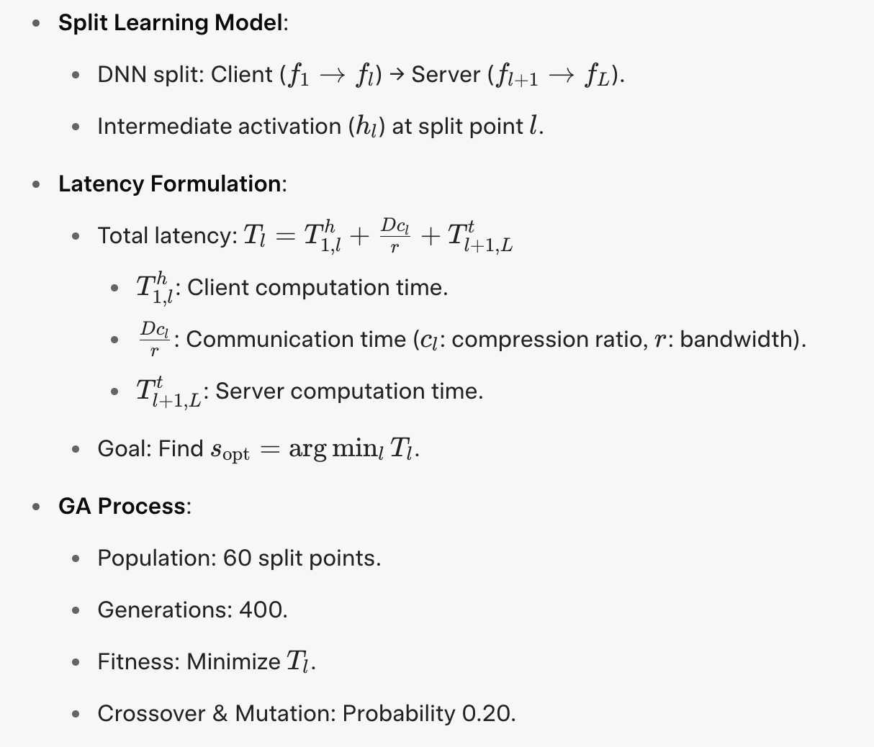
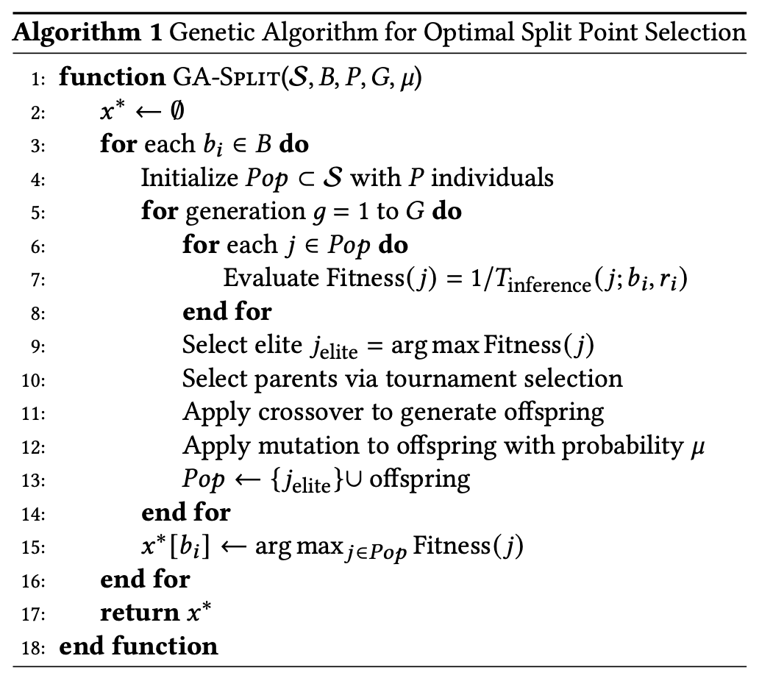
The 15th ACM International Conference on Multimedia Retrieval 2025
Methodology and Formulation
Notes:
Let’s dive into the methodology behind GA-Split. In Split Learning, we divide a deep neural network into two parts: the client, which runs the initial layers up to a split point l (L), and the server, which handles the remaining layers. The intermediate activation, hl (h_L), is sent from the client to the server, as shown here [point to DNN split diagram]. Our goal is to minimize the total inference latency, defined by this equation: Tl (T_L) equals the client computation time, plus the communication time—based on the data size and compression ratio divided by bandwidth—plus the server computation time [point to equation]. The challenge is to find the optimal split point, s_opt, that minimizes Tl. To do this, GA-Split uses a Genetic Algorithm with a population of 60 candidate split points, evolving over 400 generations. The fitness function evaluates each split point by calculating Tl, and through selection, crossover, and mutation with a probability of 0.20, we converge to the optimal split point [point to GA flowchart].
This process ensures dynamic optimization, adapting to varying conditions like bandwidth or batch size, without retraining the model. Next, I’ll show how we tested this approach in our experiments.

Slide 6
The 15th ACM International Conference on Multimedia Retrieval 2025
Experimental Setup
Model: EfficientNet-B7
Environment:
  Client: 16 threads, no GPU
  Server: High compute power
Conditions:
  Bandwidth: 0.5-100 Mbps
  Batch Size: 1-30
Metrics:
  Inference latency
  Split computing utility rate
  Offline computation cost
Notes:
Now, let’s look at how we evaluated GA-Split. We used EfficientNet-B7, a widely adopted deep neural network, as our test model [point to model]. For the environment, we simulated a resource-constrained client, like an IoT device, with only 16 threads and no GPU acceleration, mimicking real-world edge devices. The server, on the other hand, represents a powerful edge or cloud system [point to diagram]. To test GA-Split under diverse conditions, we varied the network bandwidth from 0.5 to 100 Mbps and the batch size from 1 to 30, reflecting realistic scenarios like fluctuating 5G networks or IoT data streams [point to conditions]. We evaluated three key metrics: the average inference latency, to measure performance; the split computing utility rate, to assess how often split computing outperforms full device or server execution; and the offline computation cost, to evaluate the overhead of our optimization process [point to metrics]. These setups allowed us to rigorously test GA-Split’s effectiveness, which I’ll share in the next slide.

Slide 7
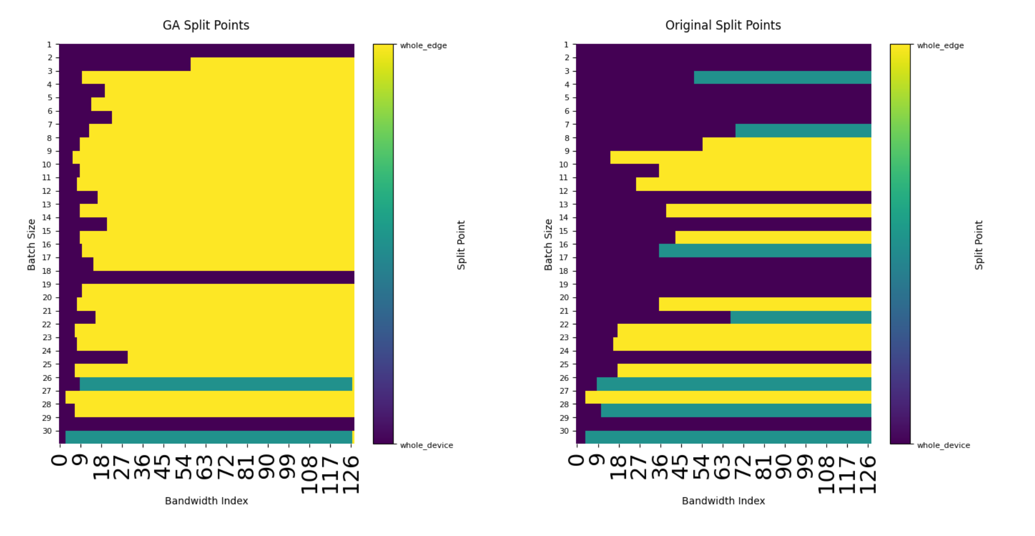
The 15th ACM International Conference on Multimedia Retrieval 2025
Results: Performance Insights
Inference Latency:
  GA-Split: 27846.72 ms
  Baseline: 27612.13 ms (~0.8% higher)
Utility Rate:
  GA-Split: 74.38%
  Baseline: 28.70% (2.6x better)
Key Insights:
  Dynamic adaptation
  Outperforms in diverse conditions
  Negligible runtime overhead
Notes:
Let’s explore the performance insights of GA-Split. In terms of inference latency, GA-Split achieves 27,846 milliseconds, nearly matching the baseline’s 27,612 milliseconds, with just a 0.8% increase [point to bullet point]. The real strength lies in the split computing utility rate, where GA-Split reaches an impressive 74.38%, a 2.6 times improvement over the baseline’s 28.70% [point to bullet point or optional bar chart]. This means GA-Split consistently outperforms full device or server execution in diverse scenarios. How does it achieve this? As shown in Figure 3 [point to Figure 3], GA-Split dynamically adapts its split point decisions based on bandwidth and batch size, unlike the baseline’s static approach. For example, in low-bandwidth conditions, it selects bottleneck layers to minimize communication costs, ensuring efficient performance across varying network conditions. Additionally, GA-Split incurs negligible runtime overhead, making it practical for edge AI applications like IoT or smart devices. Next, I’ll analyze how these results compare to existing methods.

Slide 8
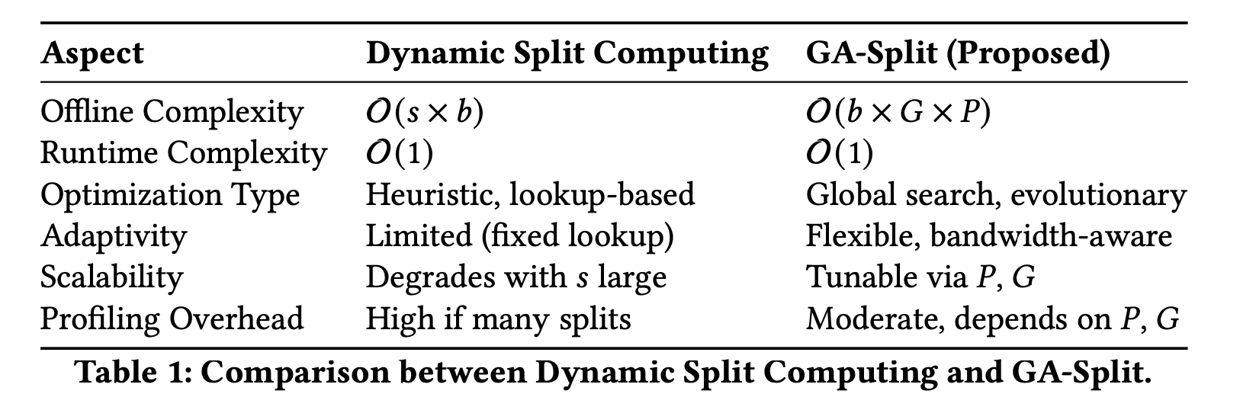
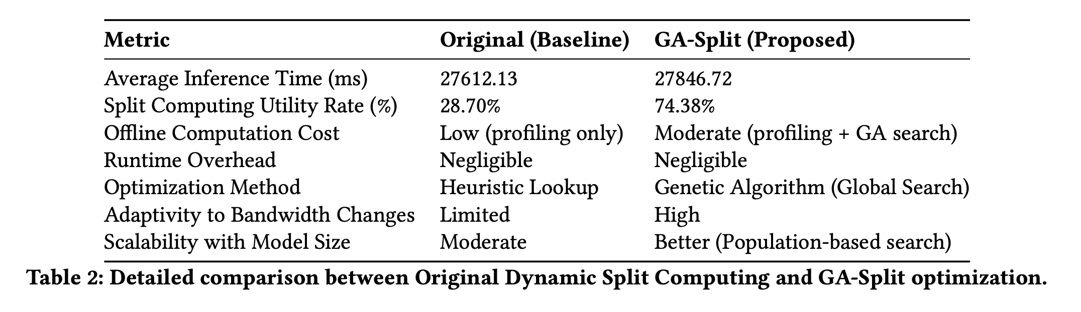
The 15th ACM International Conference on Multimedia Retrieval 2025
Analysis and Comparison

Slide 9
The 15th ACM International Conference on Multimedia Retrieval 2025
Conclusions and Future Work
Conclusions:
  GA-Split: 74.38% utility rate
  Dynamic split point optimization
  Scalable for edge AI
Future Work:
  Multi-objective optimization
  5G/6G, tinyML integration
  Multi-edge collaboration
Notes:
In conclusion, GA-Split significantly enhances split learning, achieving a 74.38% utility rate, 2.6 times better than the baseline, while maintaining low inference latency [point to Conclusions]. Its dynamic split point optimization adapts to varying network conditions, making it highly scalable for resource-constrained edge AI applications, such as IoT or mobile devices [point to image]. Looking ahead, we plan to extend GA-Split to multi-objective optimization, balancing latency, energy, and privacy. We also aim to integrate it with emerging 5G and 6G networks and explore tinyML for ultra-low-power devices. Finally, multi-edge collaboration could further enhance its scalability [point to Future Work]. Thank you for your attention! I’m happy to take any questions.

Slide 10
The 15th ACM International Conference on Multimedia Retrieval 2025
Questions and Discussion

