Slide 1

Project
Optimization
PROJECT IMPLEMENTATION SCHEDULING(topic24)
Nguyễn Huy Hoàng 20214959
Nguyễn Viết Quý Anh 20214947
Phạm Quang Trung 20214935

Slide 2



Content
1. Project requirement
2. Modeling
3. Analysis

Slide 3

Project Requirement

Slide 4
The investor need to complete N tasks by M groups of workers
Group j can start the task at time s(j)
c(i,j) is the cost for renting group j do task i
Each task i can finished by a group in set W(i) and completion time is d(i)
Between N tasks have a different priority while task i must be done first before starting task j
Each groups can only do one task at a time and when starting a task, they have to complete it without stop to do other task
Make a schedule to finish N task in which :
+) Completion time is minimized
+) Max total cost paying for a group worker is minimized

Slide 5

Input Specification

Slide 6
6 3
5 1 3 0
7 1 2 0
12 2 3 0
3 1 3 0
10 1 2 0
0 0 0
2
1 4
2 6
4 3 5
3 4 1
1 2 1
2 3 2
3 3 2
5 6 2
->N = 5: number of tasks; M = 3: number of workers
-> d(i): completion time; and workers who can do task i; end by 0
->s(j): the time that worker j can start his work
->K: number of contraints between tasks
-> number of pairs of (i,j) such that task i and j while task i must be finished first
-> c[i][j]: cost for renting worker j do task I

Slide 7
Greedy Algorithm

Slide 8
Problem Formulation

Slide 9
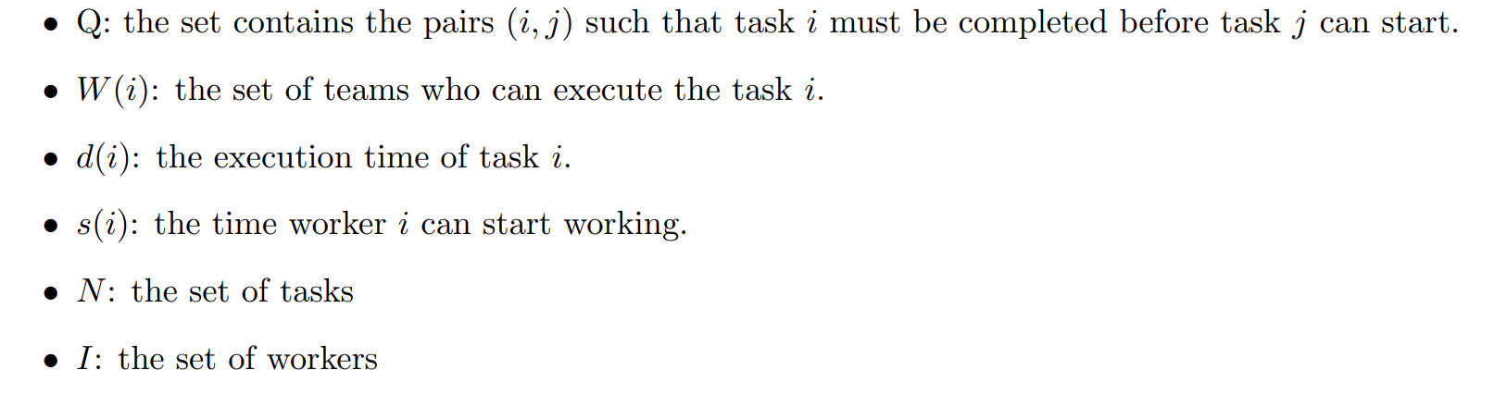
Denotation

Slide 10
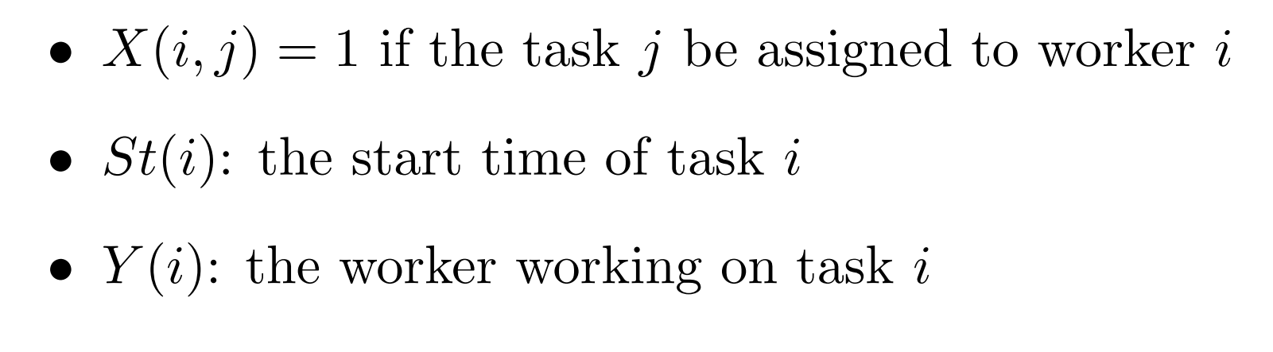
Variables

Slide 11
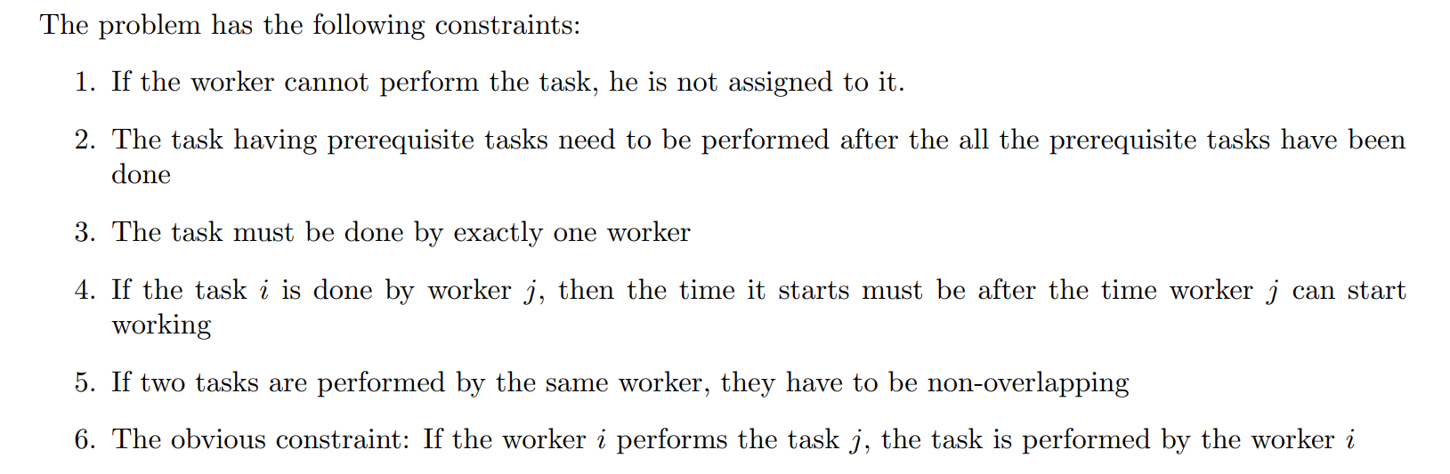
Constraints

Slide 12
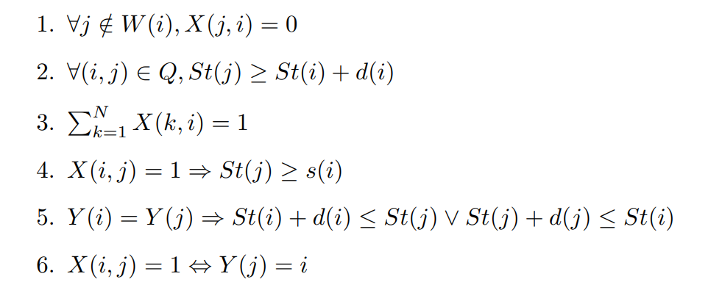
CP model

Slide 13
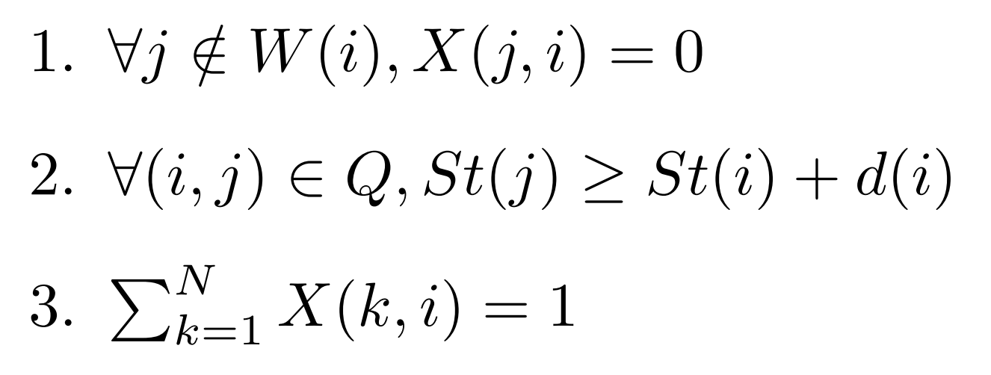
MIP model

Slide 14
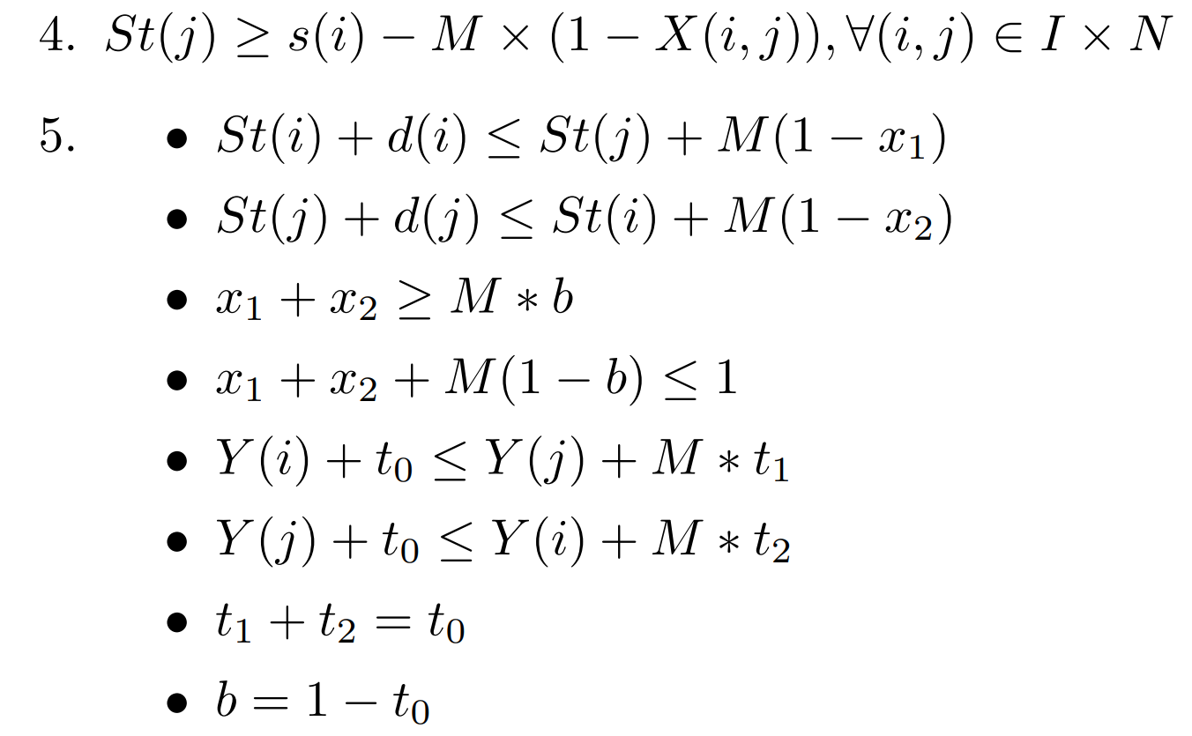
MIP model

Slide 15
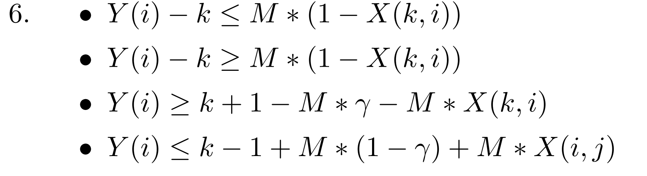
MIP model

Slide 16
Comparison between CP and MIP

Slide 17
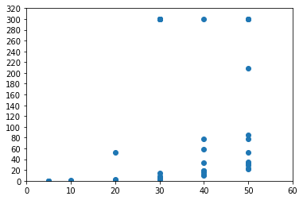
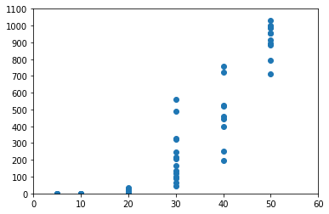
Comparison
We collected 56 input files to test the efficiency of 2 models
MIP model
CP model

Slide 18
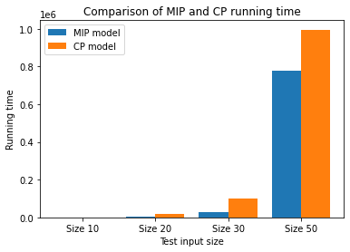
Comparison
MIP model has the running time smaller than that of CP on all 56 test.

Slide 19
List of task
Phạm Quang Trung
MIP model (100%)
Greedy Algorithm (100%)
Report (100%)
Data Analysis (10%)
Slide (30%)
Nguyễn Huy Hoàng
CP model (50%)
Data Analysis (90%)
Nguyễn Viết Quý Anh
CP model (50%)
Slide (90%)

Slide 20
Thank you for your attention!!!
Do you have any questions for us?

