Slide 1
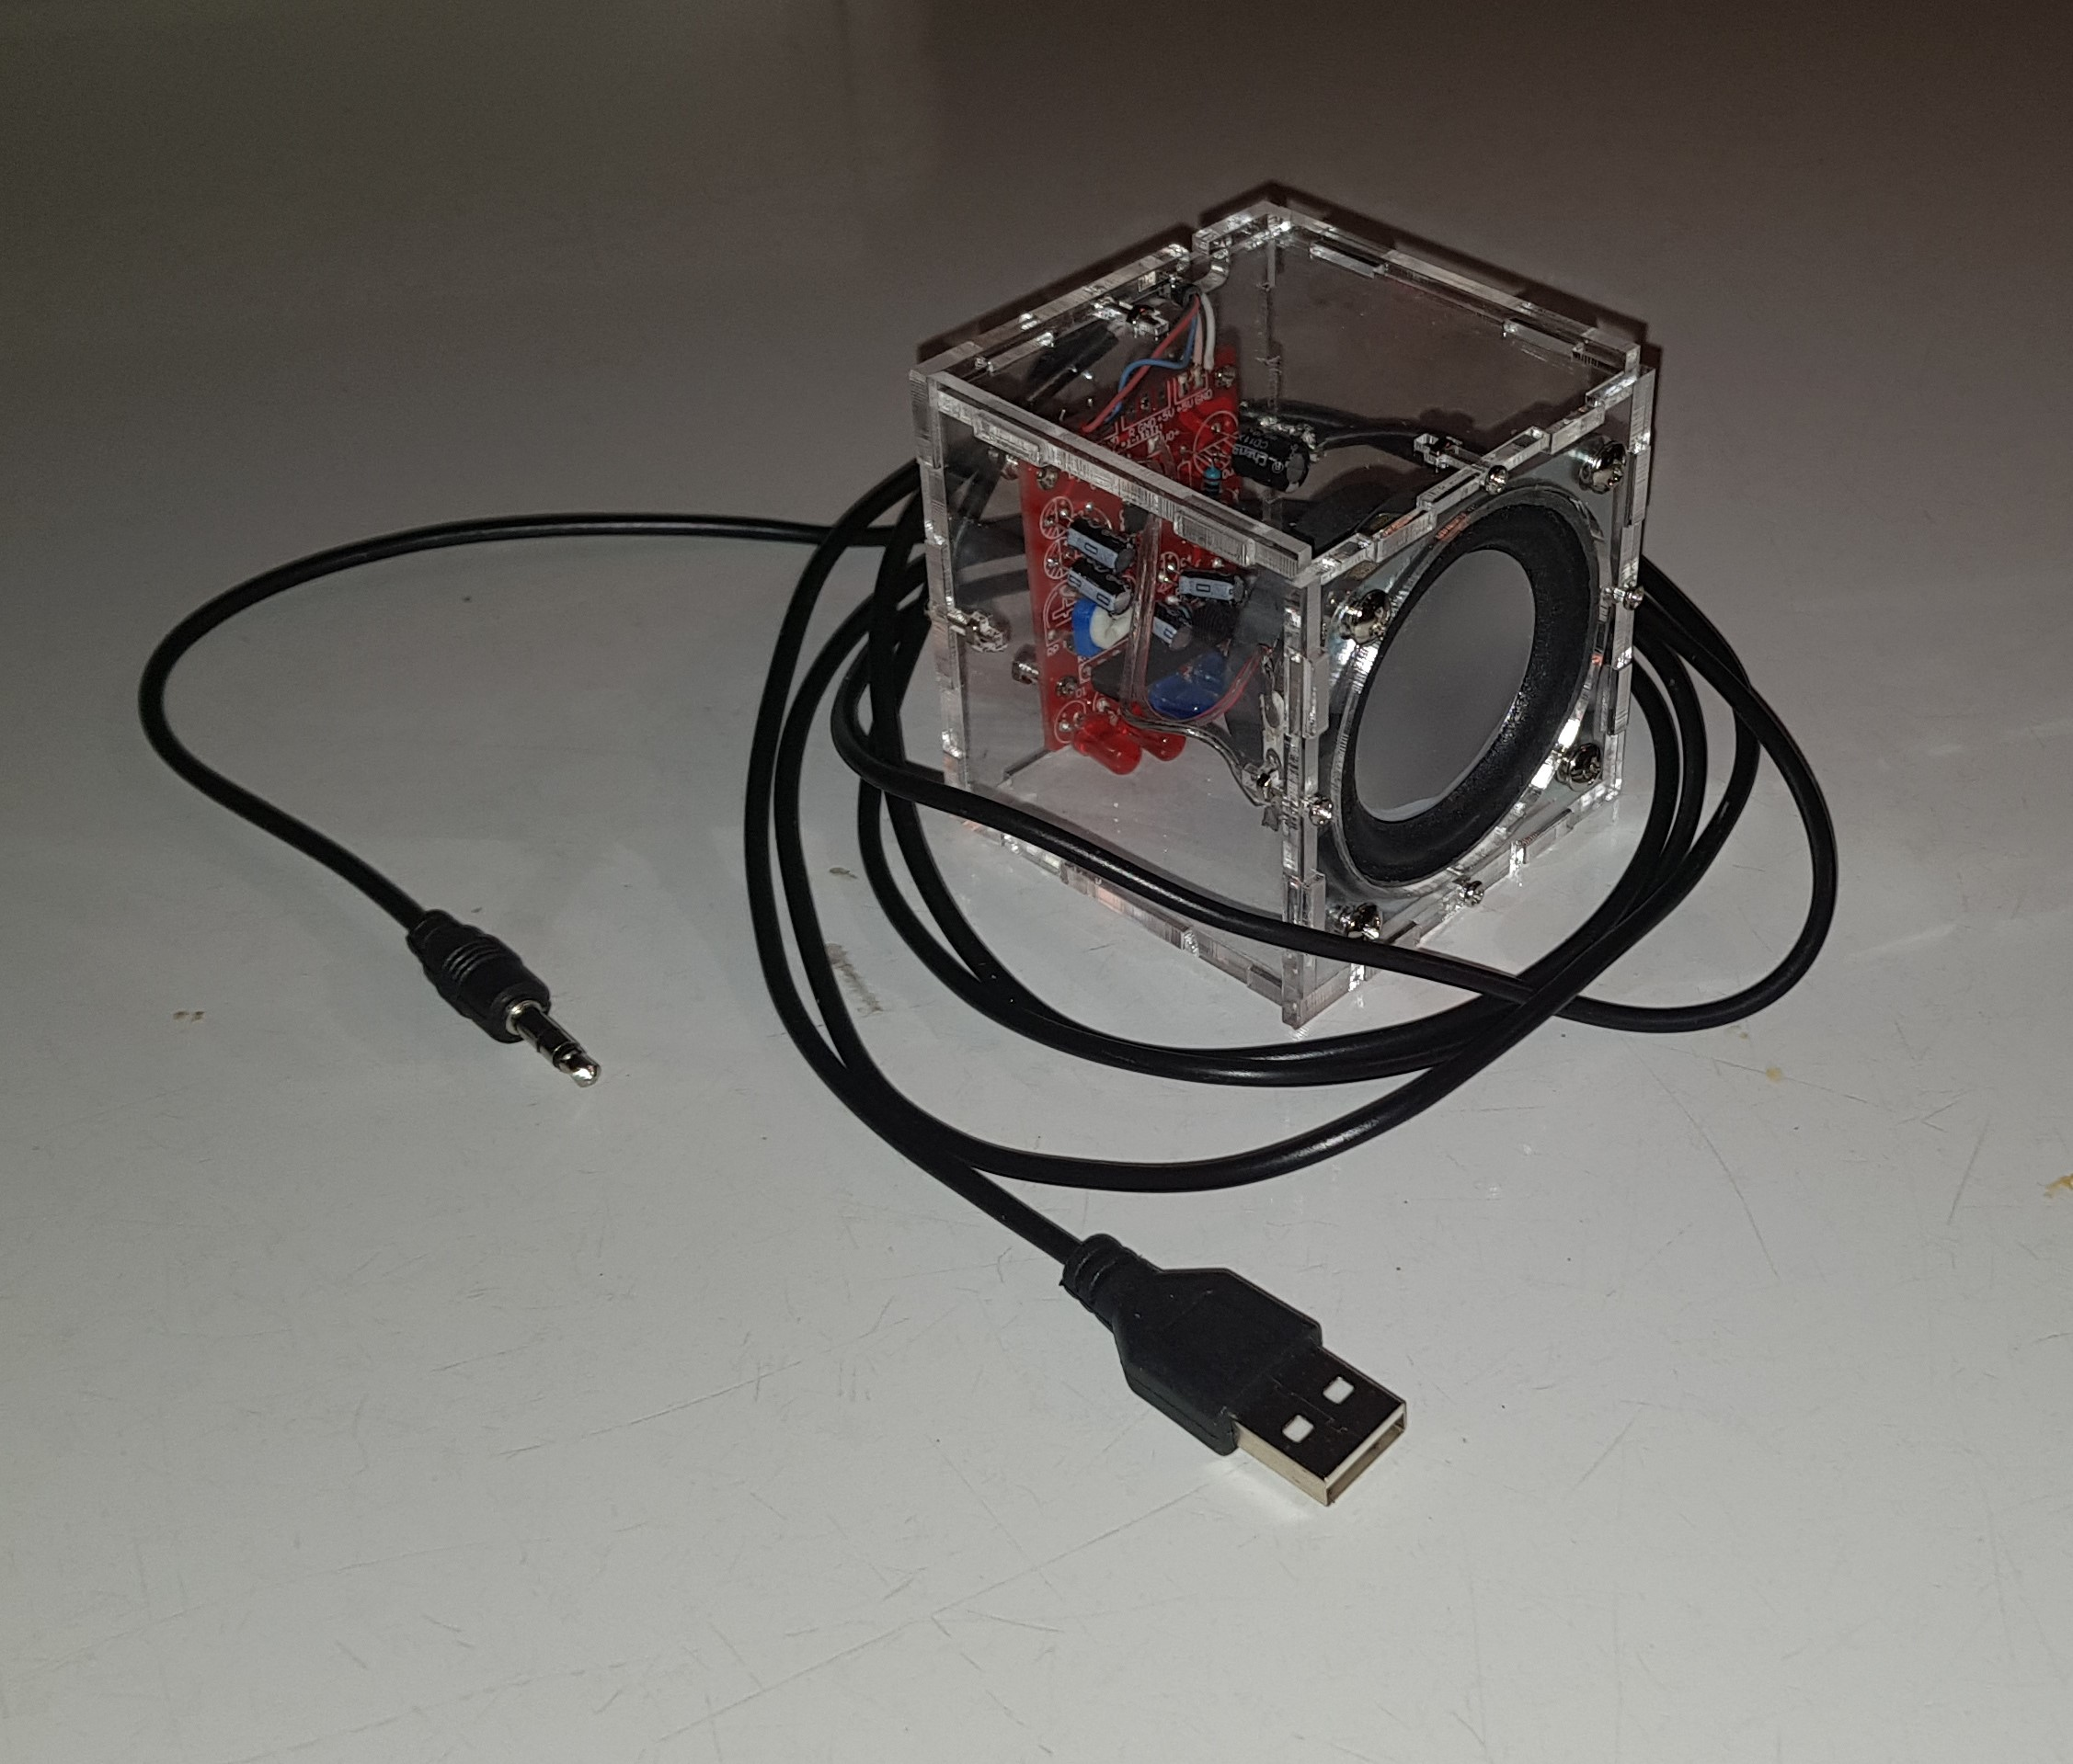
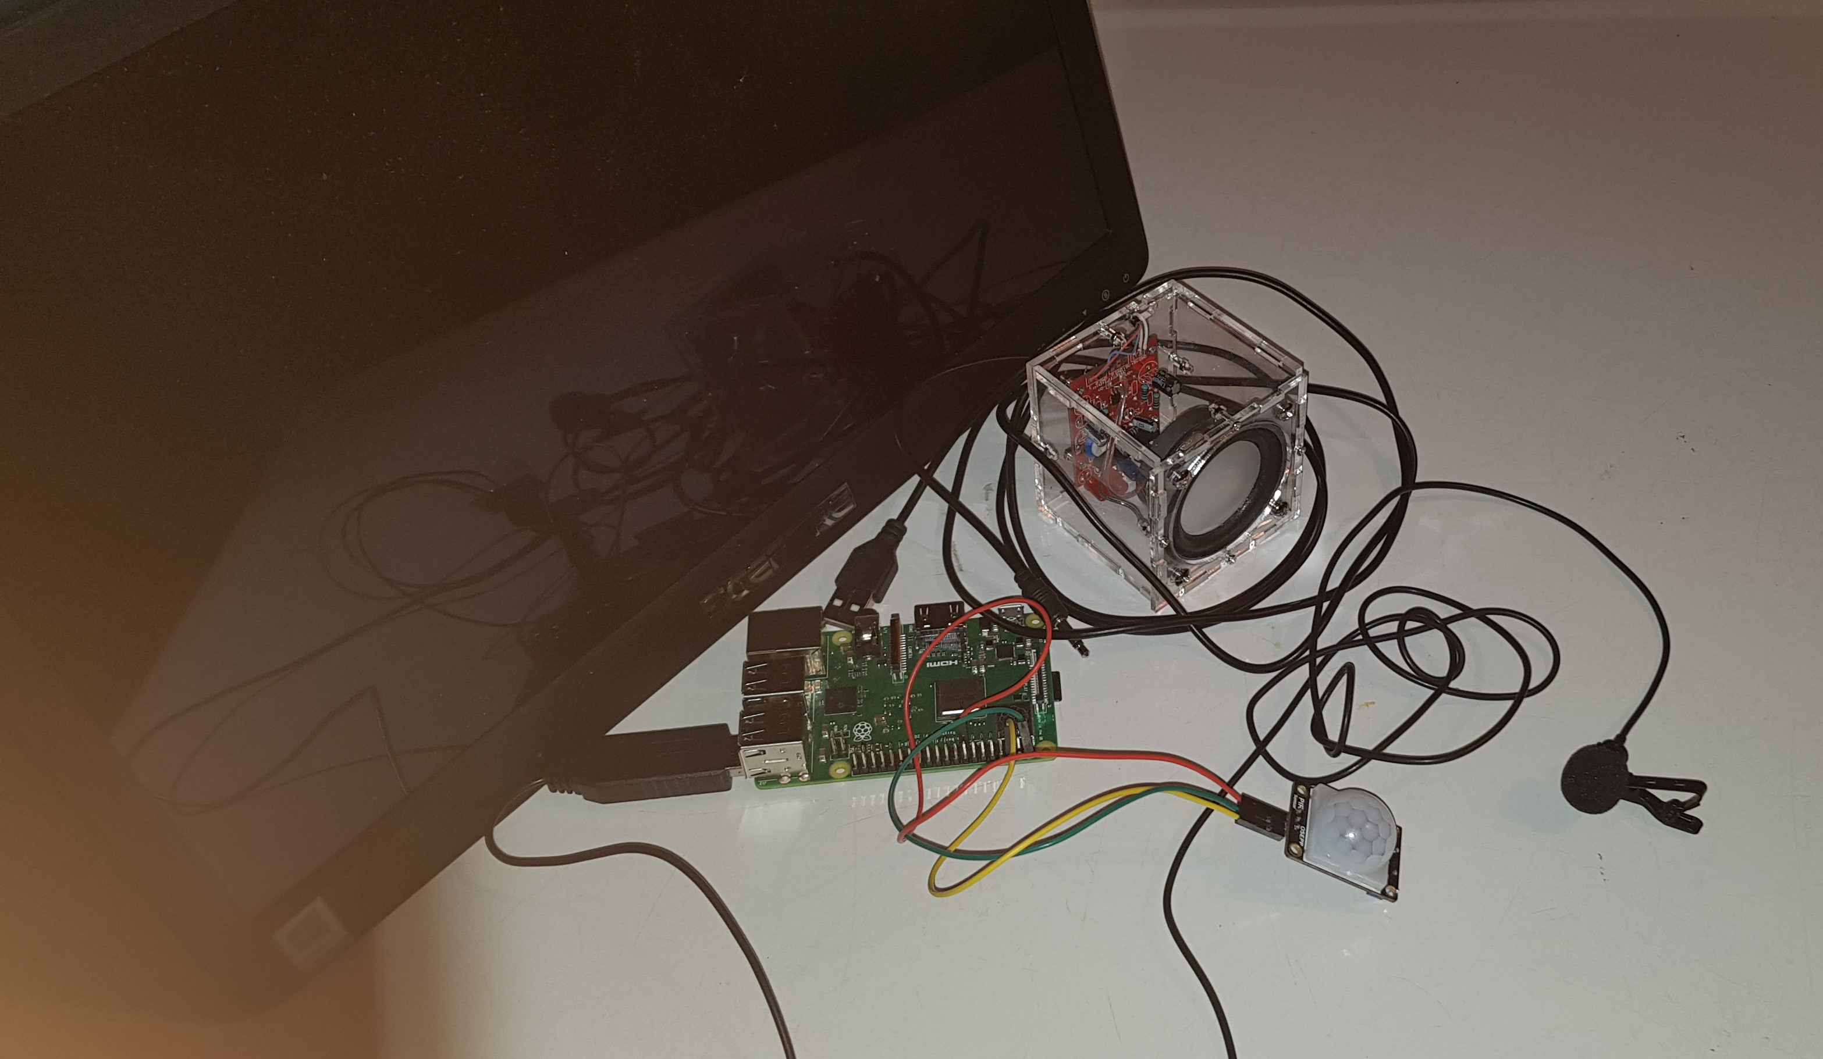
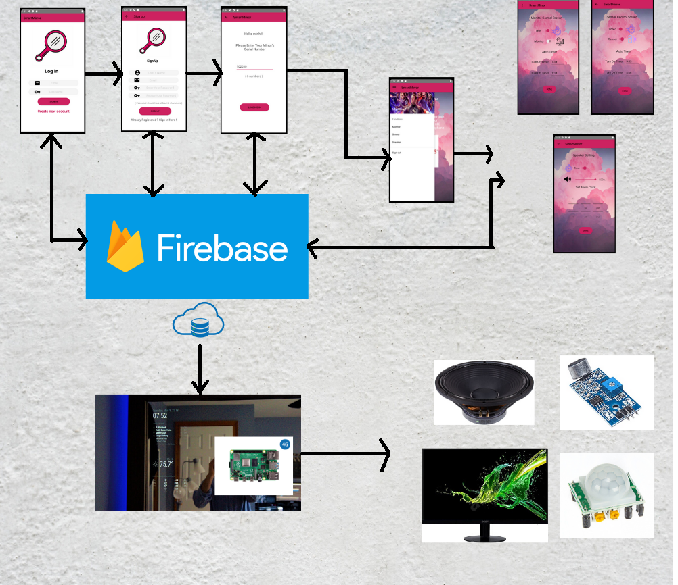
SmartMirror
Project by SmartDevices
Tuan Minh Nguyen, Haider Ibrahim and Quang Trung Trinh. Humber College, Toronto
INTRODUCTION
Idea:
Most of home mirrors nowadays doesn't have any other function other than reflecting the physical objects. We think a big old singular function mirror is a huge waste of space. What if we can utilize the mirror to an unlimited functional device?
Proposal:
Our Smart Mirror is a device that not only able to reflect physical object but also able to be hooked up with a computer system and display information. This opens the wide horizon of potential uses of a furniture that take up a lot of space but highly functional once it is interconnected to the internet. It allows users to acquire current weather, time, news header, date and also helps children to get familiar and to learn more about technology. It also interactive with the user via our microphone and speaker system which is driven by a google service.
Background:
Firstly, we would like to thank our mentor Jennifer Turliuk from MakerKids for sponsoring our project. Secondly, we would like to thank our professors Kristian Medri for helping us a lot throughout this project. Our task is to create an object that can help the kids to learn about technology. Our team and MakerKids want to help children understand that Technology is not just about writing some boring code, it is about solving life problems and make life easier.
METHOD
Agile technique
The principle we used to complete all our technical parts and paperwork is an agile method. Each sprint consist of achieving
technical aspects of project whether it's hardware or software, and a written portion.
Software development strategy
Our software consists of two components, MagicMirror and set of Linux services running in the background to support various means of controlling the smart mirror peripherals. Each software piece was developed independently and encapsulated from one another. Moreover, it tests thoroughly under the various circumstance and finally integrated with the magic mirror.
Low - Software architecture
RESULTS
Our project named SmartMirror is divided into two parts: hardware and software application.
The Android application’s purpose is to interact and control the mirror. We built this application by Java code in Android Studio since our Software Project course. We used Firebase as our database to store peripherals’ information. Users are recommended to register their accounts when having our SmartMirror in order to interact with the mirror. Their account information will also be stored to remember the membership. Users will have to enter their mirrors’ serial numbers so our Firebase can specify each mirror’s peripherals’ information. As a result, they can control the peripherals shown on the mirror from the setting of SmartMirror Application.
Our hardware is embedded to the backside of the monitor along with sensors connected to them.
PRINTING
In order to create the case, we had to measure all sides of our Raspberry Pi and also our monitor because we tend to attach it right into the back of the monitor. Then we use CorelDraw to design the 3D prototype of it. But due to some problem, we only have the case for our Speaker now.
Python scripts
S1
S2
S3
S4
MagicMirror
CONCLUSIONS
With the completion of the whole computer system of the SmartMirror and the application that control the system remotely, there are still spaces for advancement in our project. Full wall-installation and demo period would be execute to measure the quality and durability of the product as well as other measures like power consumption, etc.… Further customize-needed features such as the module to teach Kids coding that interact with the physical Mirror will be implemented to fit the needs of our sponsor.
AIM
The objective of the project is to find an IoT solution to our sponsor MakerKids. Makerkids, it's a private school that teaches kids about robotics and programming to empower next-generation tech leaders. Our sponsor required an IoT solution that is interactive, cool hackable by children. We proposed a Smart mirror as a prototype to meet the sponsor requirement, and this solution fit requirement for the following reason;
The smart mirror internal parameters such as Alarm or remote control will teach the kids that the program is modified.
The smart mirror display nice and cool widgets that represent useful information such as news that can capture kid attention.
It teaches kids about coming IoT, Sensors, and how various things can be put together to create something cool.
Smart mirror software
S1: Alarm service
S2: Monitor state
S3: Speaker timer
S4: Monitor state timer
ACKNOWLEDGEMENTS
Templates from:
https://publicaffairs.illinois.edu/resources/research-poster-template/
Report Sample:
https://www.oacett.org/getmedia/9f9623ac-73ab-4f99-acca-0d78dee161ab/TR_GUIDELINES_Final.pdf.aspx

