Slide 1
Mock Project: Digital Clock
TRAINEE: NGUYỄN TRUNG HÒA – EMB04
TRAINER: ĐẶNG NGHĨA NHÂN

Slide 2
OUTLINE
01
02
03
04
REQUIREMENTS
HARDWARE
SOFTWARE
DEMO

Slide 3
01
Requirements

Slide 4
BASIC AND EXTRA REQUIREMENTS
Press button 1
Display time
Display date
Press button 2
Turn off the display mode
Turn on the display mode
Setting date, time by UART serial communication
Setting alarm time by UART serial communication
Display time/date on LED through LPSPI

Slide 5
02
HARDWARE

Slide 6

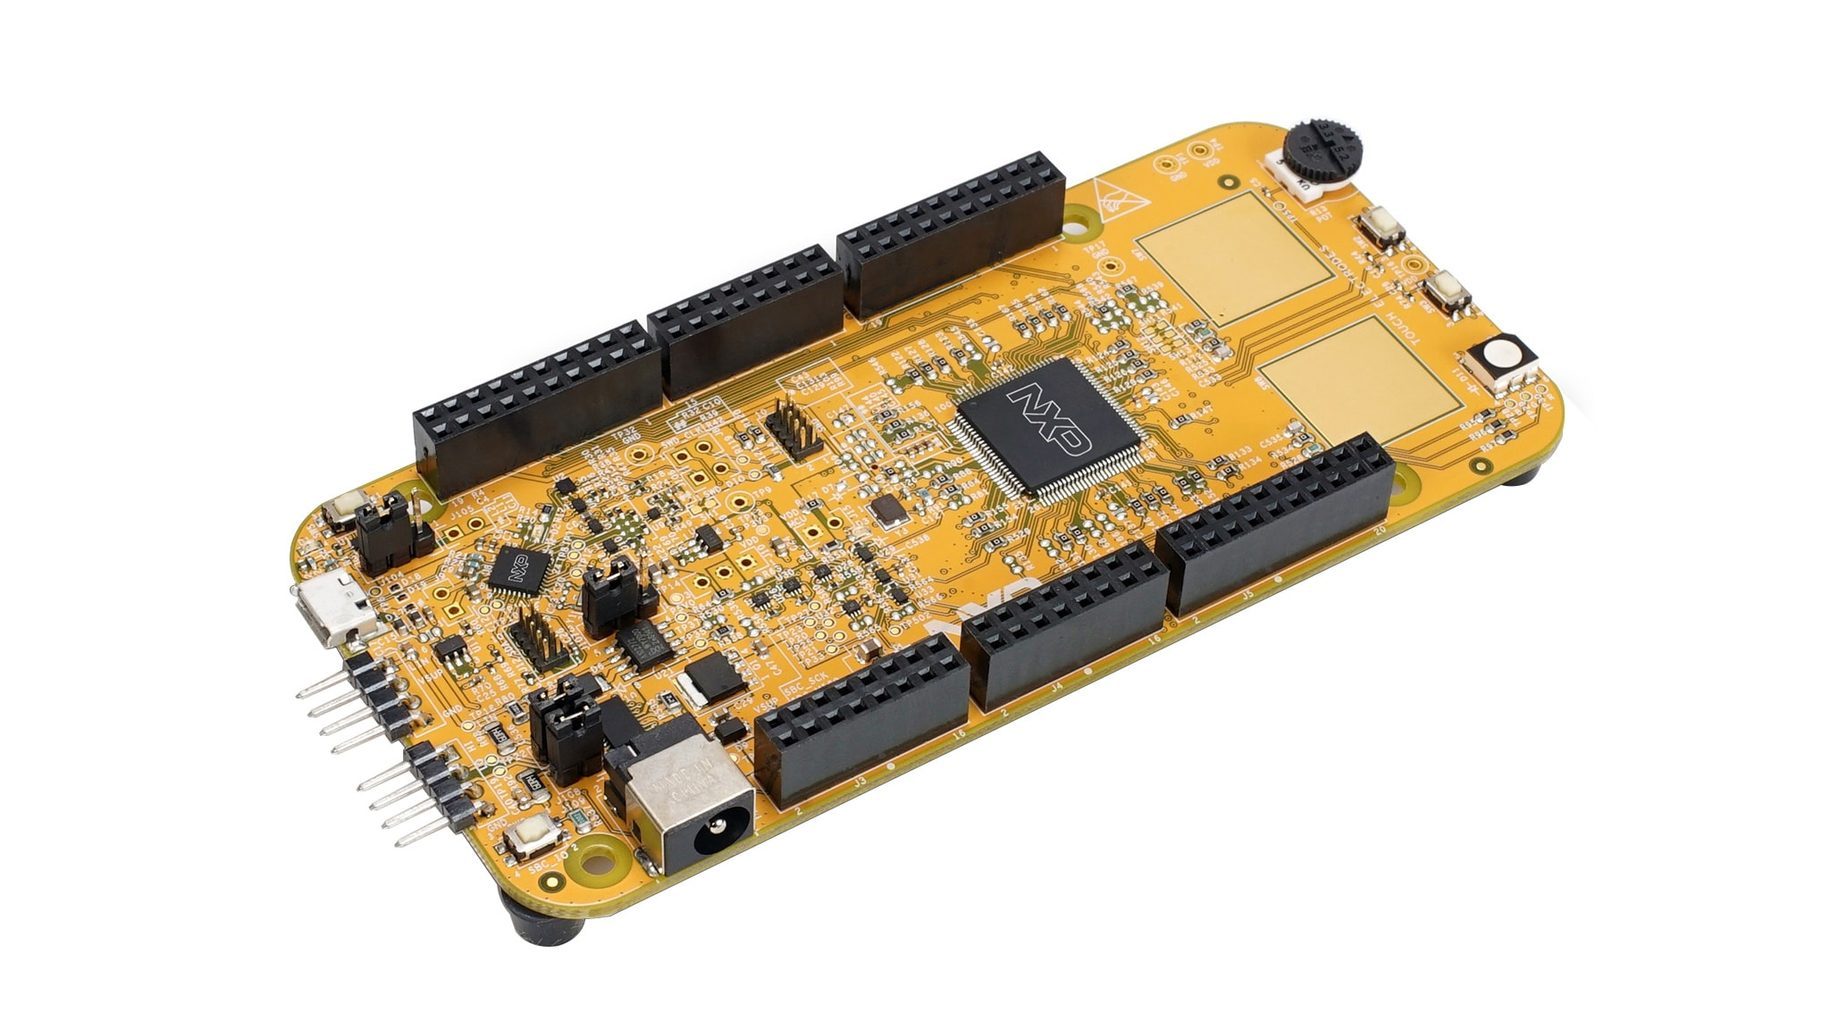
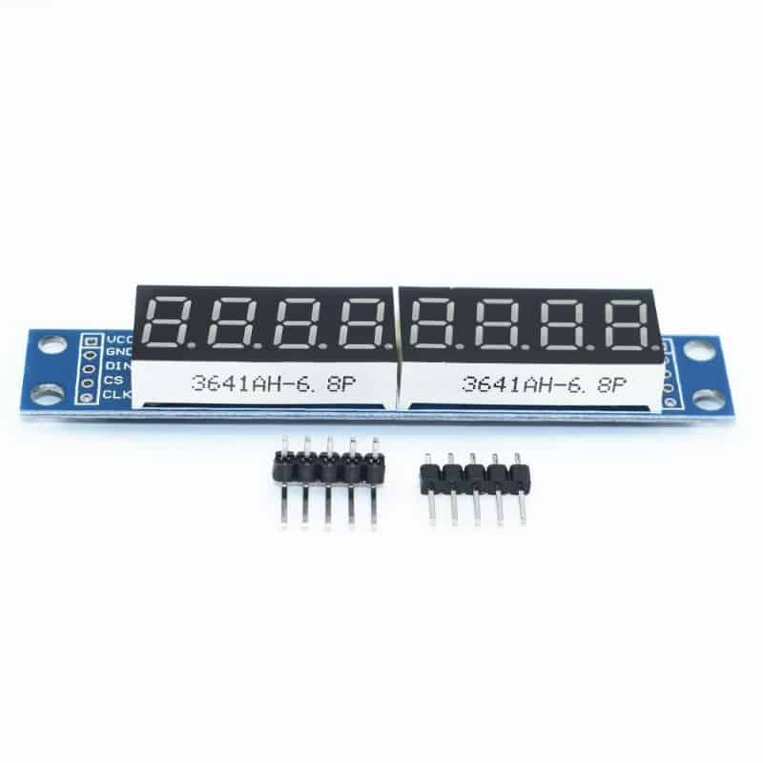
HARDWARE
5V supply for MCU
Transmit and receive data to MCU through LPUART
Nạp code
Control display time/date (Using button on board)
Control display modes (Using button on board)
Receive data through LPUART
Transmit notification through LPUART
Control Max 7219 through LPSPI
Display time and date
Blinking LED when alarm

Slide 7
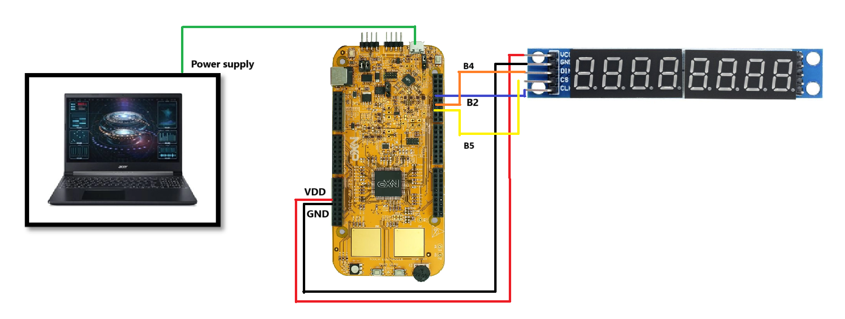
HARDWARE

Slide 8
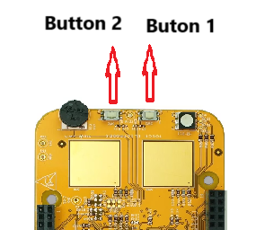
HARDWARE

Slide 9
03
SOFTWARE

Slide 10

3.1. PERIPHERALS
GPIO
LPIT
LPUART
LPSPI

Slide 11
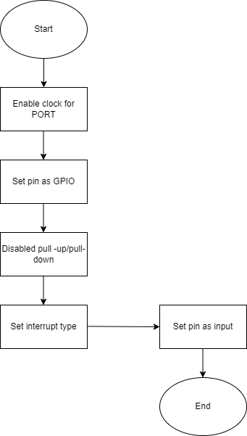
3.1.1. GPIO
Configure GPIO pin 12, 13 Port C to input interrupt
Button 1 – pin 13: Display time or date
Button 2 – pin 12: Turn on/off display mode

Slide 12
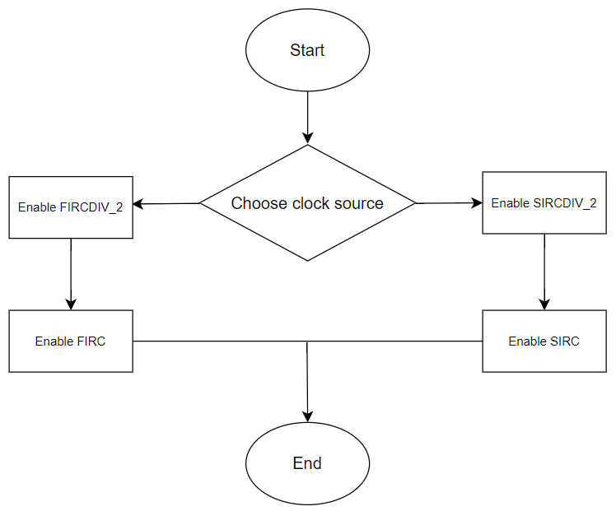
3.1.2. SET CLOCK SOURCE FOR PERIPHERALS
Enable FIRCDIV_2 for LPUART and LPIT Timer
Enable SIRCDIV_2 for LPSPI

Slide 13
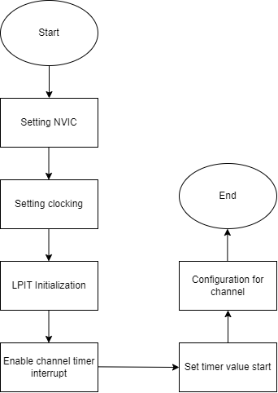
3.1.3. LPIT
Configuration for LPIT timer channel 1 to be digital clock
Configuration for LPIT timer channel 2 to blink LED when alarm

Slide 14
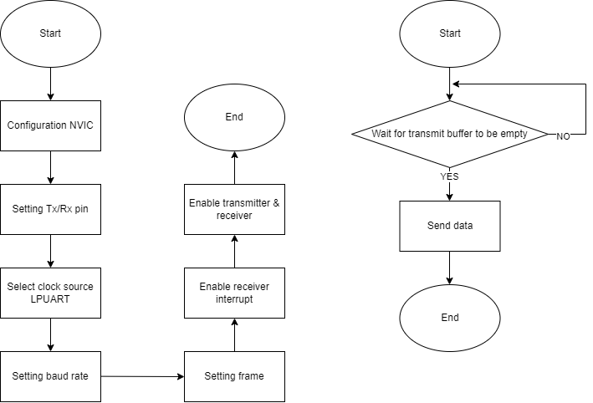
3.1.4. LPUART
Configuration for LPUART
LPUART interrupt receive data for digital clock
LPUART transmit notification when assign time/date/alarm time to digital clock

Slide 15
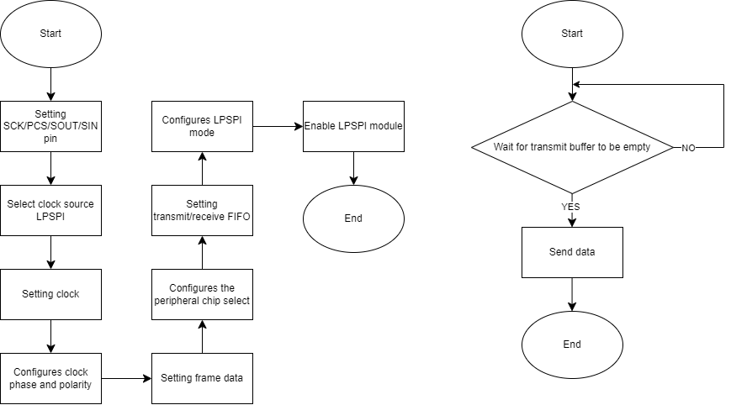
3.1.5. LPSPI
Configuration for LPSPI
LPSPI transmit time/date value to LED

Slide 16
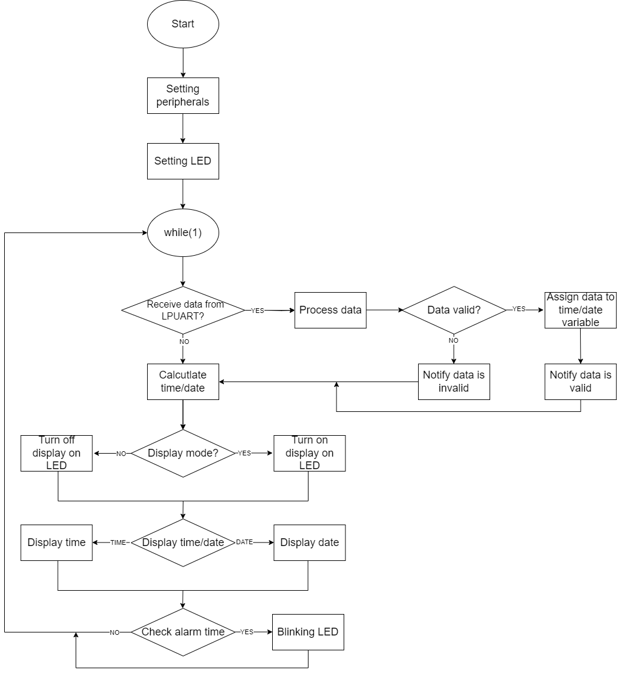
3.2.MAIN PROGRAM
Main program flow:
Setting peripherals
Setting LED
Main program while(1)
Receive data from LPUART
Calculate time/date
Display mode
Display time/date
Check alarm time

Slide 17
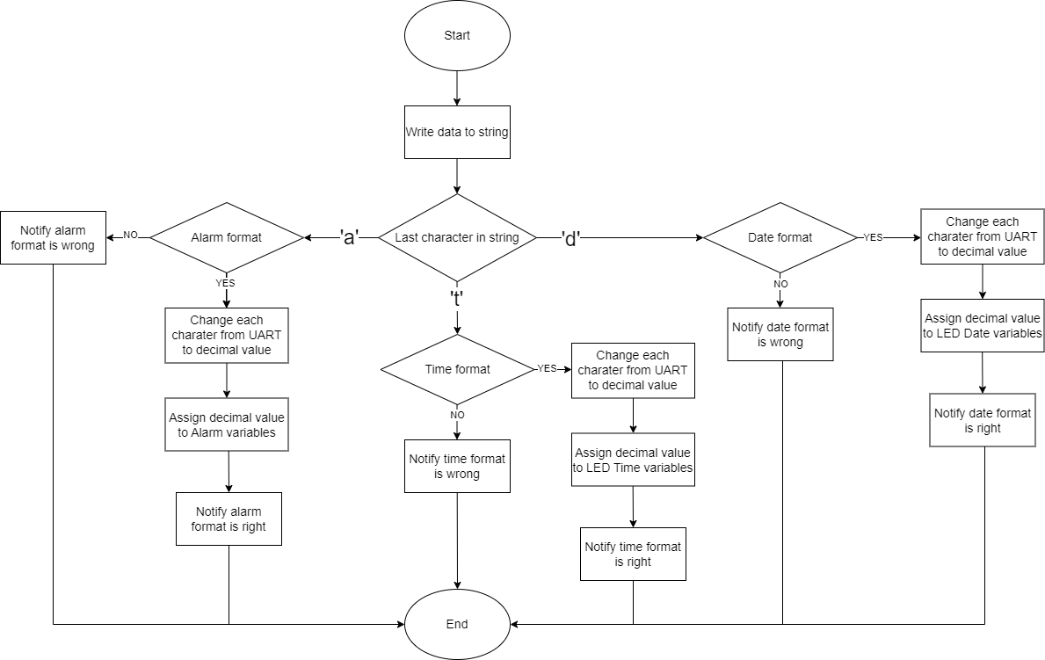
3.2.1. RECEIVE DATA FROM LPUART
LPUART flow:
Write data to string
Check last character in string: a, t, d
Check time/date/alarm format
Change character to decimal
Assign decimal value to variables of time/date/alarm

Slide 18
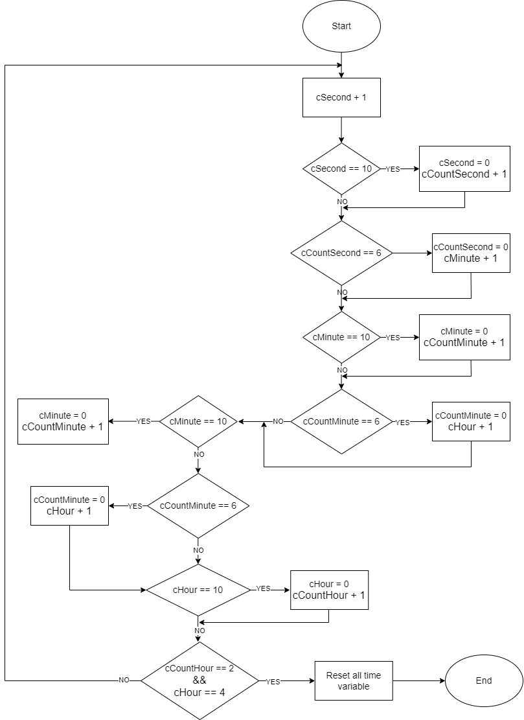
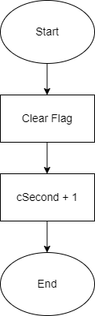
3.2.2. CALCULATE TIME
Calculate time flow:
When LPIT channel 1 count down 1 second, interrupt handler executed, variable “cSecond” + 1
Use variable “cSecond” to calculate minute, hour, day

Slide 19
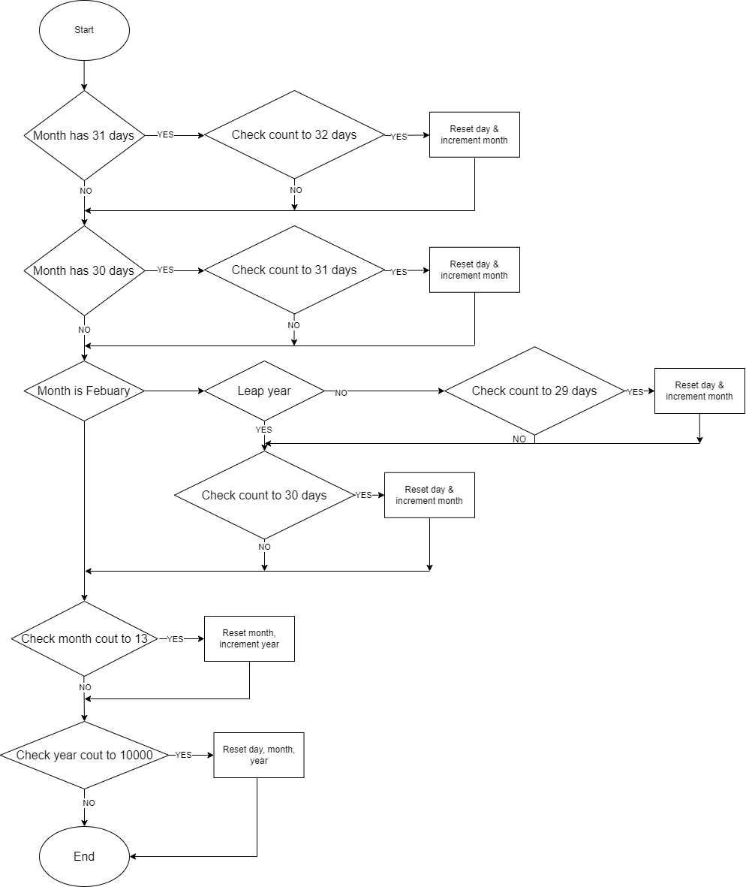
3.2.3. CALCULATE DATE
Calculate date flow:
Check current month has 31 days? Check current day value is 32 to reset day or not
Check current month has 30 days? Check current day value is 31 to reset day or not
Check current month is February or not
Check current year is leap year or not
If leap year, check current day value is 30 to reset day or not
If leap year, check current day value is 29 to reset day or not
Check current month is 13 to reset month or not
Check current year is 10000 to reset year or not

Slide 20
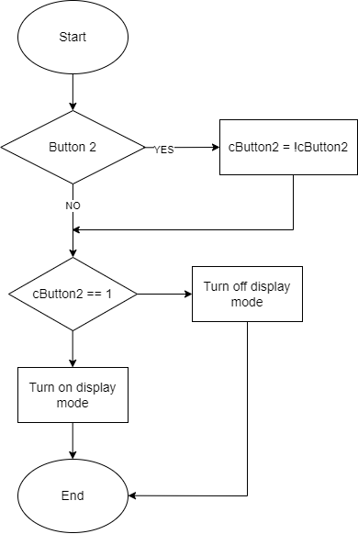
3.2.4. DISPLAY MODE
Display mode flow:
Check pressing button 2
Case 1: Press – Change status of flag of button 2
Case 2: Don’t press – Don’t change status of flag of button 2
Check flag of button 2
Case 1: Flag = 1 – Turn off display mode
Case 2: Flag = 0 – Turn on display mode

Slide 21
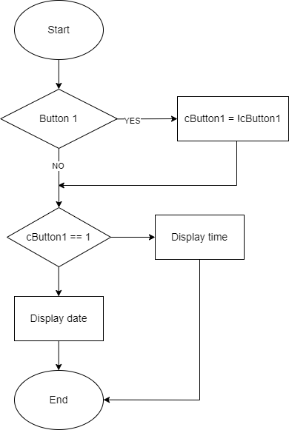
3.2.5. DISPLAY TIME/DATE
Display time/date flow:
Check pressing button 1
Case 1: Press – Change status of flag of button 1
Case 2: Don’t press – Don’t change status of flag of button 1
Check flag of button 1
Case 1: Flag = 1 – Display date
Case 2: Flag = 0 – Display time

Slide 22
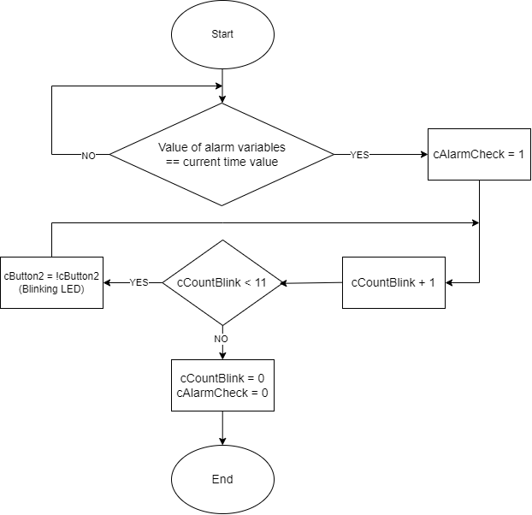
3.2.6. CHECK ALARM TIME
Check alarm time flow:
Check alarm time equal with current time
Case 1: Equal – Change status of alarm flag
Case 2: Don’t equal - Return
Varibale “cCountBlink” + 1
Check cCountBlink < 11
Case 1: YES – Change status of flag of button 2
Case 2: NO – Reset cCountBlink and alarm flag

Slide 23
3.3. USER MANUAL
Button
Button 1: Change display time or date
Button 2: Turn on/off display mode
Set value
Use Hercules software to set time, date, and alarm time with correct format
Set time: hh-mm-ss(t)
Ex: 05-10-20t (hour: 5, minute: 10, second: 20 and keyword ‘t’ for time format)
Set time: dd-mm-yyyy(d)
Ex: 05-10-2024d (day: 5, month: 10, year: 2024 and keyword ‘d’ for date format)
Set alarm time:hh-mm-s(a)
Ex: 05-10-20a (hour: 5, minute: 10, second: 20 and keyword ‘a’ for alarm time format)
Notification on Hercules: When change time/date /alarm done, on Hercules window will notify that change time/date/alarm successfully or not

Slide 24
04
DEMO

