Slide 1
Project: Time Keeping System
TRAINEE: NGUYỄN TRUNG HÒA – EMB04
TRAINER: ĐẶNG NGHĨA NHÂN

Slide 2
OUTLINE
01
02
03
REQUIREMENTS
SOFTWARE STRUCTURE
DEMO

Slide 3

01
Requirements

Slide 4
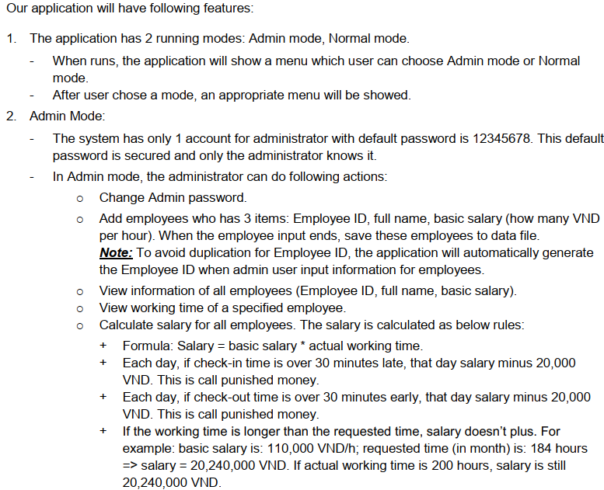
BASIC AND EXTRA REQUIREMENTS

Slide 5
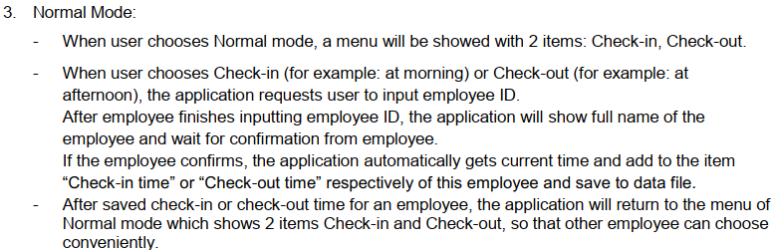
BASIC AND EXTRA REQUIREMENTS

Slide 6
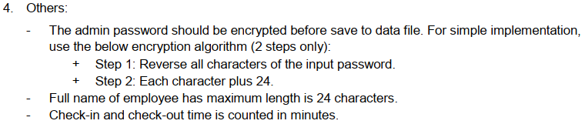
BASIC AND EXTRA REQUIREMENTS

Slide 7
BASIC AND EXTRA REQUIREMENTS
Addition requirements
Working time start at 8:30
Working time end at 16:30
Time form 12h to 13h is rest time, so it is not used for calculating salary
If check in after 12h, employee will not be fined
If check out before 13h, employee will not be fined
Employee can check in and check out more than one time in a day, software just care the first check in and the last check out of employee

Slide 8
02
SOFTWARE STRUCTURE

Slide 9
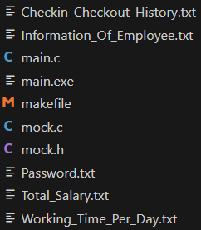
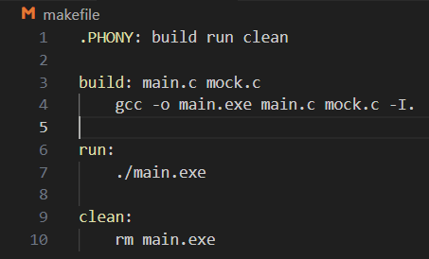
2.1. SOFTWARE FILES
main.c: Main source file
mock.h: File contain all functions declaration
mock.c: File contain all functions definition
makefile: Used to compile and run software

Slide 10
2.2. TEXT FILES
Text files used to save information of user from software

Slide 11
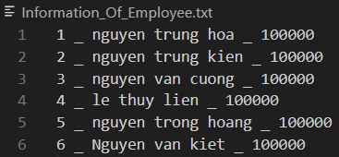
2.2.1. Information_Of_Employee.txt
Text file used to save all information of all employees When new employee added, text file will save their information
Syntax: ID _ Full name _ Basic salary

Slide 12
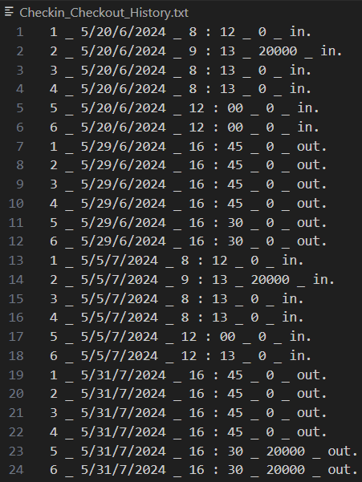
2.2.2. Checkin_Checkout_History.txt
Text file used to save check in and check out time of each employee
Employee can check in and check out more than one time in a day but Software just need the first check in and the last check out in that day to calculate working time per day
If employee check in late, it will contain fine money
Syntax: ID _ Date _ Time _ Fine money _In/Out)

Slide 13
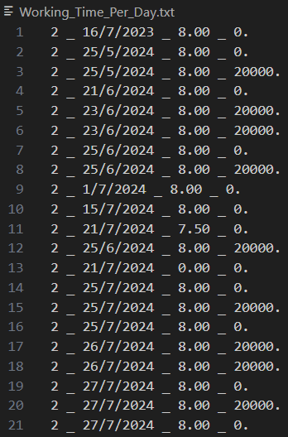
2.2.3. Working_Time_Per_Day.txt
Text file used to save working time per day of each employee
From check in and check out time, software can calculate working time per day of employee to calculate salary
Syntax: ID _ Date _ Working time per day _ Fine money

Slide 14
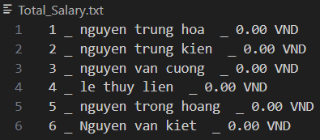
2.2.4. Total_Salary.txt
Text file used to save total salary of each employee
When admin want to see salary of employees, software will calculate working time from this day of previous month (a month) to this day of current moth for salary
Syntax: ID _ Name _ Salary

Slide 15

2.2.5. Password.txt
Text file used to save password for admin mode
Password in text file is encrypted from original password
encryption algorithm (2 steps only):
Step 1: Reverse all characters of the input password.
Step 2: Each character plus 24.
Example: This is encrypted password (KJI) from original password (123)

Slide 16
03
DEMO

Slide 17
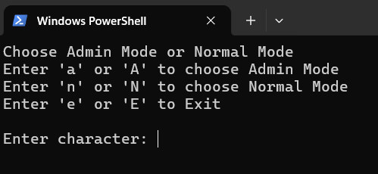
3.1. Main tab of software
Choose Admin mode
Choose Normal mode
Exit the program

Slide 18
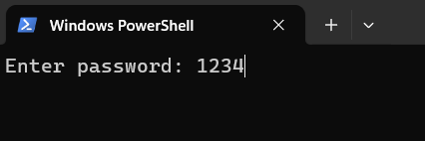
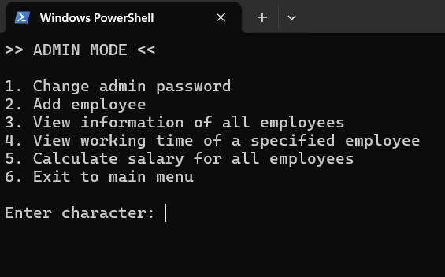
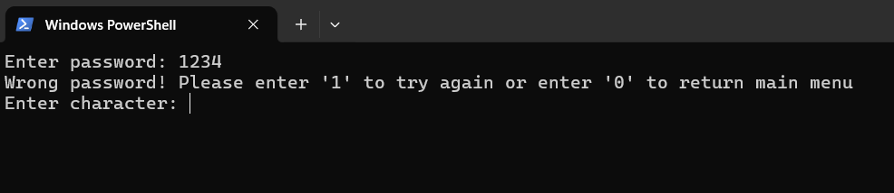
3.2. Admin mode of software
Enter password to access “Amin mode”
If password right, go to “Admin mode”
If password wrong, enter password again or return to main tab

Slide 19
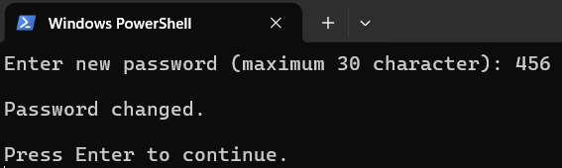
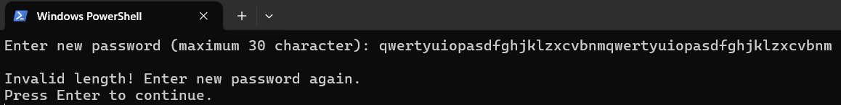
3.2.1. Change admin password
Change password for “Admin mode”
If new password is valid, text file will save new password
If new password is invalid, text file will not save and user enter password again

Slide 20
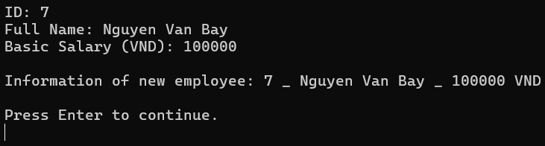
3.2.2. Add new employee
Add new employee by add full name, basic salary to text file
ID is added automatically

Slide 21
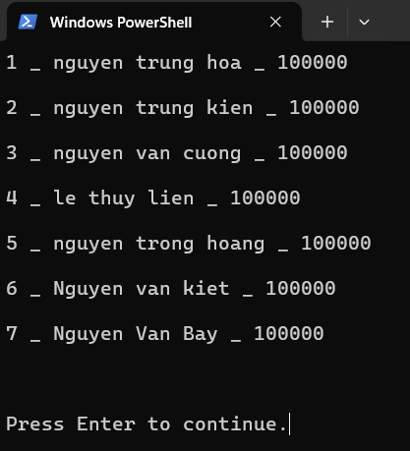
3.2.3. View information of all employees
View all employees information from text file

Slide 22
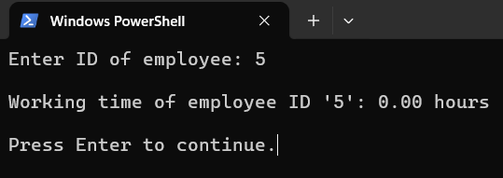
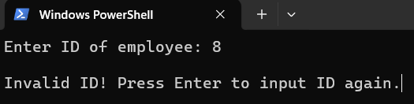
3.2.4. View working time of employee
Enter ID to view working time of specific employee
If ID exist, software will display woring time of employee
If ID don’t exist, user have to enter ID again

Slide 23
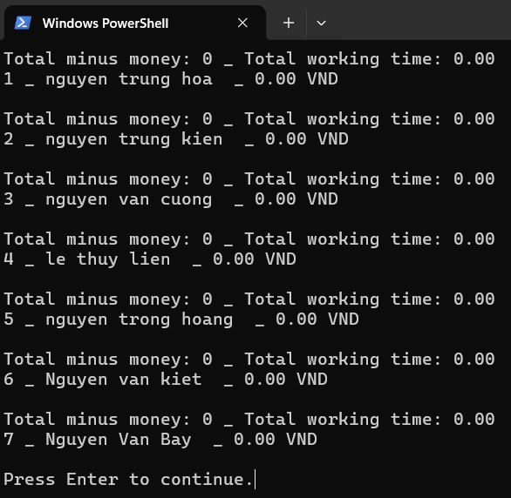
3.2.5. Calcualte salary for all employees
Software calculate salary for all employee for a month by calculate salary of working time and fine money

Slide 24
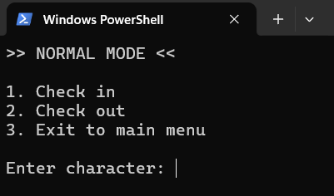
3.3. Normal mode of software
Normal mode is for employees
Employee will check in or check out everyday

Slide 25
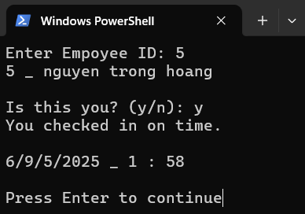
3.3.1. “Check in” function of software
Enter ID and check information, if OK, let’s check in
Working time start at 8:30, so if check in before or on that time will be “Check in on time”
If later 8:30, it will be “Check in late”

Slide 26
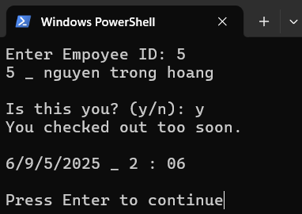
3.3.2. “Check out” function of software
Enter ID and check information, if OK, let’s check out
Working time end at 16:30, so if check out before that time will be “Check out too soon”.
If later or on 16:30, it will be “Check out on time”

Slide 27
Thank You For Watching!

