Slide 1
FAI E2E DATA ENGINEERING PIPELINE
STOCK & CRYTO DATA CAPSTONE PROJECT
TRUNGHPB

Slide 2
Business Model
A news agency website that gathers stock/crypto data from different asset exchanges and update users with news relating to the assets, performance overview of their portfolio.
Product:
Real-time and historical stock+crypto market data
Data is aggregated from asset exchanges.
Revenue (Freemium):
Monthly subscription fee for AI Chatbot integrated
Advertising
Partnerships
Cost:
Data APIs
AI Agent Chatbot API
Database costs (Servers, Clouds, data pipelines)
Focus:
Unified experience: Integration of market data with analytics suites and customizable dashboards.
News + Data Synergy: Leveraging news feed as part of financial analysis workflows.

Slide 3
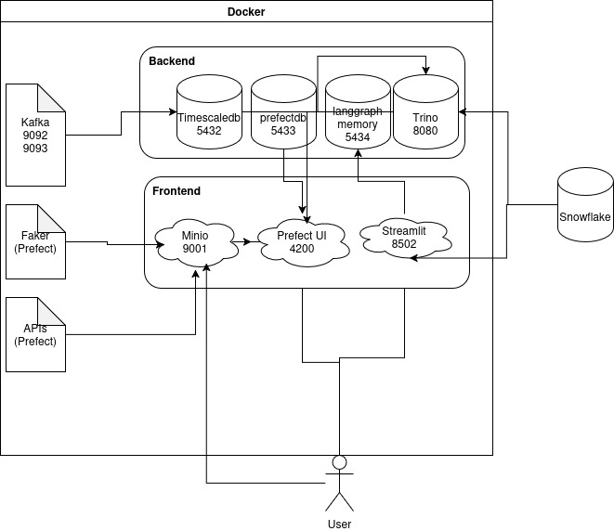
Server Layer Architecture
Infrastructure
Linux (Ubuntu 25.1.0):
System version
Docker (v29.1.3):
Docker Compose with bridge networking
Persistent volumes for all stateful services
Health checks + restart policies for resilience
Python (>= 3.12):
Main programming language
Ingestion
Streaming:
Kafka + Zookeeper
Batch Data:
- Faker
- News API
- Stock API
- Crypto API
Storage
Snowflake :
For cloud staging storage & data mart layer
Trino:
– Connect among multiple database sources
– main ingestion tool
Postgres:
- For Prefect & Langraph & Timescaledb
MinIO:
- Store all raw batch data (crypto, stock, news, etc)
Orchestrator
Prefect v3:
- Schedule data jobs for
Crypto, stock, news
Application
Langraph :
AI agent integration with Snowflake
Streamlit:
Webapp UI to show chatbot and additional tools
(OCR scanning, query tools, RAG, conversation
Context history)
Observability
PgAdmin: operational database management
Prometheus: Metrics scraping (Kafka, Postgres, Prefect)
Grafana: Dashboard for db health, ingestion, system stability

Slide 4
Tools selection
Ingestion
Kafka + Zookeeper
Kafka is an industry-standard tool widely used in modern data engineering architectures. Stream customer activity events into Kafka topics, which are then consumed by downstream services for storage in Snowflake and real-time analytics.
Alternatives Considered**: - RabbitMQ (better for task queues, weaker for streaming analytics) - Direct API ingestion into databases (tight coupling, poor scalability)
Prefect offers a Python-native orchestration experience with minimal boilerplate.
Alternatives considered**: Apache Airflow (heavier setup, steeper learning curve) - Dagster (strong but more opinionated)
Orchestrator
Prefect v3:
Prefect offers a Python-native orchestration experience with minimal boilerplate.
Alternatives considered**: Apache Airflow (heavier setup, steeper learning curve) - Dagster (strong but more opinionated)
Observability
PgAdmin
Prometheus
Grafana
PgAdmin: comes with Postgresql
Prometheus+ Grafana: Industry standard tools – easy to implement and supports pull-based metrics, time-series storage, and strong integrations.
Storage
Snowflake
Trino
Postgres
MinIO
Snowflake: cloud OLAP, can be used with AI agent query tool – easy to implement and integrate with dbt.
Trino: allows to connect multiple databases and write queries to link multiple databases, very efficient use for data engineer
Minio: S3 compatible local storage – open source, no cost and easy to implement.
Application
Langraph
Streamlit
Langchain: Modular AI agent with Python language support, easy to implement and integrate with Pinecone when using RAG
Streamlit: Python friendly, easy to implement
Tool Decision Logs

Slide 5
Conceptual Data Model (CDM)
Sources
Staging
Data Vault
Stock data
Mart + Semantic
Asset Market
(APIs)
extract
Load
extract
Crypto data
- Portfolio Performance
(Profit/Loss)
Why at
profit/loss ?
AI chatbot
Load
Transaction Data
Cust buy/sell
assets
extract
- Customer’s info
- Fraud detection
Load
extract
Customer Data
- News related to stock/crypto
assets, economy, politics
Internet News
extract
News Data
Load
Link
Hub
Satellite
Dim
Fact

Slide 6
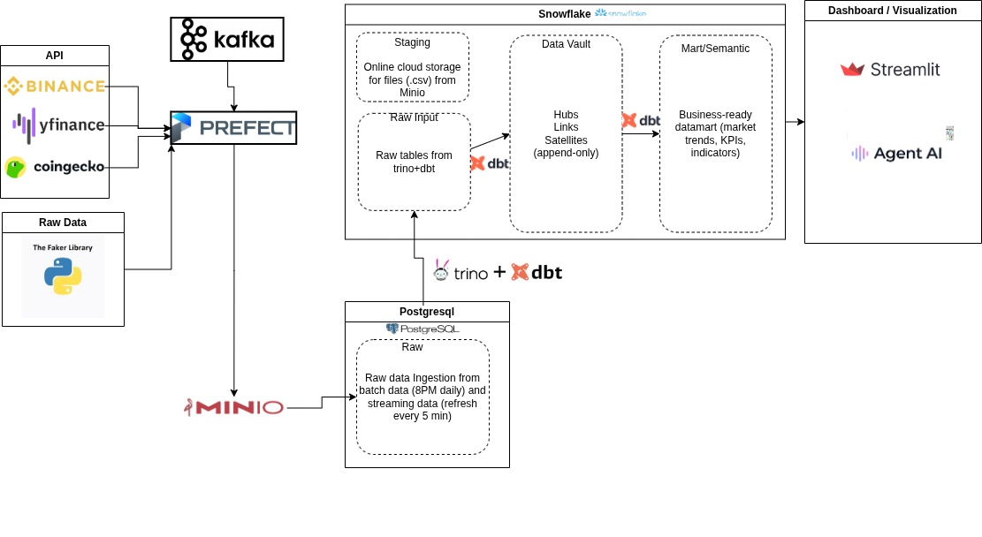

Data Stack & Flow
Governance & Quality:
- dbt-score
- dbt tests
- sqlfluff
- Github Actions (Snowflake CI)
- Nektos (Trino + Snowflake CI)

Slide 7
Logical Data Model (LDM)
S_news_content
Raw tables: 9 dbt models
Datavault (Warehouse): 20 dbt models
- Hubs: 7 models (2 ephemerals)
- Links: 5 models
- Sats: 8 models (1 ephemeral)
Data nature: high-volume, fast-changing, multi-source data.
Scaleable: Ingest data incrementally, preserve full history, adapt to schema changes
  Allows multiple satellites per hub
  Preserves source-specific differences
  Avoids forced early data harmonization
“What did we know at that point in time?”
L_news_asset
H_news
L_comp_trans
S_price_stock
H_asset
H_company
S_comp_detail
S_price_crypto
H_transaction
L_cust_comp
L_trans_asset
H_customer
L_cust_trans
S_trans_corp
S_cust_profile
S_trans_pers
Data Vault

Slide 8
Logical Data Model (LDM)
Dim_customer_history
Dim_company
fct_asset_price_comparison
Mart + Semantic : 12 dbt models
- Dims: 4 models
- Facts: 5 models
- Semantics: 3 models
1:1
Dim_customer
fct_asset_prices
semantic_transactions
fct_transactions
Dim_asset
Easier, quicker for end-users (data analyst, data science, AI agent)
More reporting-focused
Avoid unwanted data leakage
semantic_asset_performance
semantic_customer_overview
Fct_asset_news_impact
fct_news_events
Mart + Semantic

Slide 9
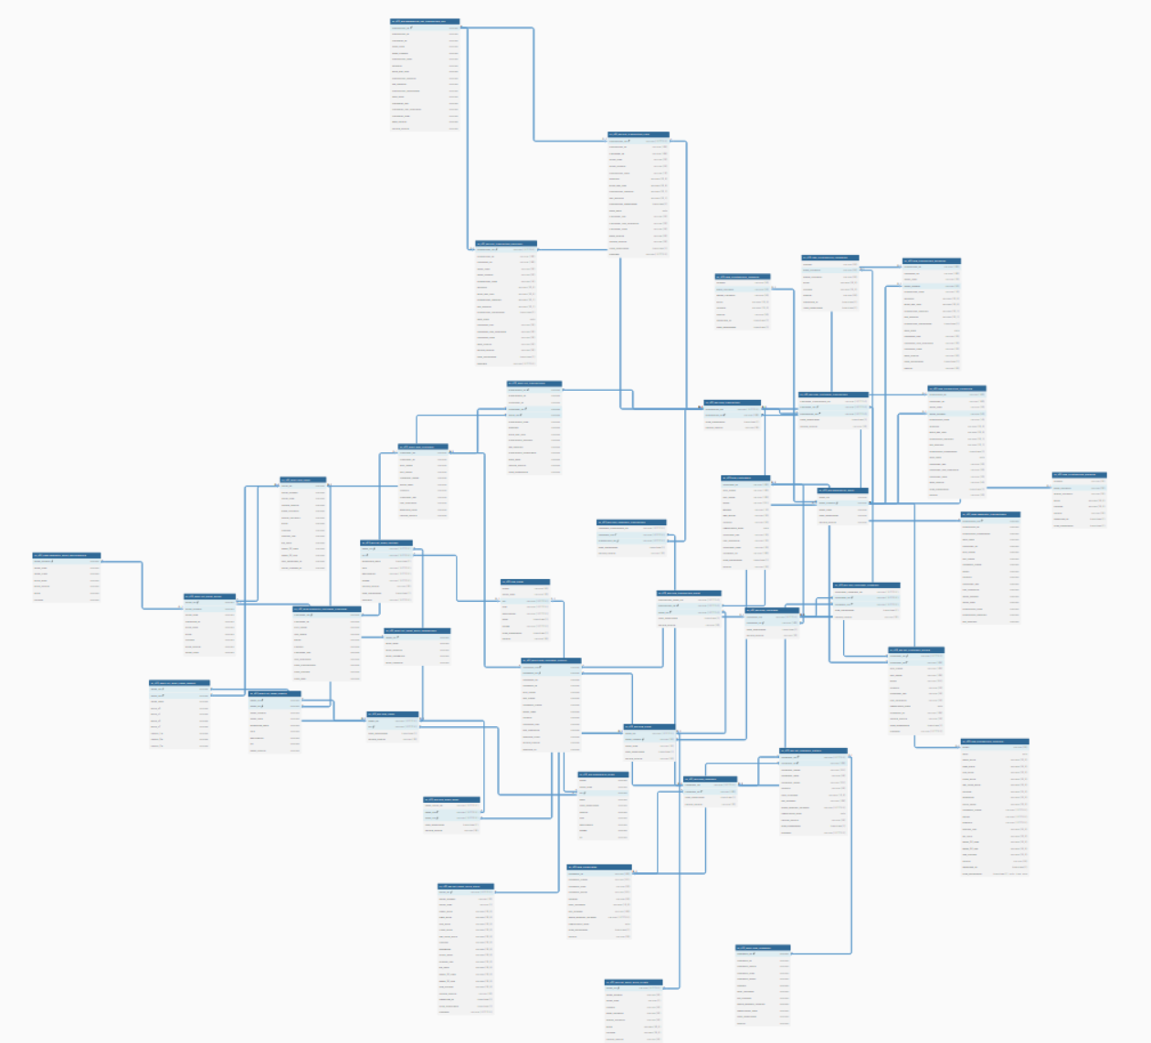
Physical Data Model (PDM)
Full PDM
PDM Data Vault
PDM Mart (simplified)

Slide 10
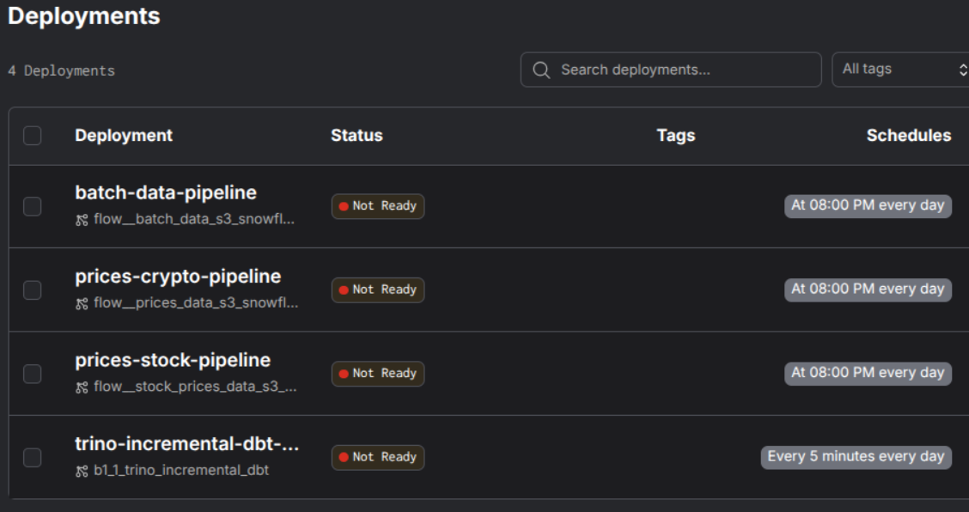
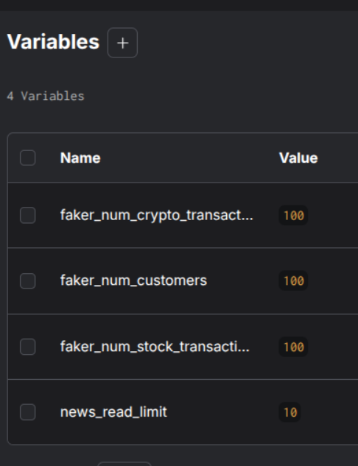
Prefect flows
1. Batch data pipeline (Faker data – customer&transactions & News API)
2. Batch data pipeline (API cryptocurrencies)
3. Batch data pipeline (API stocks)
4. Streaming data refresh pipeline (5min)

Slide 11
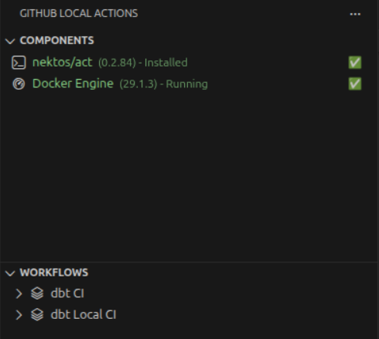
CI
Python setup
Install uv and enable caching
Install the poject dependencies (uv sync)
Dbt deps
Comparer baseline state from main branch
Dbt parse for Trino & Snowflake targets
Sqlfluff on both Trino & Snowflake (modified only)
Dbt test on modified Trino & Snowflake models
Dbt-score on both Trino & Snowflake (modified only)
Online: Github Actions CI – Snowflake db lint
Offline: Nektos – hosted your own local Actions CI

Slide 12
Features - Data Pipeline Enhancement
dbt tools (dbt-score, sqlfluff, dbt tests, dbterd)
Code linting, descriptions, owners, relationships provided for all models
Using dbt with 2 target databases (Trino & Snowflake interchargeably) – faster load on postgresql/Snowflake
Prefect (Airflow alternative)
Custom variable inputs (number of Faker/API records)
Error-prone to dbt test if batch data pipeline failed
Pgadmin/Grafana/Prometheus
Database health/load monitor dashboards
Operations database admin

Slide 13
Features – Tool Innovation
AI agent (Streamlit UI)
Button to upload PDF files to Pinecone directly on UI
OCR scanning images to be used with warehouse query tools – help users to determine customer info/ transactions supporting fraud detection.
Databases
Trino: help data engineers to connect to multiple database catalogs (Snowflake, Postgres,… etc)
Postgres with Timescaledb extension: improve OLTP processing speed for time-series focused database – fit for the project
CI
Nektos: Local Github Actions to dbt-test on local databases (Trino)
Integrate dbt-test, dbt-score, sqlfluff lint on only modified models for each target (Trino target vs Snowflake target)

Slide 14

Sample ID card (for Tesseract)
Ricardo Edwards

Slide 15
Thank you !

