Slide 1
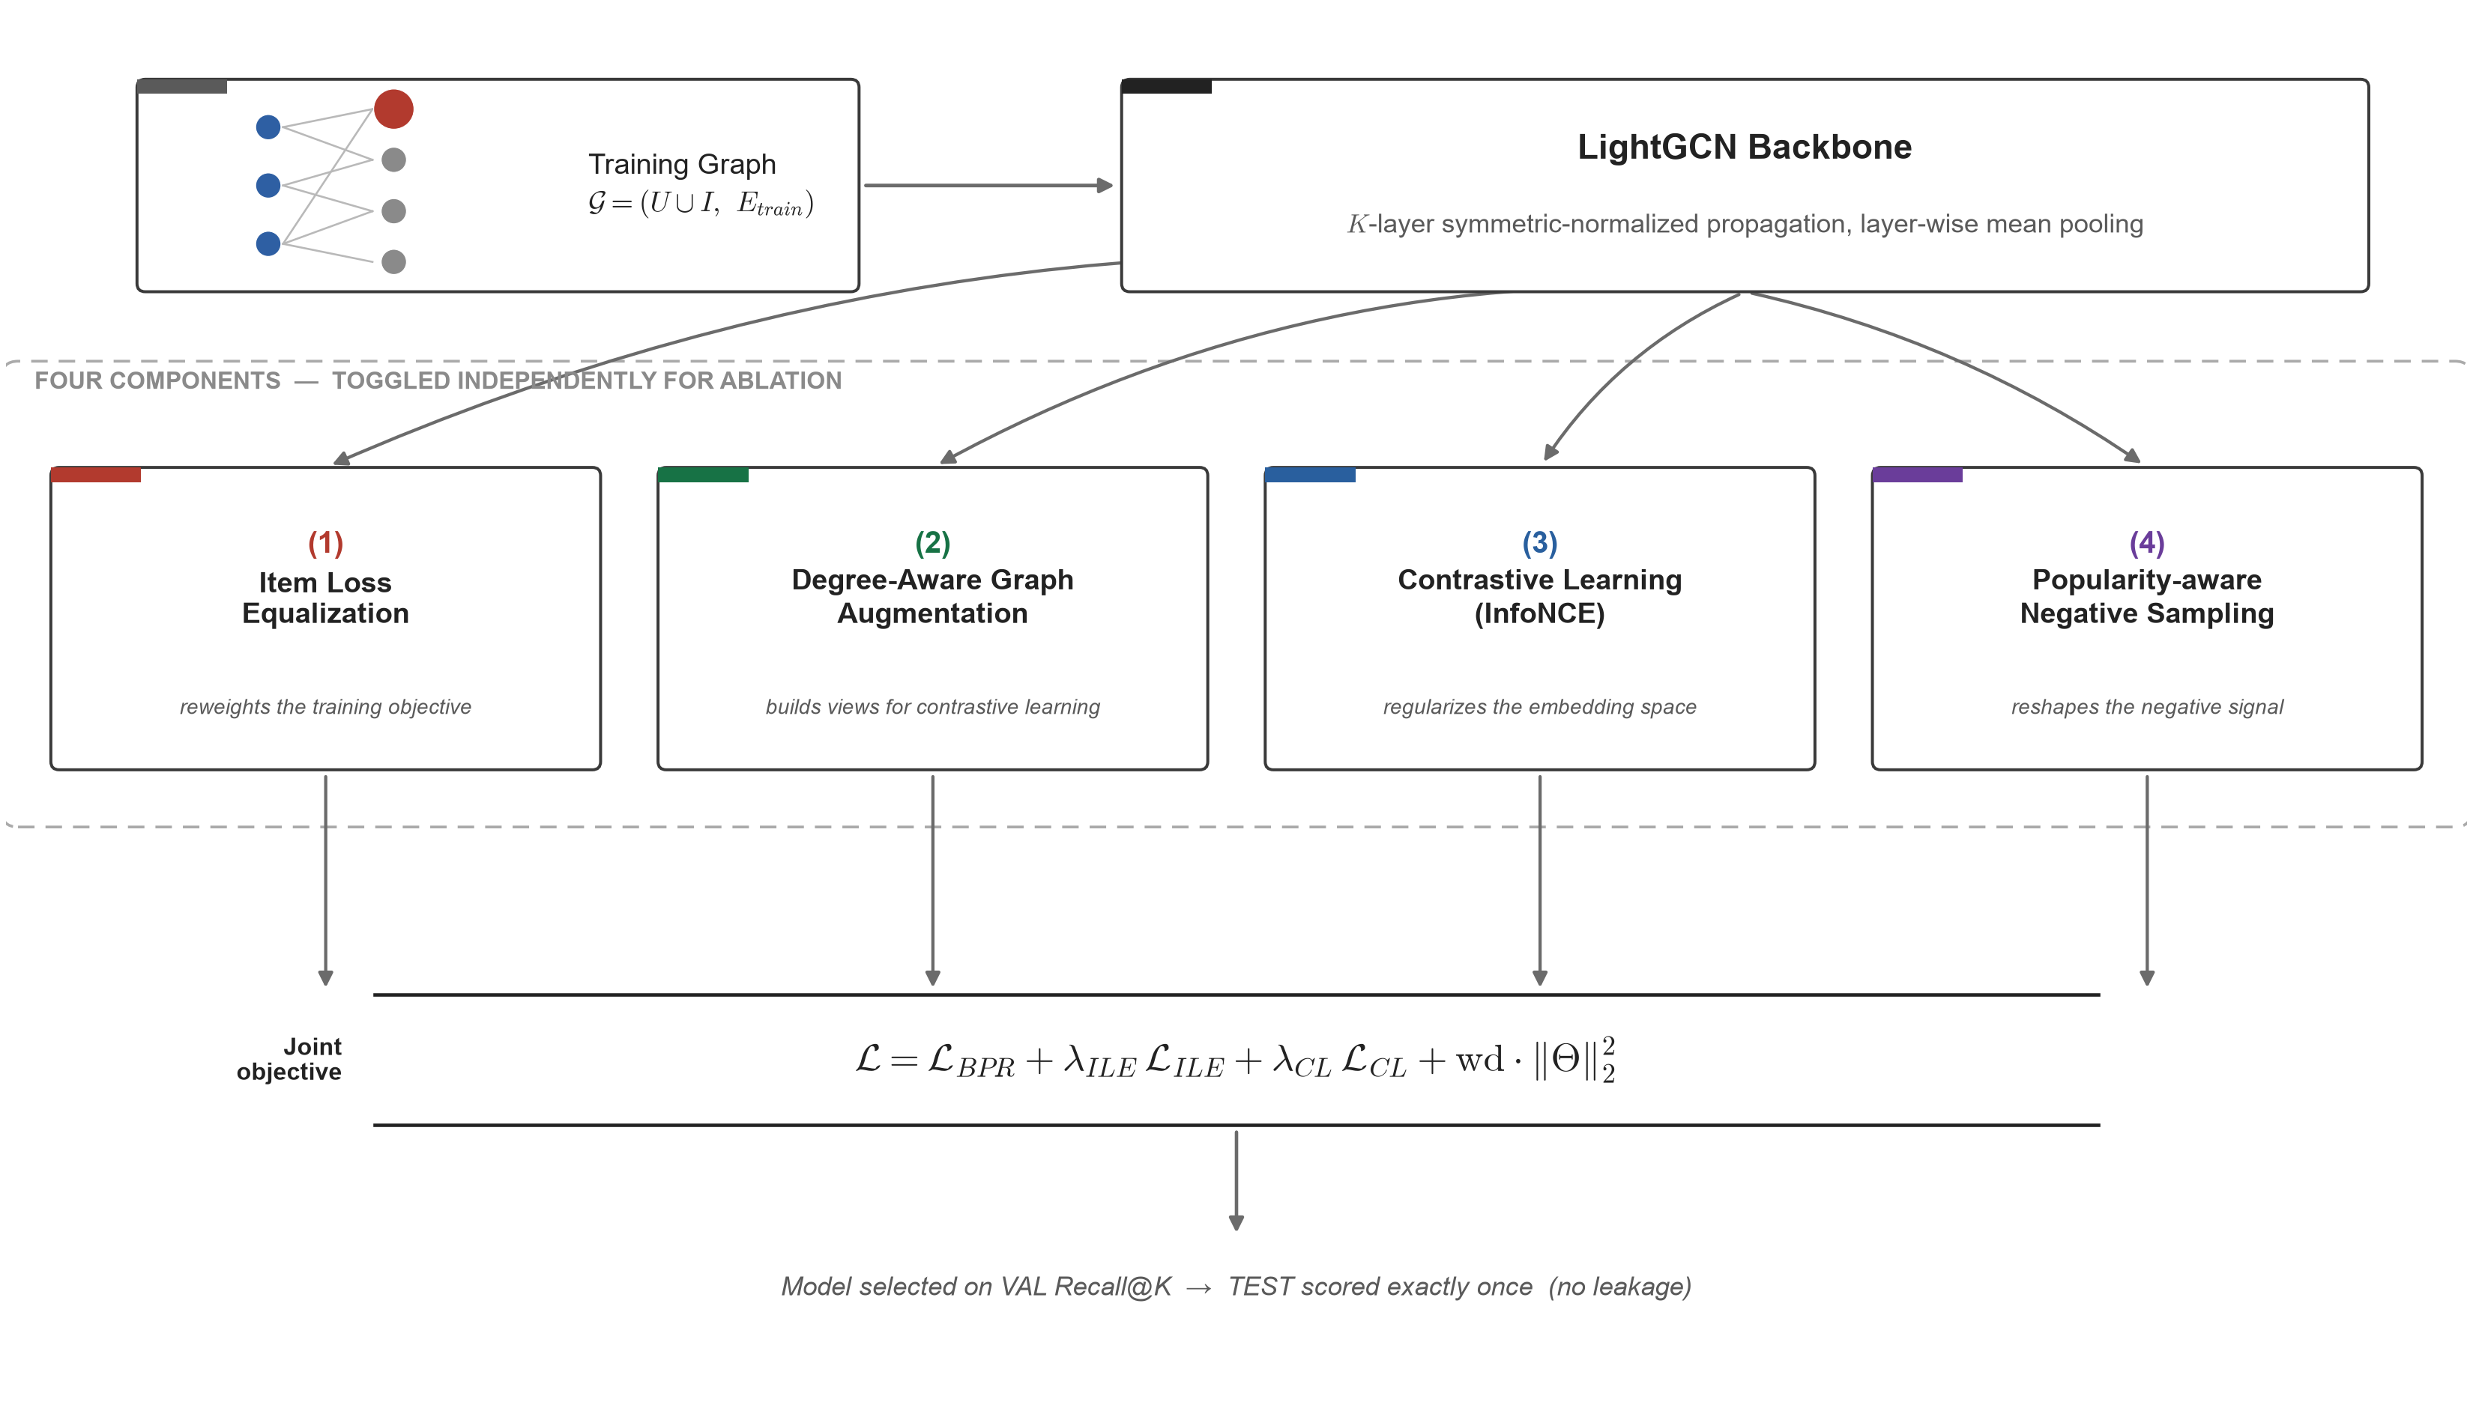
PROPOSED METHOD
Popularity-Aware LightGCN — Method Overview
Popularity-Aware LightGCN
5
Notes:
High-level map of the method: a LightGCN backbone plus four independently-toggleable components (use_ile, aug_main, use_cl, neg_pop_beta), trained jointly, with model selection on VAL only and TEST scored exactly once. Detailed mechanism, equations and diagrams for each component are on slides 6-9; this slide is intentionally kept simple as a map, not a full specification.

Slide 2
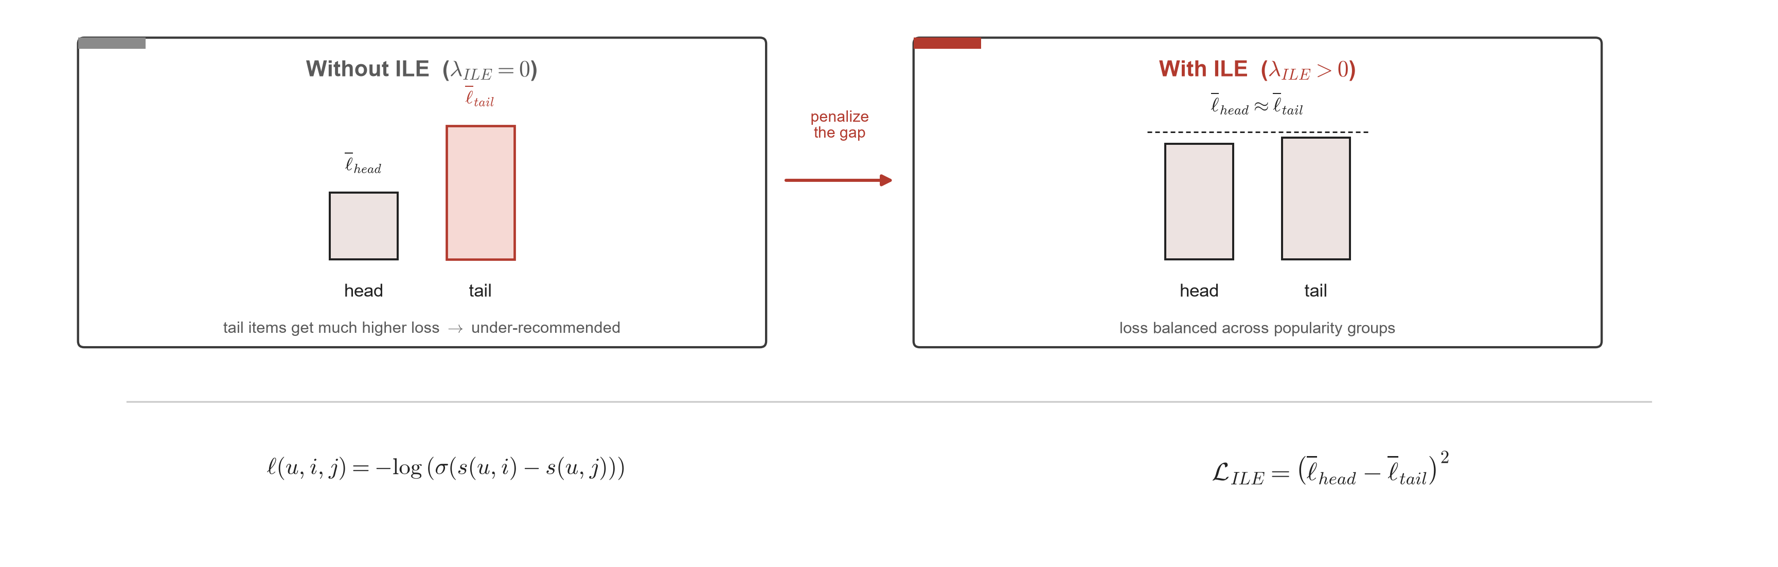
COMPONENT 1 / 4
Item Loss Equalization (ILE)
Schematic illustration of the mechanism — not measured training data.
– Popularity groups defined by training-degree percentile: tail <P50, middle P50–P80, head >P80.
– Computed only when a batch contains both a head item and a tail item.
– Squared penalty → always ≥ 0, no sign flip → minimizing it pulls tail loss down toward head loss.
Popularity-Aware LightGCN
6
Notes:
History note (not on slide): an earlier version used head_loss - tail_loss without squaring, which was unsigned/unbounded and pushed the model further toward popularity bias instead of reducing it. Fixed by squaring the gap, exactly as shown here.

Slide 3
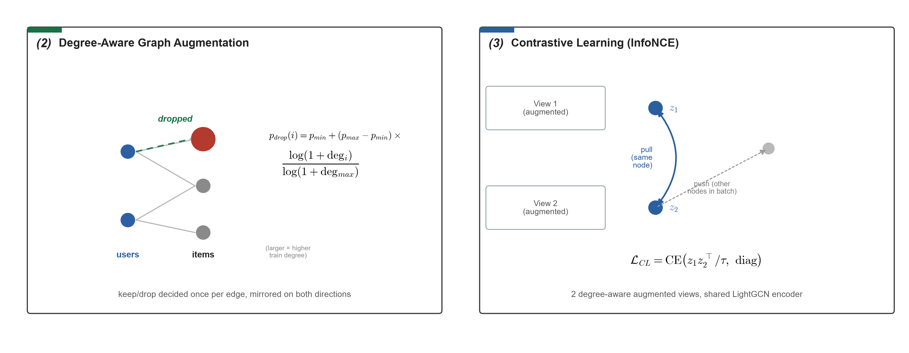
COMPONENTS 2 & 3 / 4
Degree-Aware Augmentation + Contrastive Learning
– Both components reuse the same degree-based drop signal to build two augmented graph views — they are not independent regularizers stacked for safety.
– τ and λ_CL control how strongly embeddings of the same node are pulled together across views.
– Scope note: in every reported result, this dropout only builds the two CL views — the main graph used for final scoring is never modified (aug_main=False).
Popularity-Aware LightGCN
7
Notes:
Mechanism evidence: increasing lambda_CL in the sweep monotonically increases Coverage@20 - consistent with a healthy regularizer, not a coincidence. Limitation to flag in Q&A: because (2) and (3) share the same drop-probability signal, their individual contributions are not fully disentangled in the current ablation (see slide 13). A standalone aug_main=True run exists in train_all_popaware.py (single seed, not in the headline table) as a first check.

Slide 4
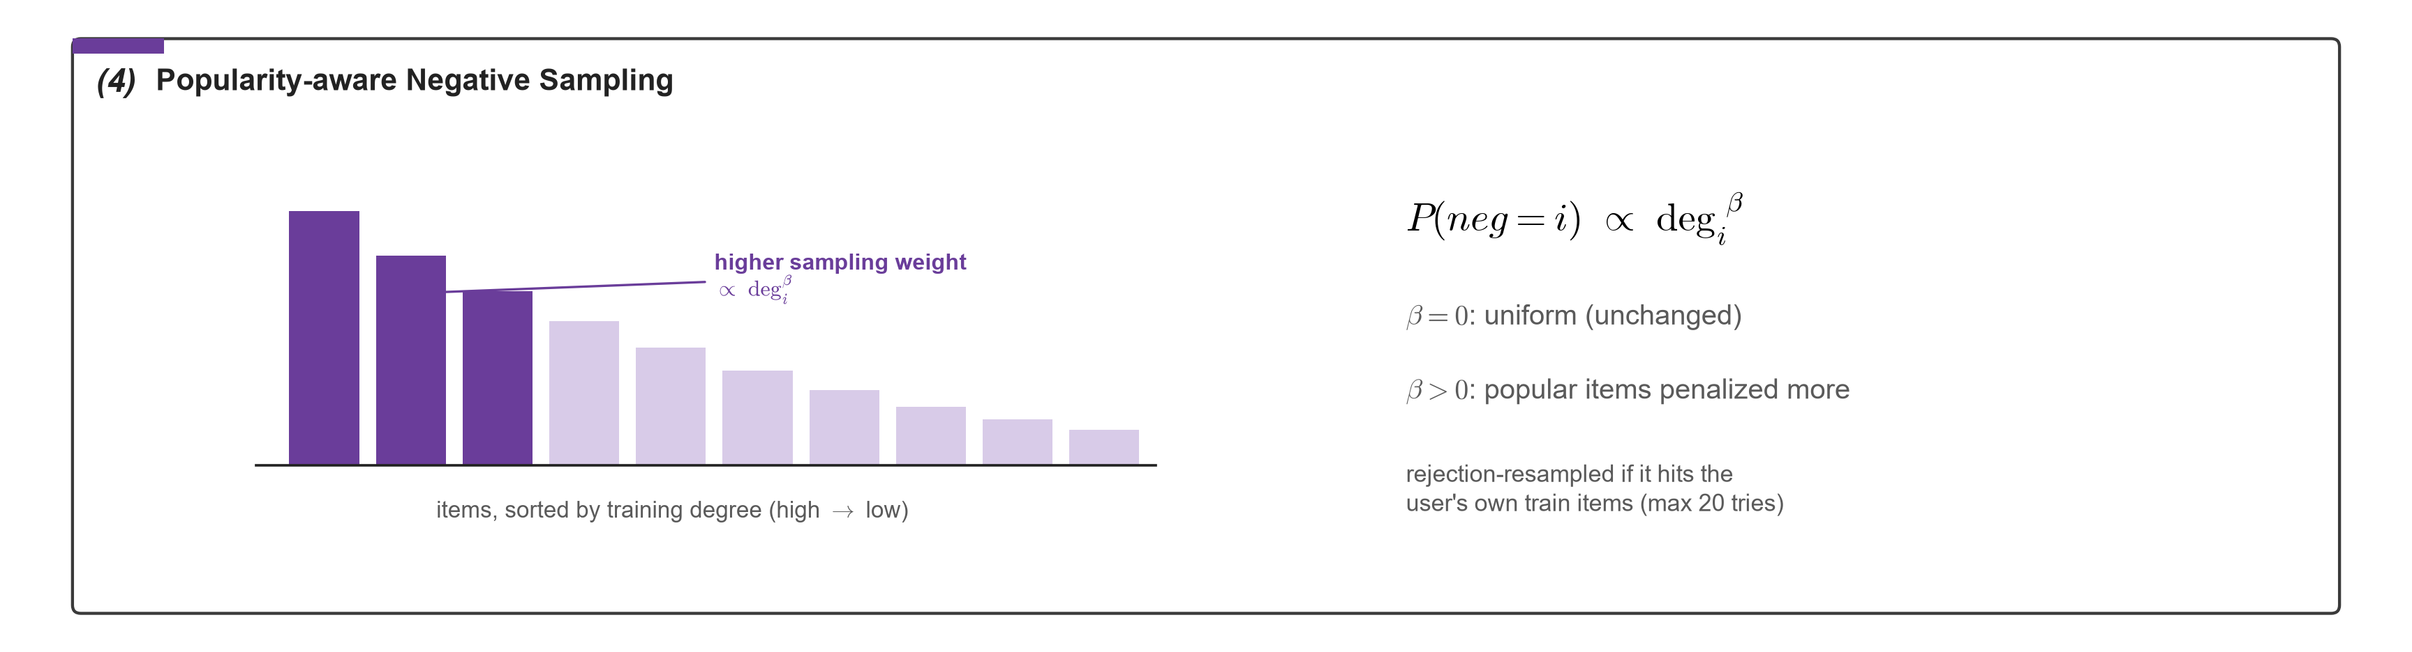
COMPONENT 4 / 4
Popularity-aware Negative Sampling
– Positives are still drawn uniformly from train edges — only the negative distribution changes.
– β controls how strongly popular items are penalized as negatives (experiments use β ∈ {0, 0.5}).
– BEST vs. high-tail (same λ_ILE=1.0, λ_CL=0.1, only β differs): β=0.5 trades a little TailRecall (0.040→0.032) for higher Coverage (0.499→0.538) — β shifts the operating point rather than uniformly improving every bias metric.
Popularity-Aware LightGCN
8
Notes:
beta=0 recovers exactly the original uniform sampler, so this is a safe extension: turning it off changes nothing. Note for Q&A: beta's effect on TailRecall/Coverage is NOT cleanly monotonic across the full sweep (checked all 12 matched pairs) - its main verified effect is trading some TailRecall for Coverage at fixed lambda_ILE/lambda_CL, not a uniform improvement on every axis. lambda_ILE's effect on TailRecall, by contrast, IS monotonic across all 8 matched triples in the sweep.

Slide 5
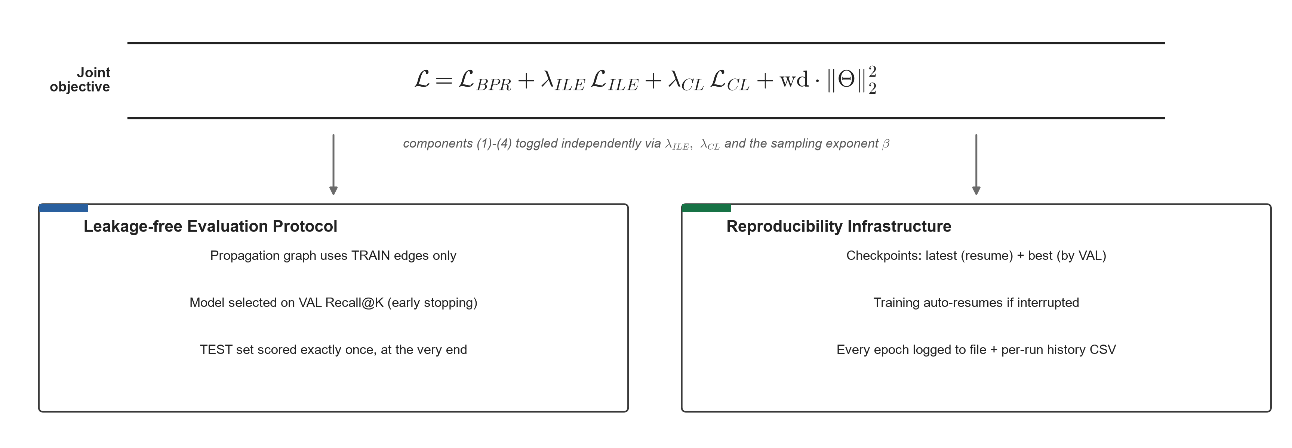
TRAINING
Joint Objective & Leakage-free Protocol
– All four components toggle independently (use_ile, aug_main, use_cl, neg_pop_beta) — enabling clean per-component ablation.
– Scope of "leakage-free": guarantees checkpoint selection within a run (VAL) and a single TEST scoring per run. Choosing which λ/β to report used a sweep evaluated on TEST (slide 10) — see limitations, slide 13.
Popularity-Aware LightGCN
9
Notes:
This infrastructure is what makes the reported numbers trustworthy: no leakage between train/val/test, and every run can be stopped, resumed, and audited from its log + history CSV.

Slide 6
EXPERIMENTS
Experimental Setup
– Dataset: MovieLens-1M, rating ≥ 4 as positive, leave-one-out validation/test split per user.
– Backbone: embedding dim = 64, num_layers = 2 (primary operating point).
– Hyperparameter sweep: 24 points = num_layers{2,3} × λ_ILE{0.1,0.5,1.0} × λ_CL{0.1,0.5} × β{0,0.5}.
– Operating-point rule: max Coverage@20 subject to Recall@20 drop ≤ tolerance vs. baseline, evaluated across the sweep (caveat: currently computed on TEST, see slide 13).
– Statistical robustness: each final configuration trained over 3 seeds {42, 0, 1}; mean ± std reported.
Configuration (num_layers = 2) | λ_ILE | λ_CL | β
LightGCN (baseline) | 0 | 0 | 0
PopAware-accuracy | 0.1 | 0.1 | 0.5
PopAware-BEST | 1.0 | 0.1 | 0.5
PopAware-high-tail | 1.0 | 0.1 | 0
PopAware-fairness | 1.0 | 0.5 | 0
Popularity-Aware LightGCN
10
Notes:
This is the table used by train_final_seeds.py. The full 24-point sweep lives in results/popaware_sweep_20260715_155058.csv.

Slide 7
RESULTS
Main Results (mean ± std over 3 seeds, K=20)
Model | Recall@20 ↑ | NDCG@20 ↑ | TailRecall@20 ↑ | Coverage@20 ↑ | ARP@20 ↓ | HeadExp@20 ↓
LightGCN (baseline) | 0.1287±0.0005 | 0.0497±0.0002 | 0.0050±0.0009 | 0.3978±0.0043 | 6.833±0.009 | 0.9587±0.0006
PopAware-accuracy | 0.1367±0.0035 | 0.0527±0.0006 | 0.0143±0.0023 | 0.4619±0.0289 | 6.500±0.051 | 0.9171±0.0144
PopAware-BEST | 0.1338±0.0030 | 0.0518±0.0004 | 0.0324±0.0049 | 0.5384±0.0293 | 6.400±0.042 | 0.8826±0.0114
PopAware-high-tail | 0.1352±0.0020 | 0.0524±0.0004 | 0.0399±0.0023 | 0.4990±0.0099 | 6.564±0.008 | 0.9117±0.0005
PopAware-fairness | 0.1052±0.0039 | 0.0415±0.0011 | 0.0274±0.0035 | 0.7135±0.0027 | 6.138±0.001 | 0.8333±0.0016
PopAware-BEST vs. LightGCN: TailRecall ×6.5 • Coverage +35% • ARP −6.3% • HeadExposure −7.9% • Recall +4.0%
– Mean±std intervals for baseline vs. every PopAware configuration do not overlap on the bias metrics — the improvement is statistically robust, not seed noise.
– Three of four PopAware configurations (accuracy, BEST, high-tail) reduce bias while simultaneously improving Recall/NDCG over the baseline; only "fairness" trades accuracy for the strongest debiasing.
Popularity-Aware LightGCN
11
Notes:
Source: results/popaware_final_meanstd_20260715_174317.csv (PopAware, 3 seeds) and results/metrics/main_results.csv (LightGCN baseline reference, 1 run).

Slide 8
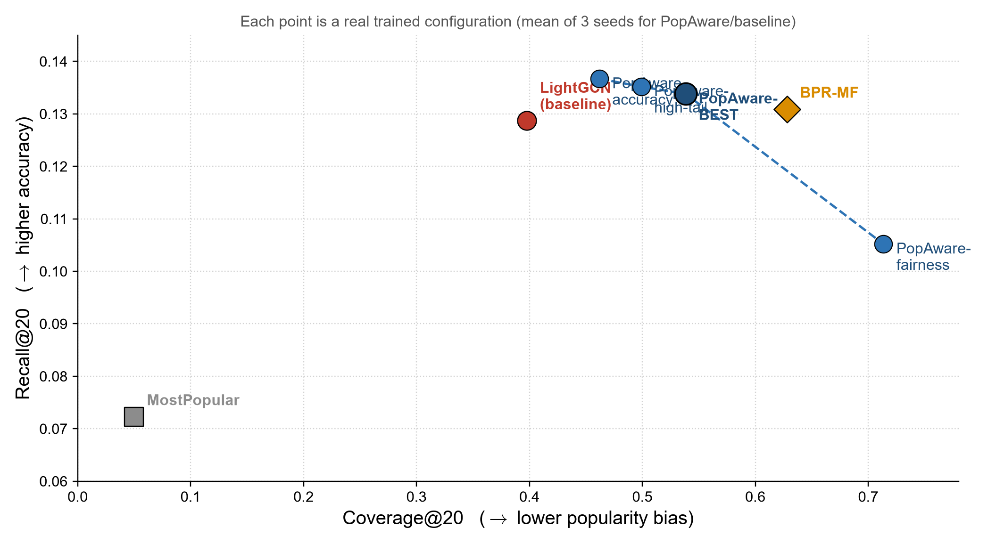
RESULTS
Frontier: Accuracy vs. Fairness Trade-off
– The four PopAware configurations form a selectable frontier — BPR-MF is only a single fixed point.
– The PopAware cluster sits to the right of plain LightGCN (higher Recall); "fairness" trades the most accuracy for the best Coverage/HeadExposure.
– Note: MostPopular/BPR-MF are single reference runs; LightGCN baseline and PopAware points are 3-seed means.
Popularity-Aware LightGCN
12
Notes:
Coordinates read directly from results/metrics/main_results.csv (MostPopular, BPR-MF, LightGCN) and results/popaware_final_meanstd_20260715_174317.csv (PopAware, mean of 3 seeds) — not a qualitative illustration.

Slide 9
ANALYSIS & CONCLUSION
Does the Method Meet Its Goals?
Original goal | Measured result (BEST vs. baseline) | Met?
TailRecall@20 increases | 0.0050 → 0.0324 (×6.5) | Yes
Coverage@20 increases | 0.398 → 0.538 (+35%) | Yes
ARP@20 decreases | 6.833 → 6.400 (−6.3%) | Yes
HeadExposure@20 decreases | 0.9587 → 0.8826 (−7.9%) | Yes
Recall/NDCG do not drop sharply (≤5%) | Recall +4.0%, NDCG slightly up | Yes
TailRecall gain is "reasonable" (not extreme) | ×6.5 baseline, less extreme than high-tail (×8.0) | Yes
6/6 original criteria met at PopAware-BEST — confirmed statistically significant across 3 seeds, not a single lucky run
Honest limitations:
– Degree-Aware Augmentation only shapes the two contrastive-learning views in every reported run (aug_main=False) — its standalone effect on the main graph is not yet validated with 3-seed ablations.
– Coverage@20 at the balanced point (0.538) is still below BPR-MF (0.628).
– TailRecall's absolute value stays small (~0.03) — read this as "substantially reduced bias", not "long-tail solved".
– Operating-point hyperparameters (λ, β) were chosen via a frontier rule computed on the sweep's TEST metrics, not a held-out validation split — a mild form of test-based tuning to disclose upfront.
Popularity-Aware LightGCN
13
Notes:
Vs. BPR-MF (a strong, naturally fairer baseline): BEST still wins on Recall, TailRecall (x2.4), and ARP; only loses on Coverage. The fairness configuration dominates BPR-MF on every fairness axis.

