Slide 1
MINOR PROJECT PRESENTATION
ON
TRAFFIC LIGHT CONTROL SYSTEM
USING
MICROCONTROLLER PIC 16F877A
MENTORS: SUBMITTED BY:
Mr. PAWAN LOCHAB AKANKSHA GUPTA , ECE-2 (14413202810)
Mr. PARVEEN KUMAR ISHITA GUPTA, ECE-2 (14813202810)
R.ASHOK KUMAR, ECE-2 (25013202810)
ARUN KUMAR, ECE-2 (01313207311)

Slide 2
OBJECTIVE
TO DESIGN AND DEVELOP A SMART TRAFFIC LIGHT CONTROLLER USING MICROCONTROLLER PIC 16F877A

Slide 3
BRIEF DESCIPTION
The project uses:-
LED as TRAFFIC LIGHT indicator
MICROCONTROLLER for auto change of signal
Microcontroller PIC 16F877A is the brain of the project.
The LED’s are automatically on and off by making the corresponding port pin of the micro controller high.
Seven segment display- shows timing of each signal
During transition from green to red, the yellow led glows.
This process continues as a cycle.

Slide 4

CYCLIC ROTATION
AFTER
5 SEC
AFTER
15 SEC
AFTER 35 SEC

Slide 5
BLOCK DIAGRAM
MICRO
CONTROLLER
(PIC 16F877A)
7 SEGMENT DISPLAY
TRAFFIC LIGHTS
POWER SUPPLY
+5 VOLTS

Slide 6
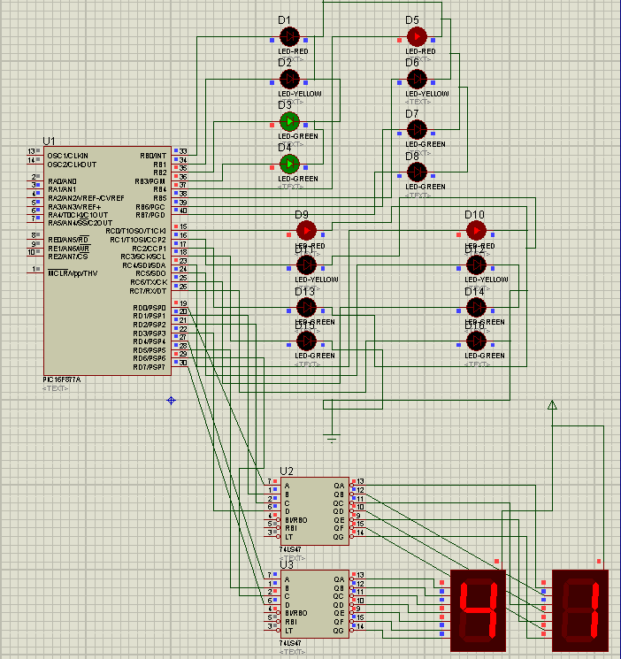
CONNECTION DIAGRAM
Lane 1
Lane 2
Lane 4
Lane 3
BCD to decimal decoder
Seven Segment Display

Slide 7
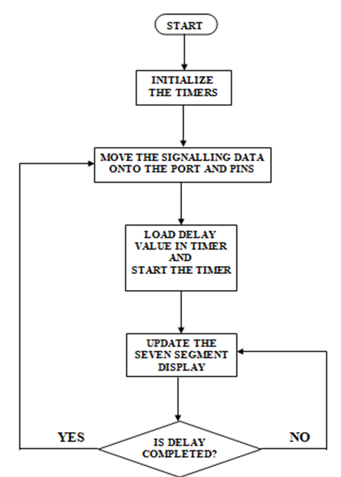
FLOW CHART

Slide 8
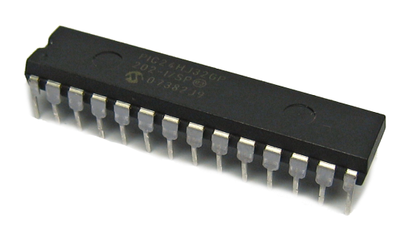
HARDWARE TOOLS
MICROCONTROLLER
AVAILABLE MICROCONTROLLERS
8051
AVR ATMEGA SERIES
PIC MICROCONTROLLERS
MICROCONTROLLER USED
PIC 16F877A
Characteristics
Operating speed: 20 MHz
Operating voltage: 4.0-5.5V
Flash Memory: 14.3 Kbytes
Data SRAM: 368 bytes
Data EEPROM: 256 bytes

Slide 9
Special Microcontroller Features
Self-reprogrammable under software control
Watchdog Timer with on-chip RC oscillator
Power-saving Sleep mode
Selectable oscillator options
Advantages of PIC 16F877A over other microcontrollers
RISC architecture
In built ADC
Noise immune
Compiler for PIC has inbuilt function facility
Low cost software solution

Slide 10
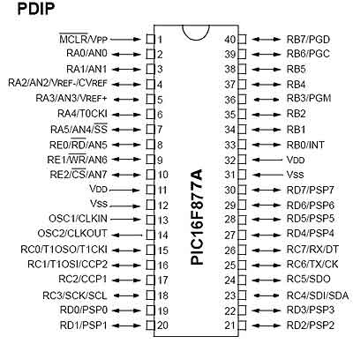
PIN DIAGRAM OF PIC 16F877A

Slide 11
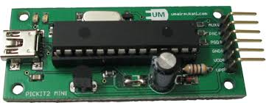
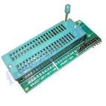
USB PROGRAMMER
AVAILABLE USB ASP PROGRAMMERS
PICKIT 1
PICKIT 2
PICKIT 3
PROGRAMMER USED
PICKIT 2
Features of PICKIT 2
• Separate programmer/debugger unit
• Open to the public
• Programmer-To-Go
• 128K byte memory

Slide 12
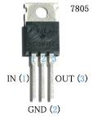
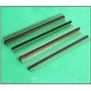
OTHER HARDWARES
VOLTAGE REGULATOR (IC 7805)
RESISTOR
CAPACITOR
BERG CONNECTOR
LED
SEVEN SEGMENT DISPLAY
Voltage regulator Berg connector

Slide 13
SOFTWARE TOOLS
IDE SOFTWARE
AVAILABLE IDE SOFTWARES
MPLAB
mikroC PRO
IDE USED
mikroC PRO
Features of mikroC PRO
mikroC PRO is easy to use as compared to MPLAB
Covers all PIC 12F, 16F , 18F family
Easy to maintain and modify
Includes documents, datasheets, images and drawings inside the code

Slide 14
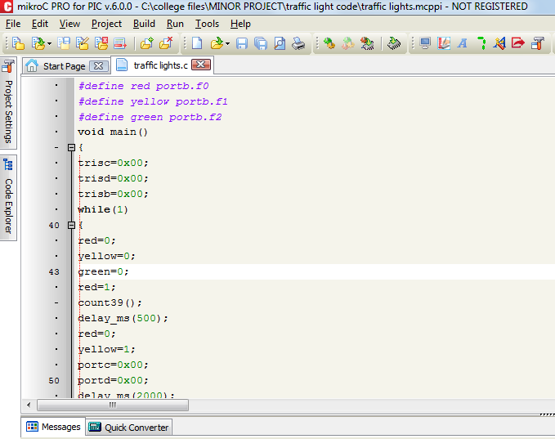

Slide 15
EDA SOFTWARE
AVAILABLE EDA SOFWARES
PROTEUS
ORCAD
EAGLE
EDA USED
PROTEUS
Components of PROTEUS
• ISIS Schematic Capture - a tool for entering designs.
• PROSPICE - Mixed mode SPICE simulation
• ARES PCB Layout - PCB design system with:
1. Automatic component placer
2. Rip-up and retry auto-router

Slide 16
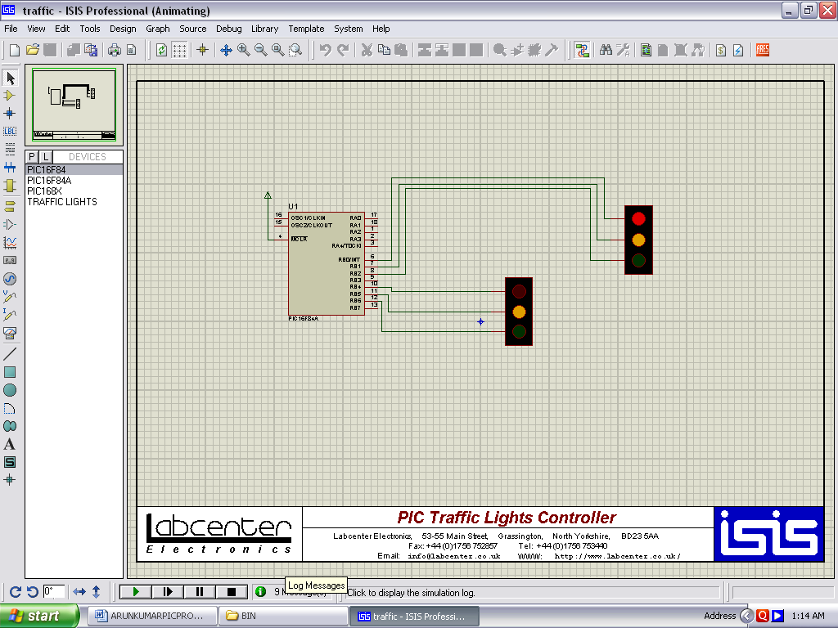

Slide 17
program
void main() { int i,a; TRISA=0X01; TRISB=0x00; TRISC=0x00; TRISD=0x00; while(1) { a=0x50; PORTB=0x1C; PORTC=0x11; for(i=0;i<=14;i++) { PORTD=a; a=a--; delay_ms(100); if(a==0x2F||a==0x1F||a==0x0F||a==0x3F||a==0x4F) { a=a-6; } } PORTB=0x14; PORTC=0x11; for(i=14;i<=49;i++) { PORTD=a; a=a--; delay_ms(100); | if(a==0x2F||a==0x1F||a==0x0F||a==0x3F||a==0x4F) { a=a-6; } } PORTD=0x00; PORTB=0x12; a=0x05; for(i=0;i<=4;i++) { PORTD=a; a=a--; delay_ms(100); if(a==0x2F||a==0x1F||a==0x0F||a==0x3F||a==0x4F) { a=a-6; } } a=0x50; PORTB=0xC1; PORTC=0x11; for(i=0;i<=14;i++) { PORTD=a; a=a--; delay_ms(100); if(a==0x2F||a==0x1F||a==0x0F||a==0x3F||a==0x4F) { | a=a-6; } } PORTB=0x41; PORTC=0x11; for(i=14;i<=49;i++) { PORTD=a; a=a--; delay_ms(100); if(a==0x2F||a==0x1F||a==0x0F||a==0x3F||a==0x4F) { a=a-6; } } PORTD=0x00; PORTB=0x21; a=0x05; for(i=0;i<=4;i++) { PORTD=a; a=a--; delay_ms(100); if(a==0x2F||a==0x1F||a==0x0F||a==0x3F||a==0x4F) { a=a-6; } }

Slide 18
a=0x50; PORTB=0x11; PORTC=0x1C; for(i=0;i<=14;i++) { PORTD=a; a=a--; delay_ms(100); if(a==0x2F||a==0x1F||a==0x0F||a==0x3F||a==0x4F) { a=a-6; } } PORTB=0x11; PORTC=0x14; for(i=14;i<=49;i++) { PORTD=a; a=a--; delay_ms(100); if(a==0x2F||a==0x1F||a==0x0F||a==0x3F||a==0x4F) { a=a-6; } } PORTD=0x00; | PORTC=0x12; a=0x05; for(i=0;i<=4;i++) { PORTD=a; a=a--; delay_ms(100); if(a==0x2F||a==0x1F||a==0x0F||a==0x3F||a==0x4F) { a=a-6; } } a=0x50; PORTB=0x11; PORTC=0xC1; for(i=0;i<=14;i++) { PORTD=a; a=a--; delay_ms(100); if(a==0x2F||a==0x1F||a==0x0F||a==0x3F||a==0x4F) { a=a-6; } } PORTC=0x41; PORTB=0x11; | for(i=14;i<=49;i++) { PORTD=a; a=a--; delay_ms(100); if(a==0x2F||a==0x1F||a==0x0F||a==0x3F||a==0x4F) { a=a-6; } } PORTD=0x00; PORTC=0x21; a=0x05; for(i=0;i<=4;i++) { PORTD=a; a=a--; delay_ms(100); if(a==0x2F||a==0x1F||a==0x0F||a==0x3F||a==0x4F) { a=a-6; } } } }

Slide 19
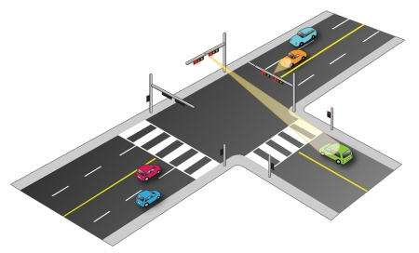
FUTURE SCOPE
This project can be enhanced in such a way as to automatically control the signals depending on the traffic density on the roads using sensors like IR detector/receiver module extended with automatic turn off when no vehicles are running on any side of the road which helps in power consumption saving.

