Slide 1

Group No. - 4
SMART TRAFFIC LIGHT CONTROLLER
BY:
Himanshi Sharma

Slide 2
Table of contents
INTRODUCTION
PURPOSE
ENHANCEMENT
SYSTEM OVERVIEW
DESIGN OF PROJECT
CONCLUSION

Slide 3
INTRODUCTION
Traffic lights have become an integral part of human’s day-to-day life.
With this motivation in the mind, this project aims at designing and implementing, a running model of traffic light controller which is controlled according to the density of vehicle on road.
We will use AT89s52 microcontroller and Infra red sensor for performing all the computation and control related task

Slide 4
PURPOSE
Control up to 4-phases traffic system with the traffic flow optimization strategies
Optimize the traffic flow at network junctions
Measurably improve traffic flow
Reduce environmental pollution caused by traffic
Most importantly increases road safety

Slide 5
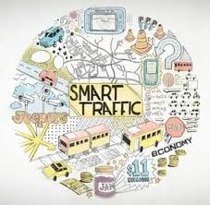
ENHANCEMENT
Bright and energy-efficient – street lighting
Image processing
Solar panel

Slide 6
Bright and energy-efficient – street lighting
The challenge
  Limited public funds
  Strict regulations
  Environmental protection
The solution
  Contribute to public safety and security on streets and sidewalks
  Reduce the risk of accidents on roadways, cycle paths and sidewalks
  Makes a city more attractive, improves the quality of life

Slide 7
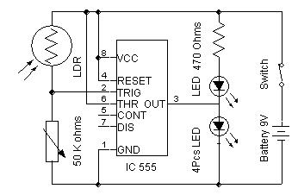
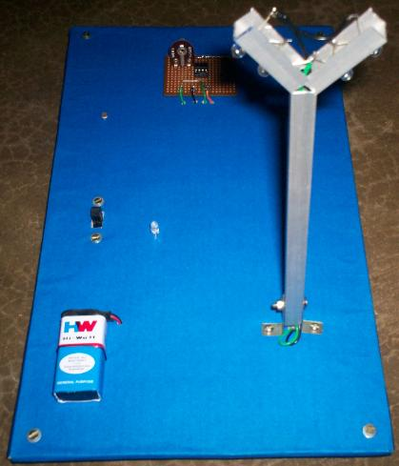
ARCHITECTURE OF STREET LIGHT

Slide 8
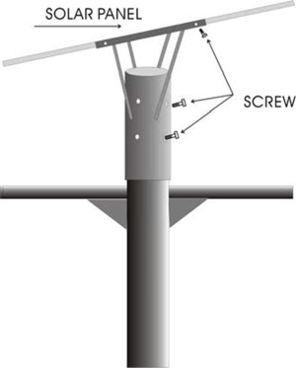
SOLAR PANEL
Life cycle costs typically 20% of existing technology
6 Watt to 45W Luminaries
Battery selection with 10yr guarantee
Installation is easy
Install the anti-skid, unloaded the lamp pole, and install the bracket on the solar panel, adjust the solar panel's direction and angle, then tight the screw at last.

Slide 9
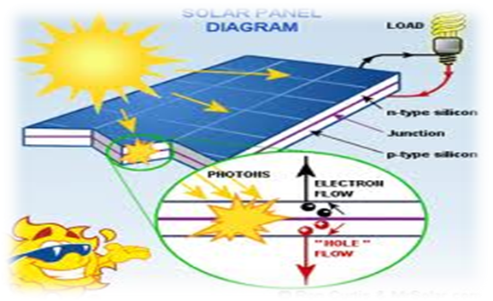

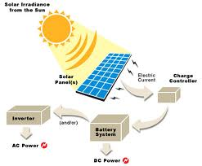
Benefits of Solar Panel

Slide 10
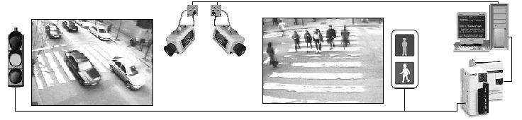
Image processing
system detects image sequences of vehicles by cameras ->
detected sequences analyzed by digital signal processing ->
accordingly traffic light conditions on the road are controlled.

Slide 11
Methodology ...
Following are the steps involved
• Image acquisition
• RGB to gray conversion
• Image enhancement
• Image matching using edge detection

Slide 12


Different gamma levels..
Gamma = 0.2
Gamma = 4

Slide 13

EDGE DETECTED IMAGE:
Edge detection of these real time images of the road is done with the help of prewitt edge detection operator

Slide 14
%age of matching..
0 to 10% - green light is on for 90 seconds.
10 to50% - green light is on for 60 seconds.
50 to 70% - green light is on for 30seconds.
70 to 90% - green light is on for 20 seconds
90 to 100% - red light is on for 60 seconds.

Slide 15
Continue…
Benefits:
Reduction of vehicle-pedestrian conflicts
Waiting time can be reduced or increased
Duration of green light can be adapted to the users’ needs.

Slide 16
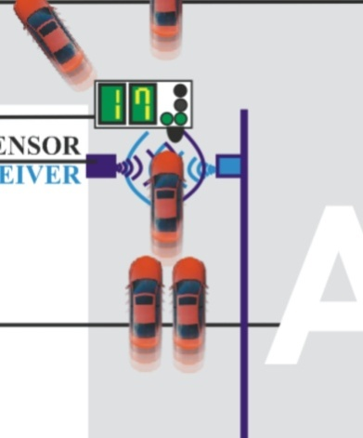
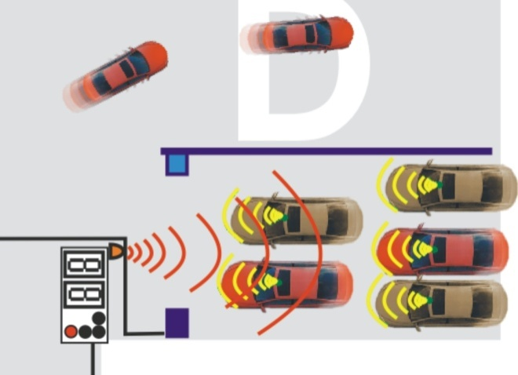
SYSTEM OVERVIEW
A pole traffic light is green
Other three poles are red
They are transmitting IR wave from the IR transmitting led
IR automated vehicle ignition off circuit works nearby 3-5 inch area straight
It off the ignition supply of the vehicle for stop

Slide 17
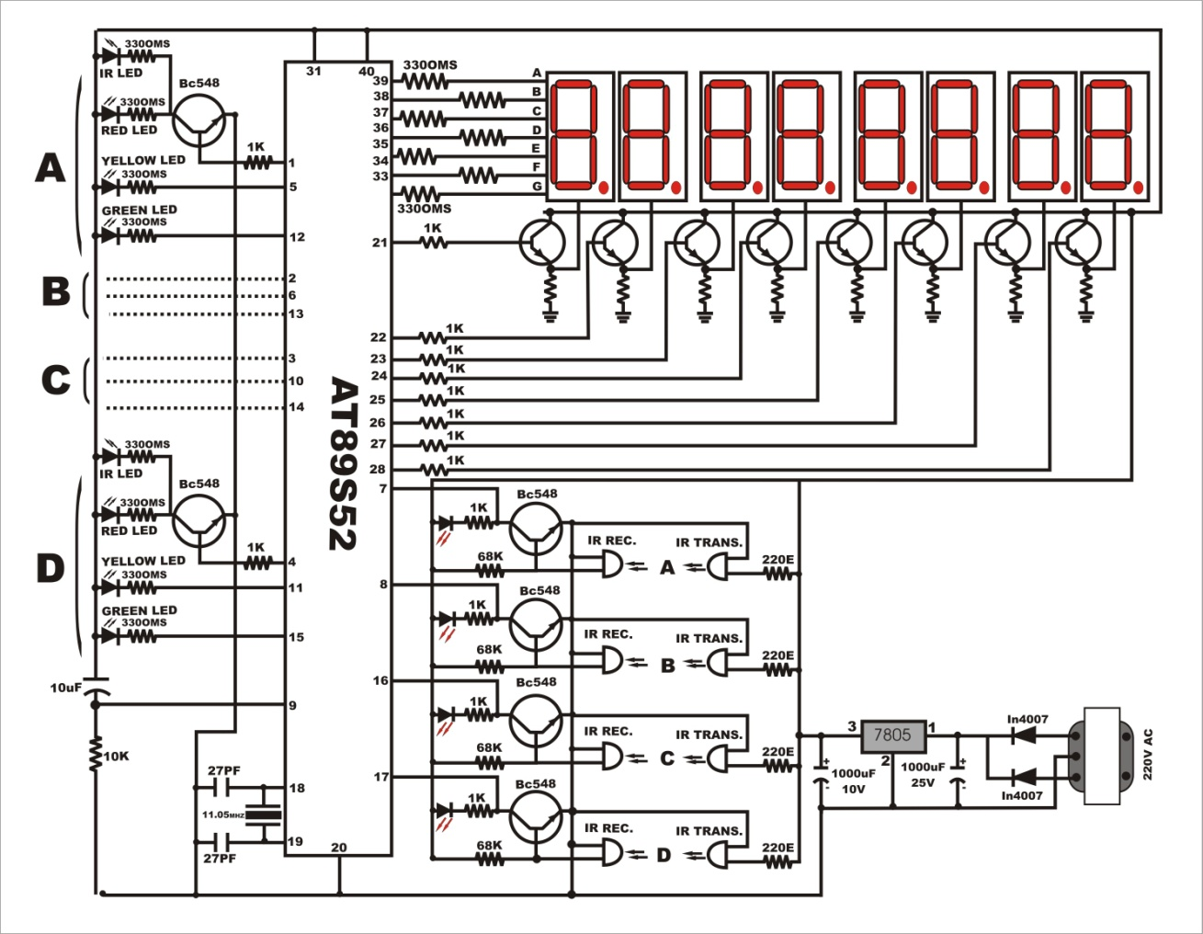
SYSTEM DESIGN

Slide 18
CONCLUSION
Use of microcontroller instead of other controllers such as PLC makes the smart traffic controller hardware a low cost system
The program downloaded into the microcontroller enables it to have a high accuracy timing, high independency and consistently
It enables the proposed smart traffic controller system to realize traffic flow optimization strategies at a single or network junctions

Slide 19


