Slide 1








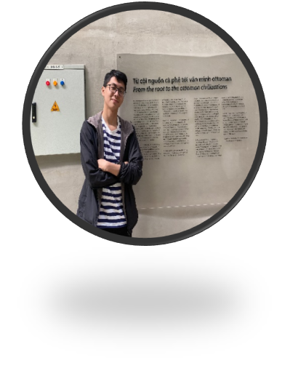
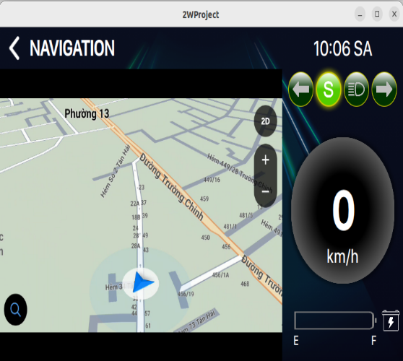
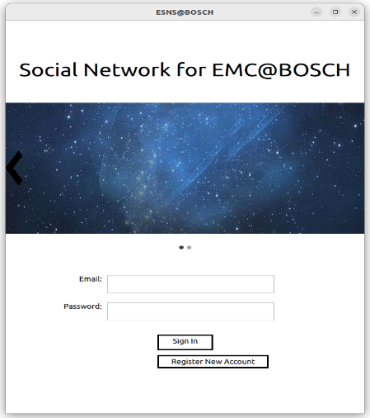
EMC-TM-TEAM-INTERN INTRODUCTION Hong Ly Trung Nhan– MS/EMC-TM-XC HCM City University of Technology and Education
About me:
Hoang Huu Han - CV.pdf
EMC32-Intern plan-hanhh-20221118.pdf
ESNS-Linux Client-QT-QML Final Code Simulation .mp4
Join Internship Program EMC@BGSW VN
From: August 2024 - Now
Training courses:
OOP/C/C++ programming.
Linux programming, Bash/Shell programming.
Qt Framework, QML (Qt Modeling Language).
Unit Test with Gtest/Gmock.
Tools: Git, Cmake, Qt Design, VSCode, SSH
Others: Design Pattern, Basic Data Structure, Agile/Scrum.
Training internal projects:
“Bash Script to Setup Development Enviroment on Ubuntu 22.04“ – Modified and implemented features. (Duration: 01 week – 02 members)
Language: Bash script
"ESNS-Linux Client“ – Designed source code and data structure; and implemented Login feature. (Duration: 02 weeks – 03 members)
Language: Qt/QML
"2W Project – Map Navigation" – Designing and developing Map feature. (Duration: 02 months – 03 members)
Language: Qt/QML
Internal project details: achievement of hanhh

