Slide 1





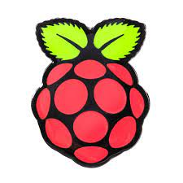
EMC-TM-TEAM-INTERN INTRODUCTION Hong Ly Trung Nhan– MS/EMC-TM-XC HCM City University of Technology and Education
Join Internship Program EMC@BGSW VN
From: August 16 2024 - Now
Training courses:
OOP/C/C++ programming.
Linux programming, Bash/Shell programming.
Tools: Git, Cmake, VSCode, SSH.
Test Concepts.
Personal and internal projects:
“Vehicle Drowsiness Detection and Alert System” – Implement hardware system and communication(Duration: 03 month – 01 member). Hardware: Raspberry Pi 4, STM32F103C8T6 MCU. Language: Python, C.
“Logger Template” – Implementation the logger template for debugging ( Duration: At Present – 01 member).
Language: C++.
About Me:
Hong-Ly-Trung-Nhan-CV.pdf
EMC-TM-Intern plan-training-nhanhtl-20240509.mpp

