Slide 1

Let’s GO!
Team Apprentice: Chen Feiyu
Suhe Bater
Tian Xi

Slide 2
Get out!
Wanna get out? (house, lifestyle etc…)
Where? What? How? With who?
Team apprentice + SB Cloud, we have a solution for you!

Slide 3
SB Cloud
One of the advantages of the cloud is the ability to handle big data
We plan to use the cloud to store and analyze large quantity of data. Then provide a efficient, flexible trip plan to customers

Slide 4
Concept
Fast and easy way to identify point of interests (POI)
Don’t feel like traveling alone? Share it! Plan your trip together!

Slide 5
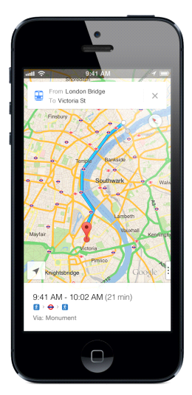

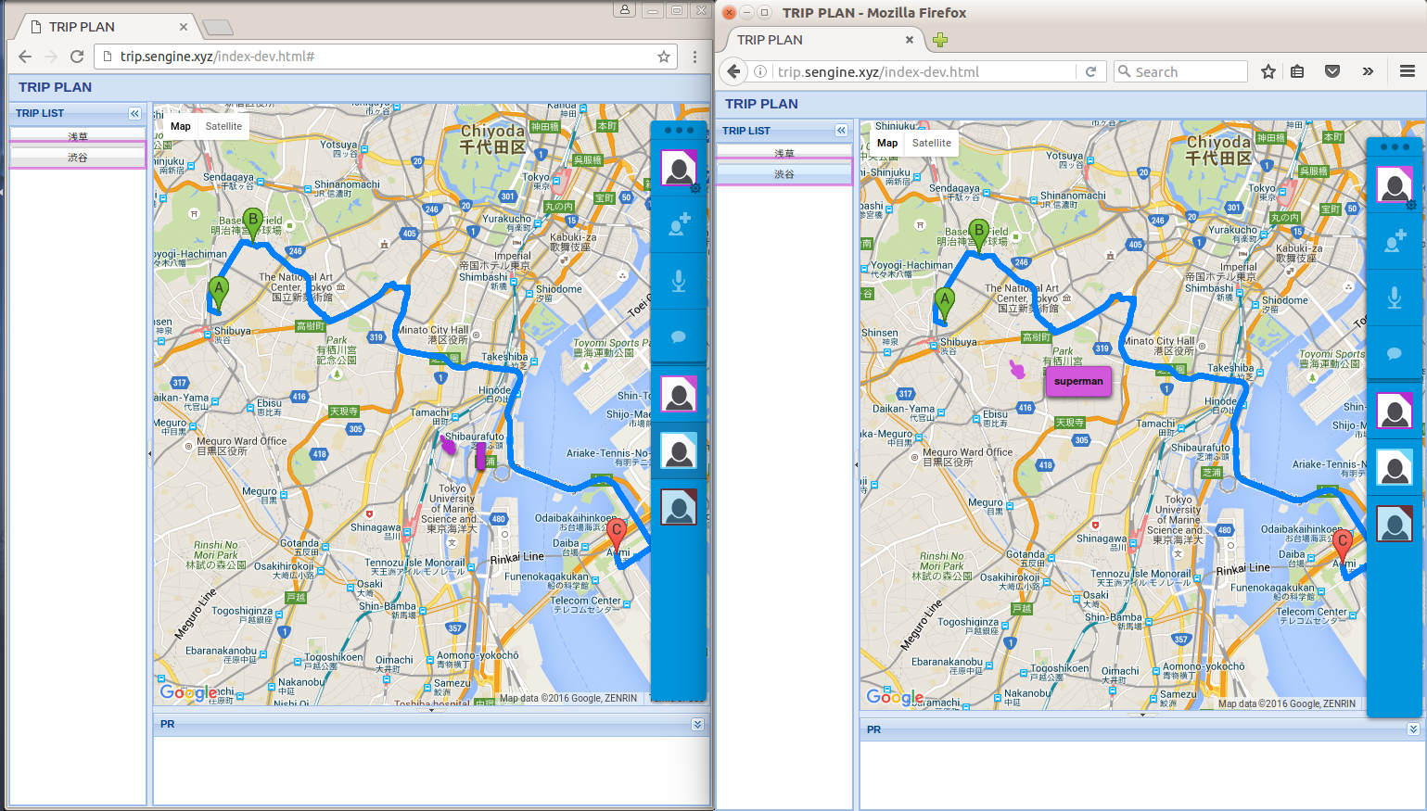
Concept

Slide 6
User Experience
Access through a mobile app or web browser
Select city or use current location
App suggests a list of POI based on search or location
Choose POIs
Trip plans provided by the app
Share the trip plan with your friends
Create profiles, recommendations will be profile based
Check-in at spot visited, give a rating and earn points
(check-ins will be used for data mining)
Redeem these points at tourist locations or restaurants as cash
Rate your partner

Slide 7
Why our app?
Fast POI determination (hot spots)
Places will be interesting to you (profile matching)
Trip plan sharing before it is final

Slide 8
Demo
First half: iOS App
Second half: website

Slide 9
Thank you
SB Cloud

