Slide 1
Bees
A Real time Discussion Network Driven by AI
Presented by T4

Slide 2
Concept
We build a real time discussion interactional system.
Post your questions, experiences, emotions when they occur to you now. Many users all over the world will help you or share their ideas.
Find your groups with similar interests of your discussion!

Slide 3

Scenario
OMG, Mom forgot to book a hotel for me!
Where can I live in Tokyo tonight?
I wanna find a hotel!

Slide 4
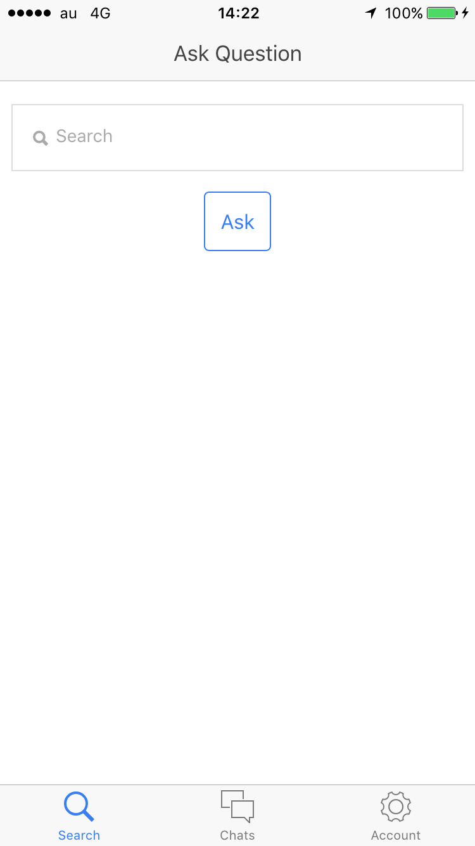
Don’ worry, ask here!
Hi there, I wanna find a hotel near Meguro, does anybody have a name or an address of a hotel???

Slide 5
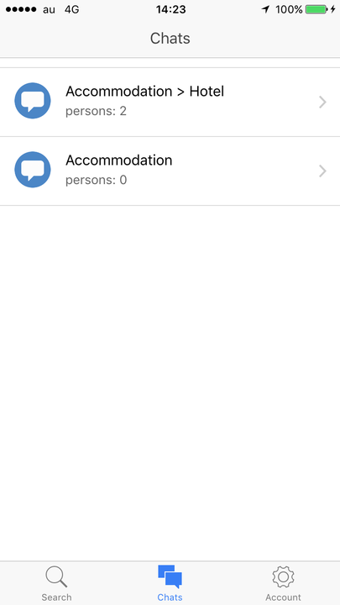
Let’s find something here.
Or, here.
Will detect your questions or discussions type and categorize them automatically by the potential purpose of your sentences, among tons of topics in the system.

Slide 6
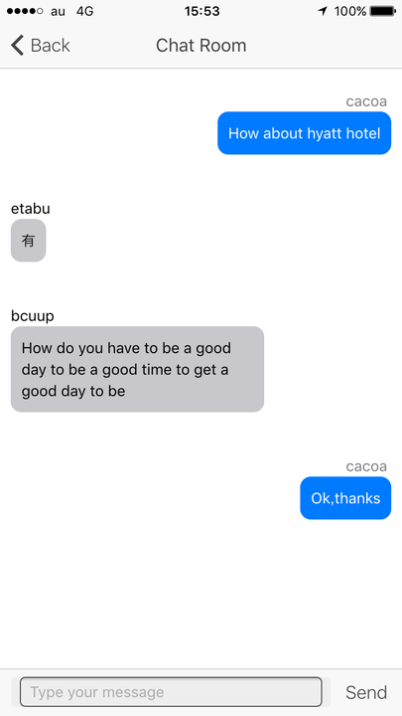


Slide 7
implementation
Ionic framework + AngularJS
Node.js
Socket.io
PredictionIO

Slide 8











